Slide 1
Tiếng Anh 1
Giáo viên: Hoàng Thị Hồng
Lớp dạy: 1A4, 1A5, 1A6
Đơn vị công tác: Trường TH Hưng Đạo

Slide 3

REVIEW 3
Period 1

Slide 4

Table of contents
01
02
Warm-up and Review
Activity 1.
Listen and repeat.
03
04
Activity 2.
Look and circle.
Fun corner and Wrap-up

Slide 5


01
Warm-up and Review

Slide 6


Slide 7


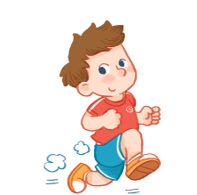

running

Slide 8

bus

Slide 9

Lucy

Slide 10

lake

Slide 11

sun

Slide 12

lemon

Slide 13

truck

Slide 14

leaf

Slide 15


Very Good!

Slide 16
02
Activity 1. Listen and repeat.

Slide 17


Listen and repeat.

Slide 18

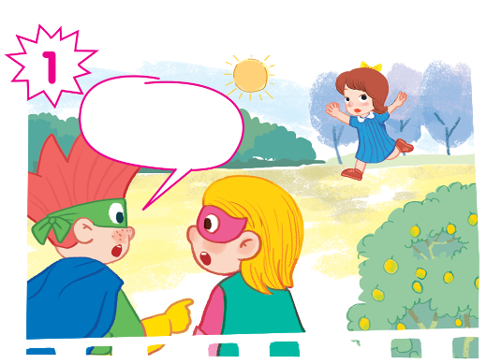
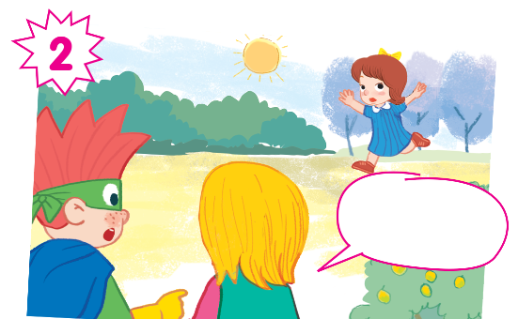
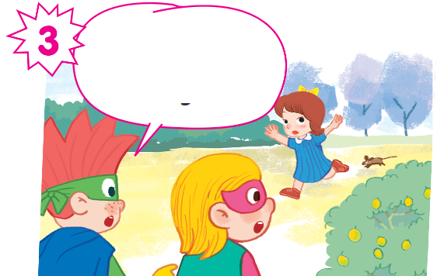
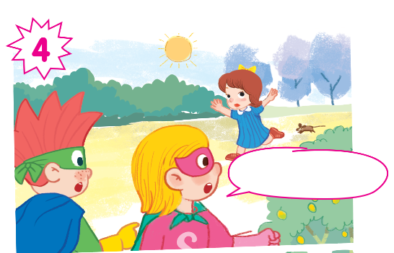

Slide 19

Listen and repeat.
Look at Mary!

Slide 20

Listen and repeat.
She’s running.

Slide 21

Listen and repeat.
And there’s a mouse. It’s running, too.

Slide 22

Listen and repeat.
Oh! Run, Phil!

Slide 23
Look at Mary!
She’s running.
And there’s a mouse. It’s running, too.
Oh! Run, Phil!

Slide 24
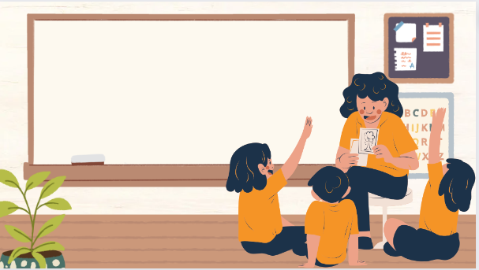
Play as a character

Slide 25
Look at Mary!
She’s running.
And there’s a mouse. It’s running, too.
Oh! Run, Phil!

Slide 26
03
Activity 2. Look and circle.

Slide 27
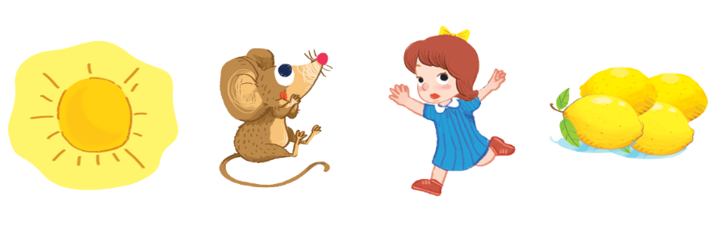
Look and circle.
bus lake locks lemons
monkey mouse running sun

Slide 28
Look and circle.
bus lake locks lemons
monkey mouse running sun

Slide 29



Look and circle.
bus lake locks lemons
monkey mouse running sun

Slide 30





Look and circle.
bus lake locks lemons
monkey mouse running sun

Slide 31



Look and circle.
bus lake locks lemons
monkey mouse running sun

Slide 32




sun
mouse
running
lemons

Slide 33
04
Fun corner and Wrap-up

Slide 34
Fill in the blanks.
Look at
______ Mary!

Slide 35
running
She’s ______.

Slide 36
And there’s a ______. It’s ______, too.
mouse
running

Slide 37
run
Oh! ____, Phil!

Slide 38
Website: hoclieu.vn
Fanpage: https://www.facebook.com/tienganhglobalsuccess.vn/

