Slide 1
Tiếng Anh 1
Giáo viên: Tô Thị Hà
Lớp dạy: 1A1, 1A2, 1A3
Đơn vị công tác: Trường TH Hưng Đạo

Slide 3
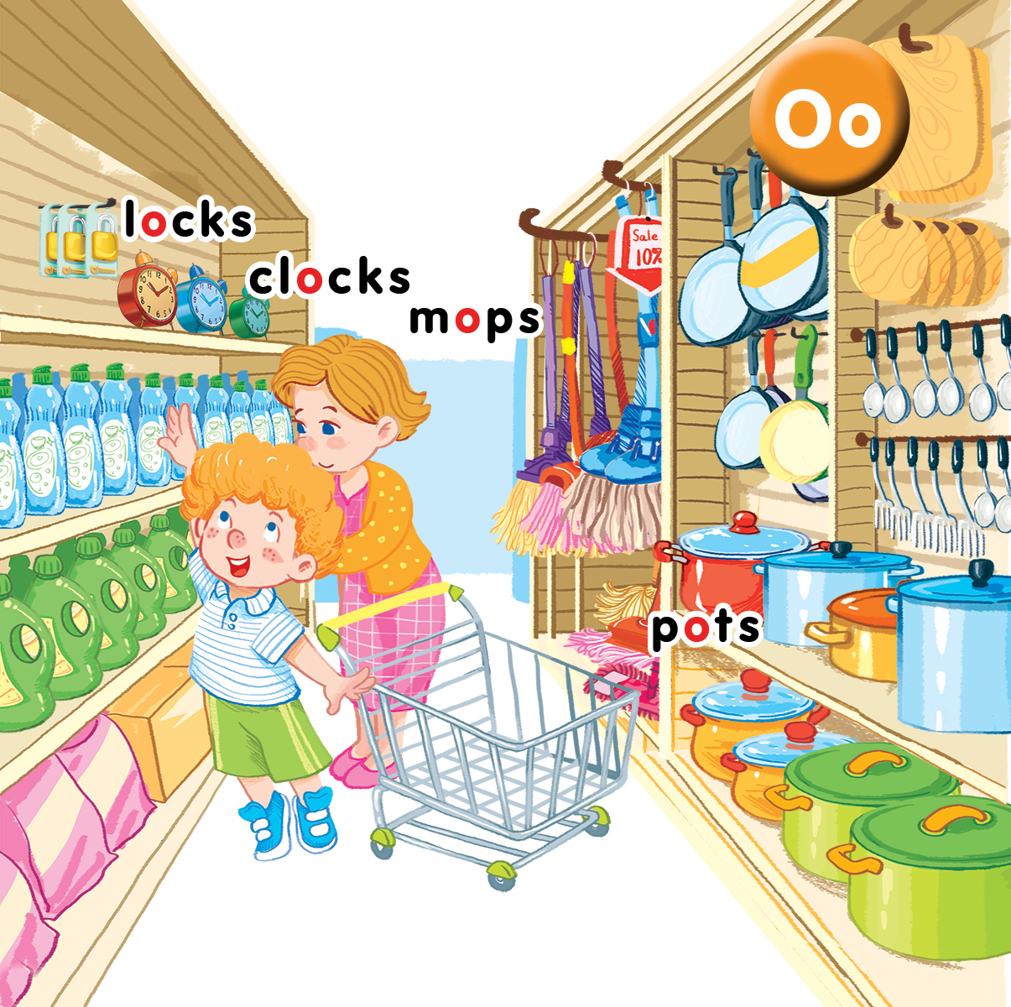
Unit 9 In the shop Lesson 3
Notes:
Goal:
By the end of the lesson, pupils will be able to :
- introduce a thing with the structure How many____?
- sing along the unit song.

Slide 4

Warm-up
Notes:
Goal: Warm up and revise the unit keywords.
Time: 3 minutes
Practice the chant using TPR
Have pupils listen and do the TPR actions with teacher.
If possible, change the words of the chant by using flashcard and pupils chant along the new lyrics when they see the flashcard.

Slide 5

Listen and chant
O, o, locks and clocks.
There are two locks.
There are three clocks.
O, o, mops and pots.
There are four mops.
There are five pots.

Slide 6


Listen and repeat
Notes:
Listen and repeat is divided in to 2 steps.
Step 1
Goal: Introduce the sound and the meaning of the structure How many_____?– “_____”.
Time: 5 minutes.
Introduce the structure and have pupils listen many times.
Hold up a flashcard for clocks and ask How many clocks? Count 1, 2 and say 2.
Stick the flashcard for clocks on the board.
Do the same with other words and have pupils answer for the question How many…?
Play the recording, and have pupils listen and repeat.
Step 2
Goal: Pupils will be able to repeat the structure How many___? - ______
Time: 3 minutes.
Have pupils open the book, listen and repeat in chorus, groups and in pairs.

Slide 7
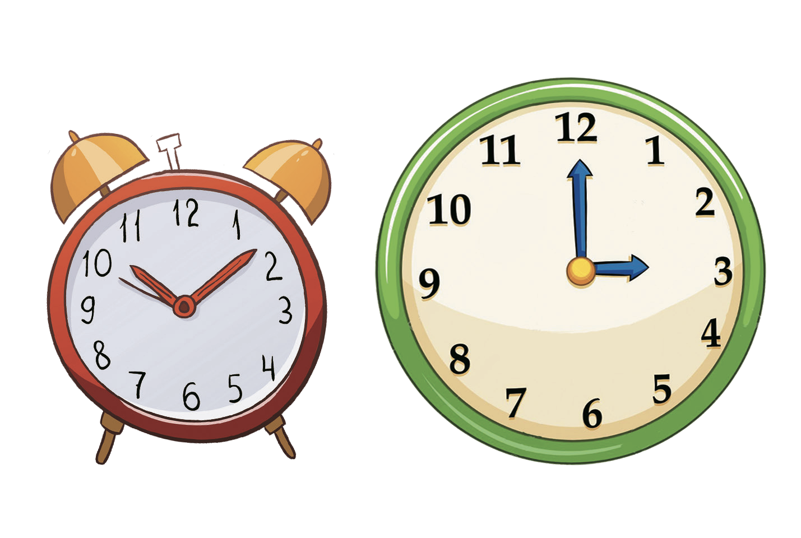
clocks

Slide 8

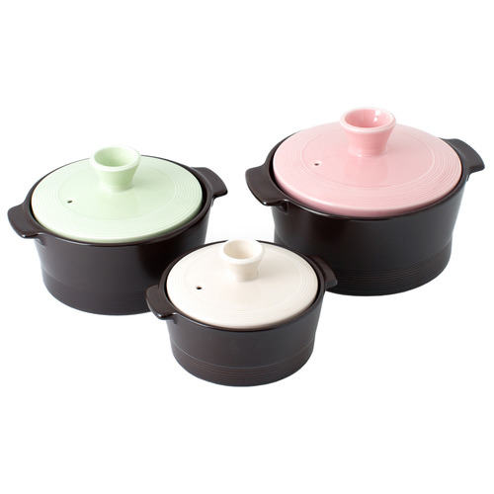



How many….…?

Slide 9


Let’s talk
Notes:
Let’s talk is divided into 3 steps.

Slide 10
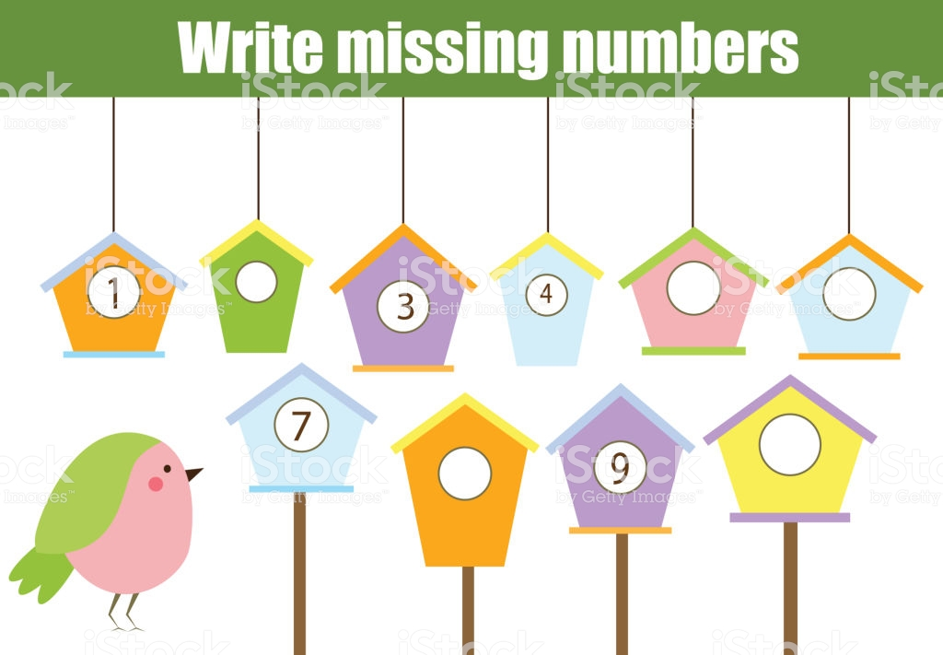
Game: Missing numbers
Notes:
Step 1
Find the missing number
Goal: Pupils will be able to say numbers.
Time: 1 minute
Have pupils look at the slide and say the missing numbers.

Slide 11
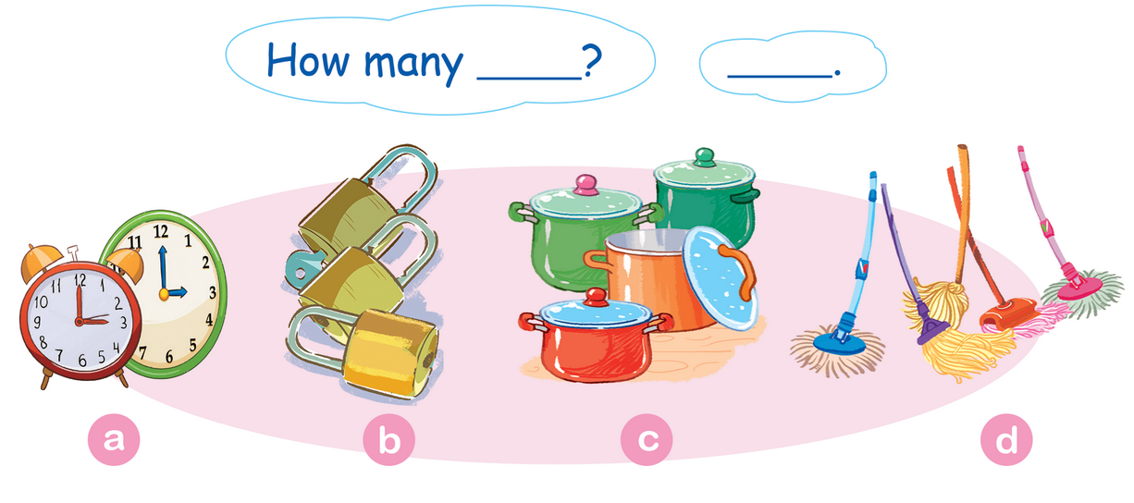
Let’s talk.
Notes:
Step 2
Goal: Practice the exchange How many___?
Time: 5 minutes
Have pupils say the exchange: How many____? - _____ in chorus.
Have pupils choose one flashcard. Teacher asks: How many____?
Pupil gives the answer. -________.
After that, ask the whole class if it is Yes or No.
Have the whole class repeat that sentence in chorus.
Step 3
Goal: Pupils will be able to point, ask and answer the whole sentence.
Time: 3 minutes
Demonstrate the activity, point, ask and answer. Have pupils do it in pairs.
If possible, have pupils draw a draft picture of objects then ask their friends, using the structure How many____?

Slide 12


Let’s sing
Notes:
Let’s sing is divided into 3 steps.
Step 1
Goal: Pupils will be able to read the song lyrics.
Time: 3 minutes
Have pupils read the song lyrics in chorus then in groups.
Step 2:
Goal: Pupils will be able to sing a long the song.
Time: 3 minutes
Have pupils listen and sing a long the song in chorus then in groups.
Step 3
Goal: Pupils will be able to sing the song with TPR.
Time: 3 minutes
Have groups create their own TPR for the song then present.
Finish the song with the TRP for high five and fist bump.

Slide 13
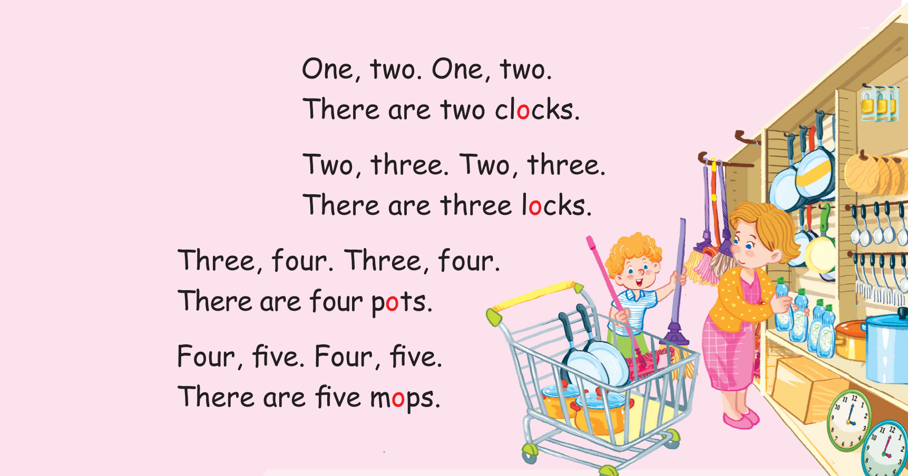
Let’s sing!

Slide 14
Game
Notes:
Memory game
Goal: Revise the structure, the words in a game.
Time: 5 minutes
Play the game in groups.
Write on board the number from 1 to 10
Show pupils pictures/slides of different objects
Then hide the pictures
Ask How many…?
Have 1 pupil of each group runs to the board and slap to the number.
For the next question, have pupil say it with the support of the teacher.

Slide 15


Slide 17


Slide 18


Slide 19

Goodbye
locks
Notes:
Goodbye
Time: 1 minutes
Teacher and pupils say goodbye to the words.

Slide 20

Goodbye
clocks

Slide 21

Goodbye
mops

Slide 22

Goodbye
pots

Slide 23
Website: hoclieu.vn
Fanpage: facebook.com/www.tienganhglobalsuccess.vn

