Slide 1

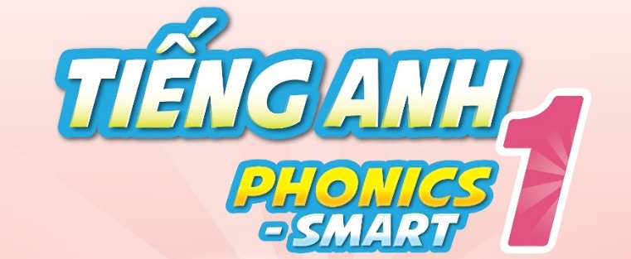

Slide 2
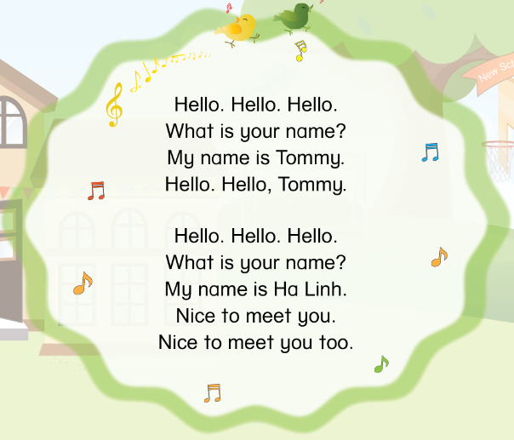


Slide 3



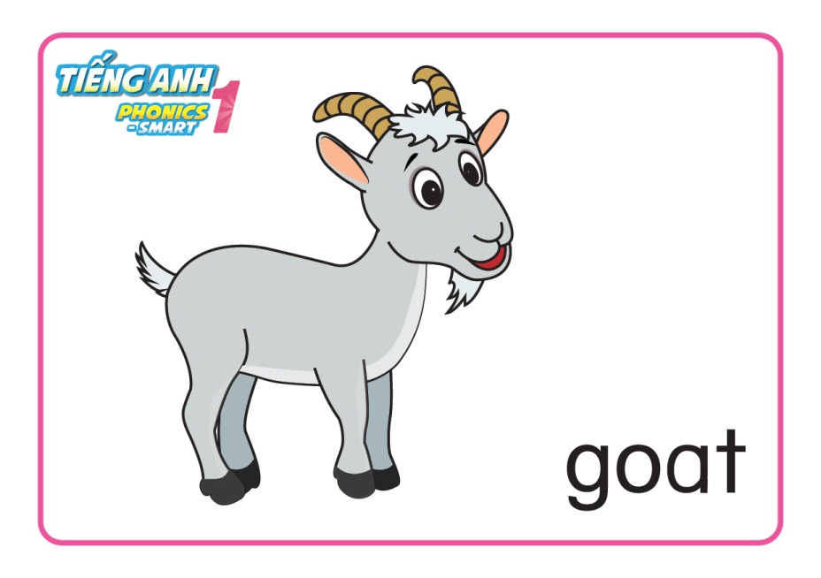
REVISION

Slide 4
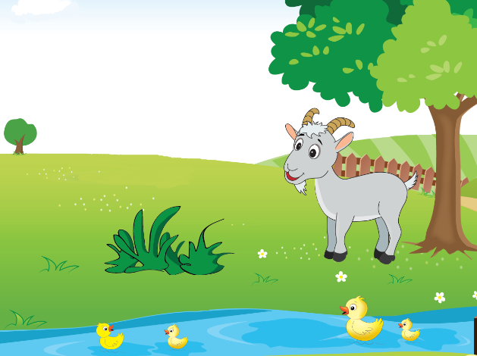
Unit 7
Lesson 3

Slide 5
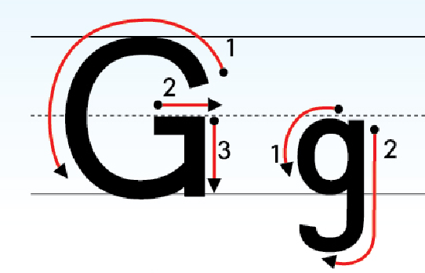
Unit 7: Lesson 3:
1. Trace the letters.

Slide 6
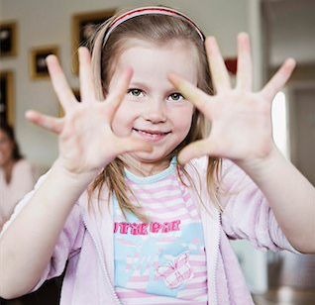
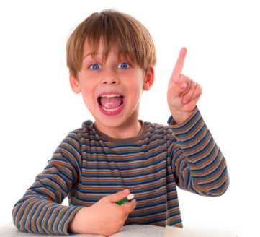
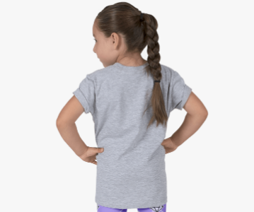
Unit 7: Lesson 3:
1. Trace the letters.
Let’s write letter Gg:
in the air, on your palms and on your friend’s back

Slide 7

Unit 7: Lesson 3:
1. Trace the letters.
Let’s write letter Gg on your board.
G
G
G
g
g

Slide 8


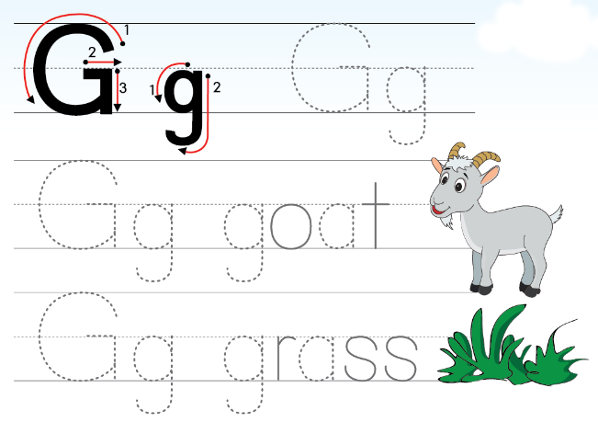
Unit 7: Lesson 3:
1. Trace the letters.
34

Slide 9
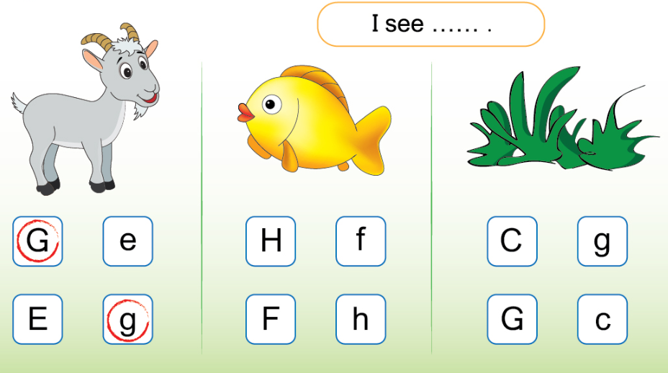
Unit 7: Lesson 3:
1. Trace the letters.
2. Circle and say.
34

Slide 10

Unit 7: Lesson 3:
1. Trace the letters.
2. Circle and say.

Slide 11
BIG WHEEL GAME
1
2
3
4
5
6
7
8
SPIN
STOP
Notes:
- HS chọn câu hỏi, trả lời và quay lấy sao.

Slide 12


What do you see?
I see …
back

Slide 13
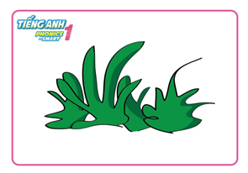
What do you see?
I see …
grass
back

Slide 14

What do you see?
I see …
back

Slide 15
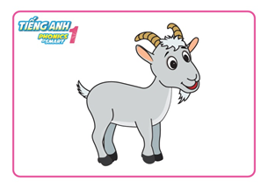
What do you see?
I see …
goat
back

Slide 16
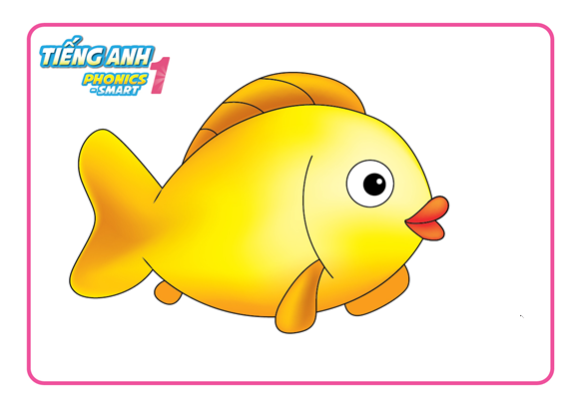
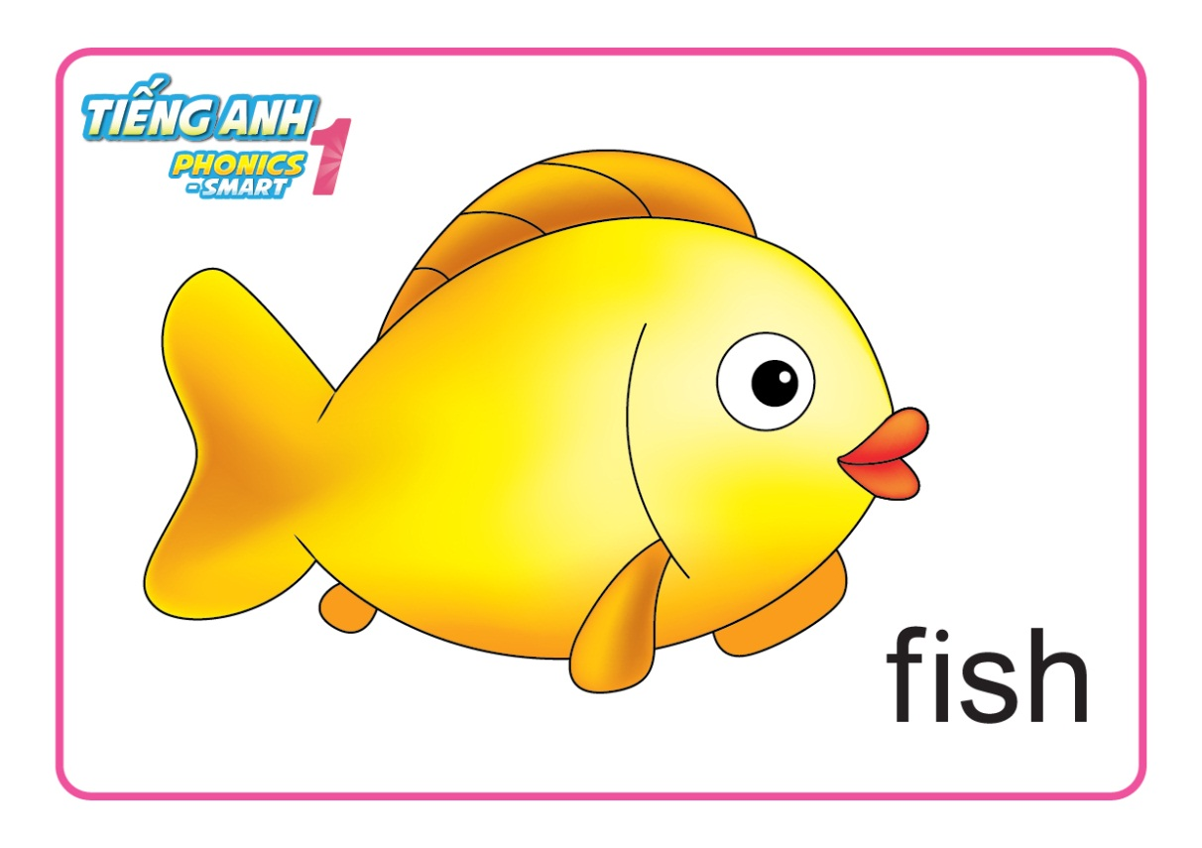
What do you see?
I see …
fish
back

Slide 17
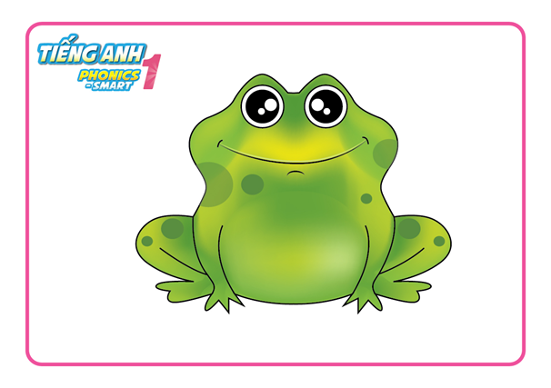
What do you see?
I see …
frog
back

Slide 18
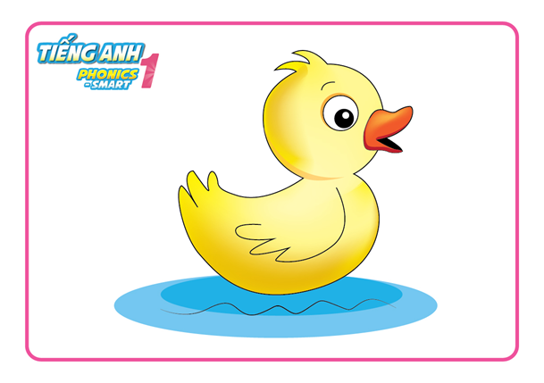
What do you see?
I see …
duck
back

Slide 19
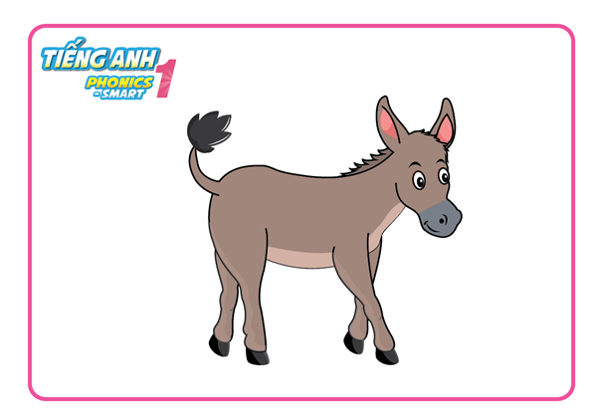
What do you see?
I see …
donkey
back

Slide 20
Unit 7: Lesson 3:
1. Trace the letters.
2. Circle and say.

Slide 21
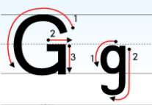
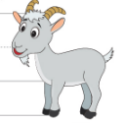


Unit 7: Lesson 3:
1. Trace the letters.
2. Circle and say.
Notes:
- Tổng kết

