Slide 1



Slide 2

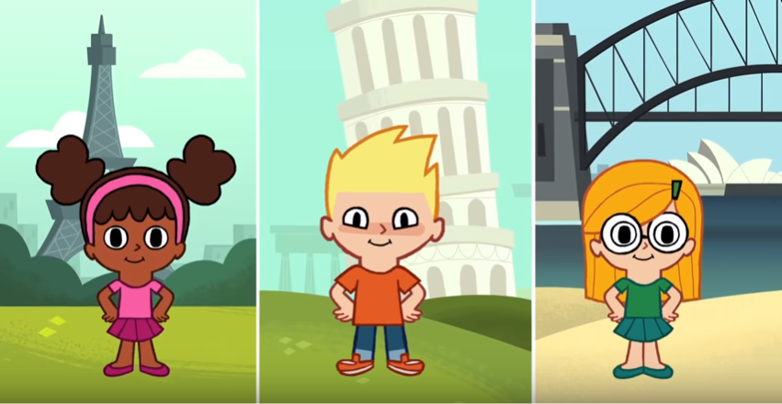
Let’s sing Hello song!

Slide 3
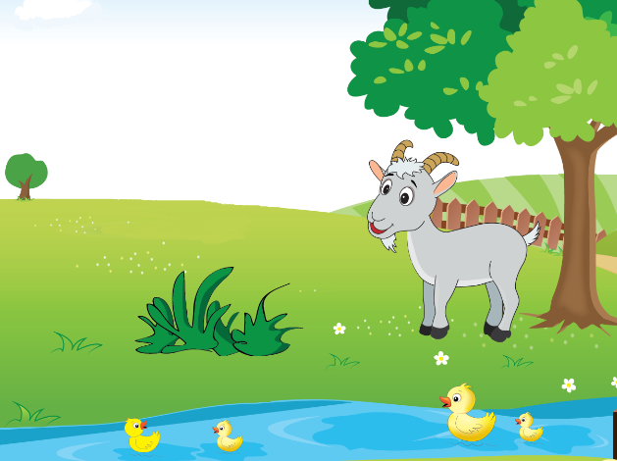
Unit 7
Lesson 1

Slide 4



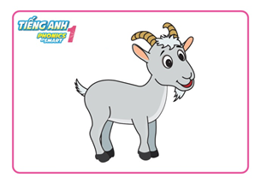
Unit 7:
Lesson 1:
G g
1. Look, listen and repeat.
grass
goat
Notes:
- Click vào loa hoặc vào tranh để nghe

Slide 5
Unit 7:
Lesson 1:
G g
1. Look, listen and repeat.
Game
Lucky Number
Notes:
- Audio: letter A, /a/, apple, ant

Slide 6

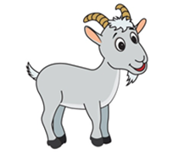

Game: Lucky Number
1
2
3
4
5
6
7
8
9
Notes:
Click vào số để ra câu hỏi

Slide 7


back

Slide 8

grass
back

Slide 9


back

Slide 10

back

Slide 11


back

Slide 12

goat
back

Slide 13

back

Slide 14
grass
back

Slide 15
goat
back

Slide 16
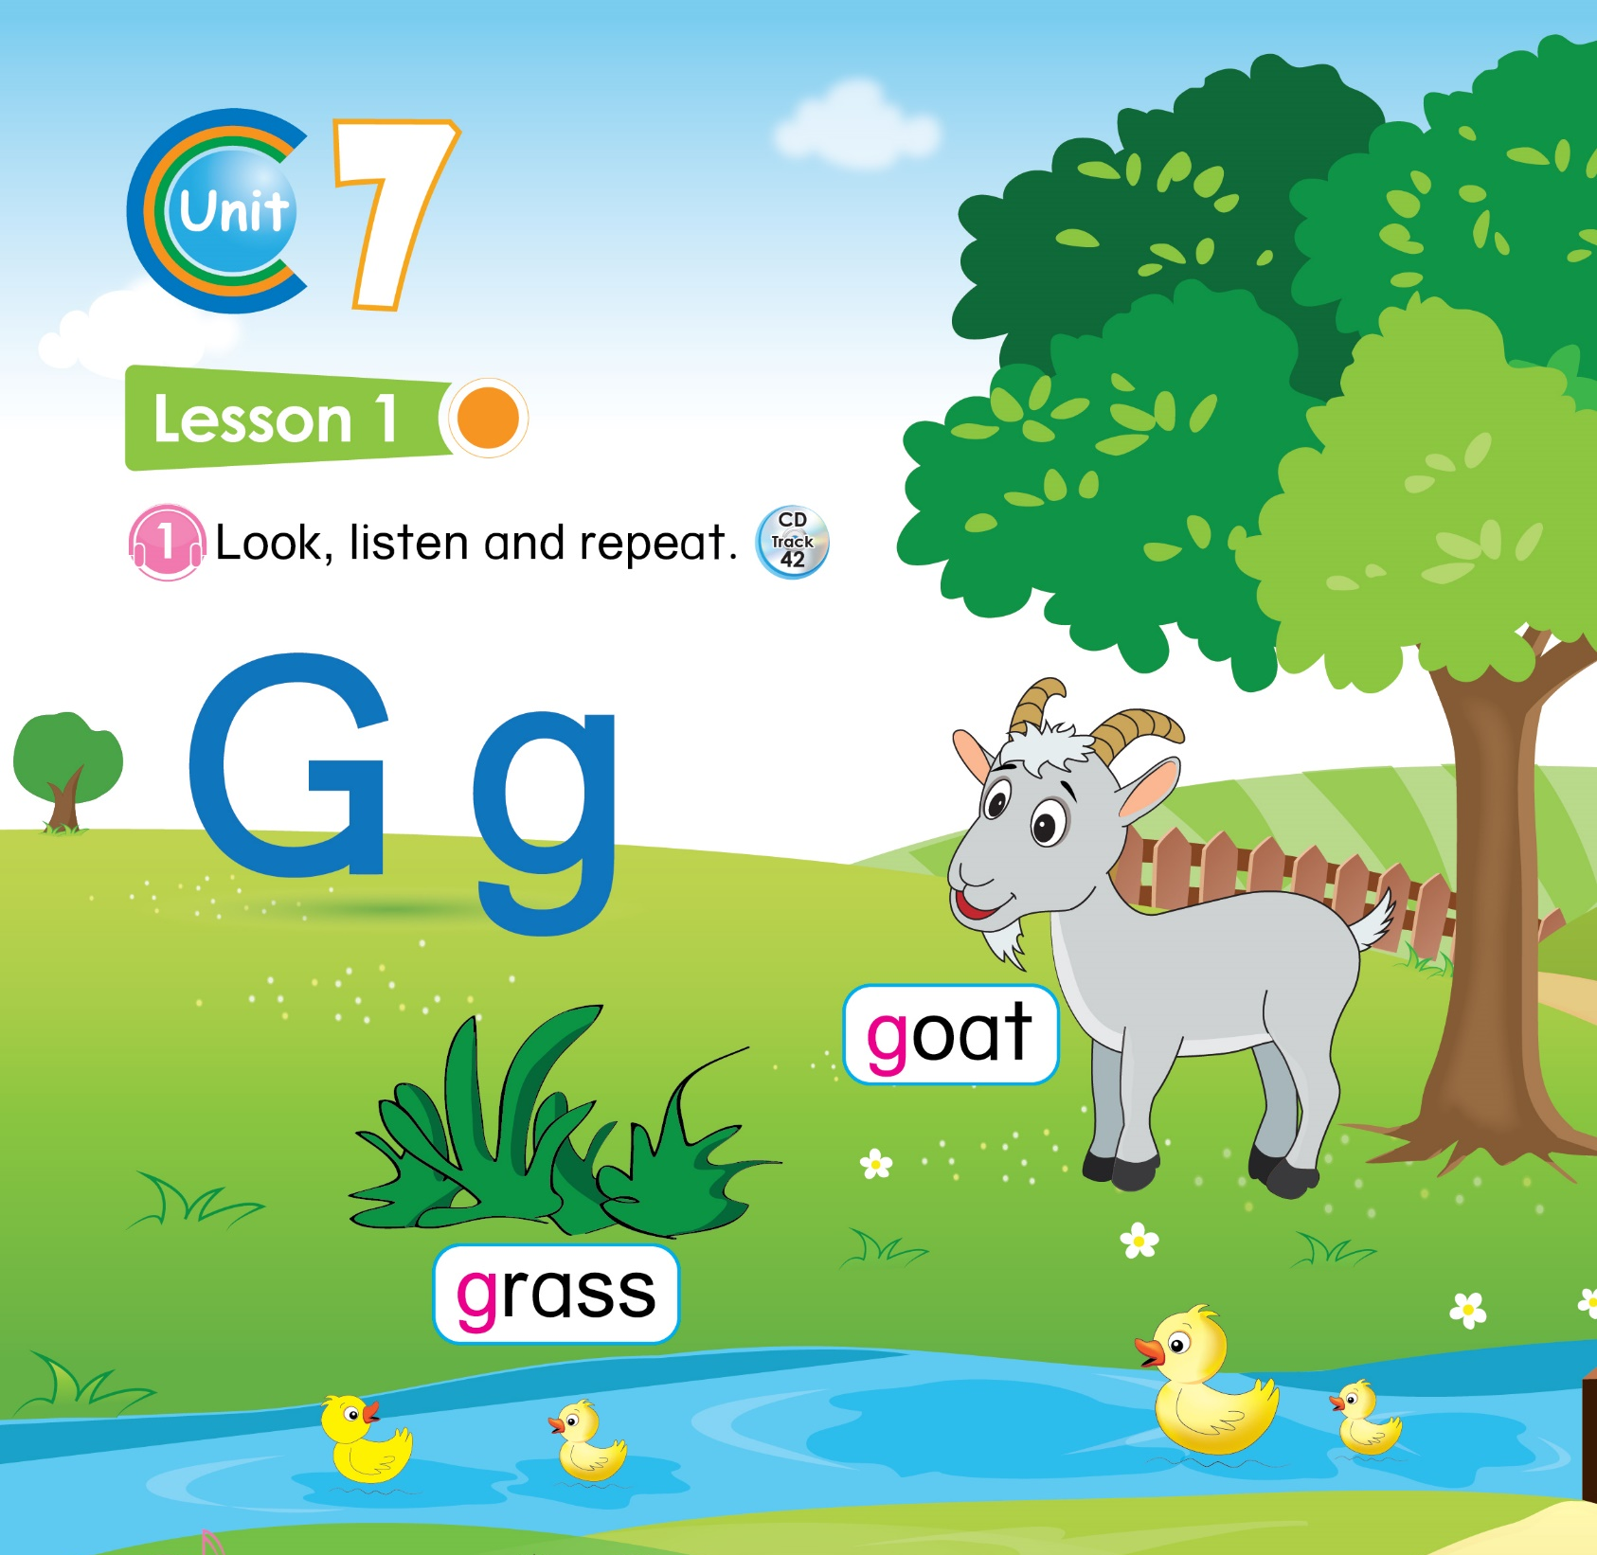

32

Slide 17

Unit 7:
Lesson 1:
G g
1. Look, listen and repeat.
2. Let’s chant.

Slide 18
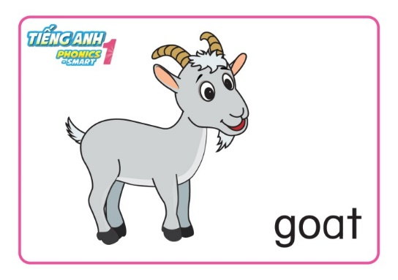

Unit 7:
Lesson 1:
G g
1. Look, listen and repeat.
2. Let’s chant.
Notes:
- Tổng kết

