Slide 1




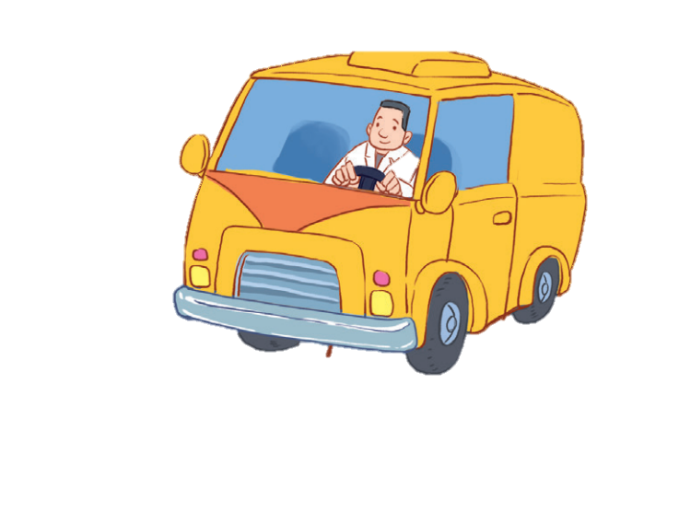


12
LESSON 1 – Period 1

Slide 2
1
Warm-up and review
Game: Memory game
Notes:
Step 1: Divide the class into 2 teams.
Step 2: Each pupil from each team goes to the front and touches 2 squares. If they match the right word with the correct picture, they will score one point for their team.
Step 3: Encourage pupils to join in the game.
Step 4: Give points for pupils.

Slide 3





MEMORY GAME
brother
father
grandpa
mother
grandma

Slide 4




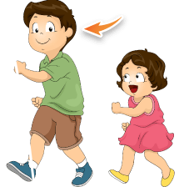


EXIT
mother
father
brother
grandma
grandpa

Slide 5
Look, listen and repeat.
2

Slide 6
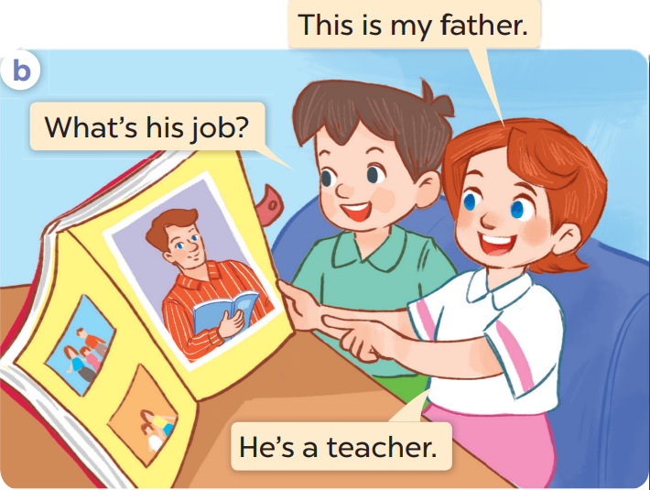
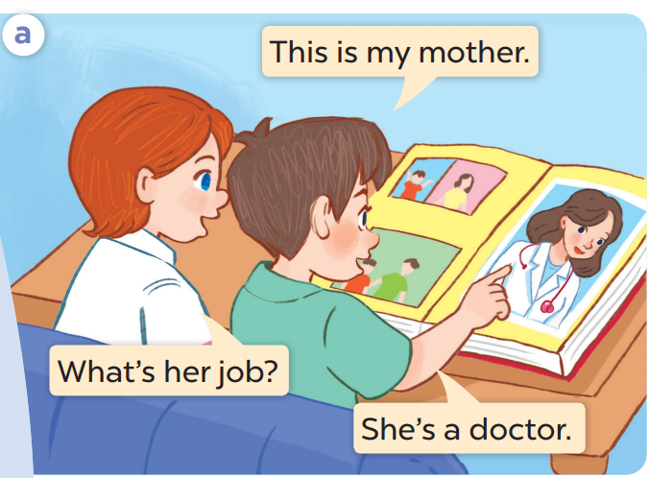

Slide 8
Listen, point and say.
3

Slide 9
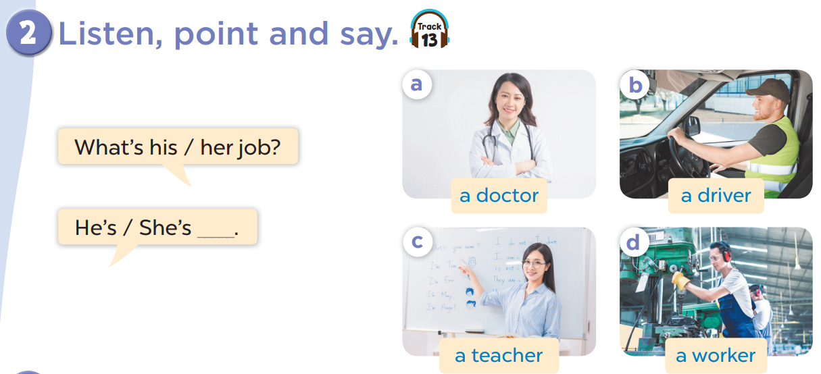

Slide 10


Listen and choose.

Slide 11


Listen and choose.

Slide 12
Listen and choose.

Slide 13
Listen and choose.

Slide 14
Listen and choose.

Slide 15
Listen and choose.

Slide 16
Listen and choose.

Slide 17
4
Let’s talk.

Slide 18
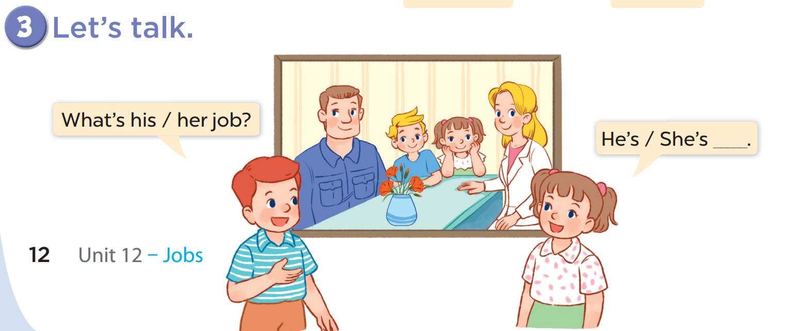

Slide 19
Look and say.
Notes:
Ask two pupils to look at the pictures and practise speaking with the structure of the lesson.
One pupil asks, the other answers the question. (This can be more interesting when teacher lets pupils play rock, scissors, paper. Who wins will ask, the other has to answer.)

Slide 20




What’s her job?
She’s a doctor.

Slide 21


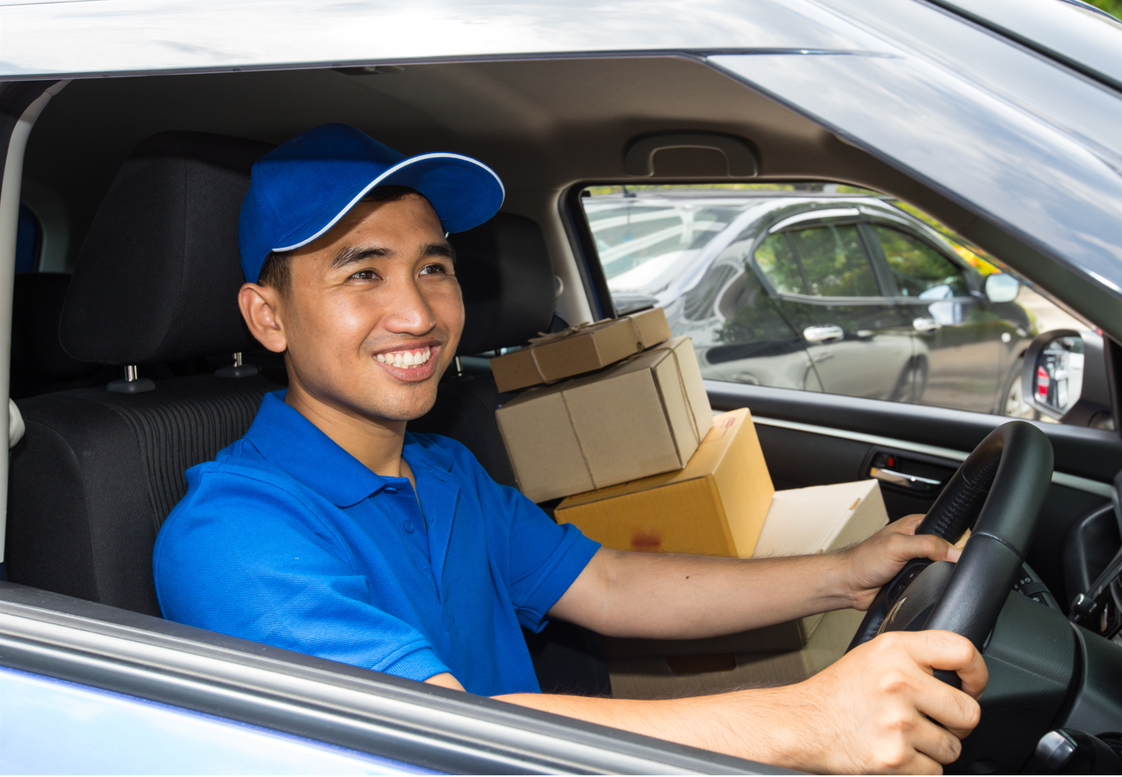
What’s his job?
He’s a driver.

Slide 22


What’s her job?
She’s a teacher.

Slide 23
5
Fun corner and wrap-up

