Slide 1



Slide 2
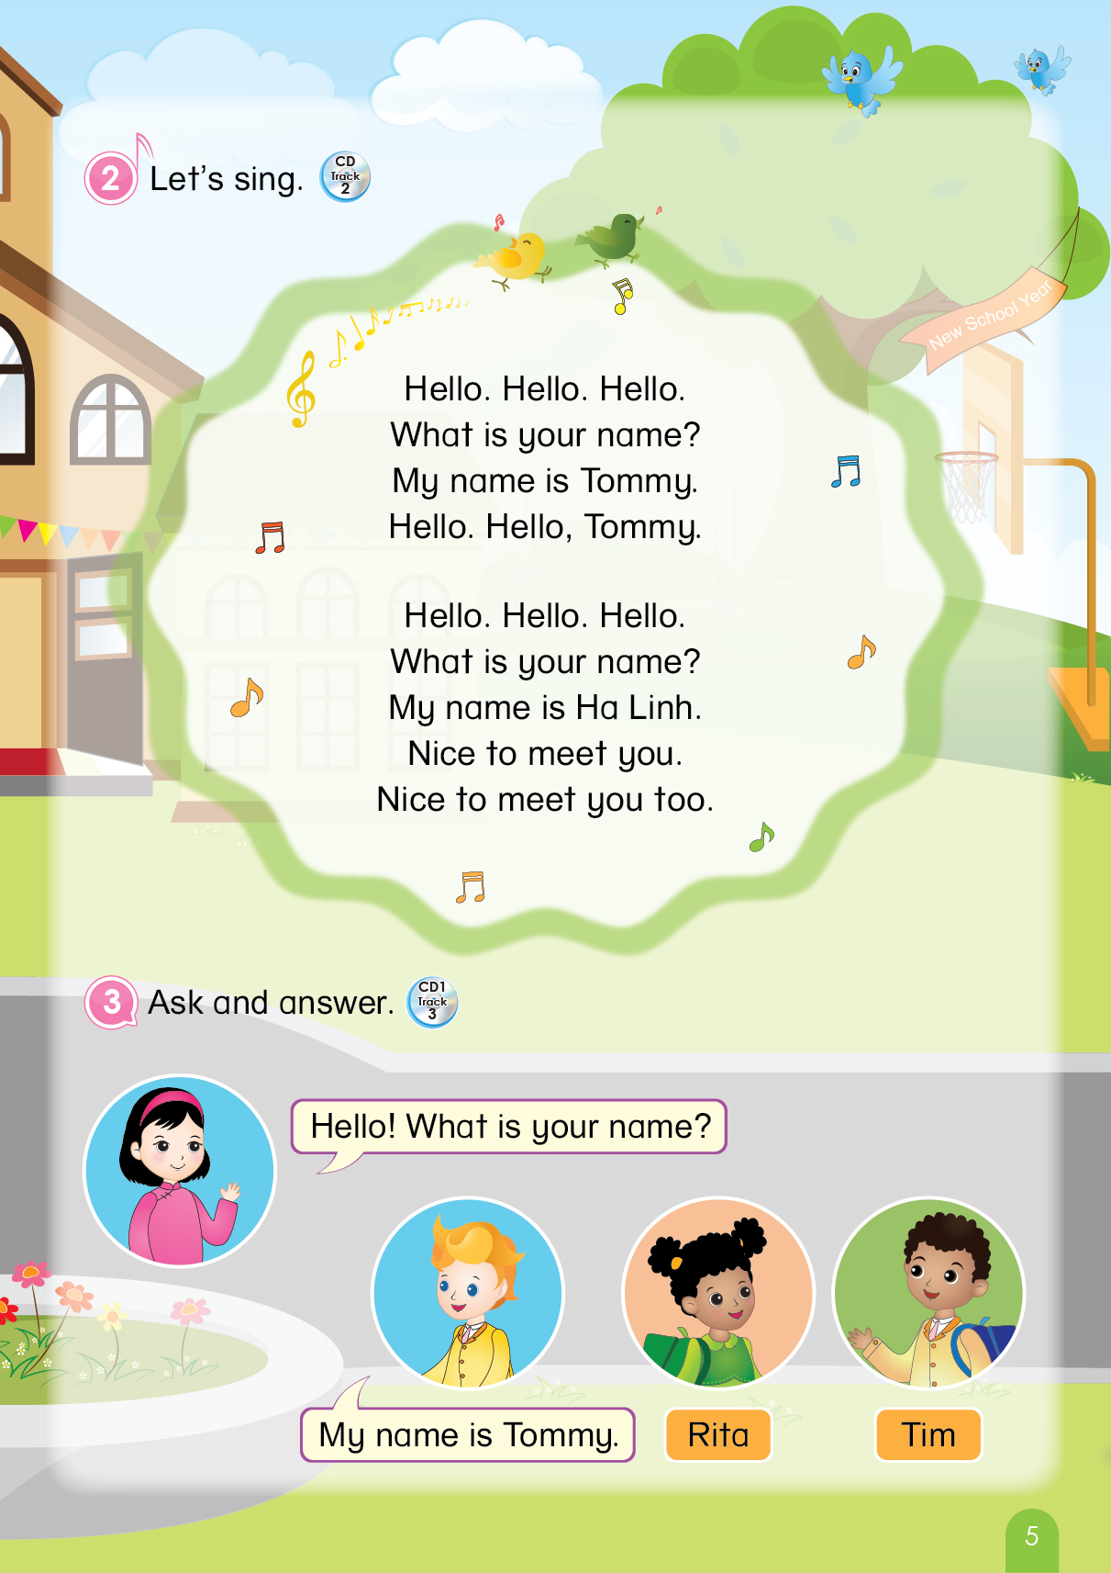

Notes:
Teacher says “Hello, everyone. How are you? How’s the weather? Is it sunny? Great! Now, let’s sing a song with me.”
Warm up: Sing “Hello song” – “Excellent! You sing very well.”
Divide class into 2 groups (optional) – “Today, we will have 2 groups – Group 1 and Group 2. You are Group 1, you are Group 2.”

Slide 3

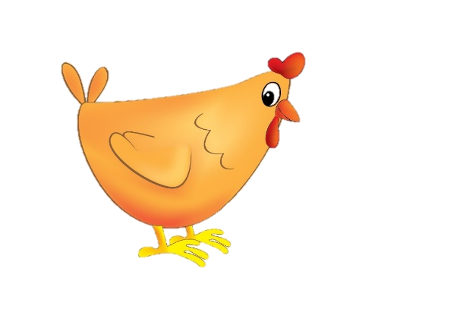

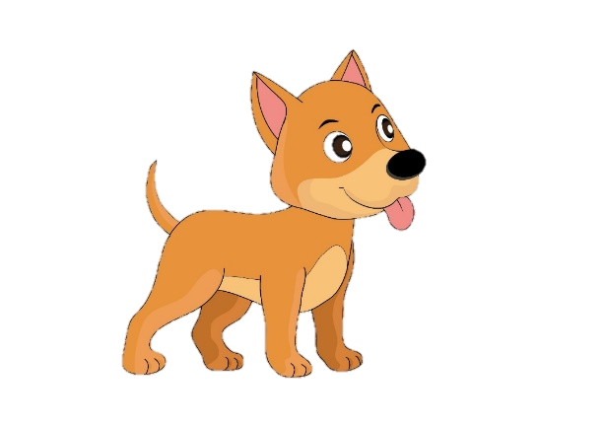
Let’s review!
Game: Can you point?
1
2
Notes:
- Teacher gives instructions of this activity:
+ have them listen to each audio and ask them to point their finger as the same as the direction of the animal in the picture (e.g. if it is the dog, students point their finger to the left; if it is the chicken, students point to finger up to the sky.)
Teacher makes sure all students understand the game’s rule.
“Now, class, what is it? Let’s listen and point at the correct place.”
“Where is dog? Yes! And chicken? Great!”

Slide 4
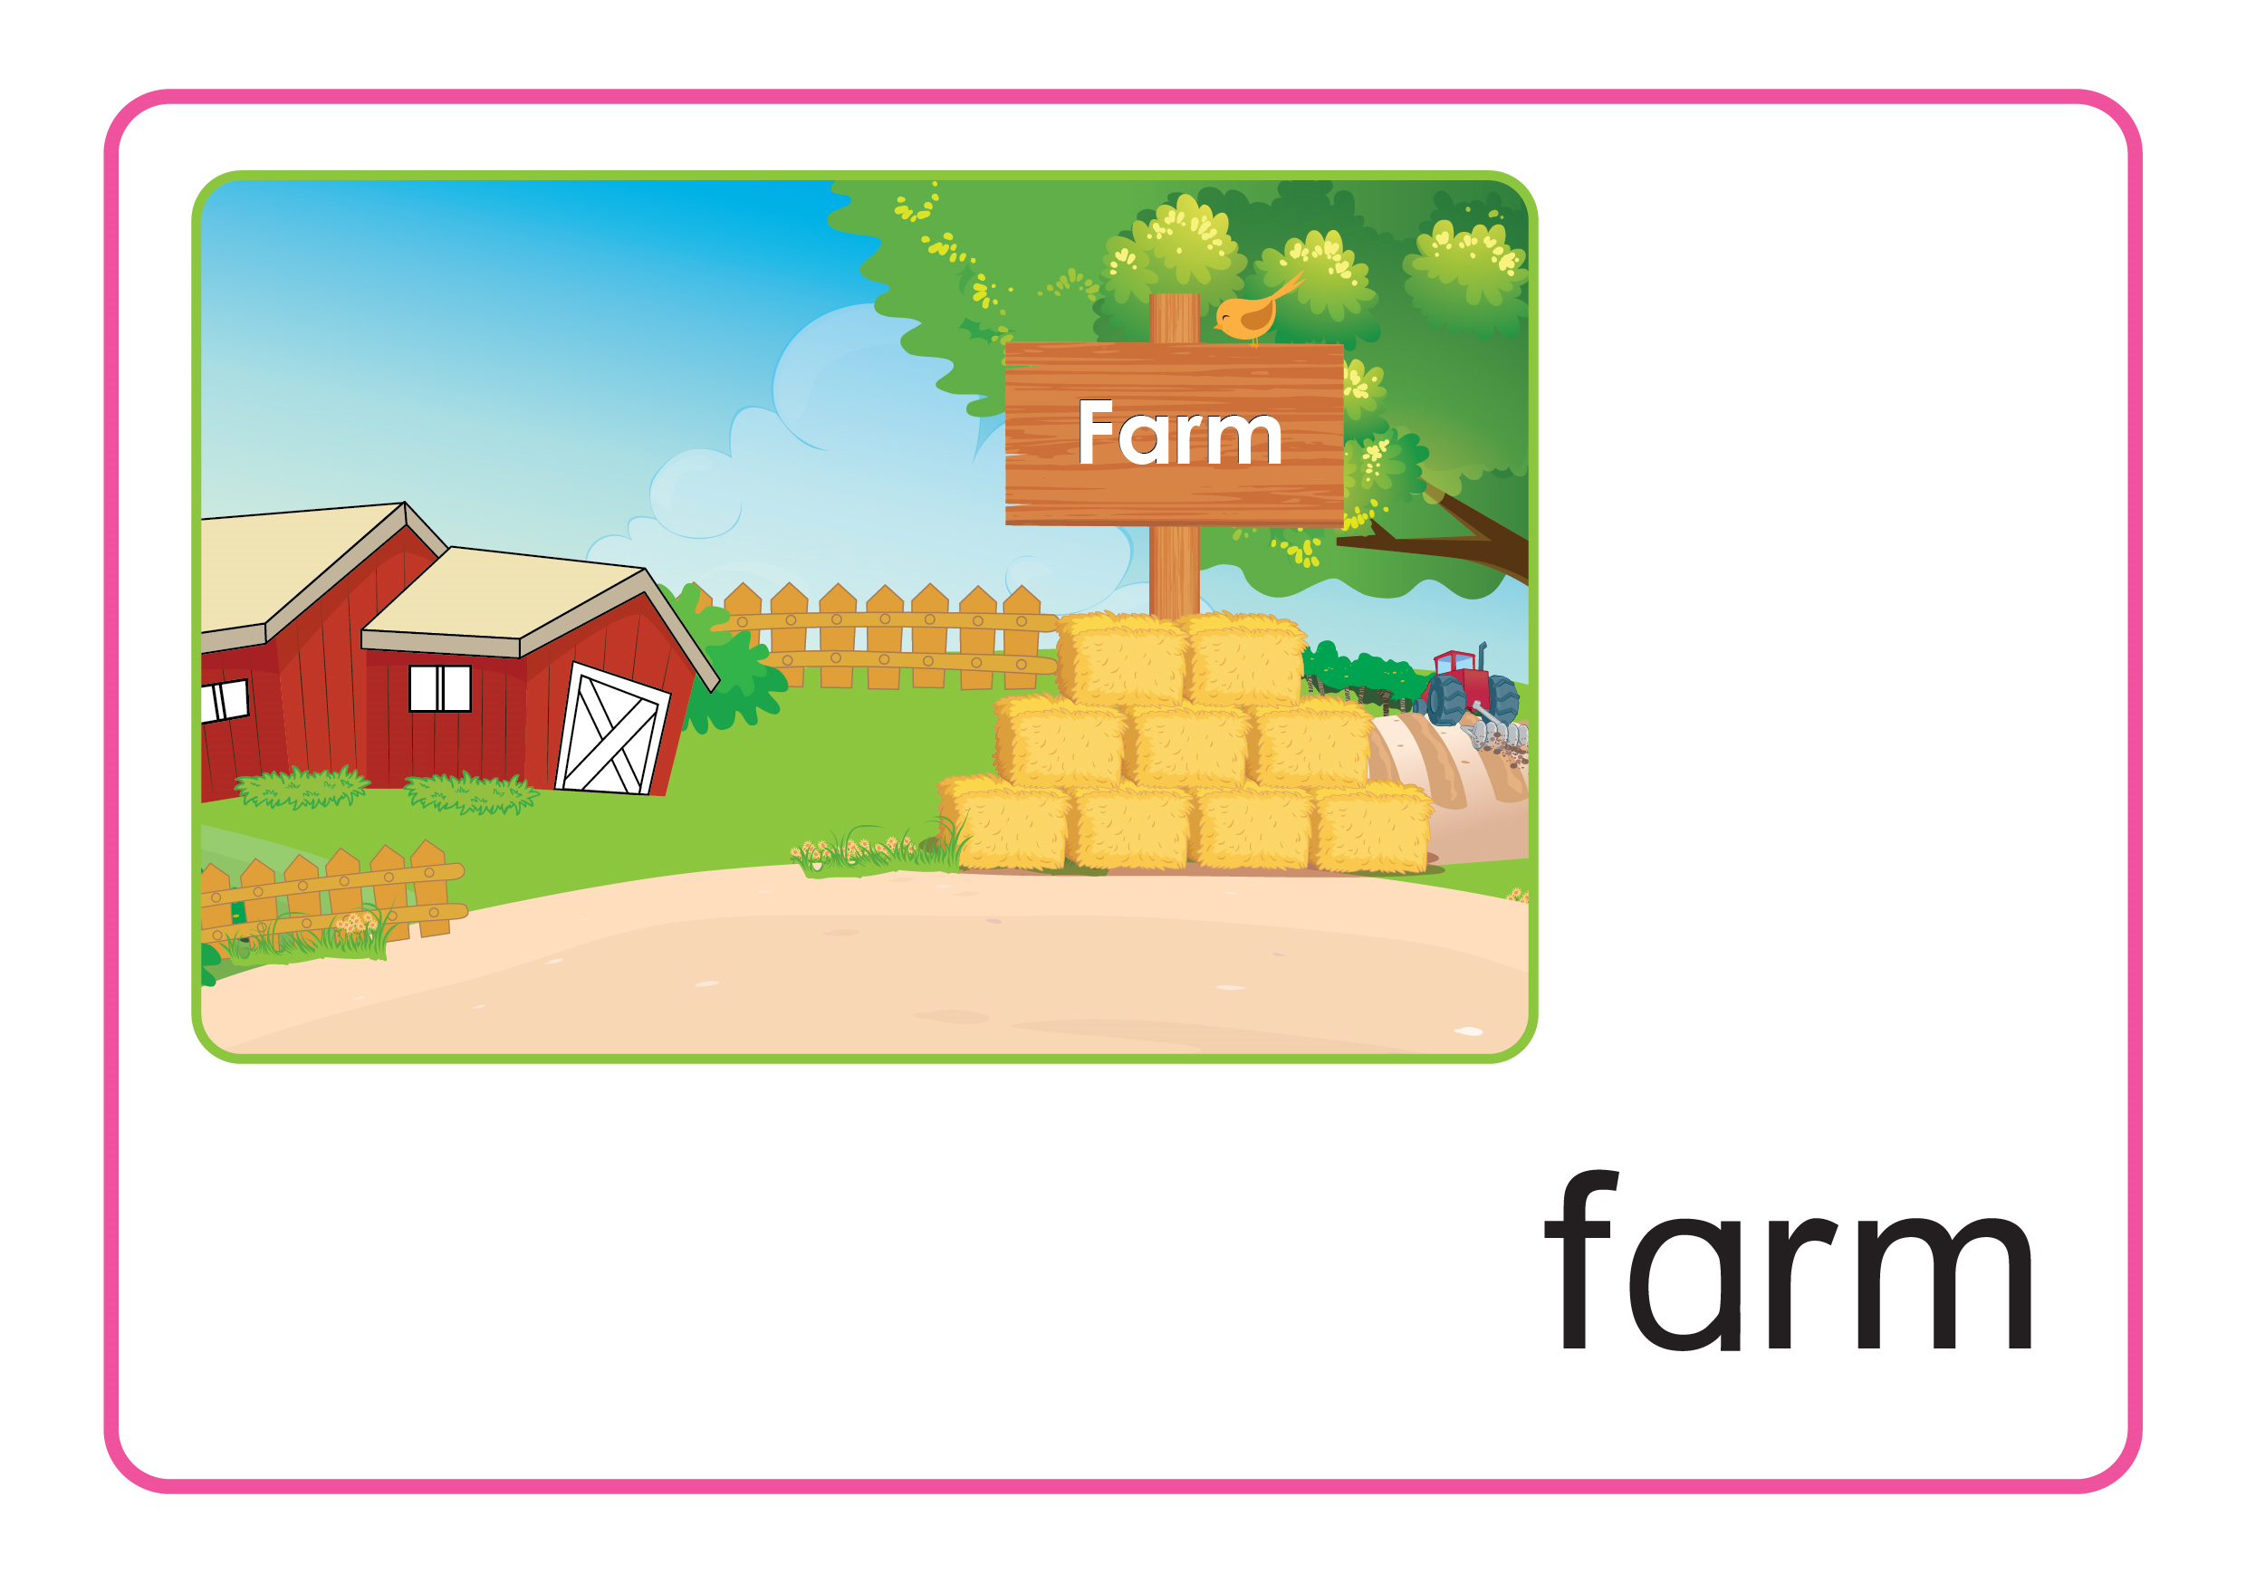


Game: Can you point?
1
2
Notes:
“Where is egg? Yes! And elephant? Great!”

Slide 5
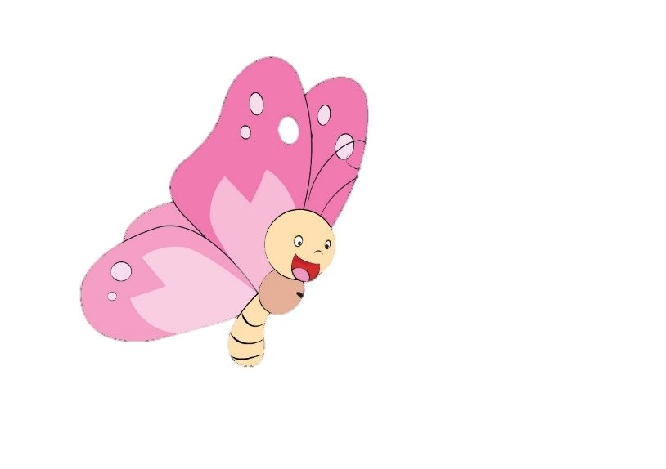


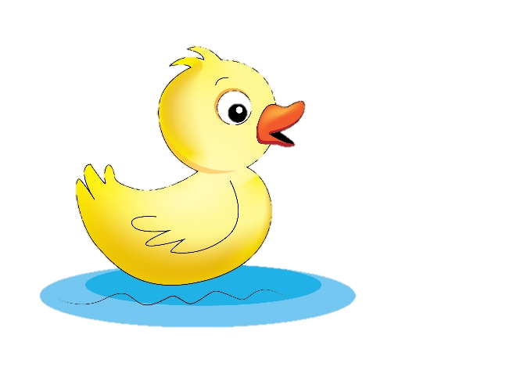
Game: Can you point?
2
1
Notes:
“Where is duck? Yes! And bird? Great!”

Slide 6

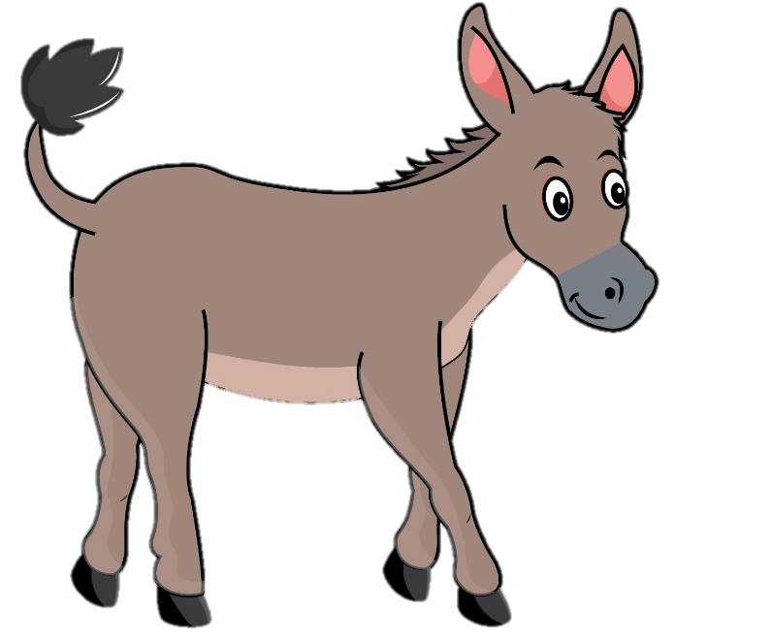
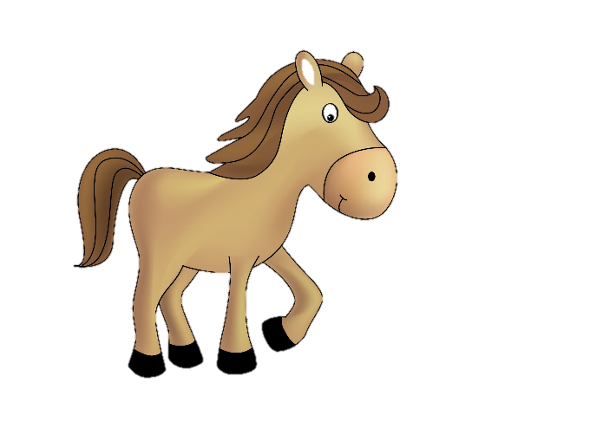
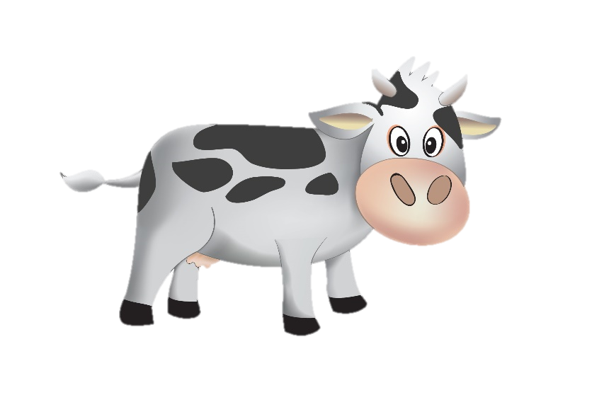
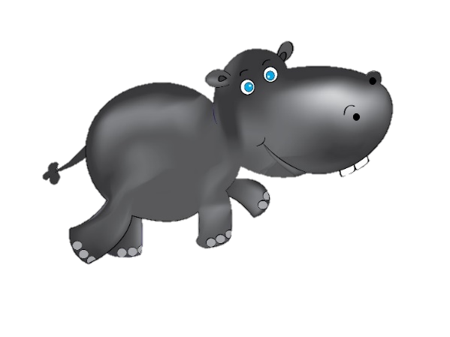
Game: Can you point?
1
2
Notes:
“Where is donkey? Yes! And cow? Great!”
The game ends, teacher gives praises to the whole class. – “Good job”.

Slide 7


Unit 8
Lesson 1
Notes:
Teacher gives students some hints of today’s lesson by pointing the horse and hippo, possibly saying “We have two more friends today. Let’s find out who they are.”

Slide 8


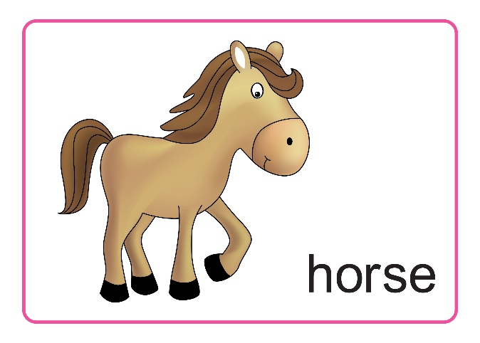
Unit 8:
Lesson 1:
H h
1. Look, listen and repeat.
Hh
h
Notes:
Teacher asks students to listen twice for each letter, sound and words. “Listen 2 times”
Teacher asks students to repeat twice after one-by-one listening, and checks pronunciation. – ”Listen and repeat.”
Teacher does the gestures of the letter, sound and words, and has students do the same while repeating. – “Look at me, listen and repeat.”

Slide 9
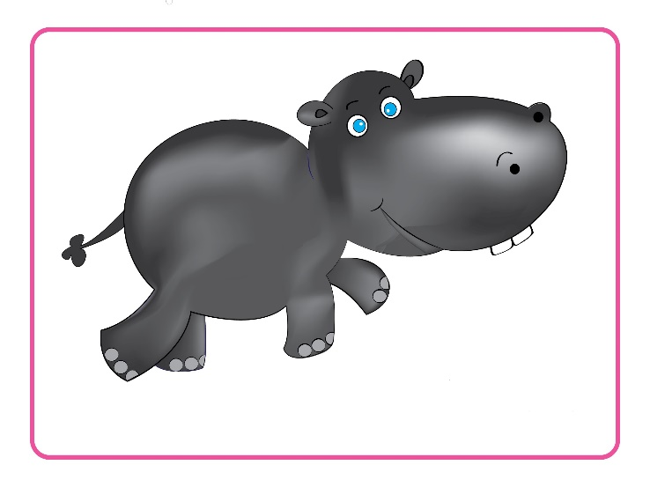
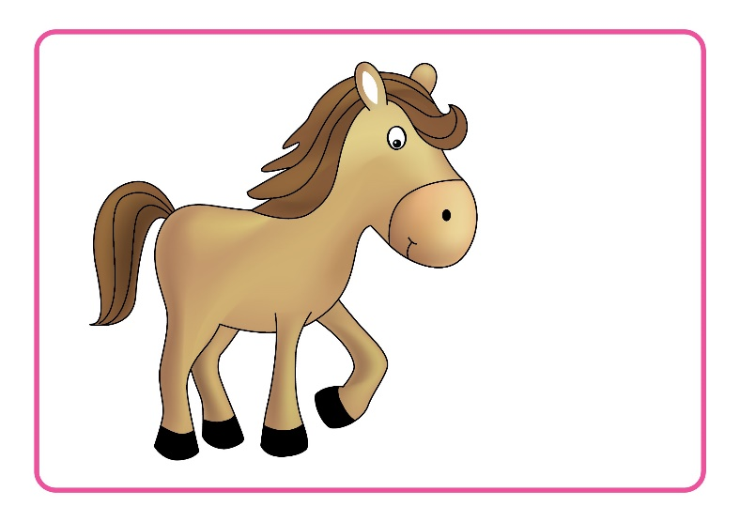
Unit 8:
Lesson 1:
H h
1. Look, listen and repeat.
Hh
h
Game:
Let’s guess!
Notes:
Teacher leads in the game and gives instructions:
+ have them listen to the audio.
+ collect and confirm their answer, and show the answer on the slide.
Teacher gives praises.
“Listen and show me what it is? What is it? Yes, hippo. Where is hippo? Great.”

Slide 10


1. Look, listen and repeat.
Game:
Let’s guess
Hh
h
Notes:
“What is it? Yes, H. Where is H? Great.”

Slide 11


1. Look, listen and repeat.
Game:
Let’s guess!
Hh
h
Notes:
“What is it? Yes, h. Where is h? Great.”

Slide 12


1. Look, listen and repeat.
Hh
h
Game:
Let’s guess!
Notes:
“What is it? Yes, horse. Where is horse? Great.”

Slide 13
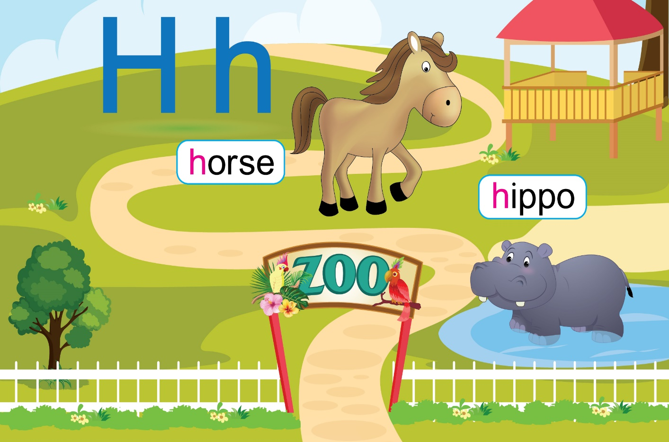
Unit 8:
Lesson 1:
H h
1. Look, listen and repeat.
LOOK
AT
YOUR
BOOK!
POINT
AND
SAY.
Notes:
Teacher asks students to open their books, hold up the book and point to the letter, sound and words. – “Open your book page 36”
Teacher has the class listen again, and for this time. Students follow by pointing to them on the page and repeat. – “Listen and point”
Teacher has them practice in pairs or groups or by individual. – “Let’s work with your friends.”

Slide 14

Unit 8:
Lesson 1:
H h
1. Look, listen and repeat.
2. Let’s chant.
Notes:
Teacher leads in the chant. – “Let’s chant with me.”
Teacher asks students to listen twice, while teacher follows the chant with gestures. – “Look and listen 2 times”
Teacher asks students to listen and repeat each line of the chant. – “Listen and repeat.”
Teacher mutes the sound and have students say each line along by group. “Now, again please.”
Teacher groups students and ask them to sit face to face and practice chanting with gestures. Offer help if necessary. “Let’s chant with your friends.”
Teacher asks the class to chant along with music and do gestures. – “Class, let’s chant with me.”

Slide 15

Unit 8:
Lesson 1:
H h
Let’s review!
Hh
A.
h
B.
Notes:
Teacher leads in the review section. - “Now, listen and choose the correct answer.”
Teacher asks students to listen to each audio for one time.
Teacher asks for answers, collects and confirms and shows the correct answer. “Listen, A or B. Great, B - h. Next, what is it? Good - H.”

Slide 16


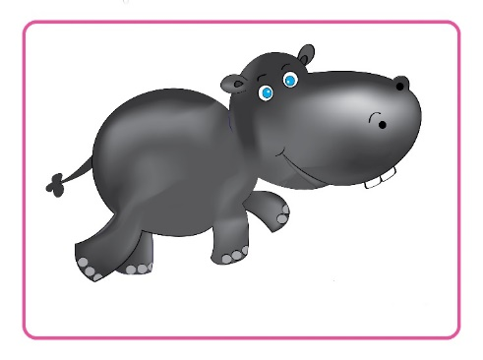
Unit 8:
Lesson 1:
H h
Let’s review!
What is it?
What is it?
horse
donkey
elephant
dog
hippo
chicken
Notes:
Teacher asks students to look at the picture and asks “What is it?”.
Teacher asks for answers, collects and confirms, and shows the correct answer. – “Yes, A. Good job. Next, what is it? Great, B”

Slide 17

Unit 5:
Lesson 2:
H h
Let’s review!
Notes:
Teacher gives praises: “Good job.”

Slide 18

Unit 5:
Lesson 2:
H h
1. Look, listen and repeat.
2. Let’s chant.
Notes:
Teacher asks students to ask and answer again: “So class, what is it? Good. And what is it? Well done. How about the animals. What is it? Great. And what is it? Nice.”
Teacher gives comments of the class’s performance: “Class, you did so well today.”

Slide 19

Unit 5:
Lesson 2:
H h
Notes:
Teacher says Goodbye. – “It’s time to say Goodbye. Goodbye, and see you.”

