Slide 1




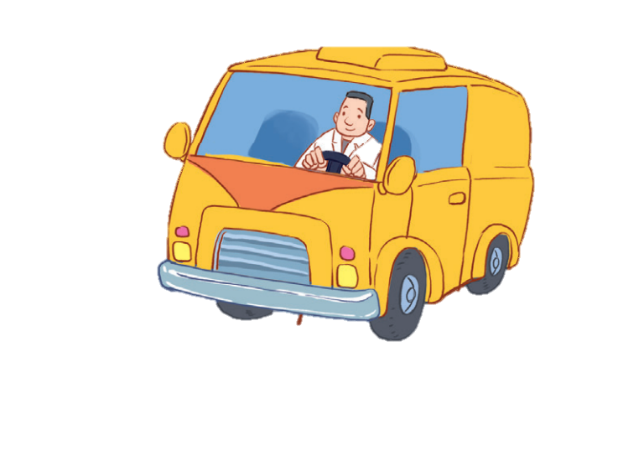


12
LESSON 3 – Period 5

Slide 2
Contents
Warm-up and review
Listen and repeat.
Listen and circle.
Let’s chant.
1
2
3
4
5
Fun corner and wrap-up

Slide 3
1
Warm-up and review

Slide 4




Picking coconut
Notes:
Step 1: Divide the class into 4 teams.
Step 2: Invite one pupil from each team to the front, listen to the recording and choose the right answer.
Step 3: Encourage pupils to join in the game.
Step 4: Give points to pupils.

Slide 5
2
Listen and repeat.

Slide 6
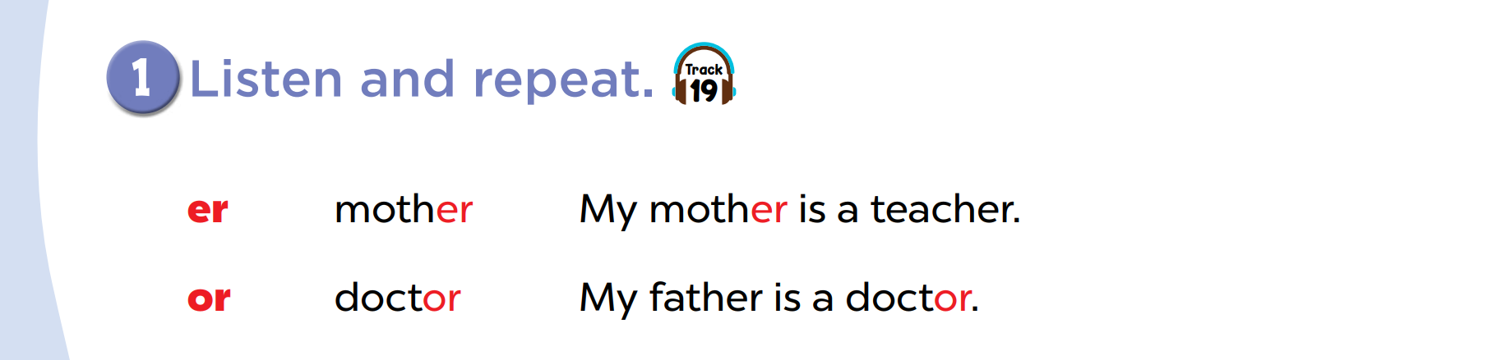

Slide 8
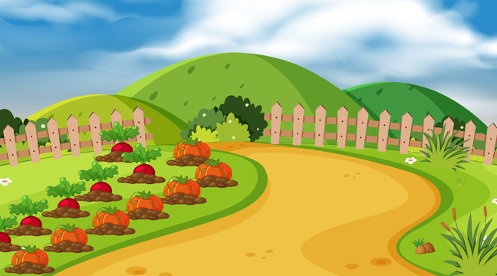
Listen and choose.
mother
or
er
doctor
Notes:
Game: Listen and choose.
Divide the class into 2 groups. Let the pupils listen to the recording, then choose the correct word.

Slide 9
Listen and choose.
or
mother
doctor
ch

Slide 10
Listen and choose.
th
or
mother
doctor

Slide 11
Listen and choose.
er
m
doctor
mother

Slide 12
3
Listen and circle.

Slide 13
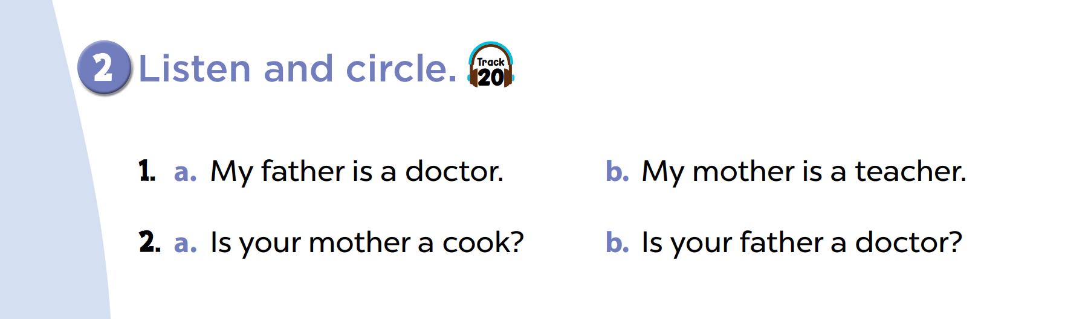

Slide 15

Chinese whisper
Notes:
Step 1: Divide the class into four teams.
Step 2: Invite 5 pupils from each team to line up. The first pupil gets a card/ listens to the teacher’s whisper. Pupils whisper sentences to the next friends in their lines. The last pupils say the sentence aloud.
Step 3: Encourage pupils to join in the game.
Step 4: Give points to teams.

Slide 16
4
Let’s chant.

Slide 17
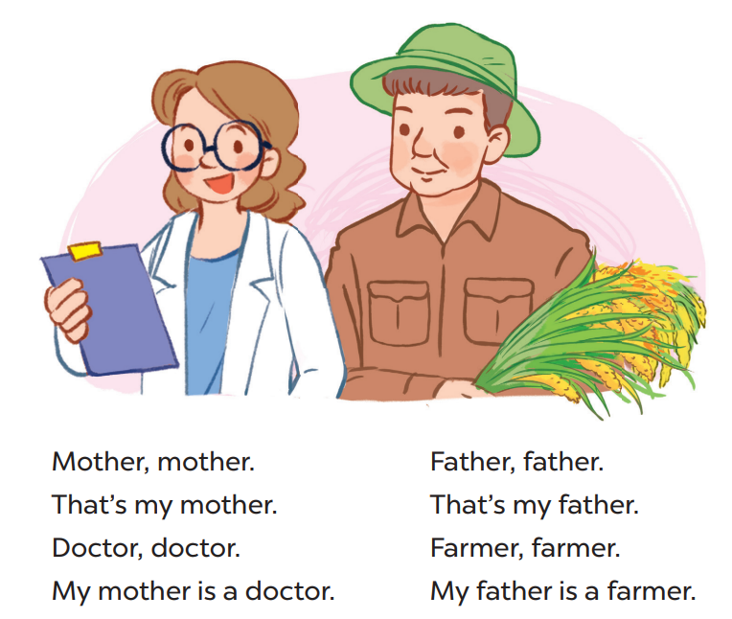

Slide 18
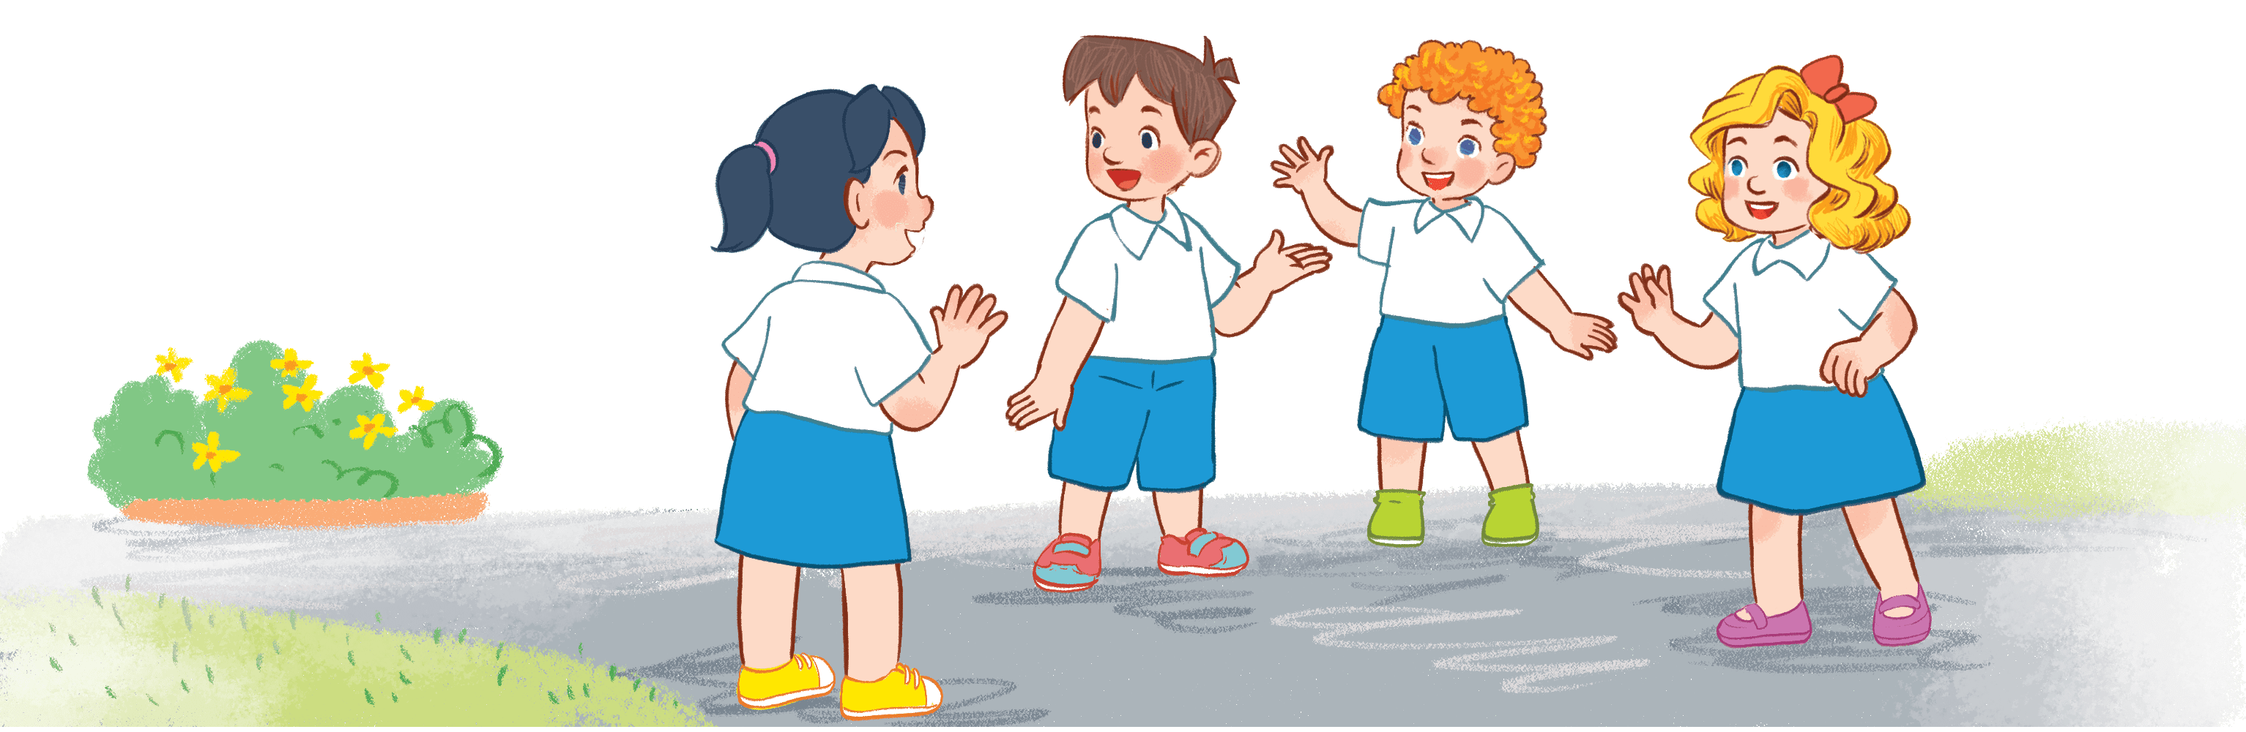
Game time
Doctor, doctor.
My mother is a doctor.
Father, father.
That’s my father.
Mother, mother.
That’s my mother.
Farmer, farmer.
My father is a farmer.
Notes:
Step 1: Divide the class into 4 teams.
Step 2: Set rules: invite one pupil from each team to stand up and say 1 sentence aloud, the next one continues. Then take turns reading the chant. Who can make it correctly will get points for the team.
Step 3: Encourage pupils to join in the game.
Step 4: Give points to pupils.

Slide 19
5
Fun corner and wrap-up

