Slide 1

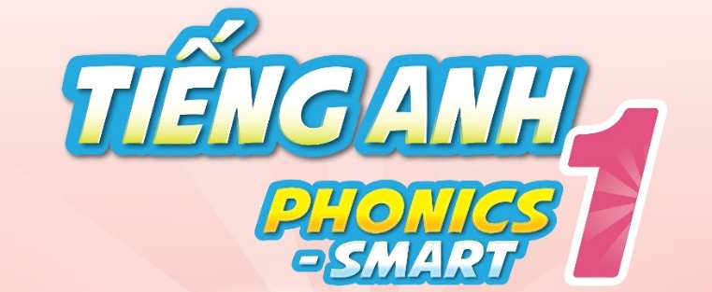

Slide 2

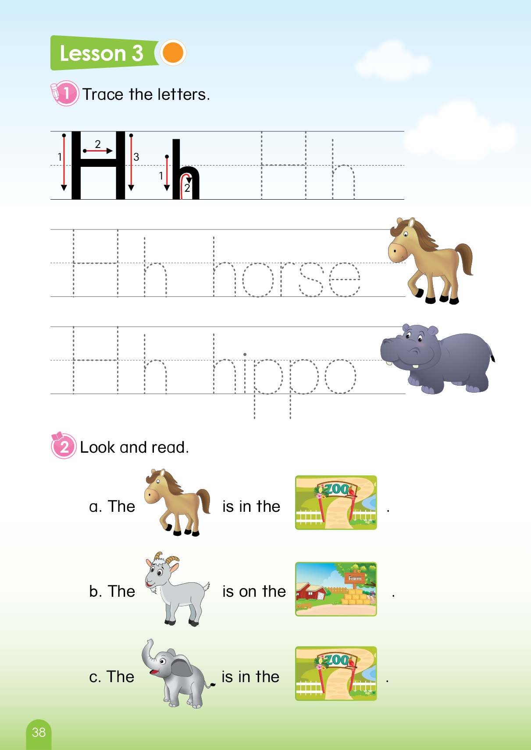
Let’s play game
“Where…?
Notes:
T says “ Hello, everyone. How are you? How’s the weather? Is it sunny? Great!
Warm up: “Let’s play a game called “ Where?”
Split the class into 2 groups – “Today, we will have 2 groups – group 1 and group 2. You are group 1, you are Group 2.”
Introduce the game : “Where?”
T says ”you can see number 1 & number 2. you need to choose the number to find the animals.”

Slide 3

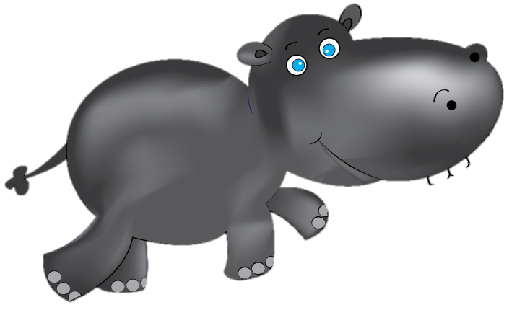
Where is the hippo?
1
2
Notes:
1. Teacher asks : “ Where is the hippo? Number 1 or number 2?”
2. Then the students choose the number.
3. Keep doing that for other questions.
4. T says: “ Where is the hippo? Number 1 or number 2?”
Number 2. Ok (click), Oh, There is no hippo here. Is a hippo in the number 1?
Ok let’s check. (click) .(Click the sound to say yeah)
Here is the hippo.”

Slide 4
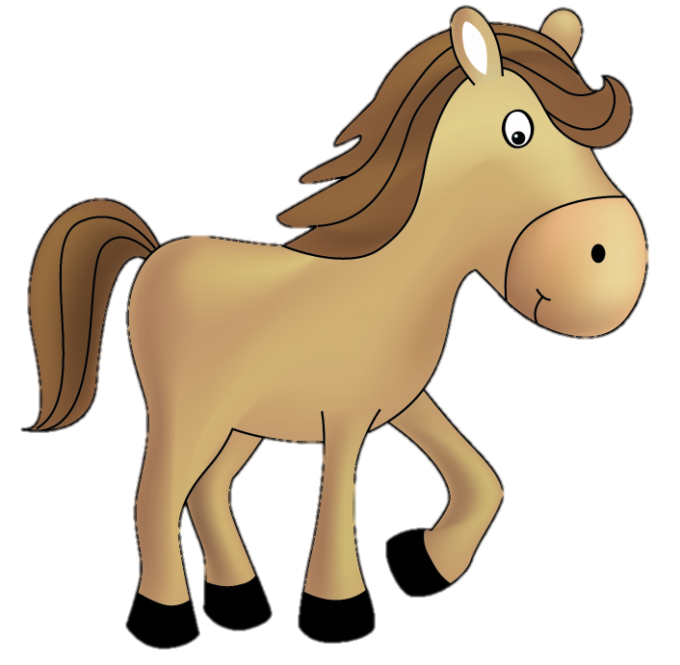
Where is the horse?
1
2
Notes:
1.T says: “Where is the horse? Number 1 or 2?”
“Number 2 (click) –Yeah it’s a horse”
(Click the sound to say yeah)

Slide 5
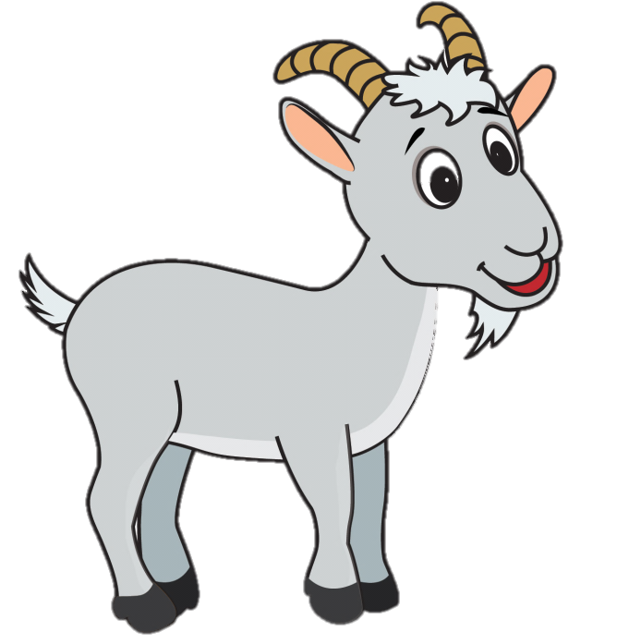
Where is the goat?
1
2
Notes:
1. T says : “Where is the goat? Number 1 or 2?
Number 2 (click) –Yeah it’s a goat.”
(Click the sound to say yeah)

Slide 6

Where is the elephant?
1
2
Notes:
1. T says: “Where is the elephant? Number 1 or 2?
Number 1 (click) –Yeah it’s a elephant.”
(Click the sound to say yeah)

Slide 7


Slide 8


UNIT 8
LESSON 3
Notes:
Introduction:
T says: “Welcome to the lesson today: Unit 8– Lesson 3”

Slide 9
Unit 8:
Lesson 3
1. Trace the letters.
Page 38
Notes:
T says: “Let’s go to part 1: Trace the letters”

Slide 10
Unit 8:
Lesson 3
1. Trace the letters.
Page 38
Notes:
Teacher asks the students to look at the screen.
Guide the students how to trace
Ask the students to trace the letters in their book.
T says : “Look at the screen. This is how to trace.
With big H: There are 3 strokes. Like this(click 3 times)
With small h: There are 2 strokes. (click 2 times)
It’s very easy. Now your turn, trace the letters in your book page 38, please.”

Slide 11
Unit 8:
Lesson 3
1. Trace the letters.
H h horse
Page 38
Notes:
1. Trace the letter Hh and “horse”
2. Guide the students use fingers to trace in the air. then trace the words in their books
3. Then show the screen and ask them to read.
4. T says: “Show me your finger. Ok, trace the letter H like this(teacher will trace in the air).Trace the letter H and the word horse in your book page 38, please.
→Good Job!”
- “Listen and repeat Hh –hippo”

Slide 12
Unit 8:
Lesson 3
1. Trace the letters.
H h hippo
Page 38
Notes:
1. Trace the letter Hh and “hippo”
2. Guide the students use fingers to trace in the air, then trace the words in their books
3. Then show the screen and ask them to read.
4. T says: “Now trace these letters and words in your book: Hh and hippo “
→ “Good Job!”

Slide 13
Unit 8:
Lesson 3
2. Look and read.
Notes:
Part 2: Look and read
T says: “Let’s go to part 2: Look and read”

Slide 14
Unit 8:
Lesson 3
2. Look and read.
Notes:
Part 2: Look and read
Teacher asks students about the pictures first to remind them.
Then read aloud in whole class, in teams, in individual
T says: “What is it? (click) – Yeah, horse”
T says: “What is it? (click)- Yeah, the zoo. Good job”
T says: “Now read this sentence: The horse is in the zoo. group 1 – good, group 2: very good”

Slide 15
Unit 8:
Lesson 3
2. Look and read.
Notes:
Part 2: Look and read
1. This activity helps students remember the words and the sentence.
2. Teacher will point and ask the students” What is the picture here?
3. T says: “ What is it here?- horse (click) – good
How about this one? The zoo (click) – awesome.
Now read again: The horse is in the zoo.”

Slide 16
Unit 8:
Lesson 3
2. Look and read.
Notes:
T says: “What is it? (click) – Yeah, goat
T says: “What is it? (click)- Yeah, the farm. Good job.”
T says: “Now read this sentence: The goat is on the farm. Team 1 – good, team 2: very good”

Slide 17
Unit 8:
Lesson 3
2. Look and read.
Notes:
1. T says: “ What is it here?- goat (click) – good
How about this one? The farm (click) – awesome.
Now read again: The goat is on the farm. “

Slide 18
Unit 8:
Lesson 3
2. Look and read.
Notes:
1. T says: “Look that this .What is it? (click)- Yes, elephant.
And this one.(click). The zoo, good.
Now read again: The elephant is in the zoo.”

Slide 19
Unit 8:
Lesson 3
2. Look and read.
Notes:
T says: “ What is it here?- elephant (click) – good
How about this one? The zoo (click) – well done
Now read again: The elephant is in the zoo.”

Slide 20

Notes:
Good job

Slide 21
Unit 8:
Lesson 3
2. Look and read.
Open your book, please
Notes:
Book using
Ask the students to read the sentences in their book
Work in the whole class, in teams, in individual.
“Now open your book page 38, read with your friends”

Slide 22

Goodbye
Notes:
Sum up – It’s time to say good bye today”.
Count the points of each group.
Group having more points will be the winner.-“So the winner is group …. Group …, you also good, too.”
Say goodbye. “Goodbye class “

