Slide 1

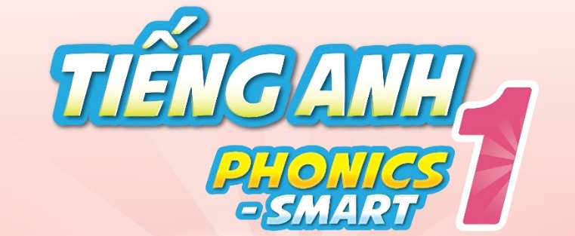

Slide 2



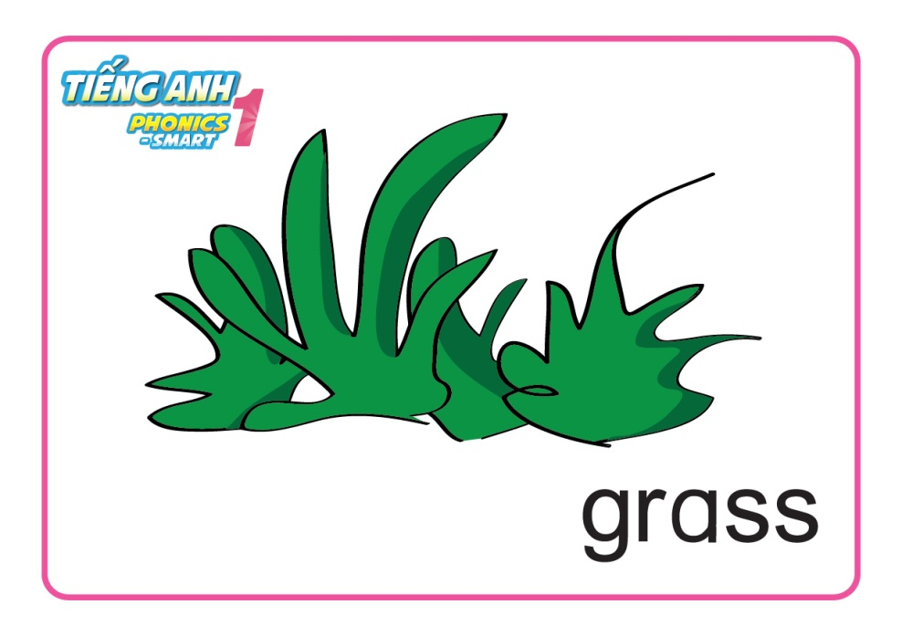
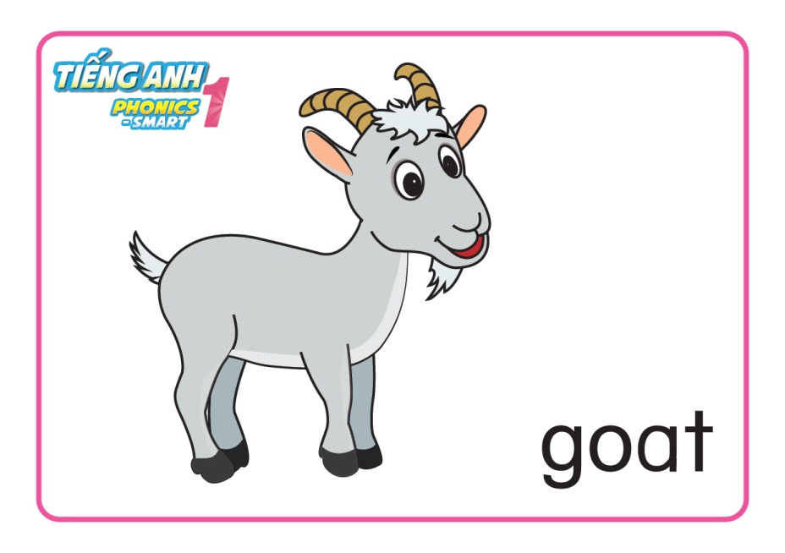
REVISION & WARM UP

Slide 3
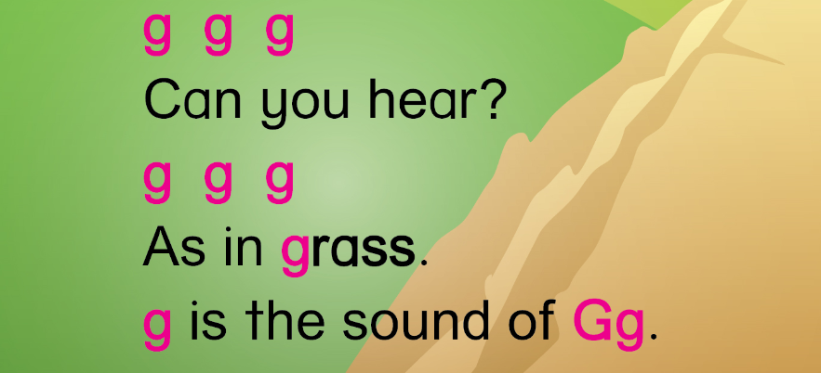
REVISION & WARM UP
Let’s sing and do the actions

Slide 4
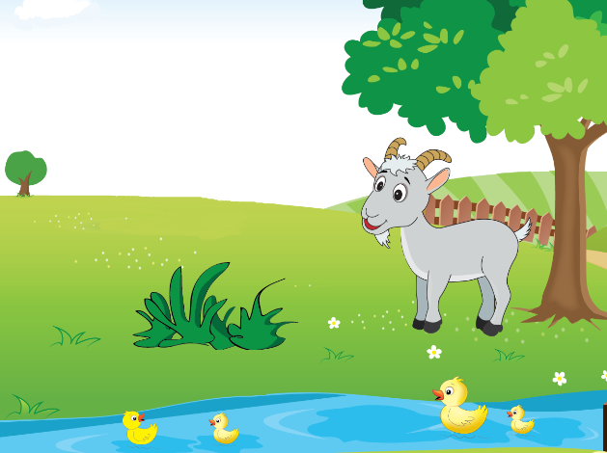
Unit 7
Lesson 2

Slide 5
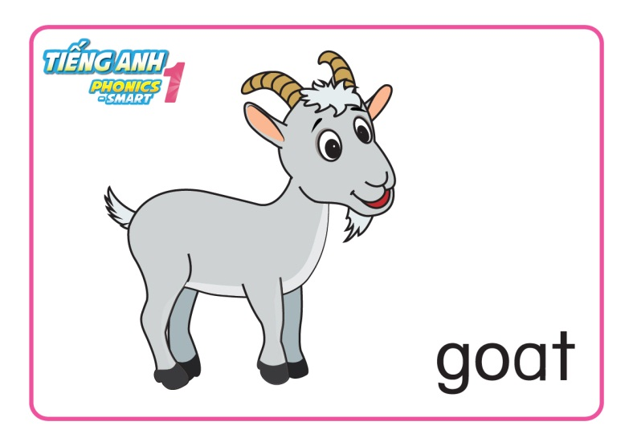

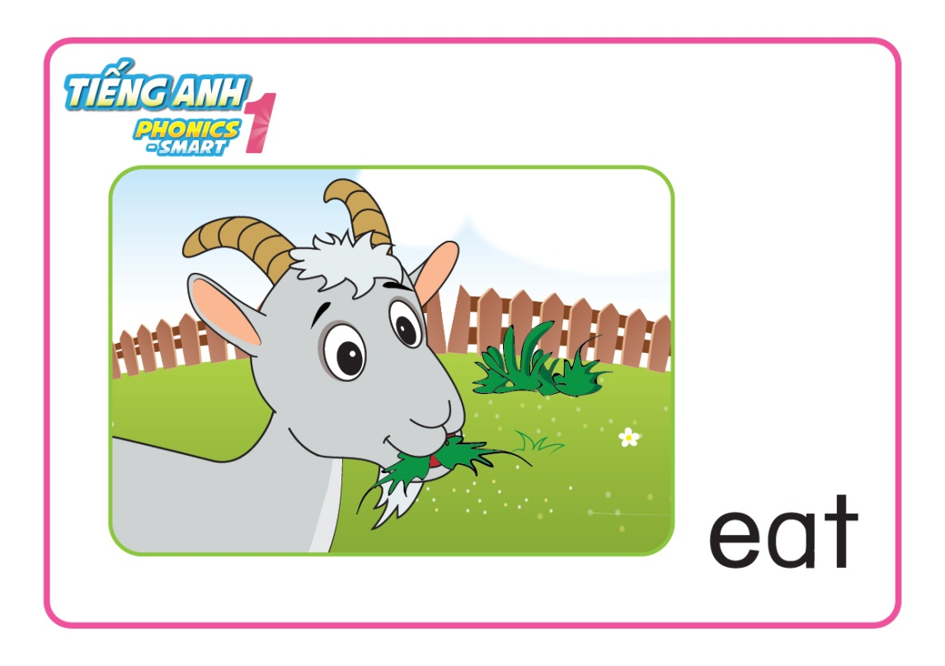
Unit 7:
Lesson 2:
G g
1. Listen and repeat.

Slide 6
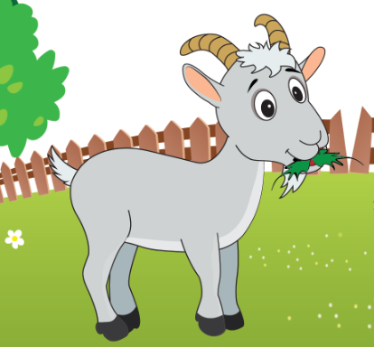
Unit 7:
Lesson 2:
G g
1. Listen and repeat.
eating grass

Slide 7
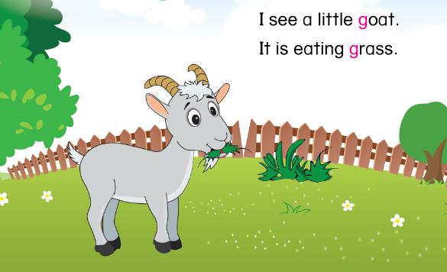
Unit 1:
Lesson 2:
G g
1. Listen and repeat.

Slide 8
Unit 7:
Lesson 2:
G g
1. Listen and repeat.
What can you see?
What can you hear?
What is the goat doing?

Slide 9
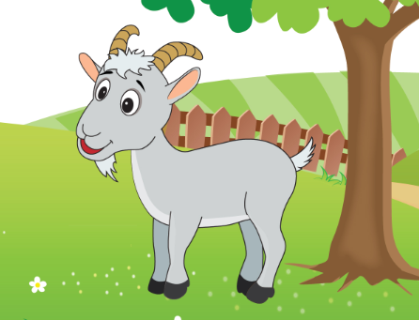
Unit 7:
Lesson 2:
G g
1. Listen and repeat.
I see a little goat.

Slide 10
Unit 7:
Lesson 2:
G g
1. Listen and repeat.
It is eating grass.

Slide 11
Unit 7:
Lesson 2:
G g
1. Listen and repeat.
Let’s say and do actions
I see a little goat.
It is eating grass.

Slide 12
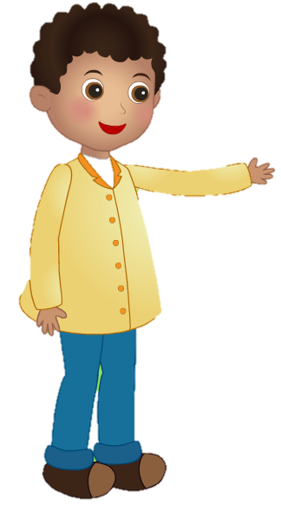
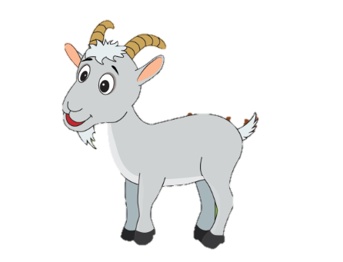
Unit 7:
Lesson 2:
G g
1. Listen and repeat.
Role-play Activity
I see a little goat.
Hello, little goat.
Hello.
Notes:
- Audio: letter A, /a/, apple, ant

Slide 13
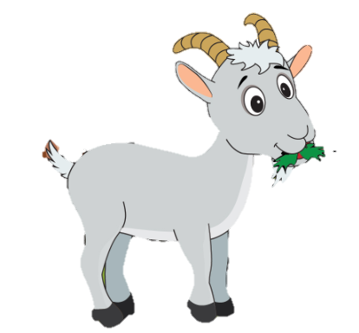

Unit 7:
Lesson 2:
G g
1. Listen and repeat.
Role-play Activity
It is eating grass.
Notes:
- Audio: letter A, /a/, apple, ant

Slide 14
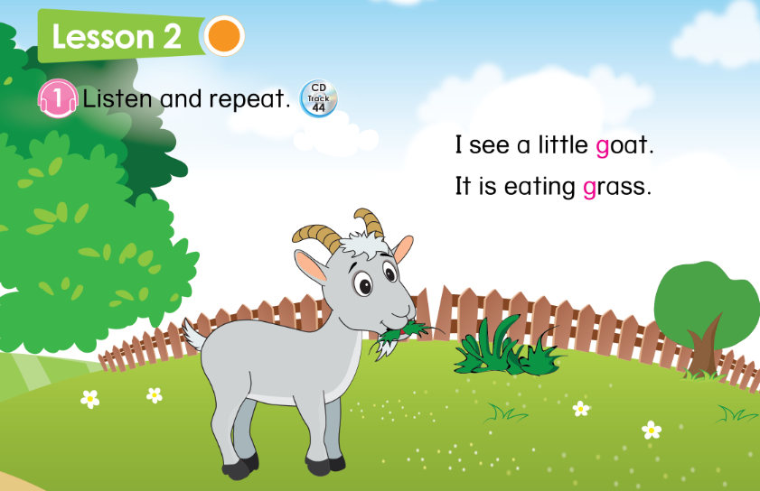

Unit 7: Lesson 2:
G g
33

Slide 15
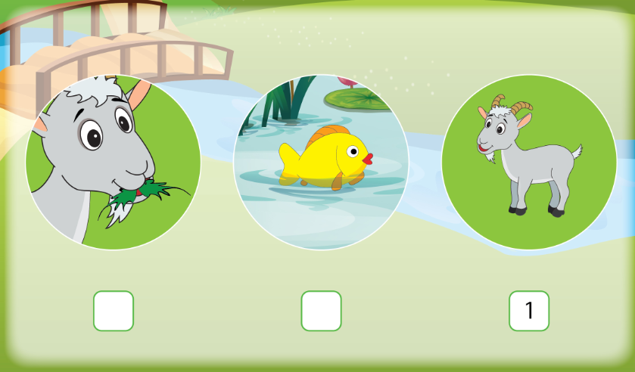
Unit 7:
Lesson 2:
G g
1. Listen and repeat.
2. Listen and number.
33

Slide 16
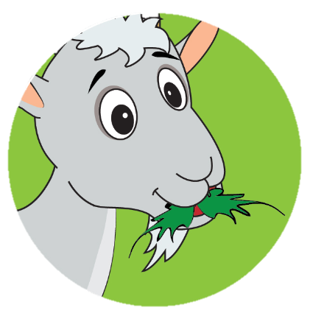
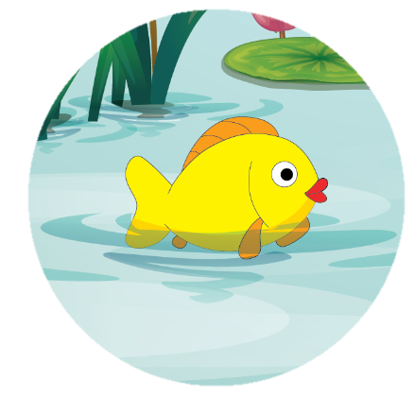
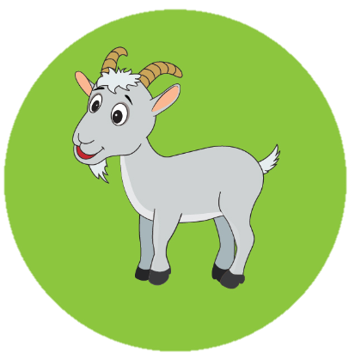


Unit 7:
Lesson 2:
G g
1. Listen and repeat.
2. Listen and number.
2
3

Slide 17
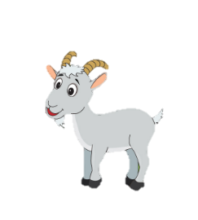
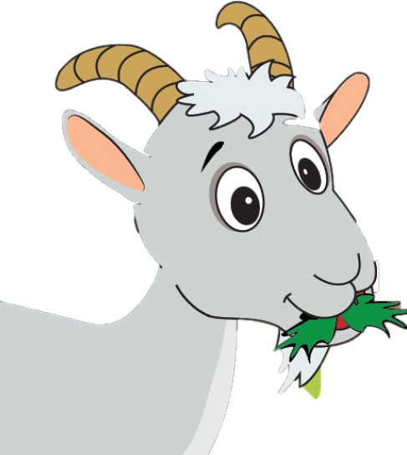
Unit 7:
Lesson 2:
G g
1. Listen and repeat.
2. Listen and number.
I see a little
.
It is
.
Notes:
- Tổng kết

