Slide 1


Daily activities
14
Lesson 1 – Period 1

Slide 2
01
Warm-up

Slide 3
Guessing game

Slide 4
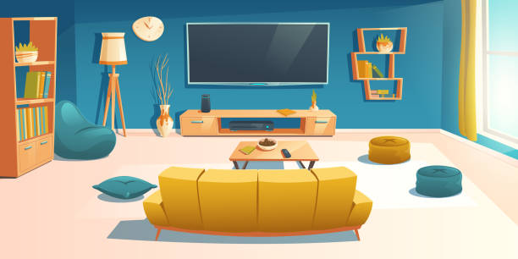
What room is this?
living room

Slide 5
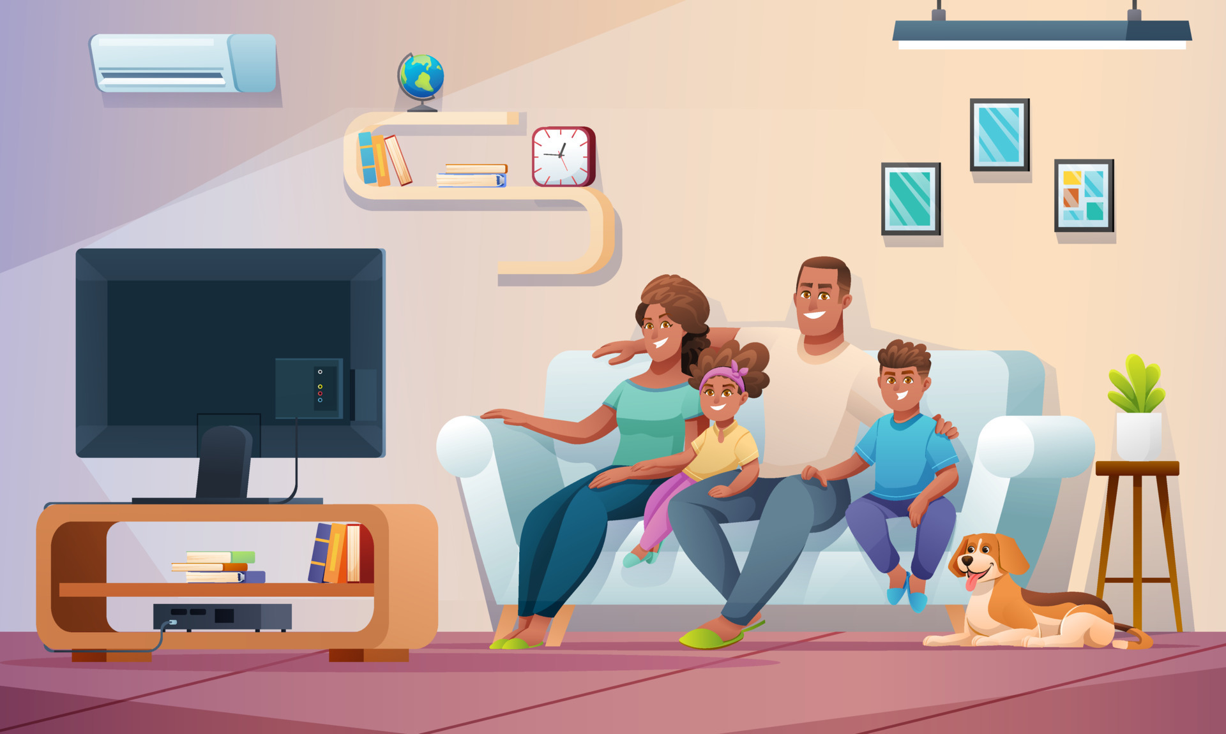
What is this?
TV

Slide 6
Where is the family sitting?
On the sofa

Slide 7
What are they doing?
Watching TV

Slide 8
02
Look, listen and repeat.

Slide 9
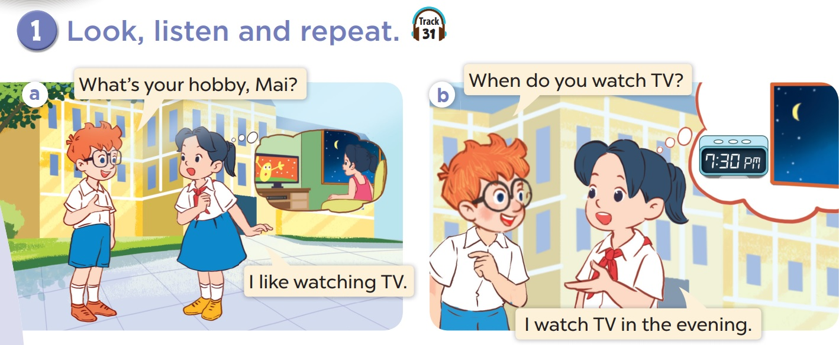


Slide 10
03
Listen, point and say.

Slide 11
Vocabulary

Slide 12


morning
in the morning

Slide 13


noon
at noon

Slide 14


afternoon
in the afternoon

Slide 15
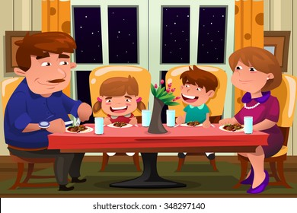

evening
in the evening

Slide 16
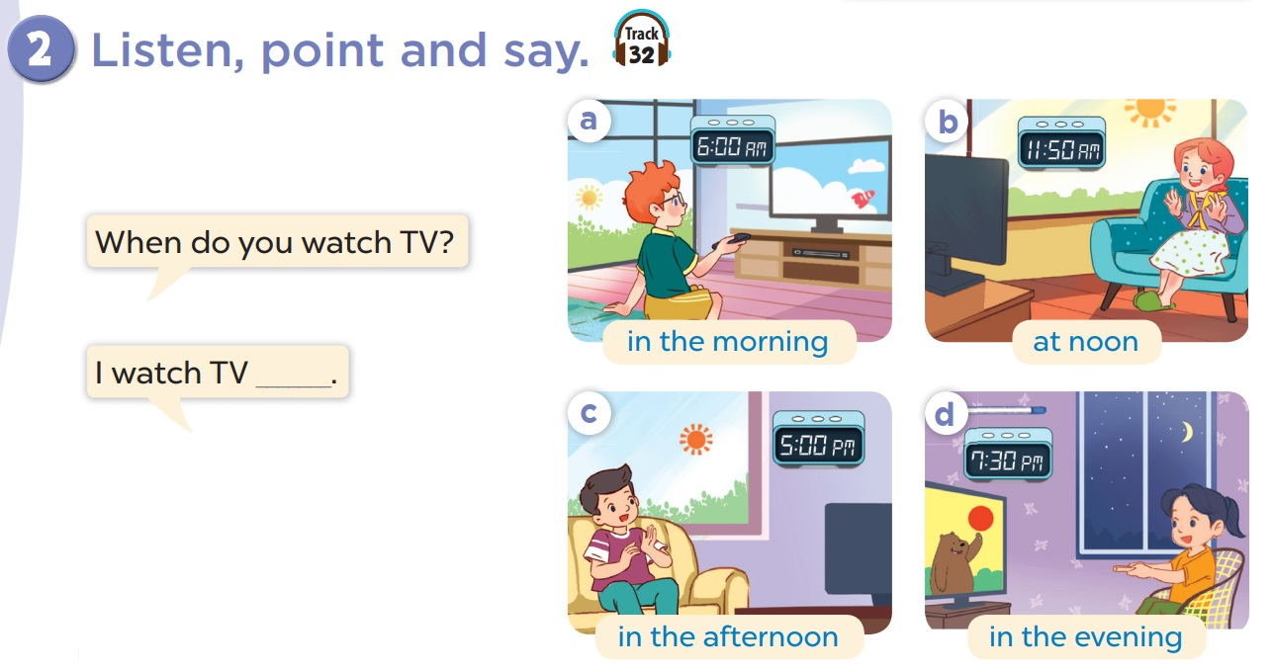

Slide 17

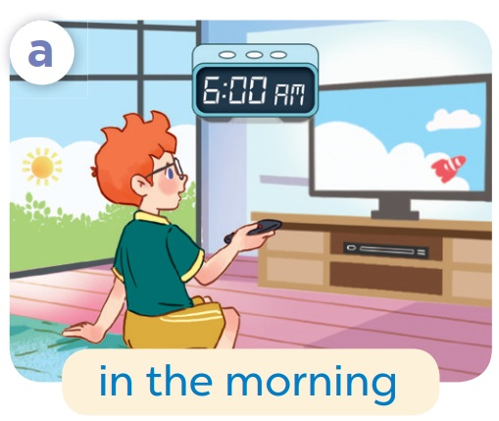

When do you watch TV?
I watch TV in the morning.

Slide 18

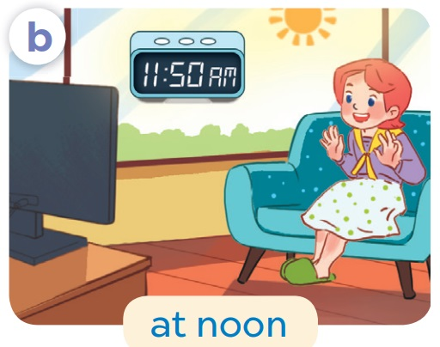
When do you watch TV?
I watch TV at noon.

Slide 19
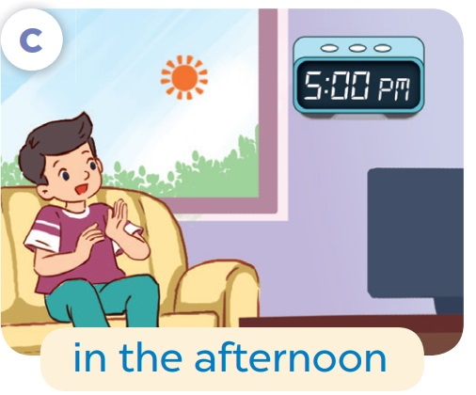

When do you watch TV?
I watch TV
in the afternoon.

Slide 20
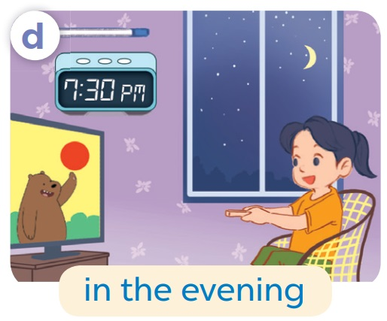
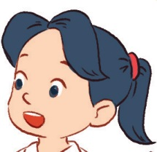
When do you watch TV?
I watch TV
in the evening.

Slide 21
04
Let’s talk.

Slide 22
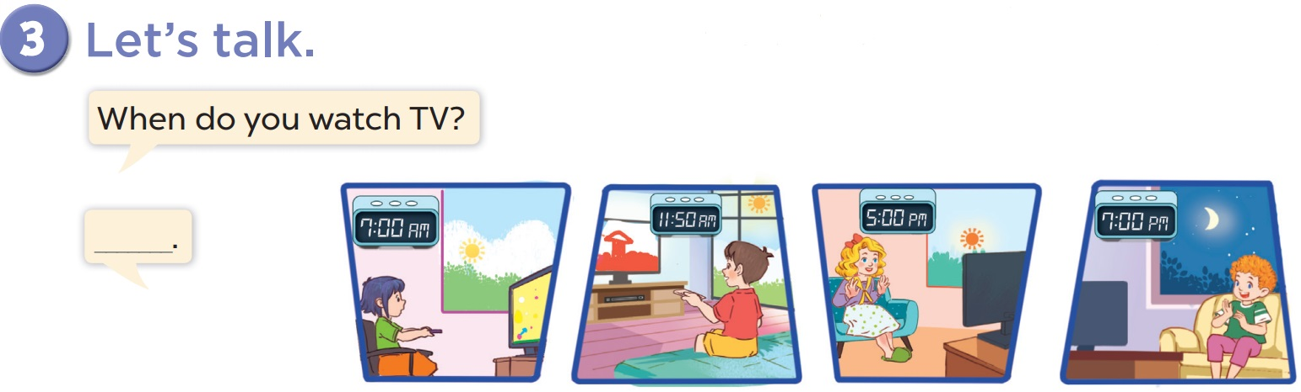

Slide 23
05
Game

Slide 24


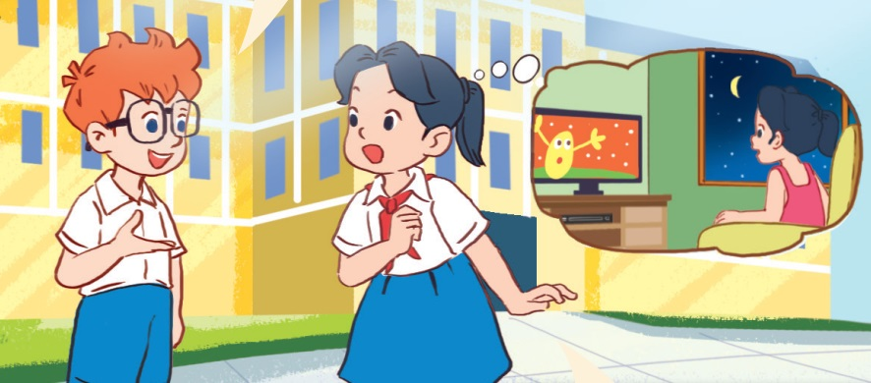
watching TV
washing TV
A: What is Mai’s hobby?
B: It’s _______________.

Slide 25
______ do you watch TV?
When
What

Slide 26
When do you _____ TV?
watching
watch

Slide 27
do
does
When ___ you watch TV?

Slide 28
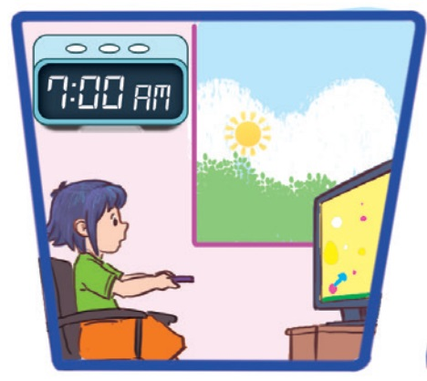
I watch TV _____.
at noon
in the morning

Slide 29
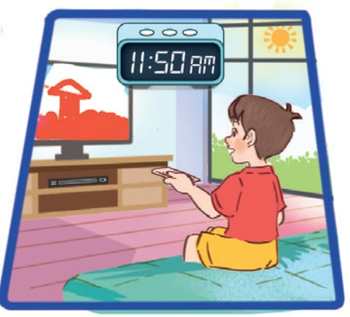
at night
at noon
I watch TV _____.

Slide 30
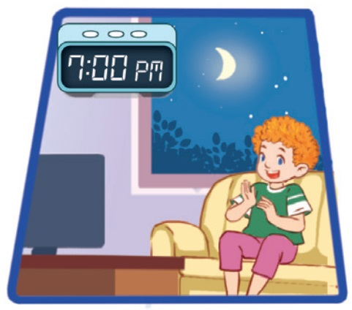
in the evening
in the afternoon
I watch TV ___.

Slide 31
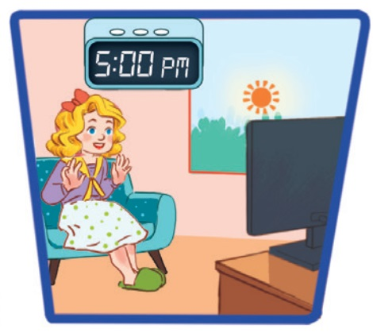
in the morning
in the afternoon
I watch TV ___.

