Slide 1



13
My house
LESSON 3 - PERIOD 5

Slide 2
TABLE OF CONTENTS
Warm-up and review
Listen and repeat.
1
2
3
4
Let’s chant.
Listen and circle.
5
Fun corner and wrap-up

Slide 3
1
Warm-up and review

Slide 4

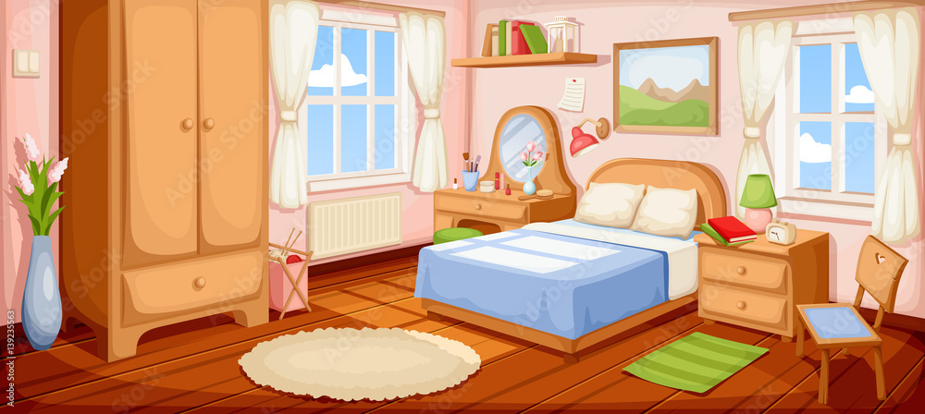




Where is the bedroom?
It’s here.
Notes:
Teacher asks the question. Students reply using the model sentences in the previous lesson. Click the rabbit to go back to the question slide.

Slide 5
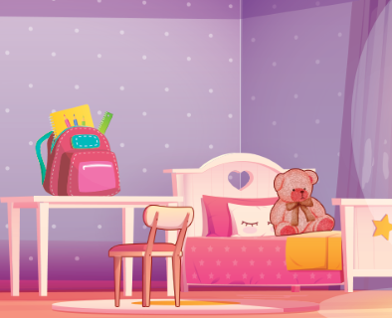


Where is the bed?
You have an egg!
It’s there.

Slide 6
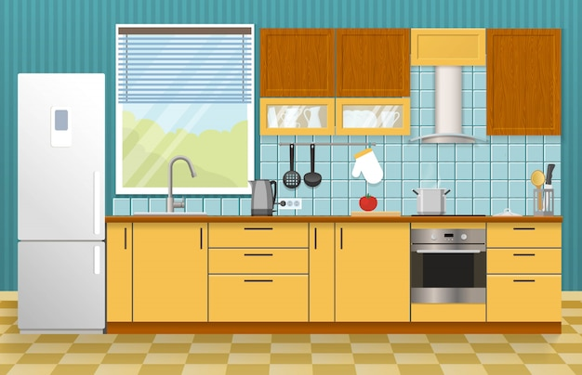
Where is the kitchen?
It’s here.
It’s here!

Slide 7

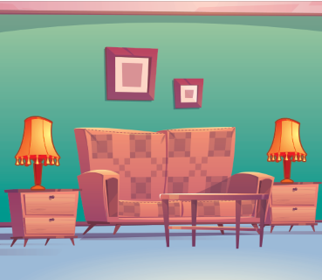

Where are the lamps?
Good luck next time!
They are in the living room.

Slide 8
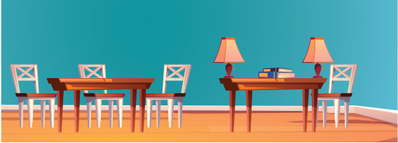
Where are the books?
They are on the table.

Slide 9
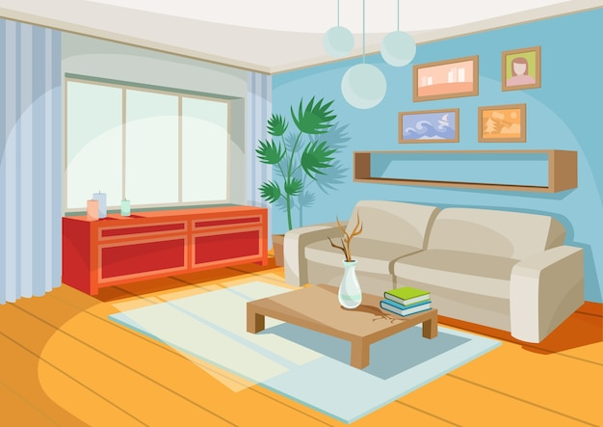
Where is the living room?
It’s here.

Slide 10
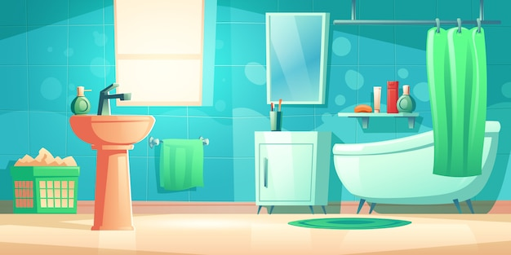
Where is the bathroom?
It’s there.

Slide 11
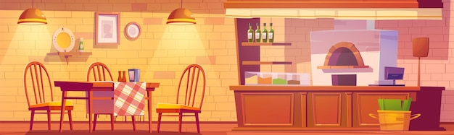
Where are the table?
It’s in the kitchen.

Slide 12
2
Listen and repeat.

Slide 13
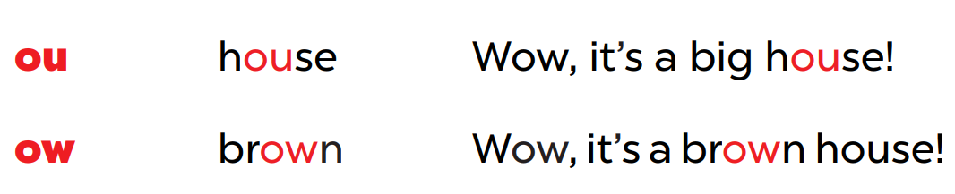

Slide 14
/aʊ/
ou
h
se
Wow, it’s a big house!

Slide 15
/aʊ/
ow
br
n
Wow, it’s a brown house!

Slide 16
3
Listen and circle.

Slide 17
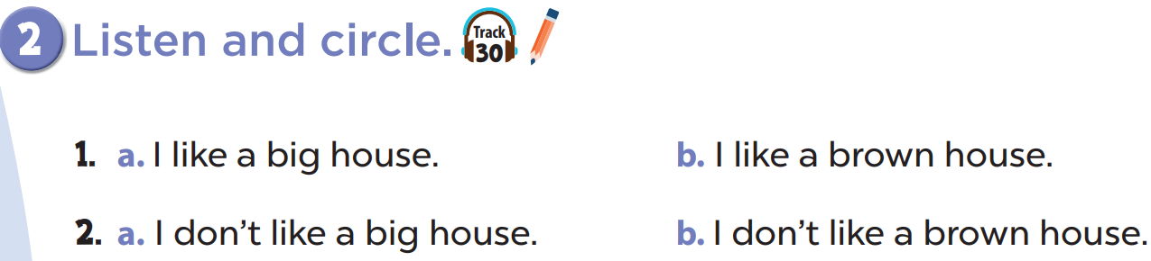

Slide 18
4
Let’s chant.

Slide 19
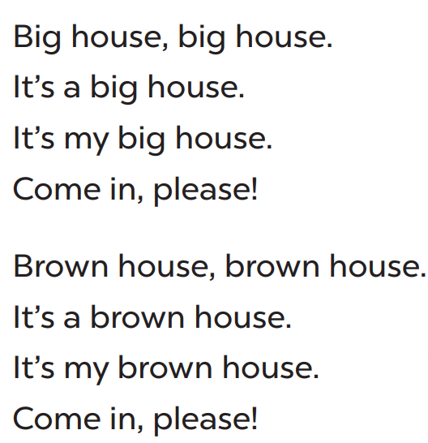
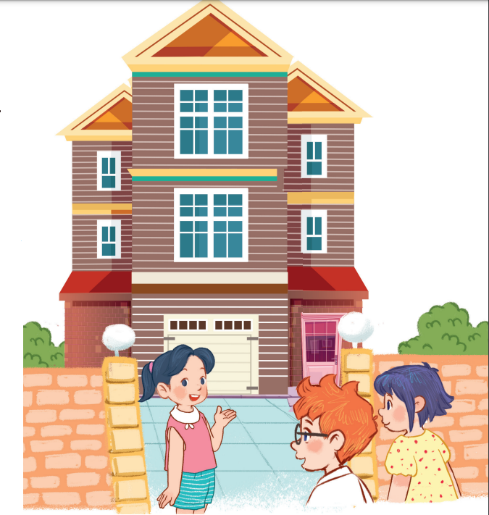

Slide 20
5
Fun corner and wrap-up

