Slide 1



Slide 2
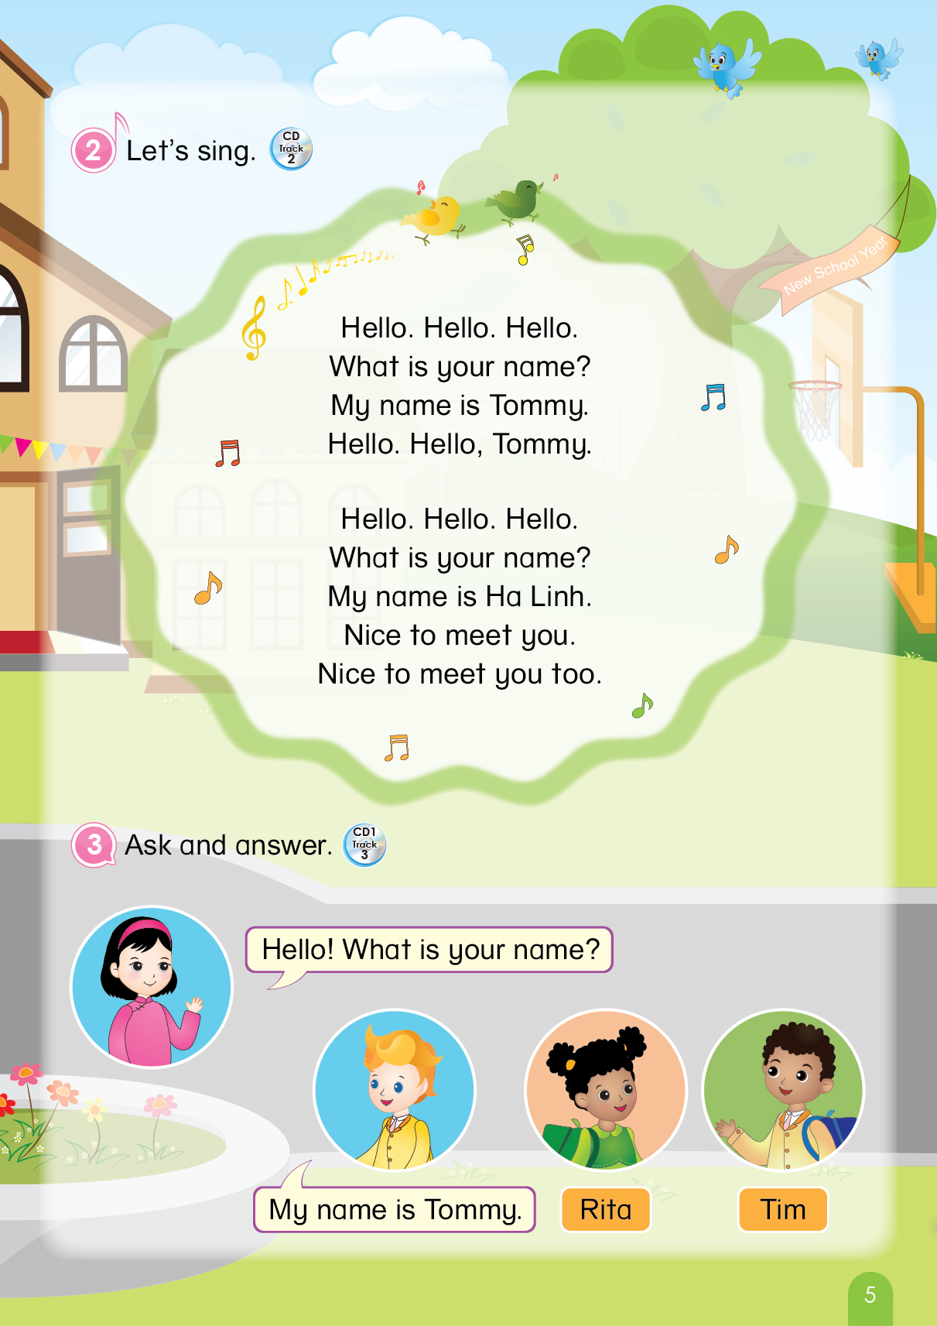

Notes:
Teacher greets and asks students to sing Hello song:
+ “Hello students. How are you?”, “Do you want to sing. OK, stand up and let’s sing.’’
Teacher divides class into groups and leads into the revision:
+ “OK. We will have ….. (number) teams. Team …., team …., and team ….”
+ “What did we learn last lesson?’’, “Do you remember?”, “OK. Let’s play a game: Whisper and snap!’’

Slide 3
Let’s review!
Game: Whisper and snap!
A big ant.
Notes:
- Teacher leads to the game for revision and gives instructions of it:
+ “Students stand in line, and turn around. The last student of each line looks at the board.”
+ “I will show you a word or a sentence, and the last student reads and whispers to the front student.”
+ “The front student runs to the board, find the right animal and slap it.’’
Teacher gives an example:
+ “What is it?”, “Whisper to your friends.”

Slide 4
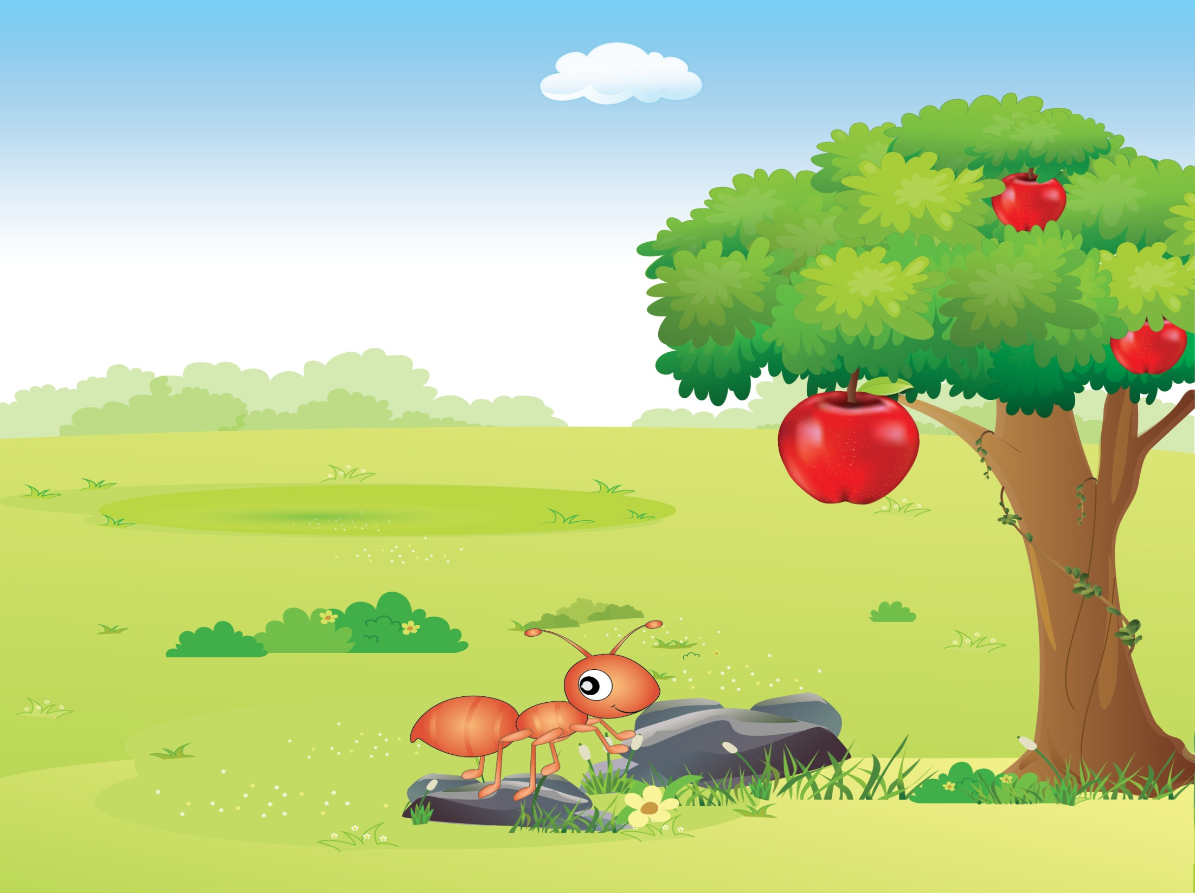
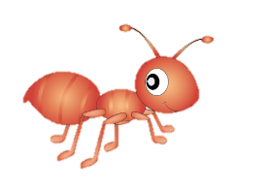
Game: Whisper and snap!
Notes:
+ “Now, run to the board. Find the big ant.”
+ “Yes, it is a big ant.”, “Good job. One point for your team.”
Teacher makes sure all students understand the game’s rule.
+ “One point for each correct slapping.’’
+ ‘’Do you understand?’’

Slide 5
Let’s review!
Game: Whisper and snap!
Three eggs.
Notes:
Teacher starts the game:
+ “Let’s start. The first word. Read. OK whisper go.”

Slide 6


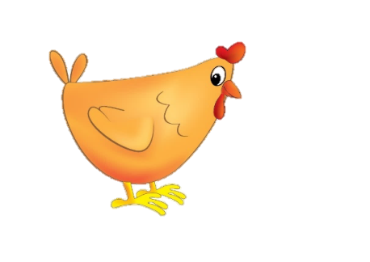
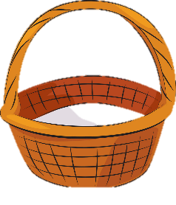


Game: Whisper and snap!
Notes:
+ “OK, quickly, find three eggs.’’
+ “Yes, that’s right. One point for your team.’’

Slide 7
Let’s review!
Game: Whisper and snap!
A donkey is running.
Notes:
+ “The second. Read and whisper now. Go”

Slide 8

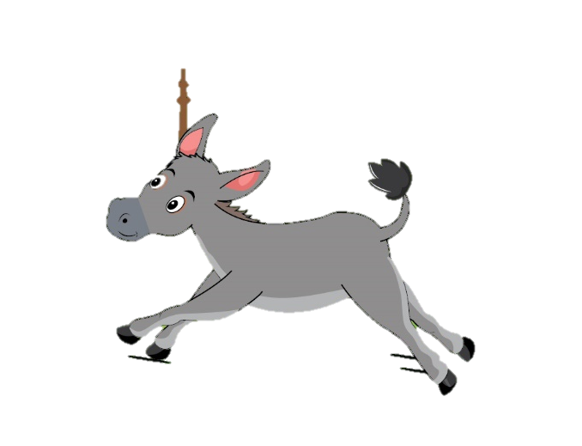
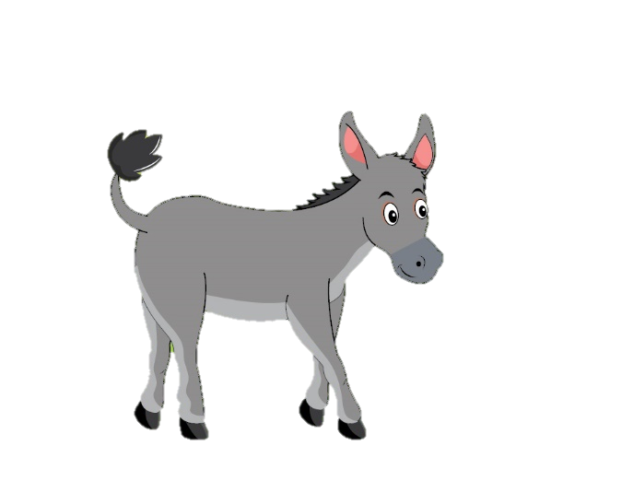
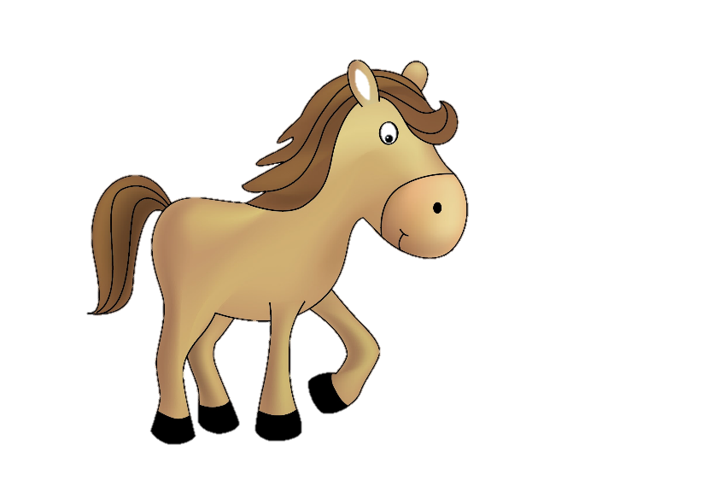
Game: Whisper and snap!
Notes:
+ “OK, quickly. The donkey is running.’’
+ “No, it is not. Find it again.”
+ “Yes. Good job. One point for your team.’’

Slide 9
Let’s review!
Game: Whisper and snap!
A bee is flying.
Notes:
+ “Next. Read and whisper. Go.”

Slide 10

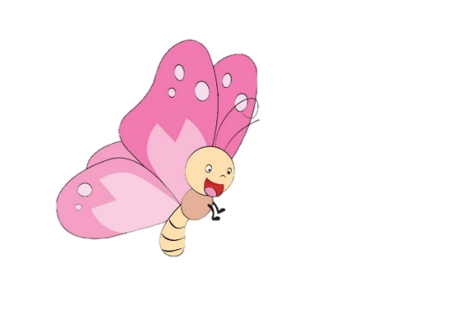


Game: Whisper and snap!
Notes:
+ “Yes, the bee is flying. Find it.”
+ “Correct. One point for your team.”

Slide 11
Let’s review!
Game: Whisper and snap!
A duck can swim.
Notes:
+ “OK. The last one. Are you ready? Now read and whisper.”

Slide 12
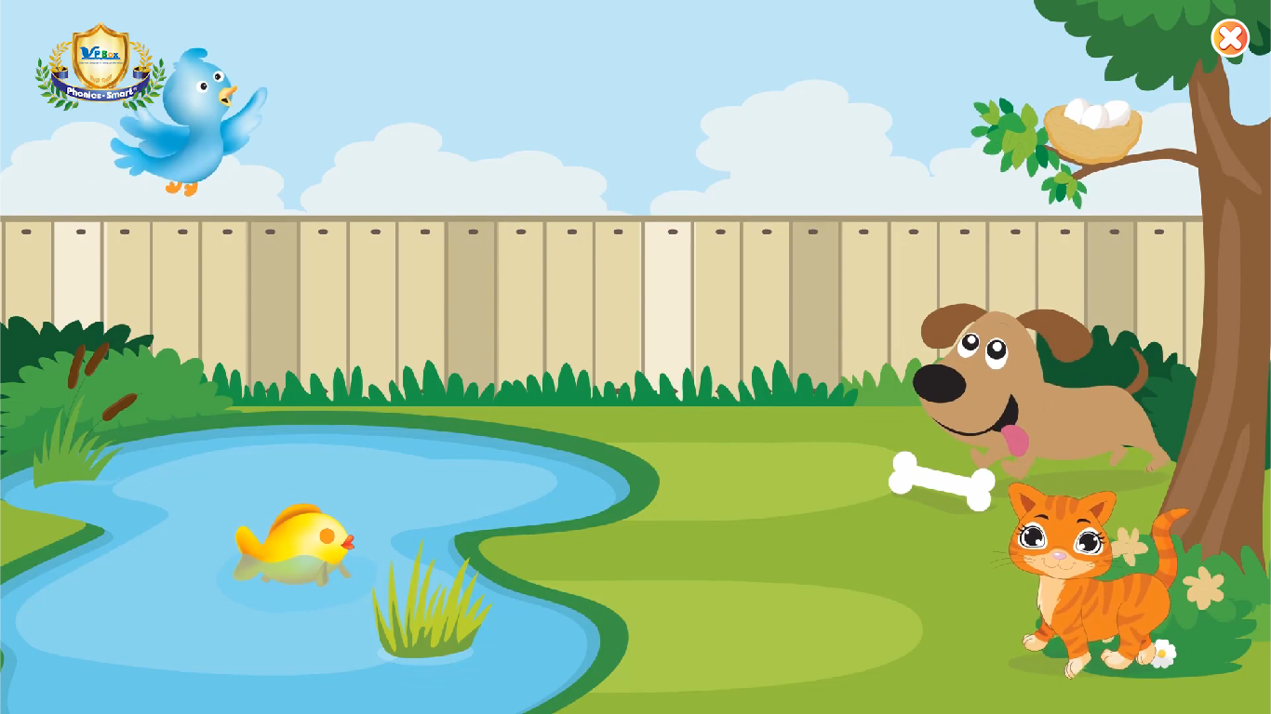



Game: Whisper and snap!
Notes:
+ “A duck can swim. Find it.’’
+ “No, it is not. Find it again.”
+ “One more time. Yes, correct, well done. One point for your team.’’
Teacher gives praises to the whole class, and leads to the new lesson.
+ “Great job, class. Clap your hands.”
+ “OK. Let’s come to our new lesson today.”

Slide 13
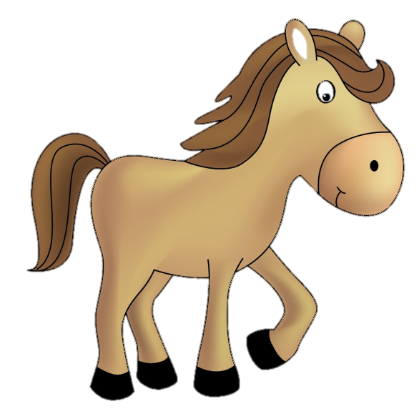

Unit 9
Lesson 3
Notes:
Teacher introduces and gives students some hints of today’s lesson by pointing the horse and hippo:
+ “Today we will learn Unit 9, Lesson 3.”
+ “Look! What can you see?
+ “Yes, good job. A horse and a hippo. Well done.”

Slide 14

Unit 9:
Lesson 3:
I i
1. Trace the letters.
What is it?
I i
i
Notes:
Teacher reviews the letter and sound:
+ “What is it? Do you remember?”
+ “That’s right. Letter I, and sound i. Good job.’’

Slide 15
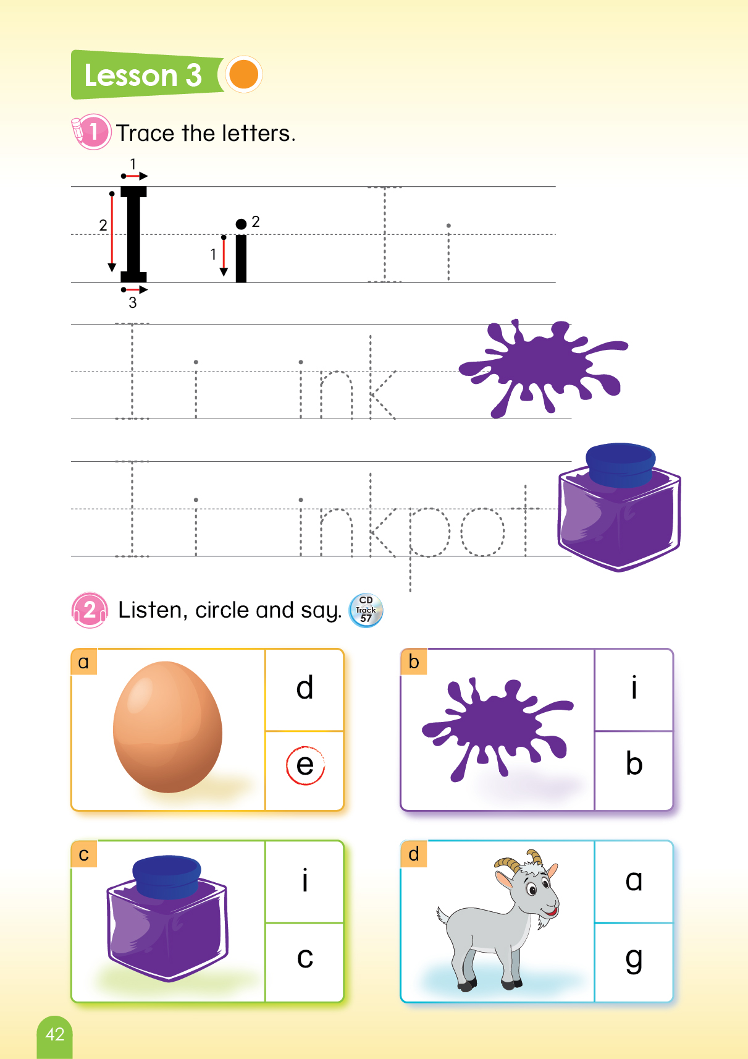
Unit 9:
Lesson 3:
I i
1. Trace the letters.
Notes:
Teacher leads to the tracing part of letters I and i:
+ “OK. Let’s trace letter I. Now, where is your finger?”
+ “Good job. Now, follow me. One. Two. Three.”
+ “One more time. One. Two Three.”
+ “The last one. One. Two. Three.”
Teacher asks students to practice:
+ “OK. Now can you write the letter I on the table?”
+ “Good job.”

Slide 16
Unit 9:
Lesson 3:
I i
1. Trace the letters.
Notes:
Teacher continues tracing sound i:
+ “OK. Let’s write sound i. Your finger, follow me. One. Two.””
+ “Again. One. Two.”
+ “Good job. The last one. One. Two. Well done.’’
Teacher asks students to practice:
+ “Now turn to your friends, and write sound i on their backs. Go.”
+ “Great. One point for the whole class.”

Slide 17
Unit 9:
Lesson 3:
I i
1. Trace the letters.
LOOK
AT
YOUR
BOOK!
TRACE
THE
LETTERS.
Notes:
Teacher asks students to open their books and trace the letter I, i and the letter i in the words ink, inkpot:
+ “Now, open your book page 42. Trace the letter I, i in your book in 3 minutes.”

Slide 18
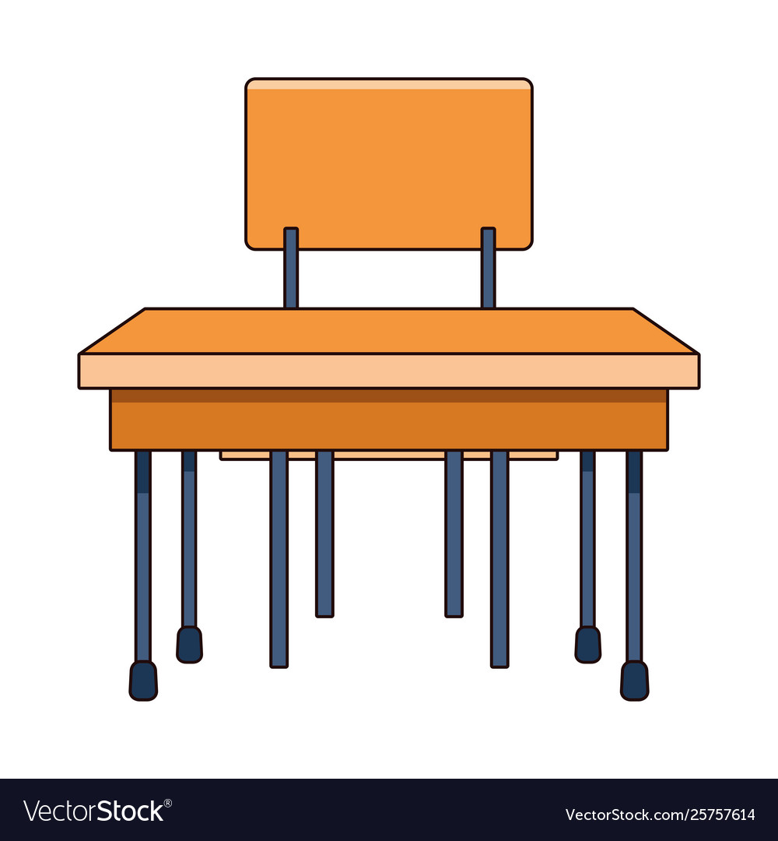


Unit 9:
Lesson 3:
I i
1. Trace the letters.
Activity: Drawing!
Notes:
Teacher may encourage students to draw an inkpot and a pen in their notebooks.
+ “Now can you draw an inkpot and a pen in your notebook?”
+ “I give 3 minutes.”

Slide 19


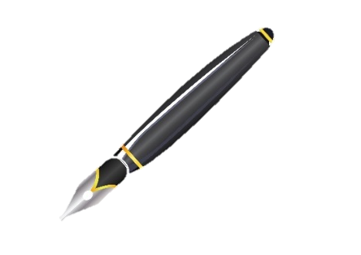
Unit 9:
Lesson 3:
I i
1. Trace the letters.
Activity: Drawing!
Notes:
Teacher asks students to write letters A and a below the drawings.
+ “Now write letters A and a under the your picture.”
+ “Well done.”

Slide 20


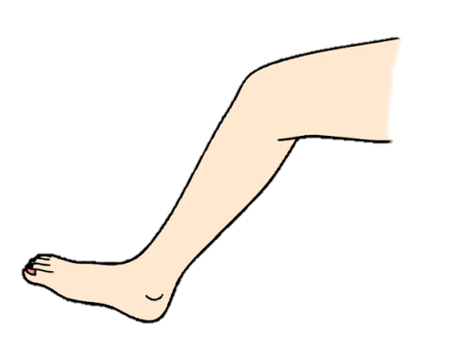
Unit 9:
Lesson 3:
I i
1. Trace the letters.
Activity: Can you trace?
Notes:
Teacher calls some students to go to the board and use their body parts (arm and leg) to write letters I and i.
+ “Now, we have a game. I need two students up here.”
+ “I need you to write letter I by your arm. Great job.”
+ “And now can your write letter i by your leg? Well done.”

Slide 21

Unit 9:
Lesson 3:
I i
1. Trace the letters.
Notes:
Teacher gives praises.
+ “Well done.”

Slide 22
Unit 9:
Lesson 3:
I i
2. Listen, circle and say.
LOOK
AT
YOUR
BOOK!
Notes:
Teacher gives instructions of part 2:
+ “We move to part 2. Now, look at the screen. What is it?”
+ “That’s right. Now, open your book page 42. You listen, circle and say.”
Teacher plays the audio twice.
+ “Now you listen again.”

Slide 23
Unit 9:
Lesson 3:
I i
2. Listen, circle and say.
i
Notes:
Teacher gives answers:
+ “Now, look at this. What is it?”
+ “Letter i. That’s right, and can you say it? Well done.”

Slide 24
Unit 9:
Lesson 3:
I i
2. Listen, circle and say.
i
Notes:
Teacher gives answers:
+ “How about this? What is it?”
+ “Letter i. Good job, and can you say it? Nice.”

Slide 25
Unit 9:
Lesson 3:
I i
2. Listen, circle and say.
g
Notes:
Teacher gives answers:
+ “The last one? What is it?”
+ “Letter g. Great, and can you say it? Well done.”

Slide 26
Unit 9:
Lesson 3:
I i
2. Listen, circle and say.
Notes:
Teacher gives praises to the whole class.
+ “Very good.”

Slide 27
Unit 9:
Lesson 3:
I i
Let’s review!
Notes:
Teacher reviews the lesson.
+ “Now, what have we learned today?”
+ “OK. Write letter I. Good job.”
+ “Now write letter i. Well done.”
Teacher gives comment of the class’s performance.
+ “You did so well today. High five.”

Slide 28


Unit 9:
Lesson 3:
I i
Let’s review!
What
is it?
What
is it?
Notes:
Teacher reviews the lesson.
+ “Now, what is it?”
+ “Good job. It is an inkpot.”
+ “And what is it? Ink. Well done.”

Slide 29

Unit 9:
Lesson 3:
I i
Let’s review!
Notes:
Teacher reviews the lesson.
+ “Now, what is it?”
+ “Good job. It is an inkpot.”
+ “And what is it? Ink. Well done.”

Slide 30

Unit 9:
Lesson 3:
I i
Notes:
Teacher reviews the lesson.
+ “Now, what is it?”
+ “Good job. It is an inkpot.”
+ “And what is it? Ink. Well done.”

