Slide 1




14
My bedroom
Lesson 2 – Period 3

Slide 2





Lesson 2
Period 3
①
Warm-up and review

Slide 3
Game: Who says fast?
Look and choose A or B
in 15 seconds.
Notes:
- Teacher holds a flashcard and a sentence with a missing word.
- Ask pupils to guess the answer as fast as possible.
- Then have pupils do the same with the rest.
- This can be played in groups to make it more interesting.

Slide 4
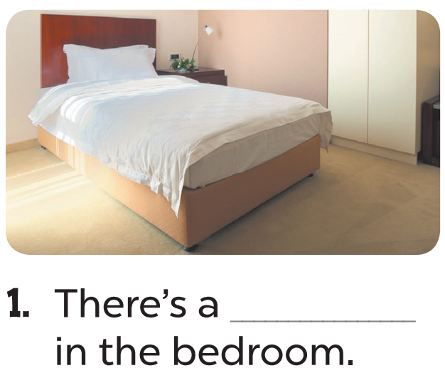
Hết giờ
timing
timing
0
:
0
0
00
59
58
57
56
55
54
53
52
51
50
49
48
47
46
45
44
43
42
41
40
39
38
37
36
35
34
33
32
31
30
29
28
27
26
25
24
23
22
21
20
19
18
17
16
15
14
13
12
11
10
09
08
07
06
05
04
03
02
01
00
+2
A. desk
B. bed

Slide 5
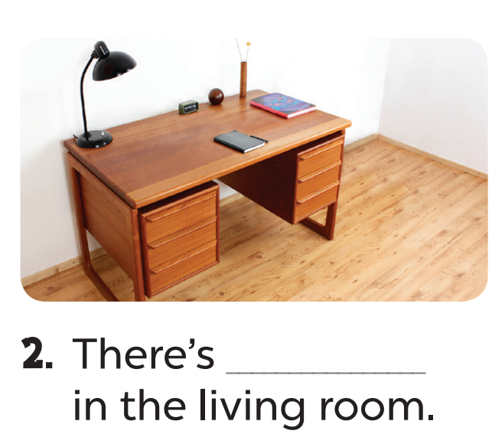
Hết giờ
timing
timing
0
:
0
0
00
59
58
57
56
55
54
53
52
51
50
49
48
47
46
45
44
43
42
41
40
39
38
37
36
35
34
33
32
31
30
29
28
27
26
25
24
23
22
21
20
19
18
17
16
15
14
13
12
11
10
09
08
07
06
05
04
03
02
01
00
+3
A. a desk
B. a bed

Slide 6
Lesson 2
Period 3
②
Look, listen and repeat.

Slide 7
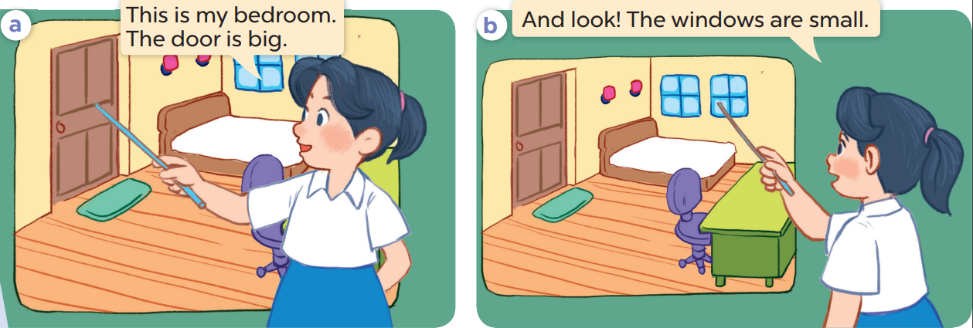

Slide 9
Lesson 2
Period 3
③
Listen, point and say.

Slide 10

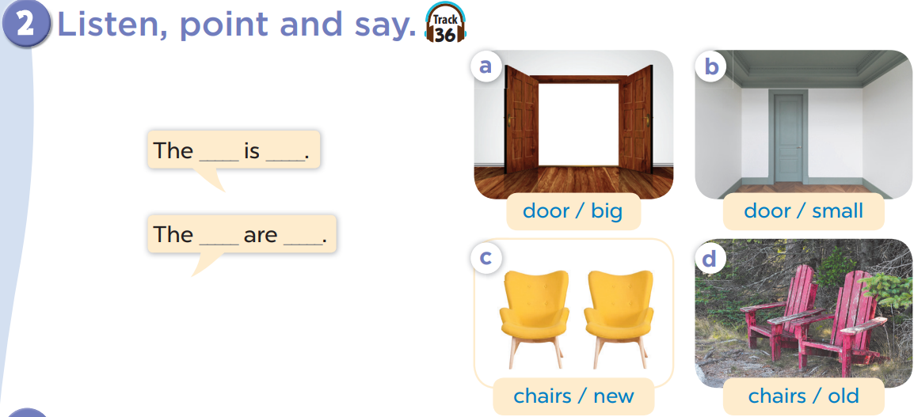

Slide 11


door small.
The………… is………

Slide 12

door big .
The………… is………

Slide 13


chairs new .
The…………… are………

Slide 14

chairs old .
The…………… are………

Slide 15

The door is big.
…………

Slide 16
The door is small.
…………

Slide 17

The chairs are old.
…………

Slide 18
The chairs are new.
…………

Slide 19
Lesson 2
Period 3
④
Let’s talk.

Slide 20
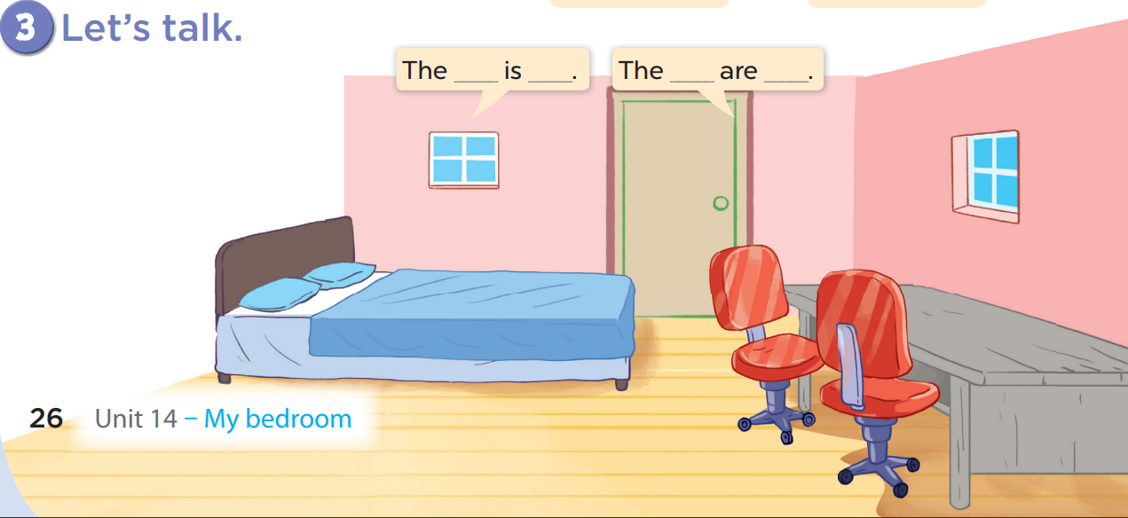

Slide 21
The bed is big.

Slide 22
The desk is old.

Slide 23
The chairs are old.

Slide 24
The windows are small.

Slide 25
Lesson 2
Period 3
⑤
Fun corner and wrap-up

