Slide 1



13
MY house
LESSON 1 - PERIOD 1

Slide 2
TABLE OF CONTENTS
Warm-up and review
Look, listen and repeat.
01.
02.
03.
04.
Let’s talk.
Listen, point and say.
05.
Fun corner and wrap-up

Slide 3
1
Warm-up and review

Slide 4
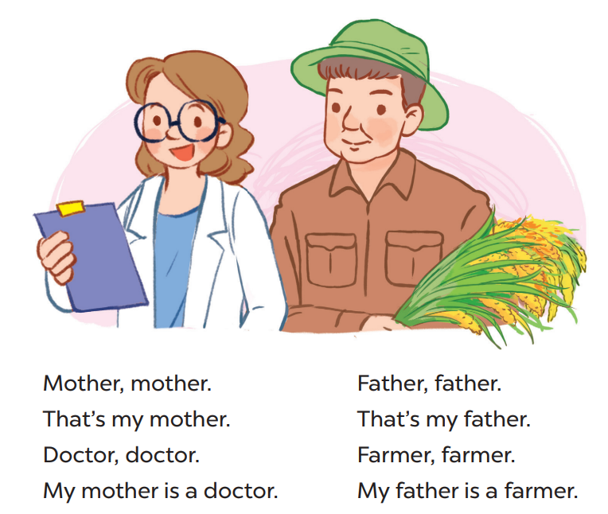
Say the chant

Slide 5
2
Look, listen and repeat. .

Slide 6
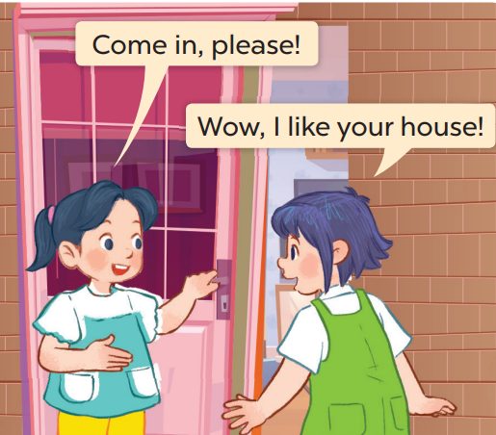
Who are they?
Where are they?

Slide 7
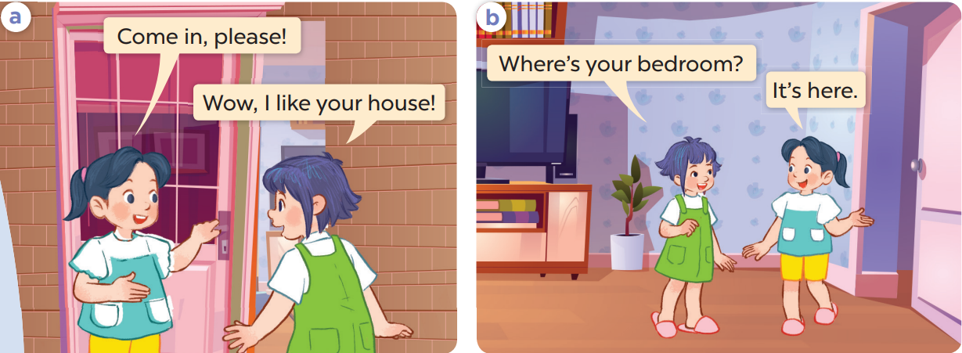
Work in pairs and repeat.

Slide 8
3
Listen, point and say..

Slide 9
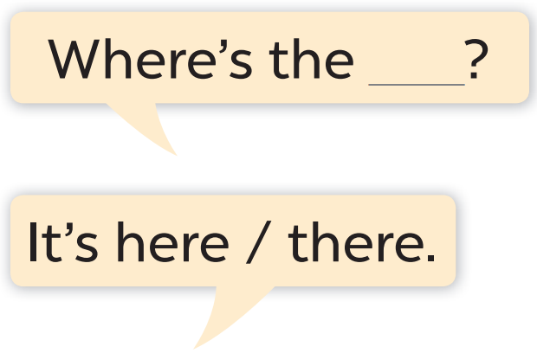
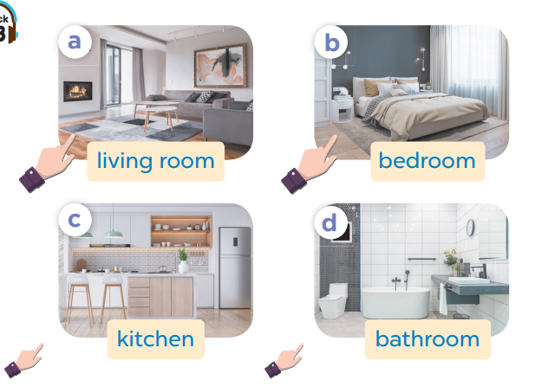

Slide 10
Work in pairs. Ask and answer.

Slide 11
Work in pairs.
Ask and answer.

Slide 12
4
Let’s talk.

Slide 13
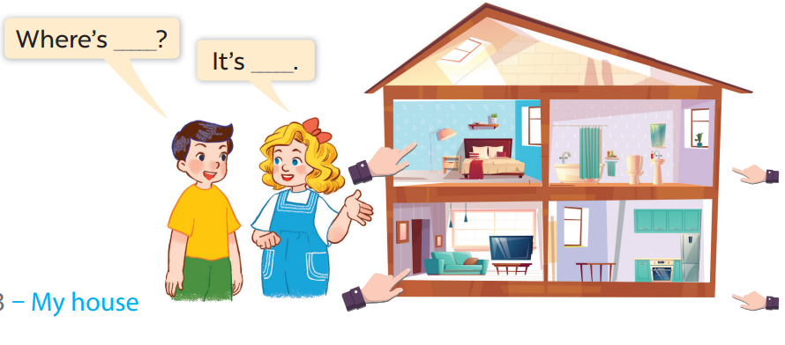
Work in pairs.
Ask and answer.

Slide 14
5
Fun corner and wrap-up

Slide 15





1
2
3
4
5
6
7
8
Next
tekhnologic

Slide 16
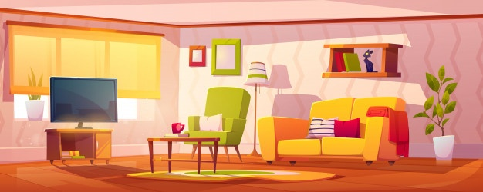

Where
………is the living room?
BACK
How
What

Slide 17
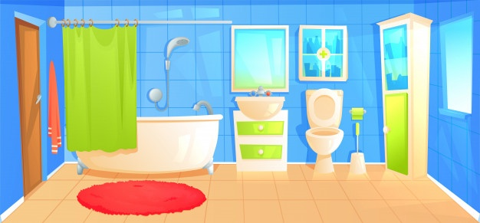
living room
Where is the………..?
BACK
kitchen
bathroom

Slide 18
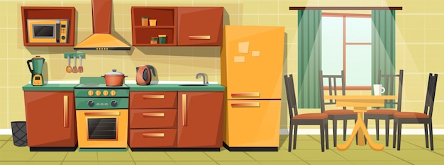

Where is the kitchen?
BACK
It’s there.
It’s here.

Slide 19

Where is the house?
BACK
It’s there.
It’s here.

