Slide 1



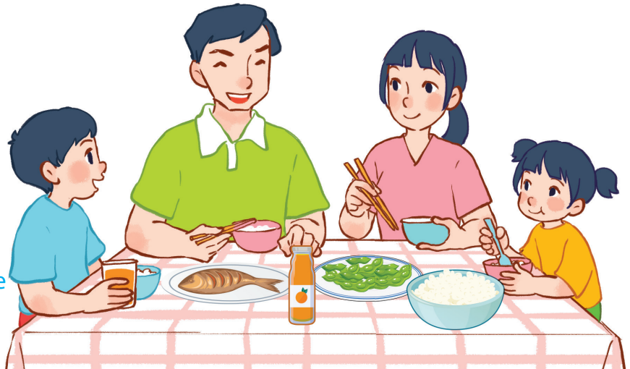
15
At the dining table
LESSON 3 – PERIOD 5

Slide 2
At the dining table
Warm-up
and review
Listen and tick.
Fun corner
and wrap-up
Listen and repeat.
Let’s chant.

Slide 3
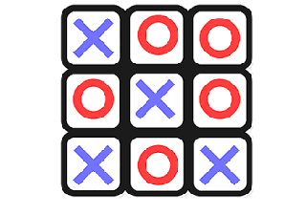

TIC TAC TOE
Warm-up
and review

Slide 4

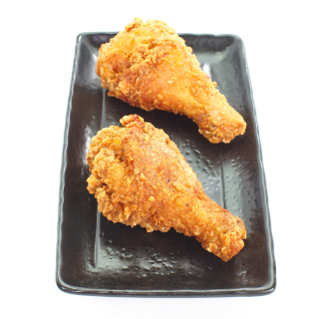

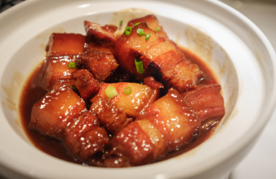




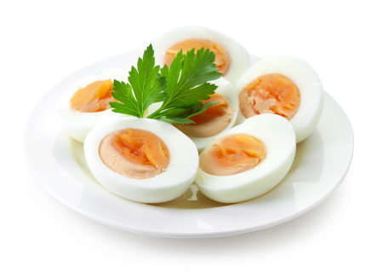
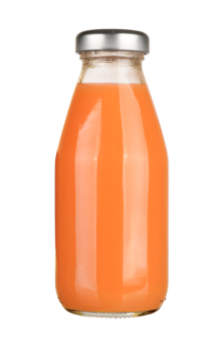

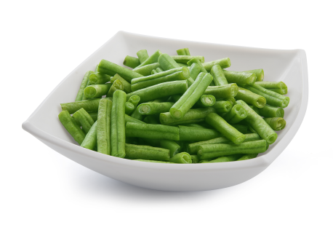
Choose and say!
I would like some…….
Notes:
Divide the class into 2 teams.
Have pupils look and say the sentences about the food or drinks they would like.
Let pupils take turns putting their marks in the squares.
The first player to get 3 marks in a row (up, down, across) is the winner.
If all 9 squares are full, the game is over.

Slide 5

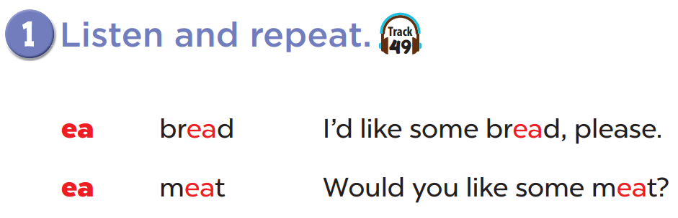

Slide 6
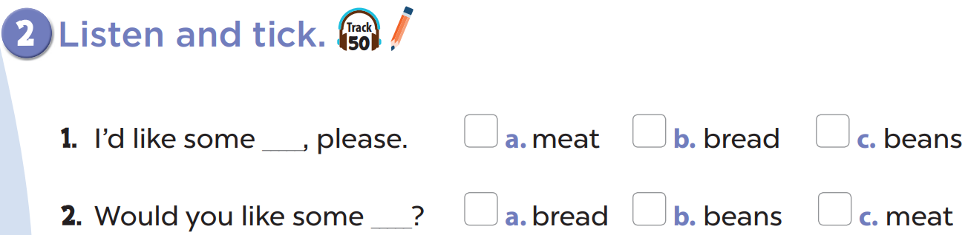

Slide 7
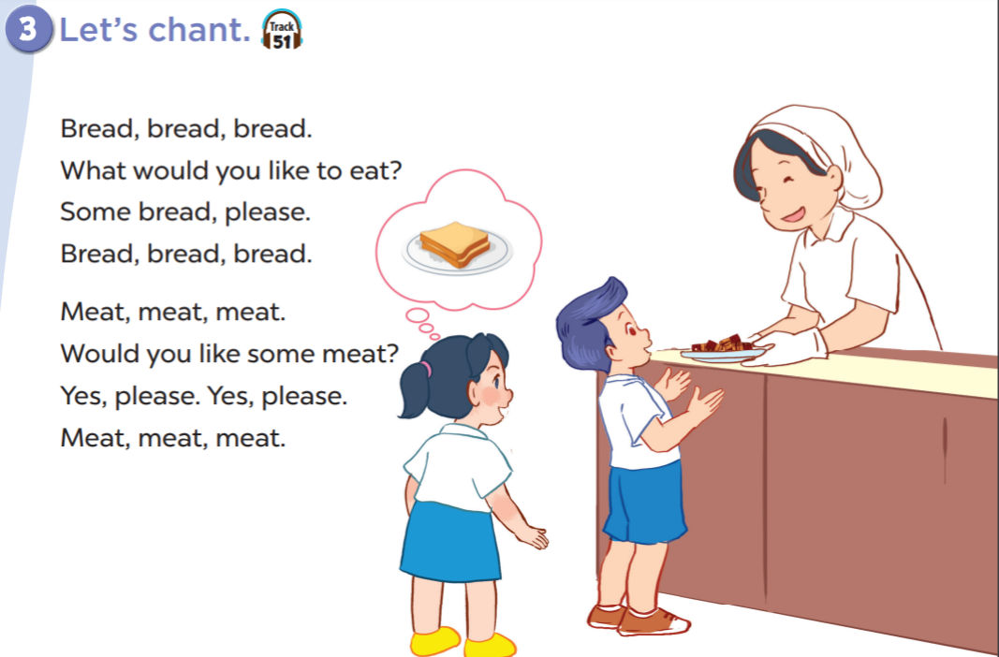

Slide 8
Fun corner
and wrap-up
WORD SEARCH
Notes:
Have pupils find out the words about food and drinks.
This game is just for fun, not for competition.

Slide 9
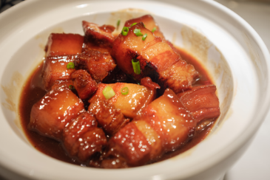
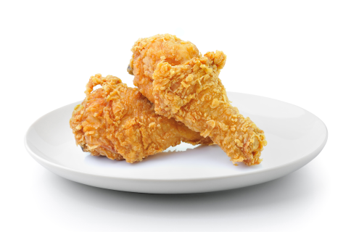
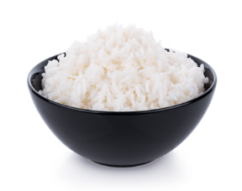

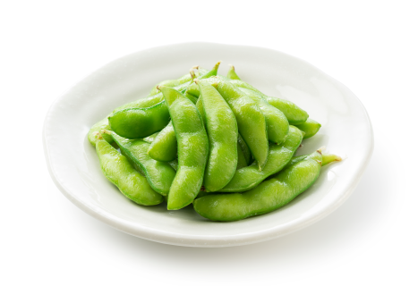
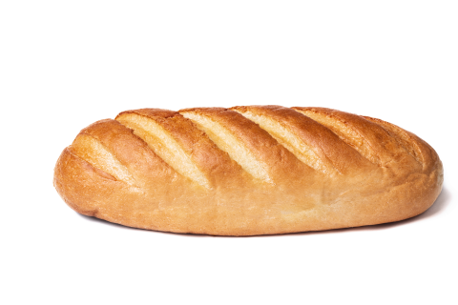



WORD SEARCH
A
W
A
T
E
R
B
M
M
J
U
I
C
E
R
I
E
C
H
I
C
K
E
N
A
R
I
C
E
P
A
M
T
F
I
S
H
Q
D
I
X
V
E
G
G
S
K
L
L
B
E
A
N
S
O
K

