Slide 1



Slide 2
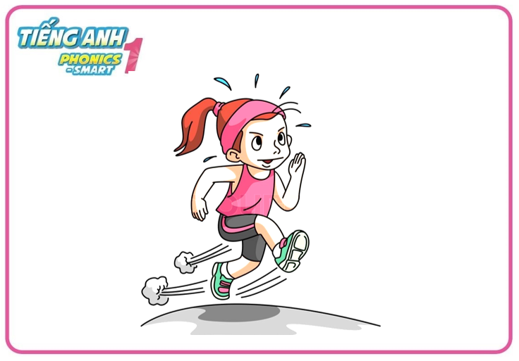
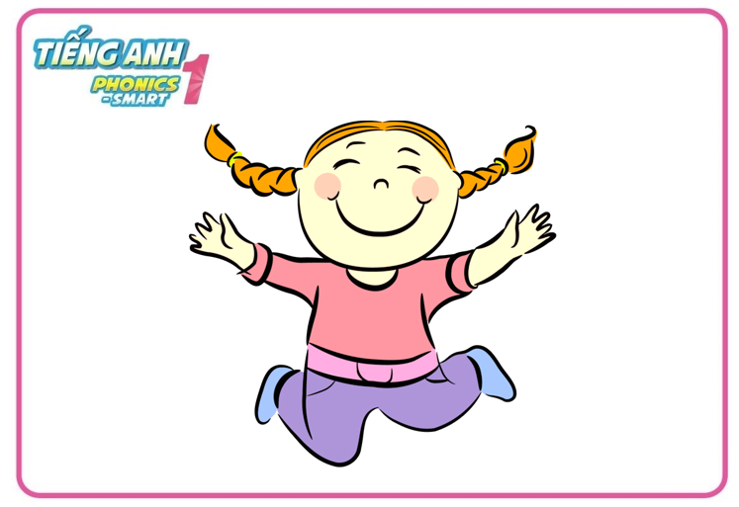

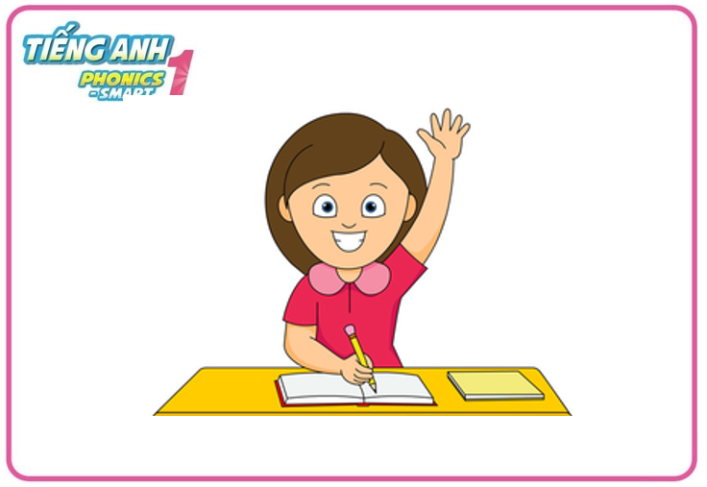
Warm - up
Game: Fast as you can
Notes:
-Let’s do 4 actions: run, walk, jump and raise your hands first.
- Teacher says the actions one by one, Ss do the correct action fast as they can.

Slide 3
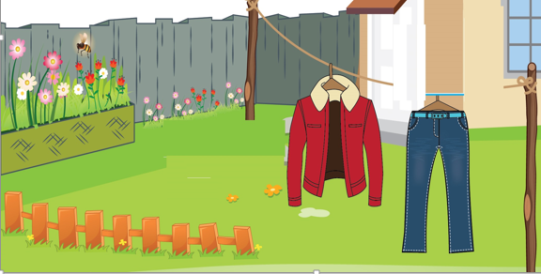
Unit 10
Lesson 3

Slide 4



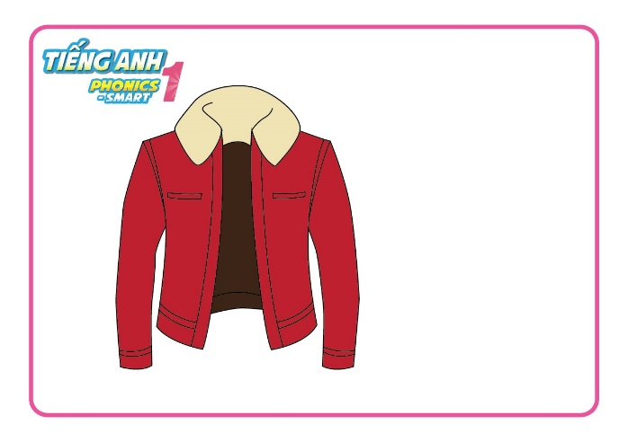
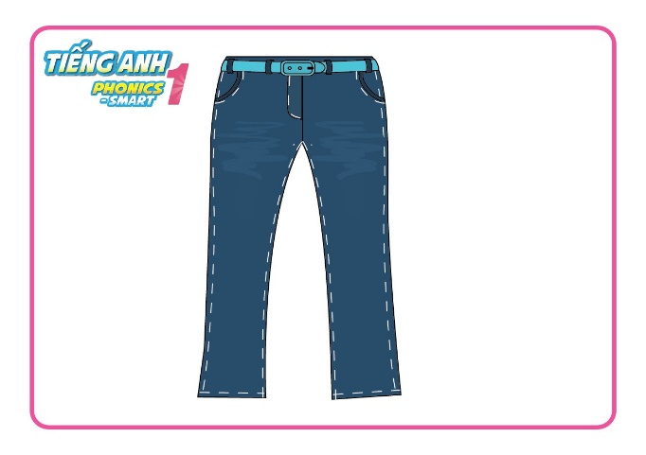
Unit 10:
Lesson 3
Revision
jacket
jeans

Slide 5

Unit 10:
Lesson 3
1. Trace the letters.
Notes:
- Have Ss watch the video and do actions.

Slide 6
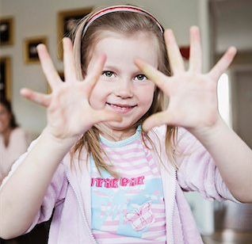

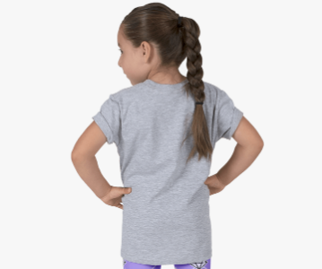
Unit 10: Lesson 3:
1. Trace the letters.
Let’s write letter Jj: in the air, in your palms and on your friend’s back

Slide 7

Unit 10: Lesson 3:
1. Trace the letters.
Let’s write letter Jj on your board
J
J
j
j
j

Slide 8
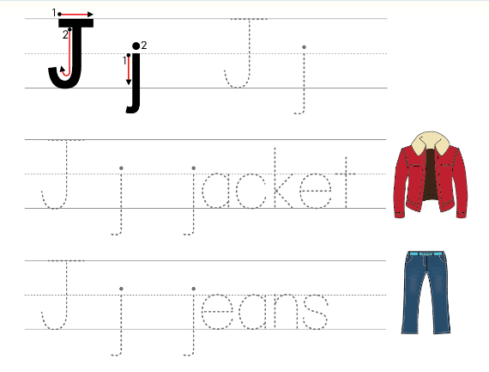
Unit 10:
Lesson 3
1. Trace the letters.
Open your book - page 46
Notes:
Hướng dẫn HS sử dụng sách.

Slide 9
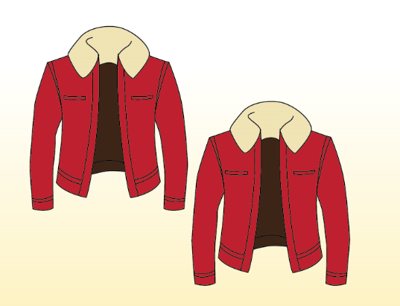
Unit 10:
Lesson 3
1. Trace the letters.
2. Look and say.
How many jackets?
What are these?
jackets
two jackets

Slide 10
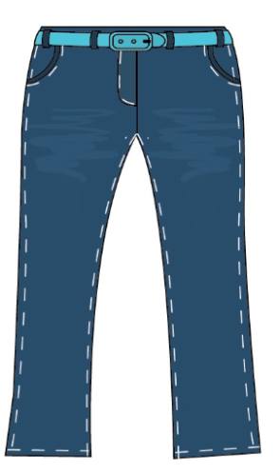
Unit 10:
Lesson 3
1. Trace the letters.
2. Look and say.
What are these?
How many jeans?
jeans
a pair of jeans

Slide 11

Unit 10:
Lesson 3
1. Trace the letters.
2. Look and say.
How many inkpots?
What are these?
inkpots
three inkpots

Slide 12
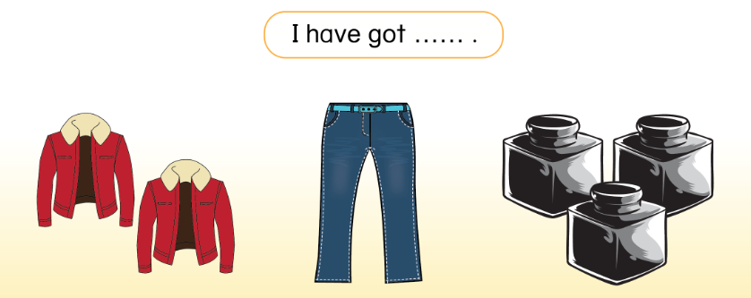
Unit 10:
Lesson 3
1. Trace the letters.
2. Look and say.
Open your book - page 46
Notes:
Hướng dẫn HS mở sách, chỉ và đọc các nội dung đã học.

Slide 13
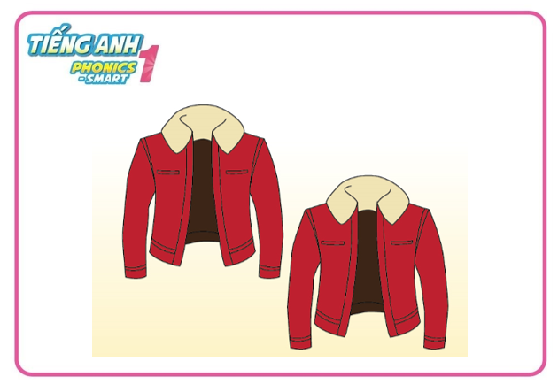
Unit 10:
Lesson 3
1. Trace the letters.
2. Look and say.
I have got
………………………
two jackets

Slide 14

Unit 10:
Lesson 3
1. Trace the letters.
2. Look and say.
I have got
……………………………
a pair of jeans

Slide 15

Unit 10:
Lesson 3
1. Trace the letters.
2. Look and say.
I have got
……………………………
three inkpots

Slide 16




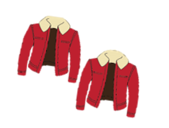


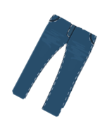






Slide 17



Spin and stop the pointer and click the pointed topic

Slide 18

three inkpots
I have got ………………………
WHEEL
CHECK

Slide 19
Spin and stop the pointer and click the pointed topic

Slide 20
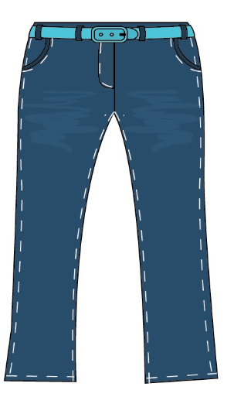
a pair of jeans
I have got ……………………………
WHEEL
CHECK

Slide 21
Spin and stop the pointer and click the pointed topic

Slide 22
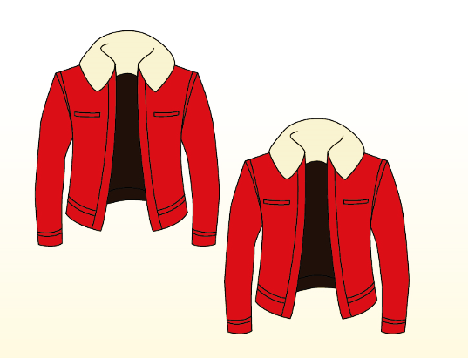
two jackets
I have got …………………..…
WHEEL
CHECK

Slide 23
Spin and stop the pointer and click the pointed topic

Slide 24
WHEEL

Slide 25
Spin and stop the pointer and click the pointed topic

Slide 26
three inkpots
I have got ………………………
WHEEL
CHECK

Slide 27
Spin and stop the pointer and click the pointed topic

Slide 28
a pair of jeans
I have got …………………………
WHEEL
CHECK

Slide 29
Spin and stop the pointer and click the pointed topic

Slide 30
two jackets
I have got …………………..…
WHEEL
CHECK

Slide 31
Unit 10:
Lesson 3
1. Trace the letters.
2. Look and say.
I have got two jackets.
I have got a pair of jeans.
Notes:
Wrap up bài học.

