Slide 1


My pets
Lesson 1 - Period 1
16

Slide 2
1
2
3
Warm-up and review
4
5
Fun corner and wrap-up
Look, listen and repeat.
Listen, point and say.
Let’s talk.

Slide 3
1
Warm-up and review

Slide 4

Notes:
Sing the song from youtube - https://www.youtube.com/watch?v=pWepfJ-8XU0

Slide 5
2
Look, listen and repeat.

Slide 6
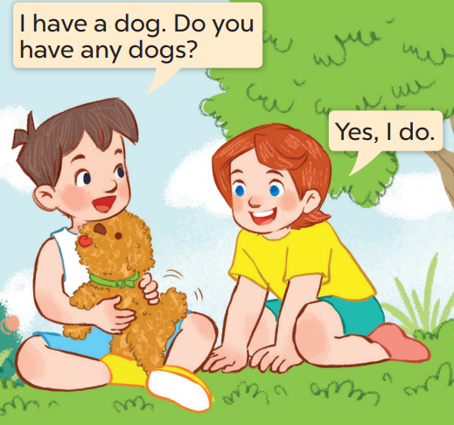
What does Minh have?
Who are they?
Now listen and repeat.
He has a dog.
They’re Minh and Lucy.

Slide 7
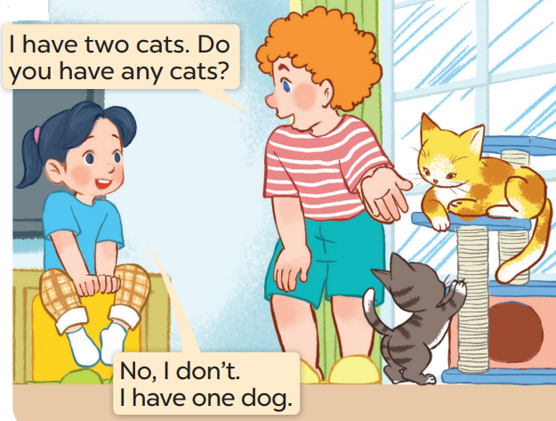
Now listen and repeat.
Whose cats are they?
What pets can you see?
Who are they?
I can see (2) cats.
They’re Mai and Bill.
They are Bill’s

Slide 8

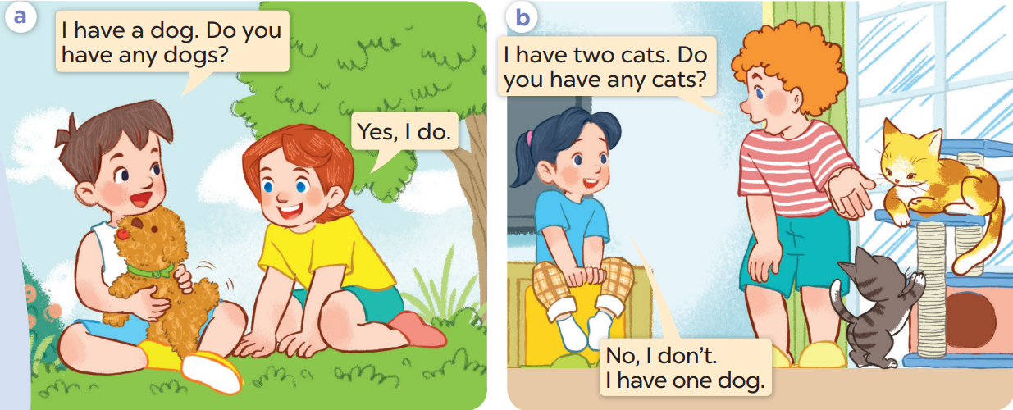
Listen again and repeat.

Slide 9
Work in pairs. Act and say

Slide 10
3
Listen, point and say.

Slide 11
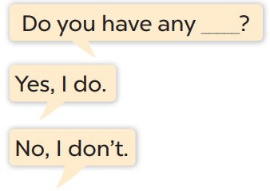
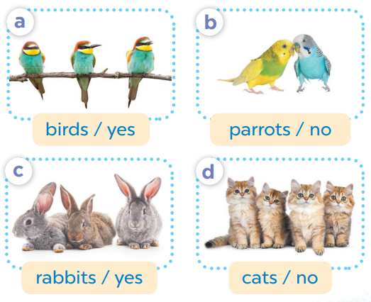

Slide 12
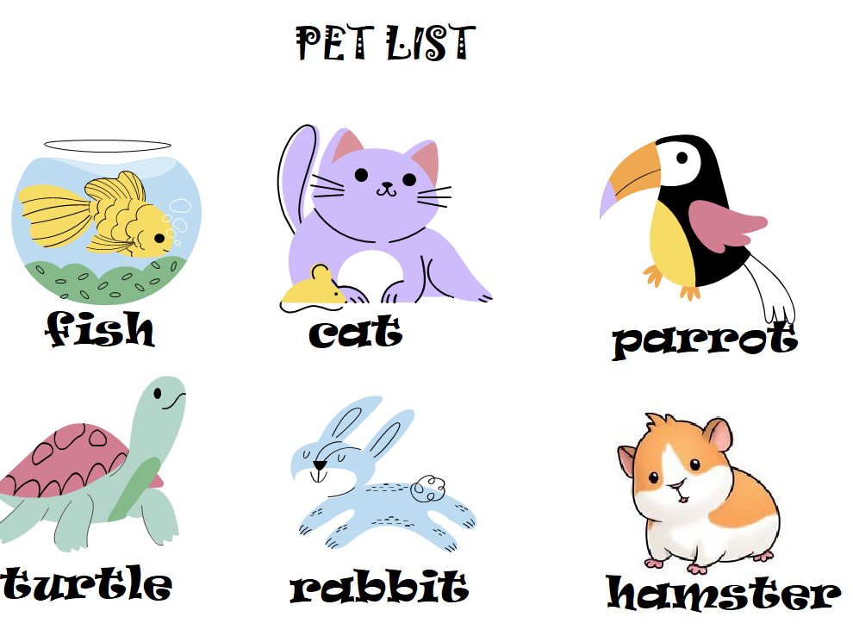


Pair work
Do you have any……….?
Yes, I do.
No, I don’t.

Slide 13
4
Let’s talk.

Slide 14
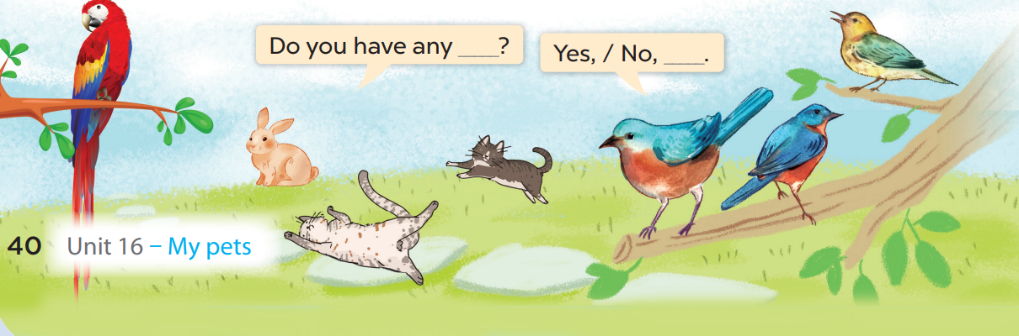

Slide 15
5
Fun corner and wrap-up

