Slide 1


My pets
Lesson 2 - Period 4
16

Slide 2
1
Warm-up and review

Slide 3
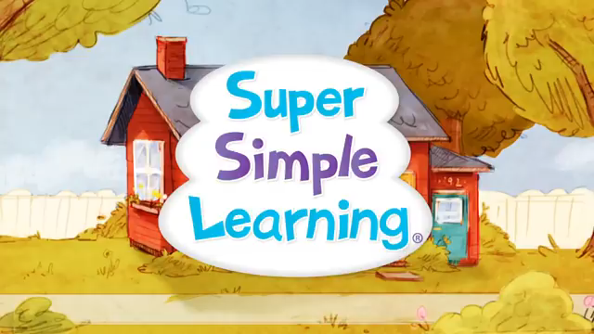
Let’s sing together!
Notes:
https://www.youtube.com/watch?v=pWepfJ-8XU0

Slide 4
2
Listen and number.

Slide 5
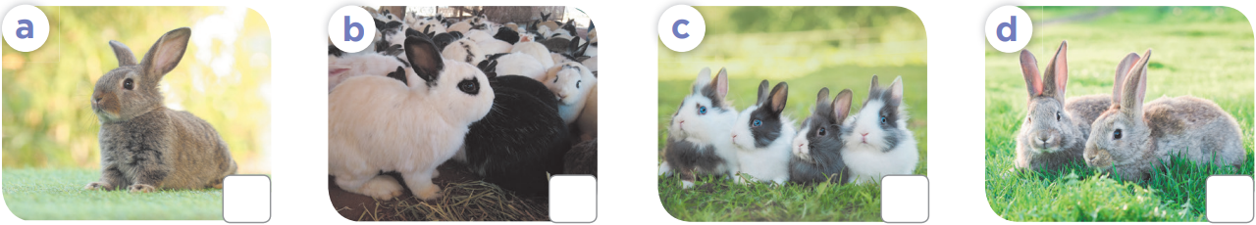
4
1
2
3

Slide 6
3
Look, complete and read.

Slide 7

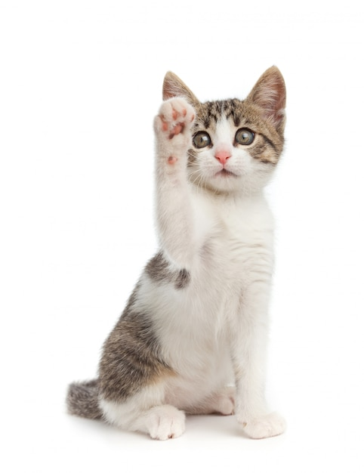






How many ………..do you have?
cat
a cat
cats

Slide 8
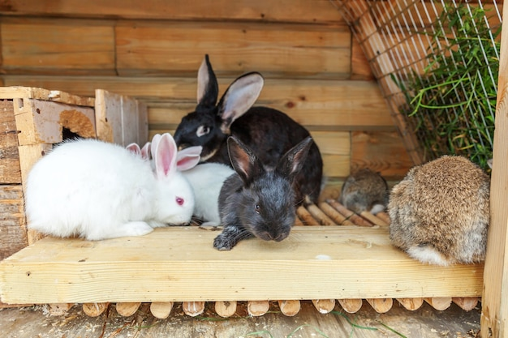
……………… many rabbits do you have?
How
What
Who

Slide 9
How many cats do you have?
I have one cat.
I have some cats.
I have many cats.

Slide 10
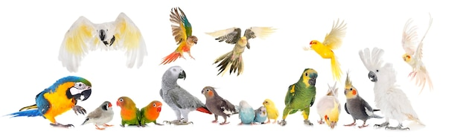
How many parrots do you have?
I have one parrot.
I have some parrots.
I have many parrots.

Slide 11
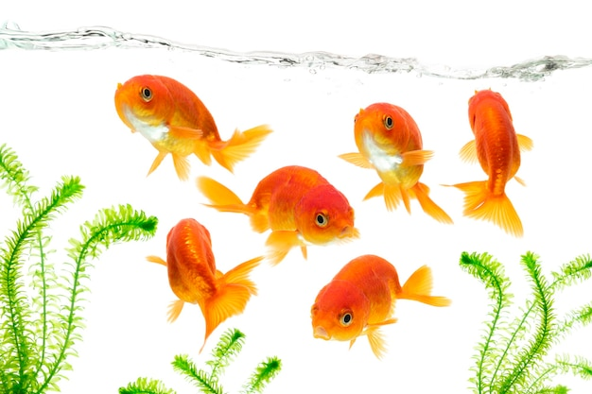
How many fish do you have?
I have one fish.
I have some fish.
I have many fish.

Slide 12
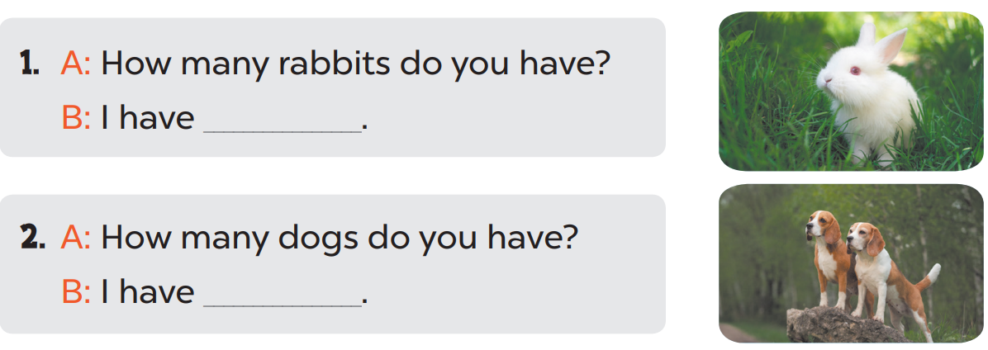
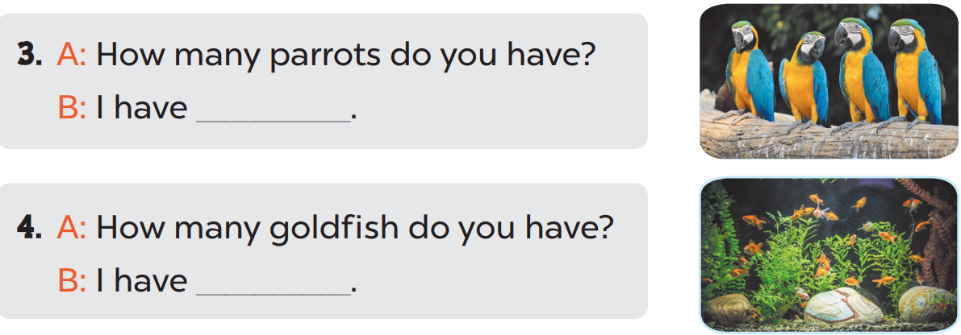
one rabbit.
two dogs.
some parrots.
many goldfish.

Slide 13
4
Let’s play.

Slide 14
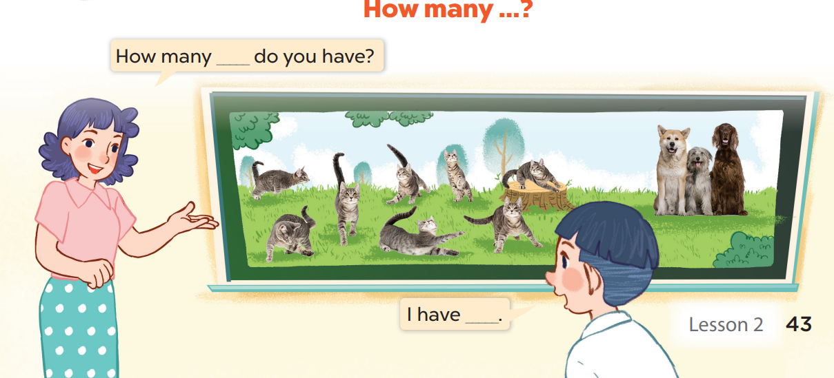

Slide 15
5
Fun corner and wrap-up

