Slide 1



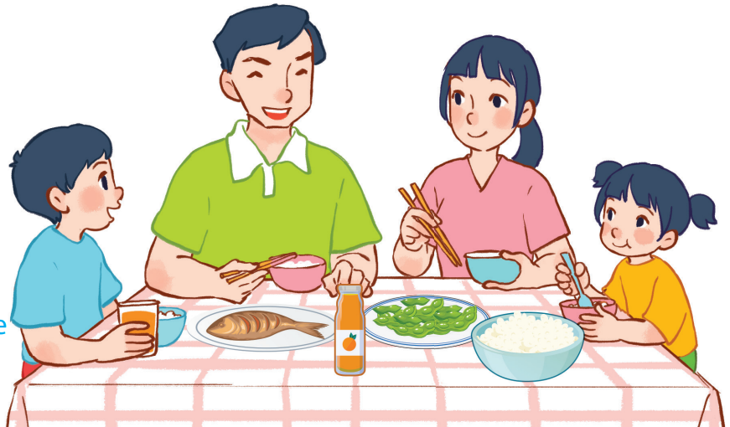
15
At the dining table
LESSON 1 – PERIOD 1

Slide 2
At the dining table
Warm-up
and review
Listen, point
and say.
Fun corner
and wrap-up
Look, listen
and repeat.
Let’s talk.

Slide 3









Team A
Team B
Warm-up
and review
Happy Flowers game
30
20
40
30
70
50
80
20
Notes:
Play game in the powerpoint Unit 15 – lesson 1 – period 1
Divide the class into 2 teams to play “Colorful flowers 1”.
Each team chooses one flower to go to the question.
Have pupils look, read and choose the right option.
Back to the menu for pupils to choose another question.
Pupils continue their turns until there are not any flowers left.
The team that gets the most points is the winner.

Slide 4

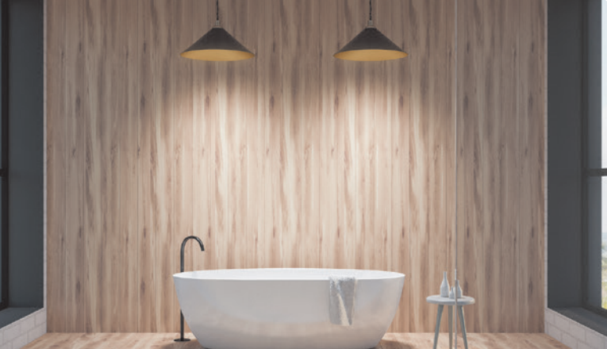


There is
There are
There are
…………… two lights in the bathroom.
Notes:
Click “Next” to go back to the questions slide.

Slide 5

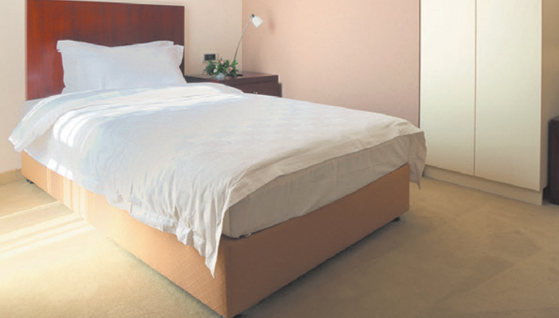


There is
There are
There is
…………… a bed in the bedroom.
Notes:
Click “Next” to go back to the questions slide.

Slide 6
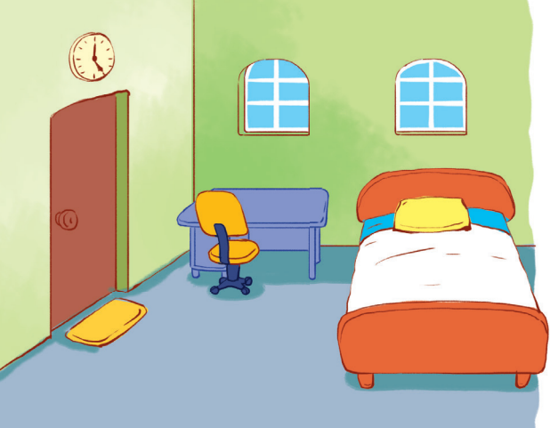
There is
There are
There is
……………a door in the room.
Notes:
Click “Next” to go back to the questions slide.

Slide 7
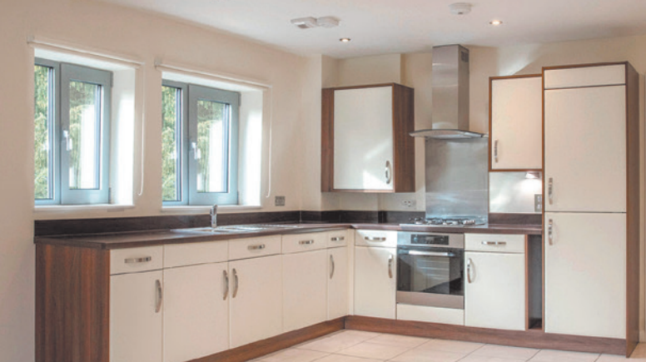
There is
There are
There are
…………… two windows in the kitchen.
Notes:
Click “Next” to go back to the questions slide.

Slide 8
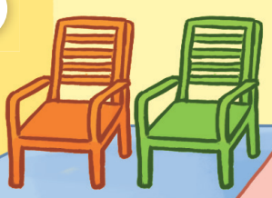
There is
There are
There are
…………… two chairs in the bedroom.
Notes:
Click “Next” to go back to the questions slide.

Slide 9

There is
There are
There is
…………… a table in the living room.
Notes:
Click “Next” to go back to the questions slide.

Slide 10
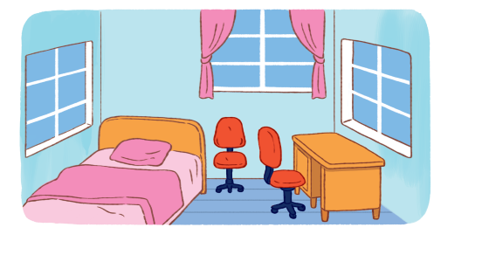
There is
There are
There is
…………… a desk in the room.
Notes:
Click “Next” to go back to the questions slide.

Slide 11
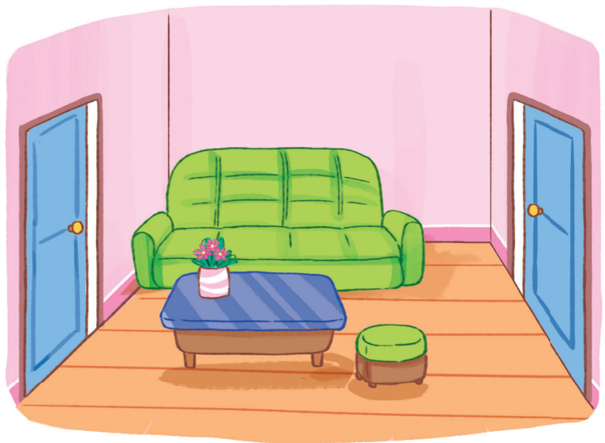
There is
There are
There are
………… two doors in the living room.
Notes:
Click “Next” to go back to the questions slide.

Slide 12


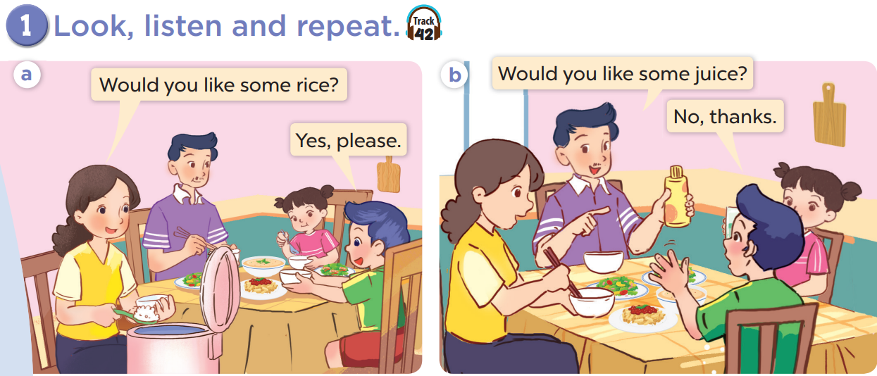

Slide 13
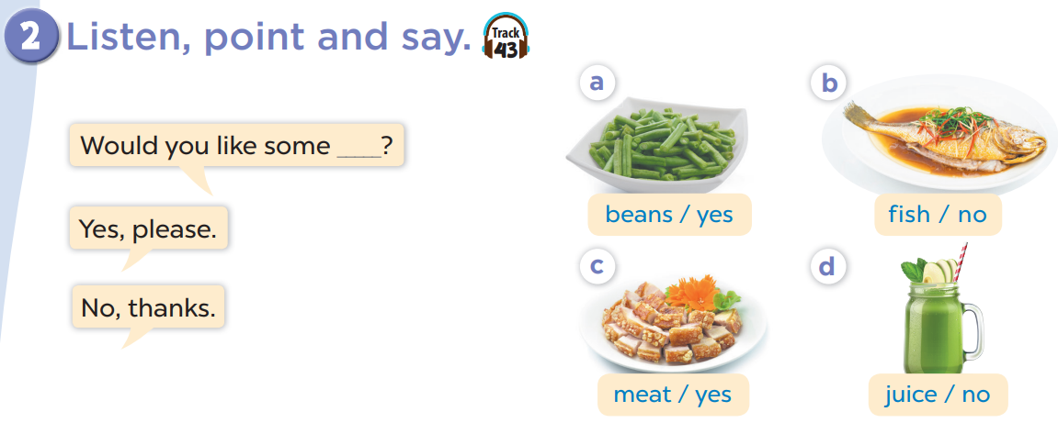


Slide 14
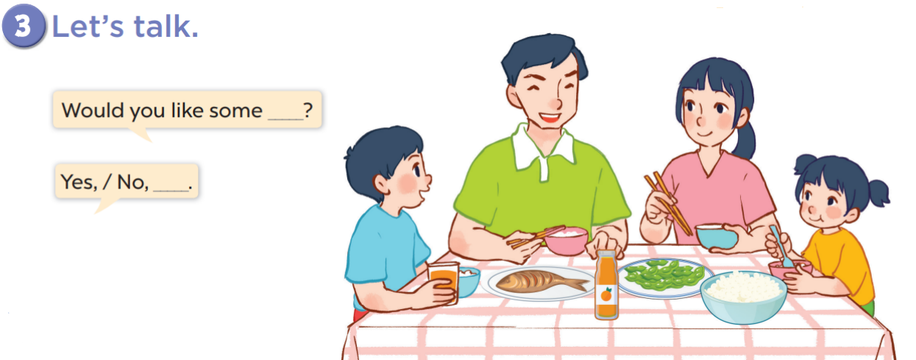


Slide 15
Would you like ……..?
Yes, please.
No, thanks
Team A
Fun corner
and wrap-up
Team B
30
50
60
30
70
40
70
90
Notes:
Divide the class into 2 teams to play “ Colourful flowers 2”.
Each team chooses one flower to go to the question.
Have pupils look, read and choose the right option.
Back to the menu for pupils to choose another question.
Pupils continue their turns until there are not any flowers left.
The team that gets the most points is the winner.

Slide 16
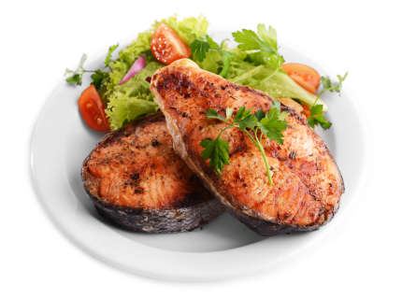
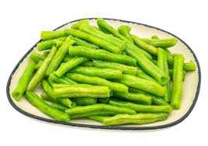
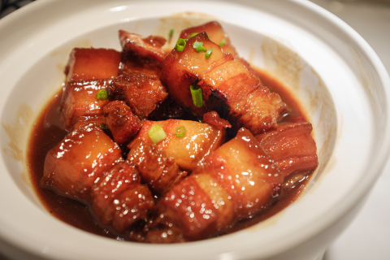


A
B
C
Would you like some fish?
Yes, please.
Notes:
Click on “Next” to go back to the questions slide.

Slide 17
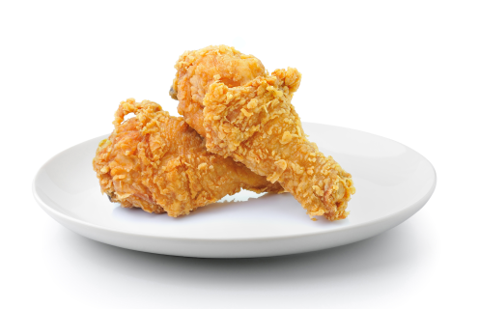
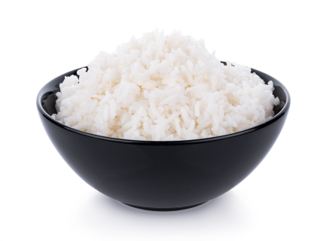
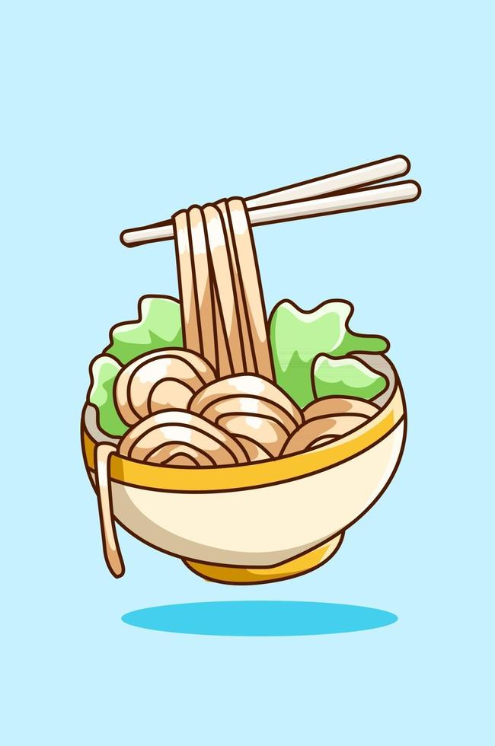


B
C
A
B
C
A
Would you like some rice?
No, thanks.
Notes:
Click on “Next” to go back to the questions slide.

Slide 18
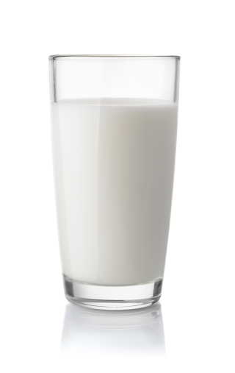

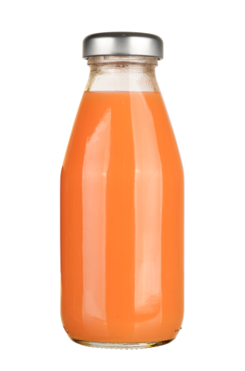
A
B
C
Would you like some Juice?
Yes, please.
Notes:
Click on “Next” to go back to the questions slide.

Slide 19
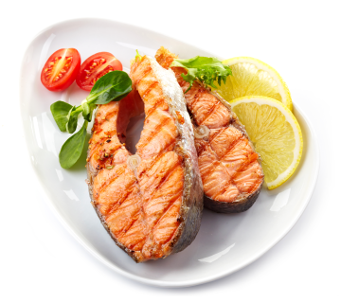
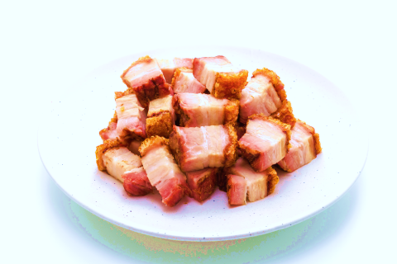
A
B
C
Would you like some beans?
Yes, please.
Notes:
Click on “Next” to go back to the questions slide.

Slide 20
A
B
C
Would you like some meat?
Yes, please.
Notes:
Click on “Next” to go back to the questions slide.

Slide 21

A
B
C
Would you like some soup?
Yes, please.
Notes:
Click on “Next” to go back to the questions slide.

Slide 22

A
B
C
Would you like some noodles?
No, thanks.
Notes:
Click on “Next” to go back to the questions slide.

Slide 23


A
B
C
Would you like some water?
Yes, please.
Notes:
Click on “Next” to go back to the questions slide.

