Slide 1



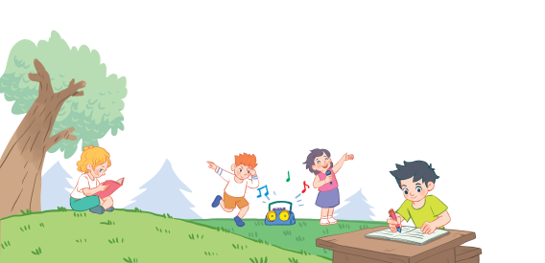
18
Period 5

Slide 2
1. Warm-up and review

Slide 3
Activity: Listen and say!

Slide 4
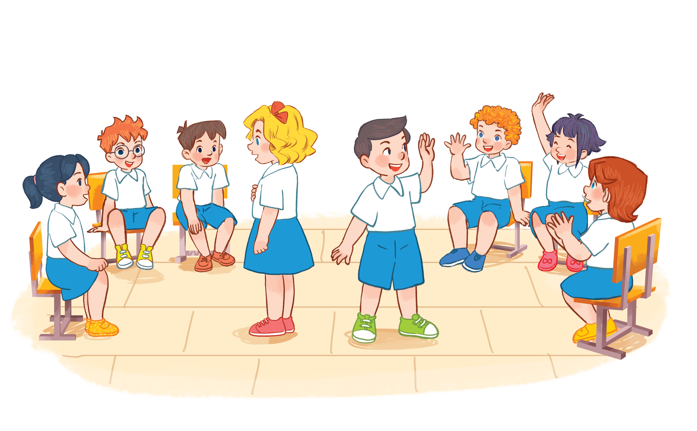

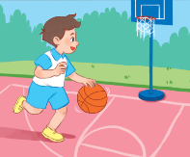
playing basketball.
I am playing basketball.
Notes:
Activity: Listen and say!
Pupils sit in a circle. Some pupils come in the middle and keep the pictures.
The others take turn saying a word, the one keeping the pictures raise their hands then say the whole sentence.
Who can make it will have points.

Slide 5
2. Listen and repeat.

Slide 6
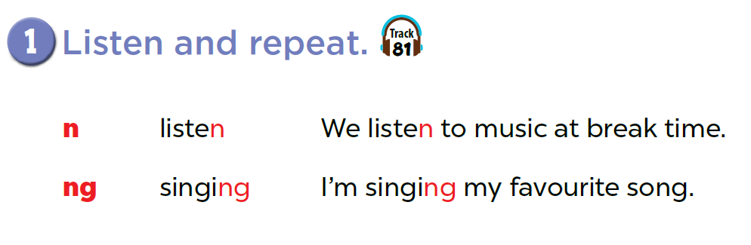

Slide 7

Game: Listen and choose!
n
listening
singing
ng
Notes:
T divides class into 2 teams: BOYS and GIRLS.
1 boy and 1 girl of each team come to the board, listen to the recording and choose the right words. (Pupils slap the words on the board)

Slide 8
Game: Listen and choose!
n
listening
singing
ng

Slide 9
3. Listen and circle.

Slide 10
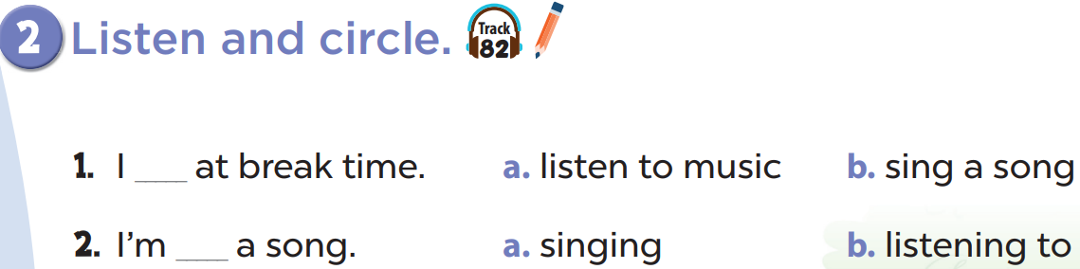

Slide 12

Game: Look and say

Slide 13
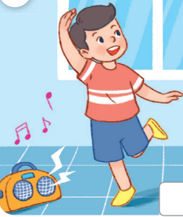
Look and say
I’m _________.
dancing

Slide 14

Look and say
I’m ________ a book.
reading

Slide 15
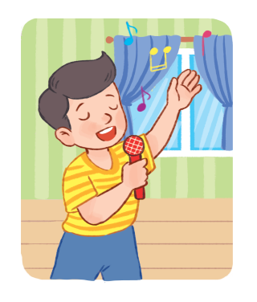
Look and say
I’m ________ a song.
singing

Slide 16
4. Let’s chant.

Slide 17
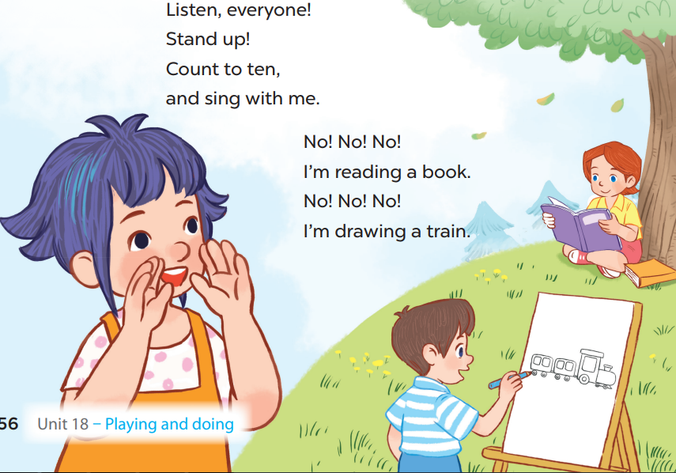

Slide 18
5. Fun corner and wrap-up

Slide 19
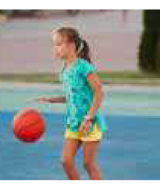
Notes:
Pupils sit in circle. Some of them hold flashcards of activities (listening to music, playing basketball, singing, drawing...), then pass it one by one with music.
When they listen to the music, they have to pass the flashcards to the person next to them. When the music stops, those who keeps the cards have to stand in the middle of the circle and say the words, the others listen and check the answer.

