Slide 1

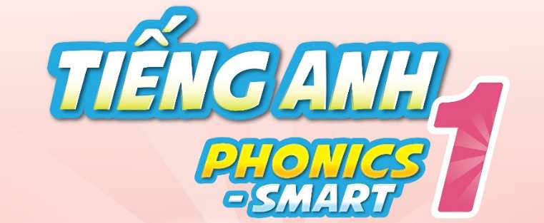

Slide 2

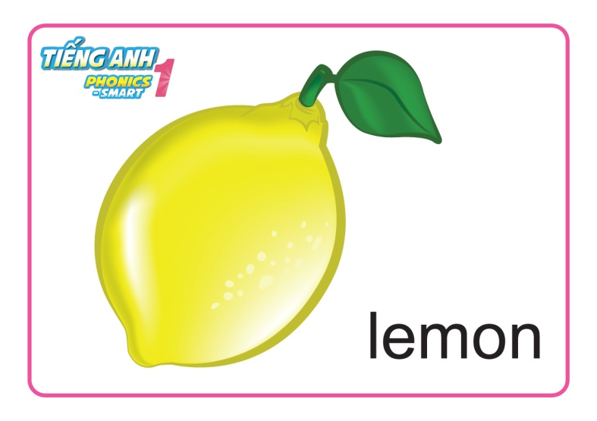
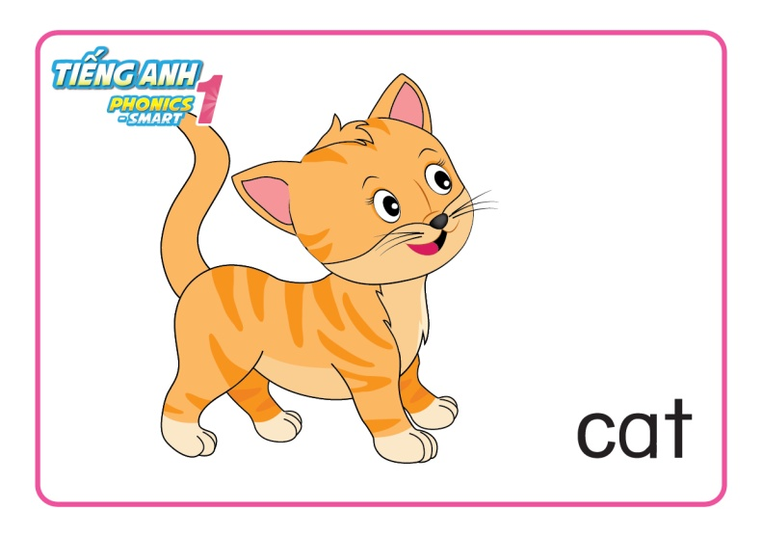

Memory Game
I have got …..
Notes:
Memory Game:
Starting with a sentence using ‘I have got...e.g. I have got a lemon.’ The first student says the sentence again and adds one more thing to the list, e.g. ‘I have got a lemon and two apples.’ Anyone who makes a mistake is out.
Start another similar sentence when it is too long to remember.

Slide 3
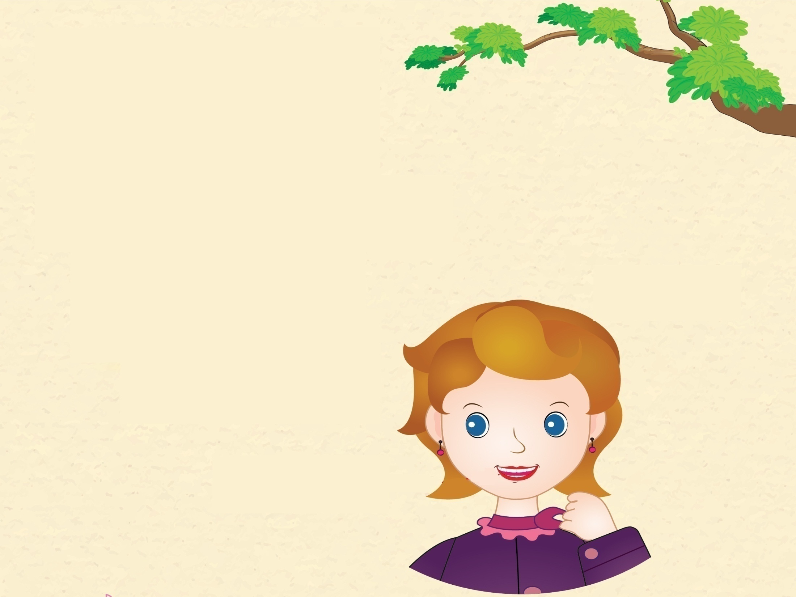
Unit 13
Lesson 1

Slide 4
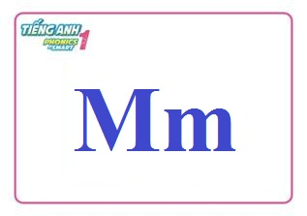
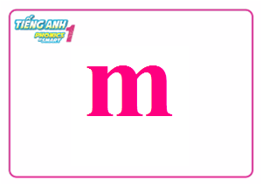

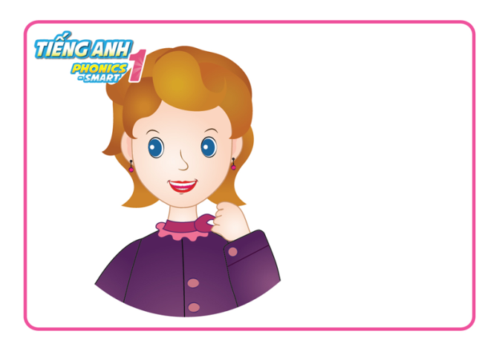

Unit 13:
Lesson 1:
Mm
1. Look, listen and repeat.
mum
mouth

Slide 5
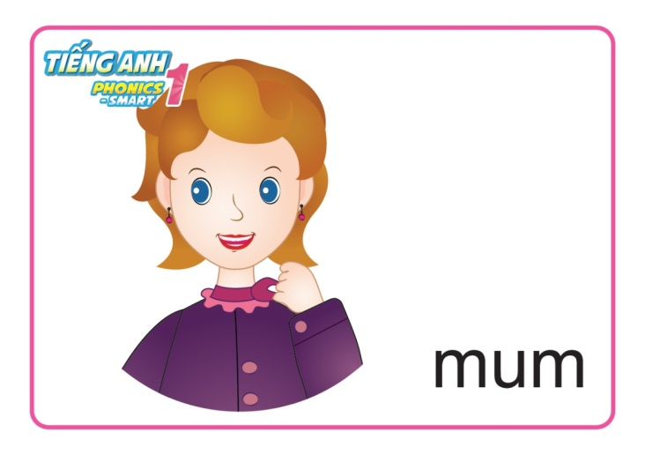

Unit 13:
Lesson 1:
Mm
1. Look, listen and repeat.
Guessing Game
Notes:
Guessing game
- Each team sends a player to the board and face the whole class (turn their back to the board).
- T shows a card of a word, each team has to use actions to describe the word to their friend.

Slide 6

Guessing Game
Check

Slide 7

Guessing Game
Check

Slide 8
Guessing Game
Check

Slide 9
Guessing Game
Check

Slide 10
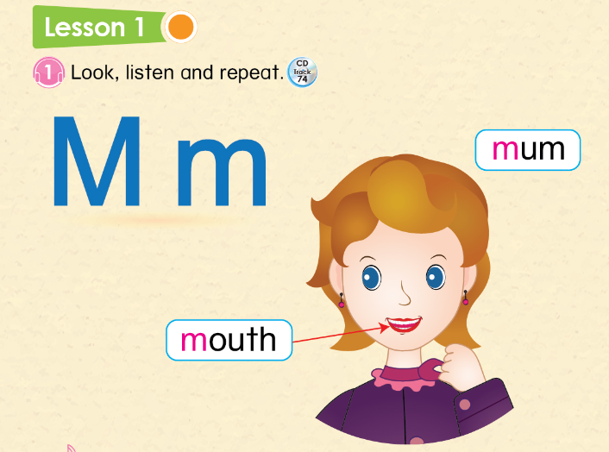
Unit 13:
Lesson 1:
Mm
1. Look, listen and repeat.

Slide 11
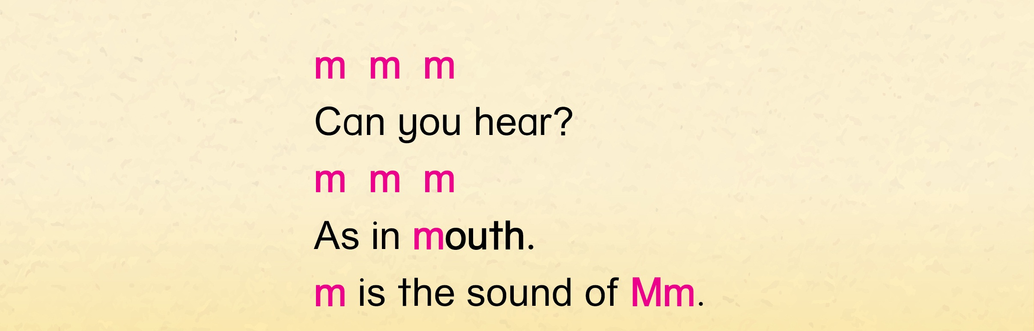




Unit 13:
Lesson 1:
Mm
1. Look, listen and repeat.
2. Let’s chant.

Slide 12
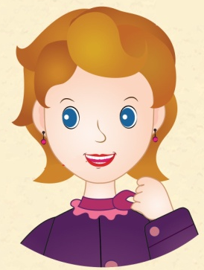


Unit 13:
Lesson 1:
Mm
1. Look, listen and repeat.
2. Let’s chant.
M
m

