Slide 1




Our toys
17
LESSON 1
Period 1

Slide 2
Contents
Look, listen and repeat.
Listen, point and say.
Warm- up and review
Let’s talk.
Fun corner and wrap-up
2
1
2
1
3
3
5
4
5
4

Slide 3
Warm- up and review
1
1
Game: Animals quiz

Slide 4
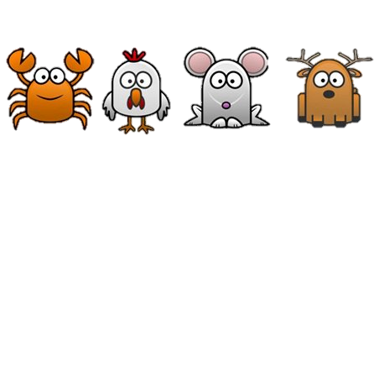


START
Notes:
Step 1: Divide the class into 4 teams.
Step 2: Invite 1 pupil to go to the board choose an animal and say aloud. The one who can make it will have 3 points.
Step 3: Encourage pupils to join in the game.
Step 4: Give points for pupils.

Slide 5





Catch the octopus

Slide 6
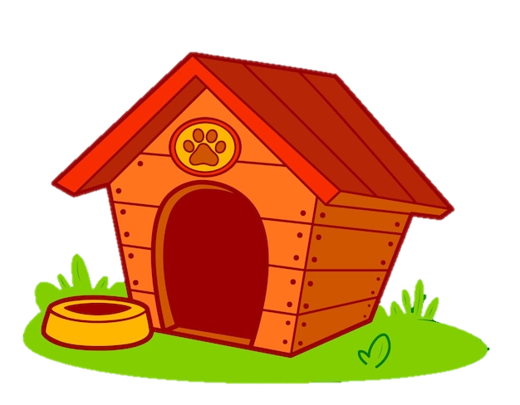

Click on the speaker and guess the animal
a parrot
a chicken
a dog

Slide 7

What animal is this?
It’s an elephant.
CHECK

Slide 8

What animal is this?
This is …
owl
owls
parrots
rabbits
turkey
parakeet
goldfishs

Slide 9
2
Look, listen and repeat.
2
9

Slide 10
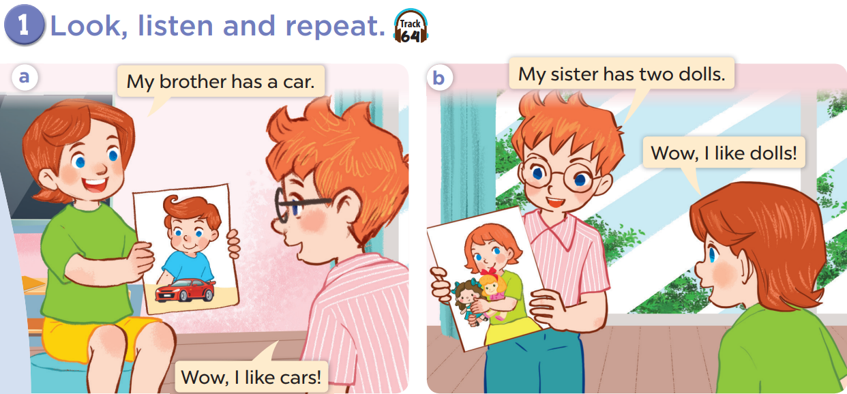

Slide 12
3
Listen, point and say.
3
12

Slide 13
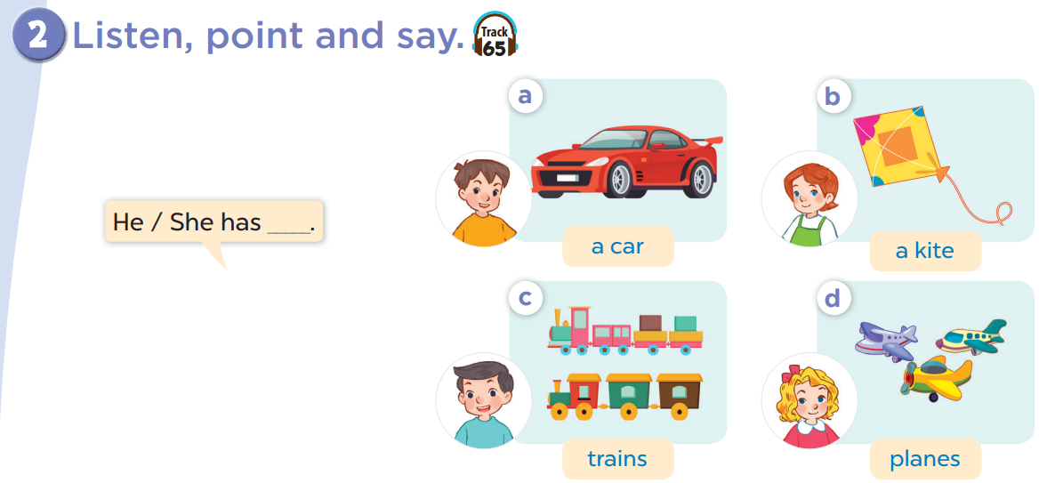

Slide 14


Slide 15
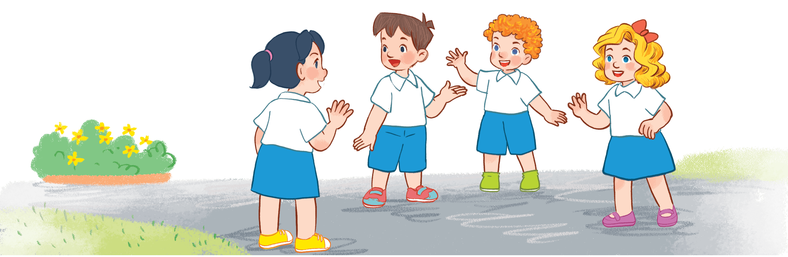
Game time!!!
Listen and choose
Notes:
Step 1: Divide the class into four teams.
Step 2: Invite each pupil from the teams to go to the board, then listen and choose the correct answer. The fastest with correct answer gets points for their team.
Step 3: Encourage pupils take part in the game.
Step 4: Give points for pupils.

Slide 16

4
Let’s talk.
4
16

Slide 17
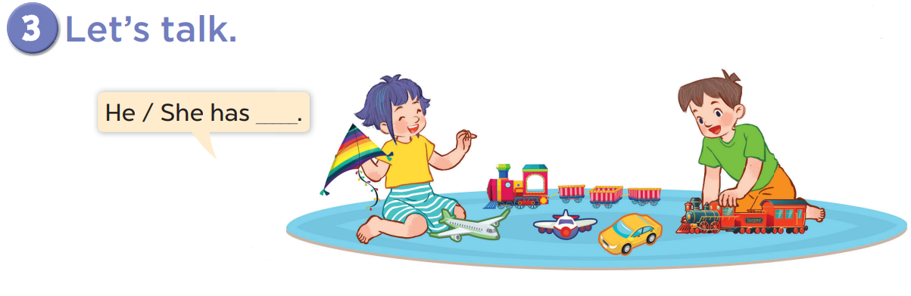

Slide 18

Game: Who says fast?
Notes:
Divide the class into four teams.
Each team has one pupil comes to the board, look at the picture, then read the sentence with a missing word.
Who can say it fast will get points for the teams.

Slide 19
5
Fun corner and wrap-up
5
Game: Guessing game
Notes:
Step 1: Divide the class into 4 teams.
Step 2: Invite 1 pupil from each team to come to the front and say aloud the answer. If correct, give points for the teams.
Step 3: Encourage pupils to practice speaking English.
Step 4: Give points for pupils.

