Slide 1



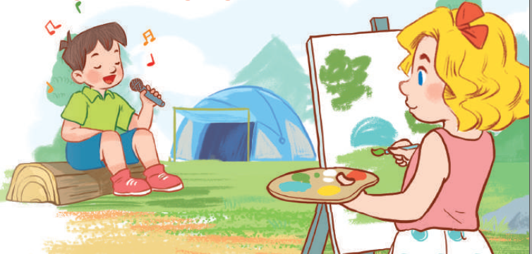
19
Outdoor activities
LESSON 1 – PERIOD 2

Slide 2
Warm-up
& Review
Listen
and tick.
Look,
complete
and read.
Let’s sing.
Fun corner
& wrap-up

Slide 3






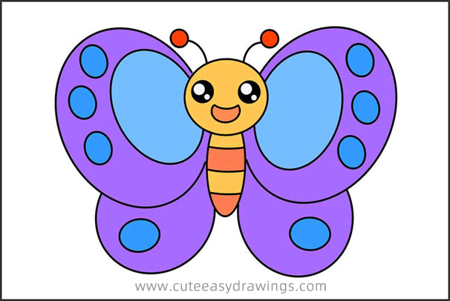
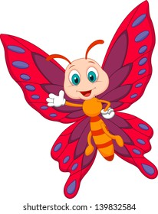



Slide 4
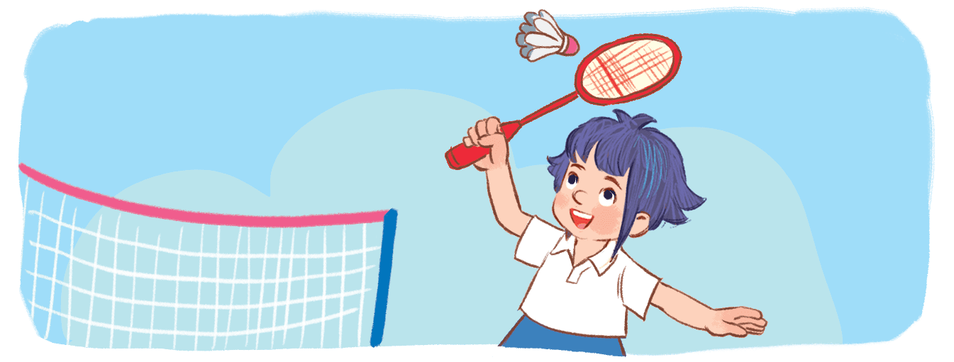


A. She’s playing badminton.
B. She’s playing basketball.
C. She’s playing volleyball.

Slide 5
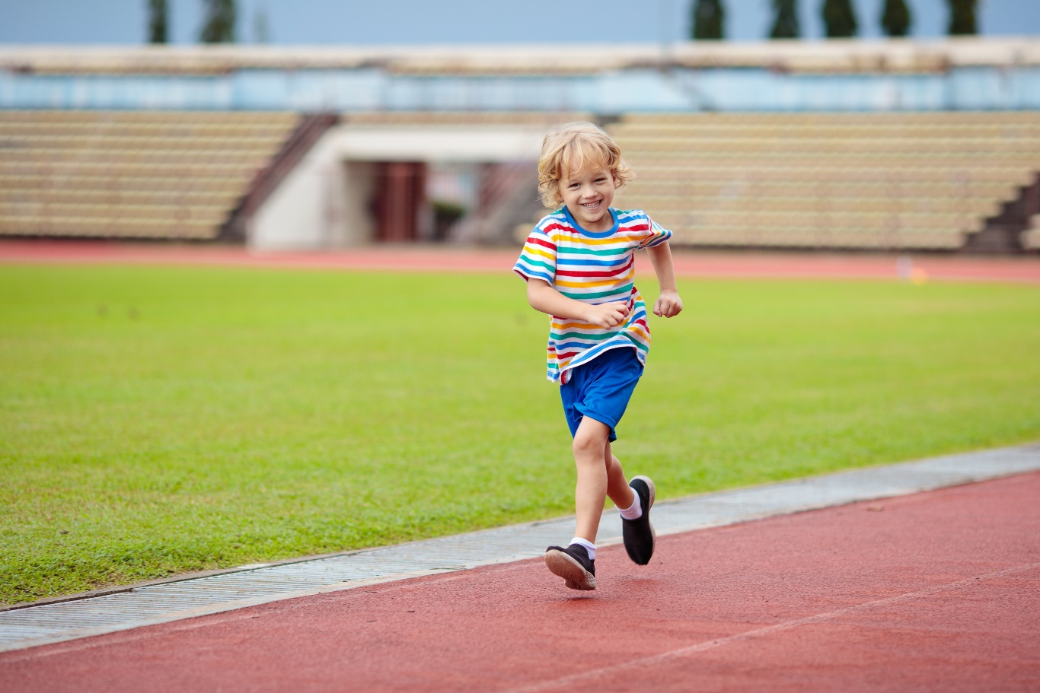
A. He’s walking.
B. He’s running.
C. He’s reading.

Slide 6


