Slide 1



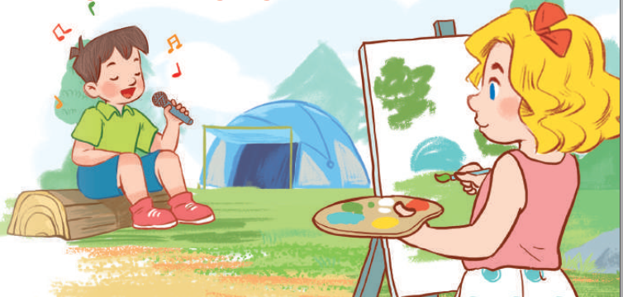
19
Outdoor activities
LESSON 3 – PERIOD 6

Slide 2
Warm-up
& Review
Read
and answer.
Let’s write.
Project
Fun corner
& wrap-up

Slide 3


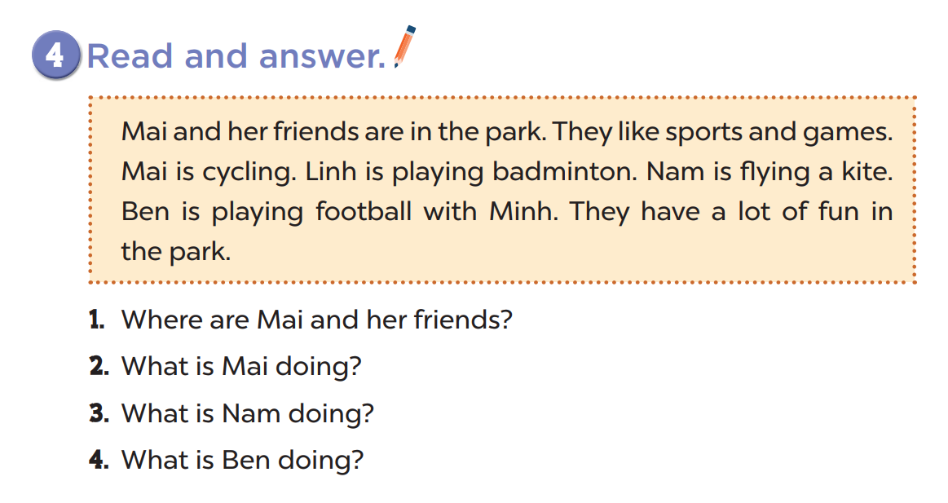
They’re in the park.
She’s cycling.
He’s flying a kite.
He’s playing football.

Slide 4
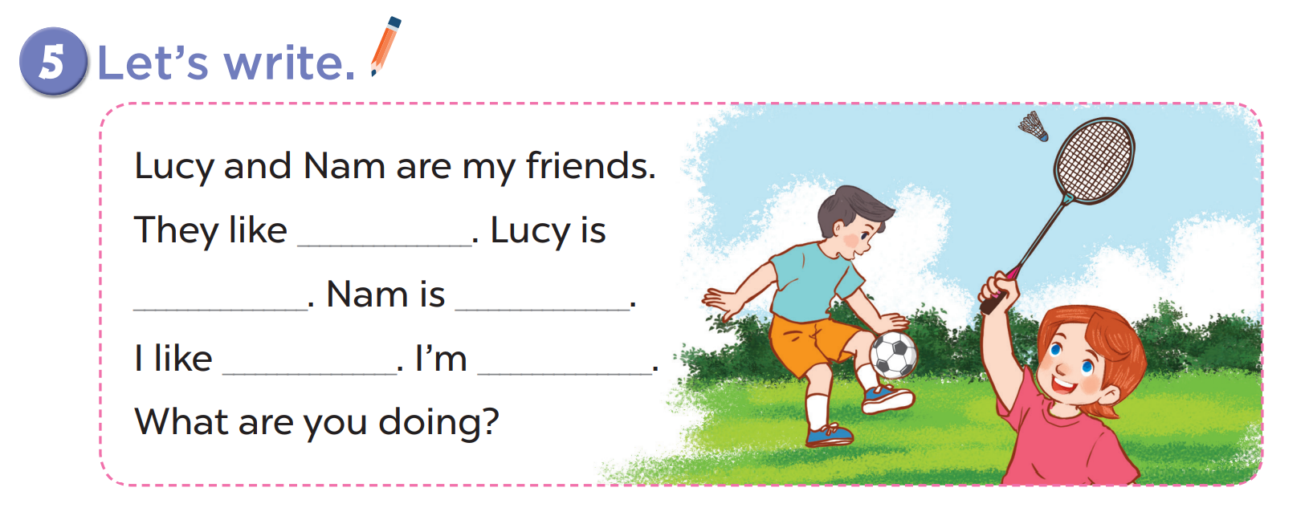

Slide 5


