Slide 2

REVIEW 1
Period 1

Slide 3

Table of contents
01
02
Warm-up and Review
Activity 1.
Listen and repeat.
03
04
Activity 2.
Look and circle.
Fun corner and Wrap-up

Slide 4


01
Warm-up and Review

Slide 5

GUESS THE WORDS
C
A
B

Slide 6


Look and choose.
a. cat
b. dog
c. duck

Slide 7

a. desk
b. door
c. duck

Slide 8

a. desk
b. bag
c. hat

Slide 9

a. ball
b. door
c. dog

Slide 10

a. cake
b. hat
c. bag

Slide 11

a. red
b. pen
c. bag

Slide 12

a. apple
b. cake
c. can

Slide 13

a. cat
b. can
c. cup

Slide 14


Very Good!

Slide 15
02
Activity 1. Listen and repeat.

Slide 16


Listen and repeat.
Hi! I’m Phonic Phil!
And I’m Super Sue!

Slide 17


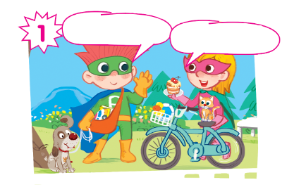

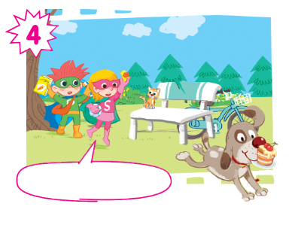
Oh, no! My cake!

Slide 18
Listen and repeat.
Hi! I’m Phil.
Hi! I’m Sue.

Slide 19
Listen and repeat.
Look! This is my dog.
And this is my cat.

Slide 20
Listen and repeat.
I have a car... and a book.
I have a ball... and a duck.

Slide 21
Listen and repeat.
Oh, no! My cake!

Slide 22
Listen and repeat.
Hi! I’m Phil.
Look! This is my dog.
Hi! I’m Sue.
And this is my cat.
I have a car... and a book.
I have a ball... and a duck.
Oh, no! My cake!
Oh, no! My cake!

Slide 23
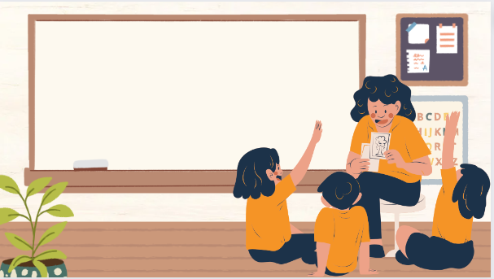
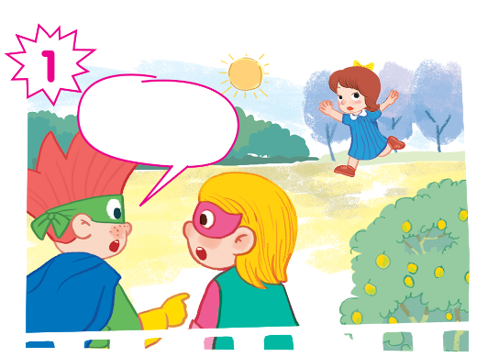
Play as a character

Slide 24
Hi! I’m Phil.
Look! This is my dog.
Hi! I’m Sue.
And this is my cat.
I have a car... and a book.
I have a ball... and a duck.
Oh, no! My cake!
Oh, no! My cake!

Slide 25
03
Activity 2. Look and circle.

Slide 26

Look and circle.
dog cake cat duck book can car ball

Slide 27
Look and circle.
dog cake cat duck book can car ball

Slide 28
Look and circle.
cake cat duck book can car ball

Slide 29
Look and circle.
cake cat duck can car ball

Slide 30
Look and circle.
cake duck can car ball

Slide 31
Look and circle.
dog
book
cat
duck

Slide 32
04
Fun corner and Wrap-up

Slide 33
Website: hoclieu.vn
Fanpage: https://www.facebook.com/tienganhglobalsuccess.vn/

