Slide 1


Slide 2
LOOKING BACK AND PROJECT
Unit
9
SOCIAL ISSUES
Unit
FAMILY LIFE
11TH GRADE
Lesson 8

Slide 3
LESSON 8
LOOKING BACK AND PROJECT
WARM-UP
Video watching
Pronunciation: Mark the intonation.
Vocabulary: Crossword
Grammar: Choose the best answer to complete each sentence.
LOOKING BACK
PROJECT
A social awareness campaign
CONSOLIDATION
Wrap up
Homework

Slide 4
WARM-UP
Watch the video and decide if the statements below are using rising or
falling intonation.

Slide 5

Watch the video and decide if the statements below are using rising or falling intonation.

Slide 6
ANSWER

Slide 7


PRONUNCIATION
Mark the intonation in these questions.
1. Should we report bullying to teachers or speak to our parents first?
2. Is this social awareness campaign about poverty or crime?
3. Have you ever experienced any physical, verbal, or social bullying?
4. Do you worry about peer pressure, body shaming, or bullying?

Slide 8
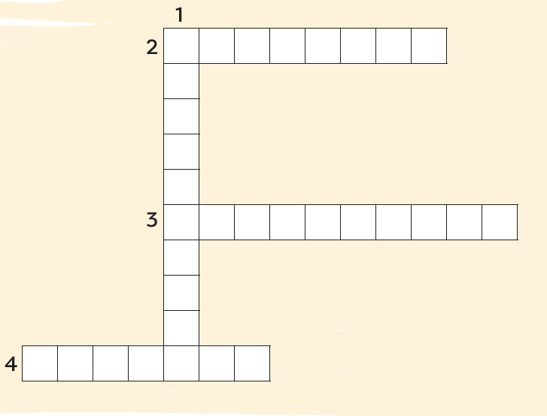

VOCABULARY
Solve the crossword.
C
P
A
N
N
F
I
D
P
R
S
I
O
N
N
V
O
L
T

Slide 9
VOCABULARY
Solve the crossword.
C
A
M
P
A
I
G
N
O
N
F
I
D
E
P
R
E
S
S
I
O
N
E
N
C
V
I
O
L
E
N
T

Slide 10


GRAMMAR
Choose the correct answer to complete each sentence below.
1. We started a campaign against bullying in our school. However / In addition, we organised classes for teens to try new things and become more confident.
2. Sharing someone’s personal information online is illegal. Therefore / Moreover, you should be very careful about what you post online.

Slide 11
GRAMMAR
Choose the correct answer to complete each sentence below.
3. Because / Because of our health campaign was successful, more teenagers now eat healthy food and exercise regularly.
4. Although / In spite of all our efforts, we were not able to solve the problem.

Slide 12

PROJECT

Slide 13


CONSOLIDATION
Review the vocabulary and grammar of Unit 9.
Give an oral presentation about a social issue in your community.
Plan activities for a campaign to raise people's awareness about a social issue and give a group presentation about it.

Slide 14

CONSOLIDATION
Do exercises in the workbook.
Prepare for Unit 10.

Slide 15

Website: hoclieu.vn
Fanpage: facebook.com/www.tienganhglobalsuccess.vn/

