Slide 1
01
Warm-up
Clip watching

Slide 2

WARM-UP
Clip watching

Slide 3
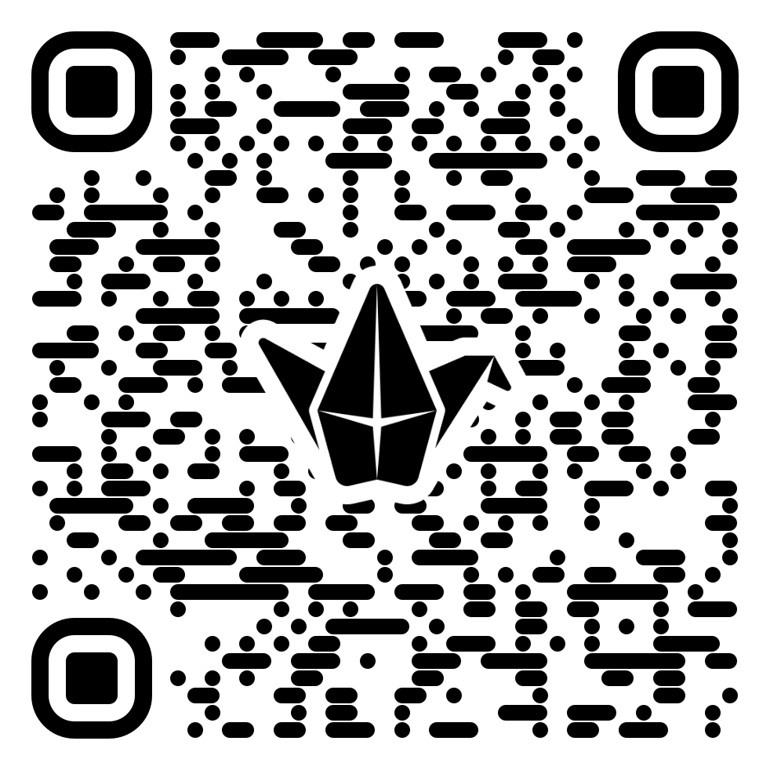
WARM UP

Slide 4
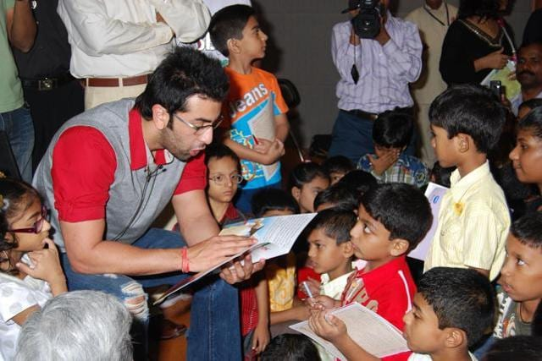
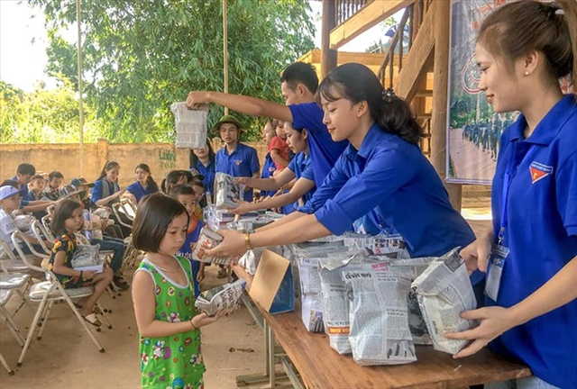
WARM-UP
Clip watching
+ Read books for children in orphanages
+ Visit and play games with them or listen to their problems
+ Work in home of sick and old people
+ Volunteer to work in remote or mountainous areas

Slide 5
Unit 4
For A Better Community
Lesson 1: Getting started
Volunteering in the community

Slide 6

Unit
1
1
Unit
Family Life
OBJECTIVES
By the end of this lesson, students will be able to gain:
An overview about the topic For a better community
Vocabulary to talk about voluntary work

Slide 7
Table of contents
01
02
03
Warm-up
Presentation
Practice
04
Production
05
Consolidation

Slide 8
02
Presentation

Slide 9
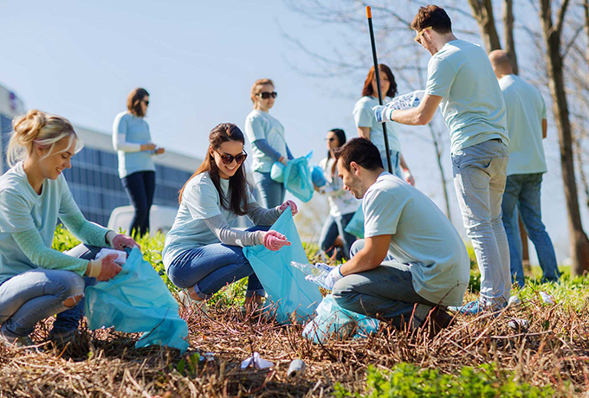

PRESENTATION
volunteer (n)
/ˌvɒlənˈtɪə(r)/
a person who does a job without being paid for it

Slide 10

PRESENTATION
advertisement (n)
/ədˈvɜːtɪsmənt/
a notice, picture or film telling people about a product, job or service

Slide 11

PRESENTATION
community (n)
/kəˈmjuːnəti/
all the people who live in a particular area, country, etc. when talked about as a group

Slide 12

PRESENTATION
PRESENTATION
boost (v)
/buːst/
to make something increase, or become better or more successful

Slide 13
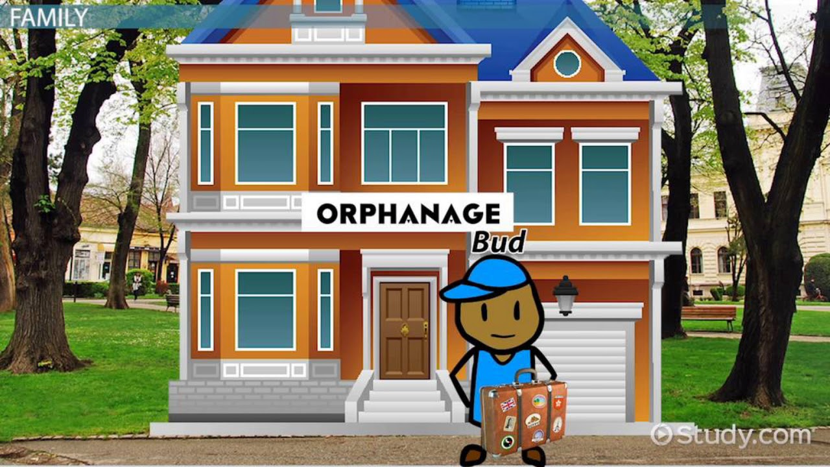
PRESENTATION
orphanage (n)
/ˈɔːfənɪdʒ/
a home for children whose parents are dead

Slide 14
PRESENTATION
New words | Pronunciation | Meaning
Volunteer (n) | /ˌvɒlənˈtɪə(r)/ | a person who does a job without being paid for it
Advertisement (n) | /ədˈvɜːtɪsmənt/ | a notice, picture or film telling people about a product, job or service
Community (n) | /kəˈmjuːnəti/ | all the people who live in a particular area, country, etc. when talked about as a group
Boost (v) | /buːst/ | to make something increase, or become better or more successful
Orphanage (n) | /ˈɔːfənɪdʒ/ | a home for children whose parents are dead

Slide 15
03
Practice

Slide 16
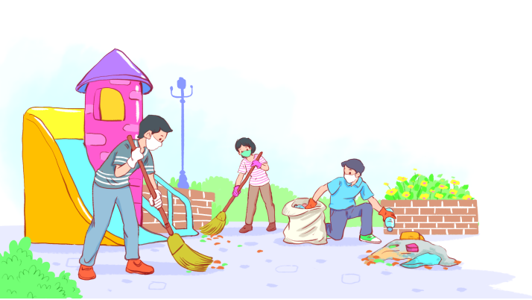
PRACTICE
1
Listen and read.
Volunteering in the community

Slide 17

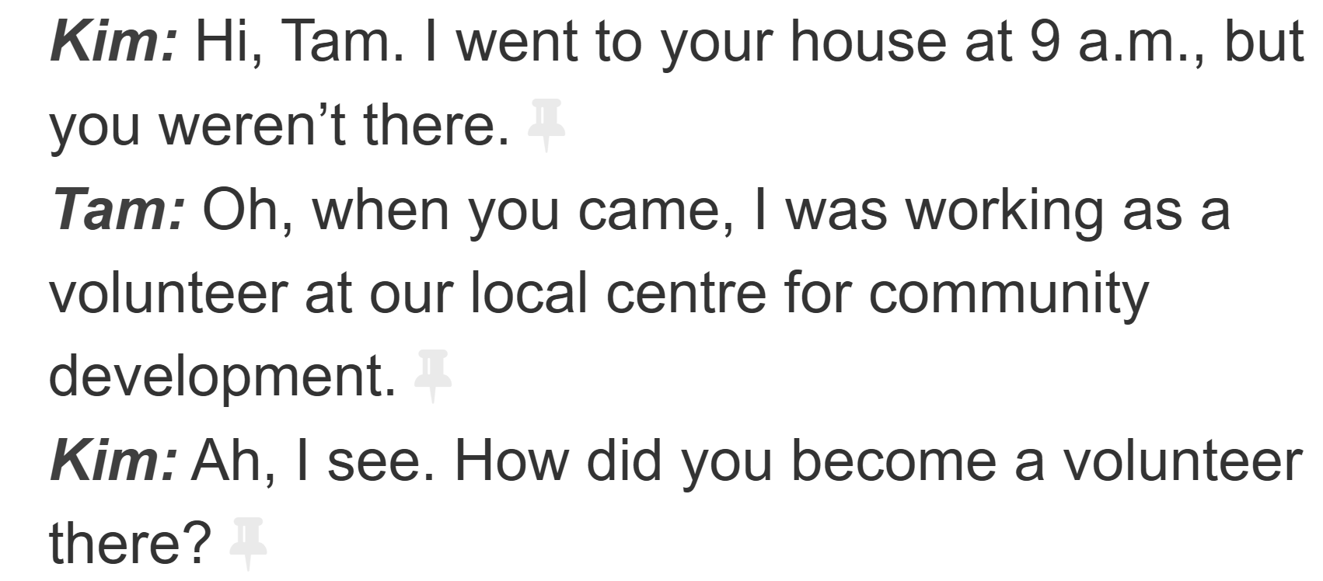
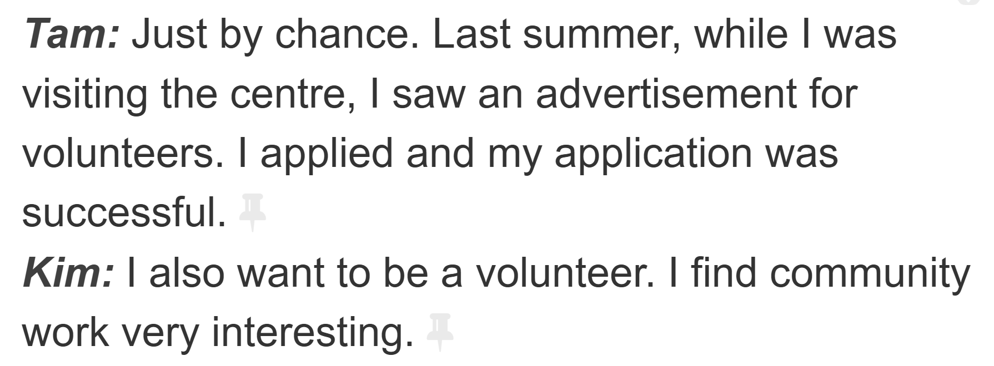
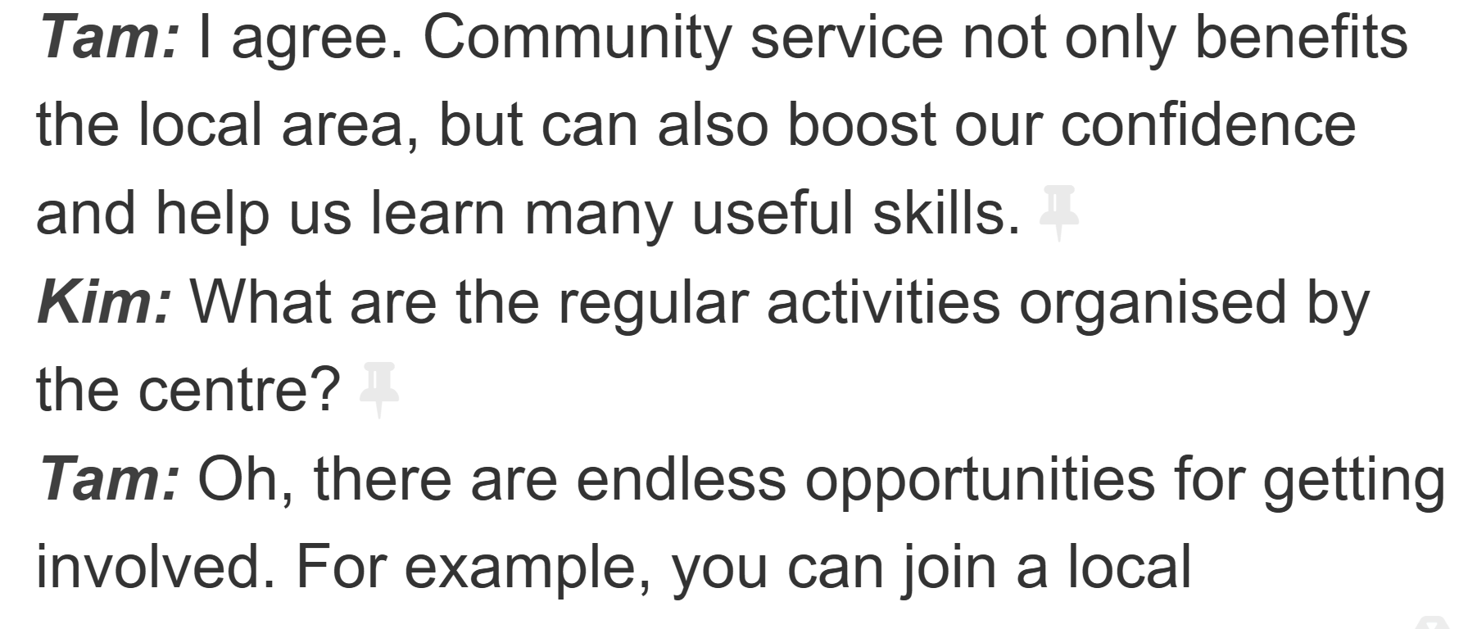
PRACTICE
1
Listen and read.
Volunteering in the community

Slide 18

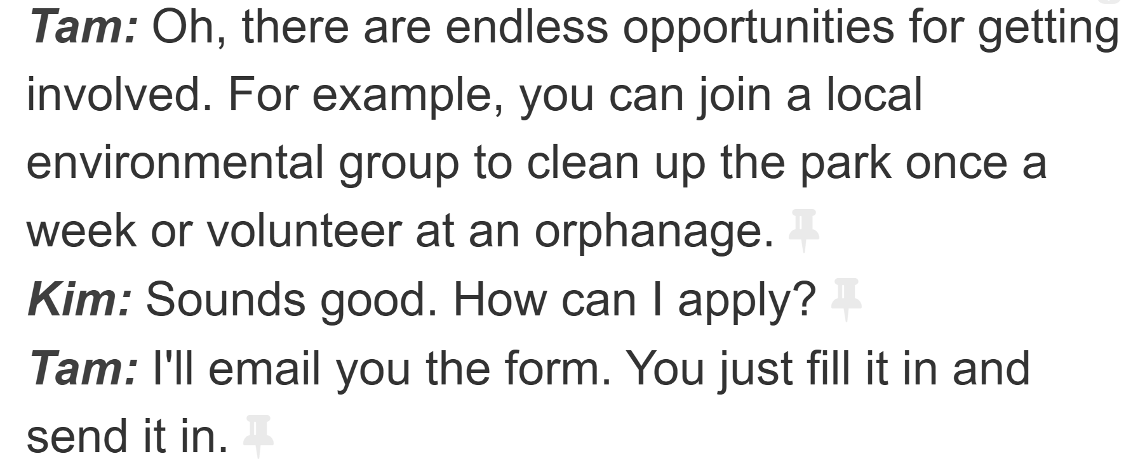
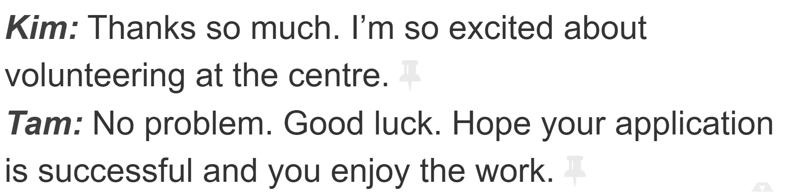

Slide 19
PRACTICE
2
Read the conversation again and answer the questions.
1. What was Tam doing when Kim went to her house?
2. What are some regular activities at the centre for community development?
3. How can Kim apply for volunteer work at the centre?

Slide 20
PRACTICE
2
Read the conversation again and answer the questions.
1. What was Tam doing when Kim went to her house?
She was working as a volunteer at the local centre for community development.
2. What are some regular activities at the centre for community development?
Cleaning up the park or volunteering at the orphanage.
3. How can Kim apply for volunteer work at the centre?
She needs to fill in the form, then send it in.

Slide 21
PRACTICE
3
Find the adjectives with the following suffixes in the conversation and write them below.
suffixes | adjectives
-ed
-ing
-ful
-less

Slide 22
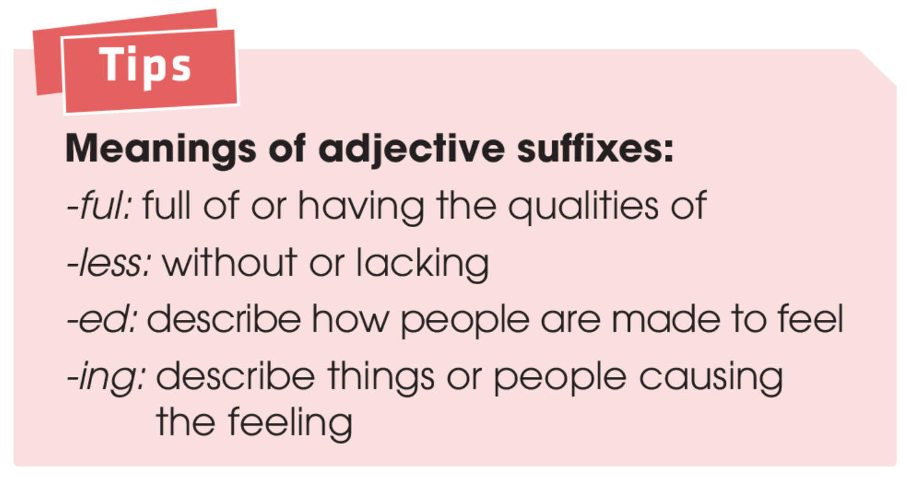
PRACTICE
3
Find the adjectives with the following suffixes in the conversation and write them below.
suffixes | adjectives
-ed
-ing
-ful
-less
excited
interesting
useful, successful
endless

Slide 24
PRACTICE
4
Find a verb phrase in the conversation to complete each sentence.
1. Oh, when you came, I____________ as a volunteer at our local centre for community development.
was working
2. Last summer, while I was visiting the centre, I _____ an advertisement for volunteers.
saw

Slide 25

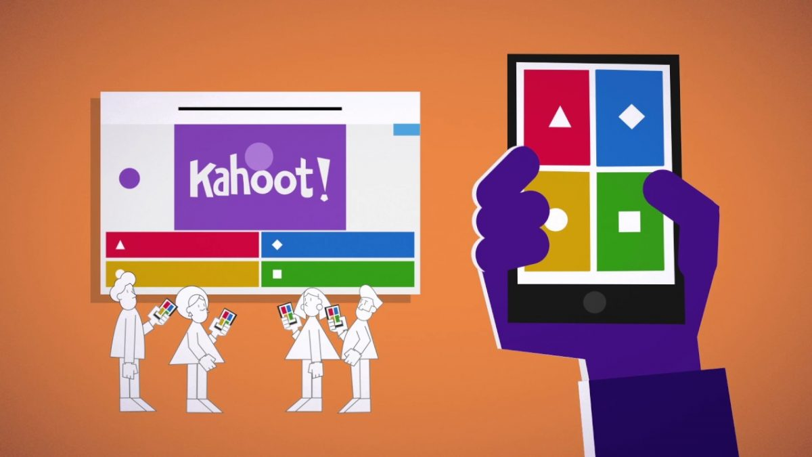

Slide 27
04
Production

Slide 28
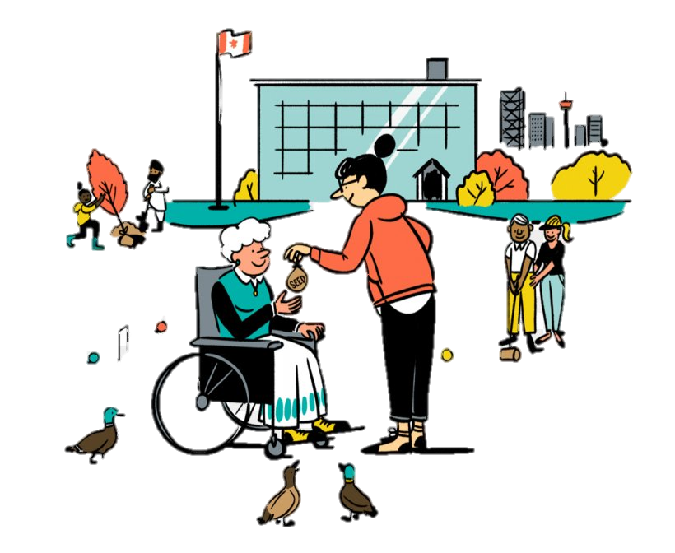
PRODUCTION
SELF-REFLECTION
- Talk about activities you are going to do to make your community a better one for a minute
- Your talk should include:
+ How many activities are you going to talk about?
+ Where do you do those activities?
+ Who do you do with?
+ How often do you do those activities?

Slide 29
05
Consolidation

Slide 30
Consolidation
1
Wrap-up
Gain an overview about the topic For a better community
Gain vocabulary to talk about voluntary work

Slide 31
Consolidation
2
Homework
1. Do exercises in the workbook
2. Prepare for the next lesson
3. Prepare for the Project

Slide 32
SEE YOU NEXT TIME !!

