Slide 1
2
Unit
A multicultural world
Lesson 3: Reading
Globalisation and cultural diversity

Slide 2
Video watching
WARM-UP
Task 1: Discuss the questions.
Vocabulary
Spelling bee
PRE-READING
WHILE-READING
Task 2: Match each section with a heading.
Task 3: Choose the correct answer A, B, or C.
POST-READING
- Task 4: Discussion.
CONSOLIDATION
Wrap-up
Homework

Slide 3

WARM-UP

Slide 4
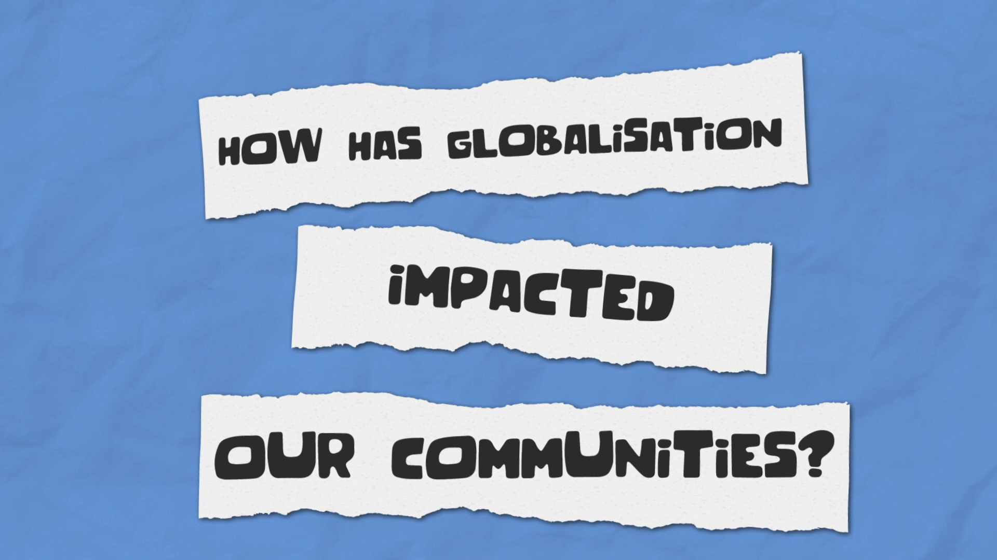
Watch a video about how globalisation has impacted our communities and list out all the impacts you hear.

Slide 5
Impacts of globalisation
Countries are becoming more connected and interdependent.
Nations with few natural resources depend on other nations for oil to fuel their economies.
Globalization exposes us to new ideas and cultures.
Each year, more indigenous communities are losing their native languages and lands to growth
Some people worry that their communities are changing and losing their traditions.
A global marketplace can be great for business but can also put local industries out of business.

Slide 6
Video watching
WARM-UP
Task 1: Discuss the questions.
Vocabulary
Spelling bee
PRE-READING
WHILE-READING
Task 2: Match each section with a heading.
Task 3: Choose the correct answer A, B, or C.
POST-READING
- Task 4: Discussion.
CONSOLIDATION
Wrap-up
Homework

Slide 7

PRE-READING

Slide 8
01
Work in pairs. Discuss the questions:
1. What is globalisation?
2. How does globalisation affect local cultures?

Slide 9


Slide 10


Globalisation (n)
/ˌɡləʊbəlaɪˈzeɪʃn/
the growing connection and interaction between countries worldwide.
Sự toàn cầu hóa

Slide 11

Custom (n)
/ˈkʌstəm/
an accepted way of behaving or of doing things in a society or a community
Phong tục

Slide 12
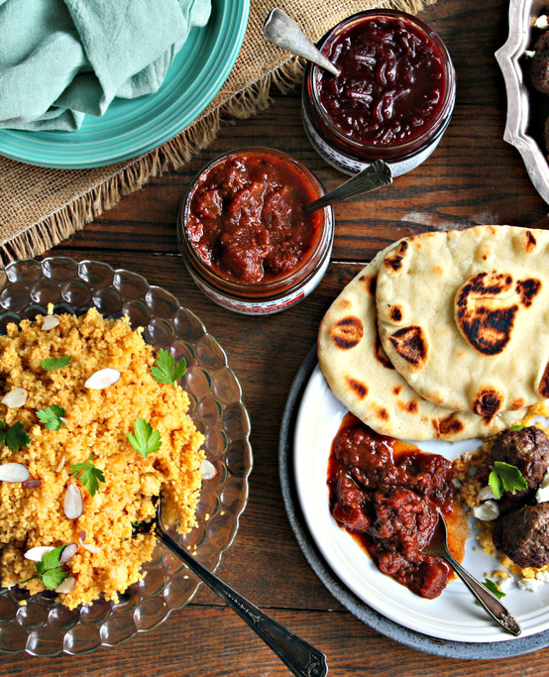
Speciality (n)
/ˌspeʃiˈæləti/
a type of food or product that a restaurant or place is famous for because it is so good
Đặc sản

Slide 13
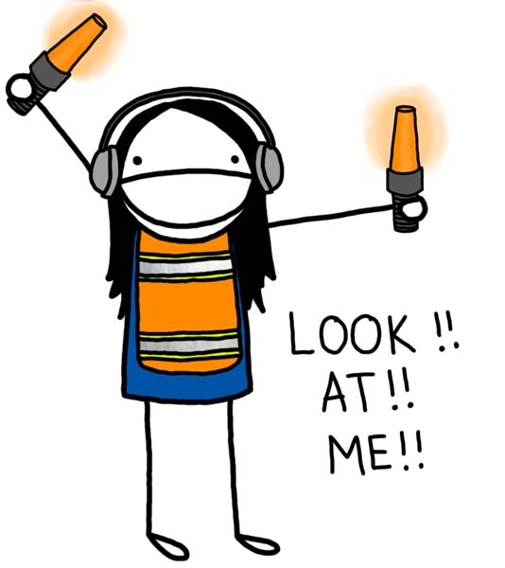
Captivate (v)
/ˈkæptɪveɪt/
to keep somebody’s attention by being interesting, attractive, etc.
Thu hút, cuốn hút

Slide 14

Keep up with
/kiːp ʌp wɪð/
to continue to be in contact with somebody
Bắt kịp với, theo kịp

Slide 15
Vocabulary | Pronunciation | Meaning | Vietnamese
1. Globalisation (n) | /ˌɡləʊbəlaɪˈzeɪʃn/ | the growing connection and interaction between countries worldwide. | Sự toàn cầu hóa
2. Custom (n) | /ˈkʌstəm/ | an accepted way of behaving or of doing things in a society or a community | Phong tục
3. Speciality (n) | /ˌspeʃiˈæləti/ | a type of food or product that a restaurant or place is famous for because it is so good | Đặc sản
4. Captivate (v) | /ˈkæptɪveɪt/ | to keep somebody’s attention by being interesting, attractive, etc. | Thu hút, cuốn hút
5. Keep up with | /kiːp ʌp wɪð/ | to continue to be in contact with somebody | Bắt kịp với, theo kịp

Slide 16
Spelling Bee

Slide 17
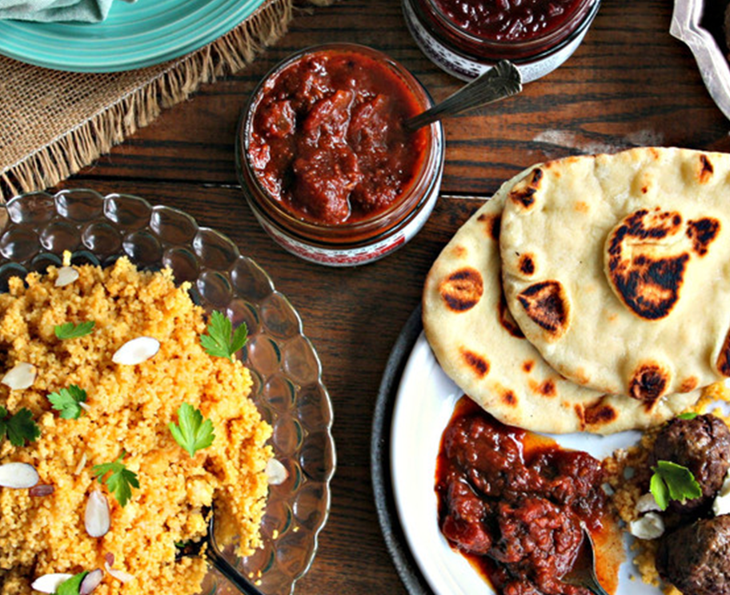
A type of food or product that a restaurant or place is famous for because it is so good
_ _ _ _ _ _ _ _ _
SPECIALTY

Slide 18
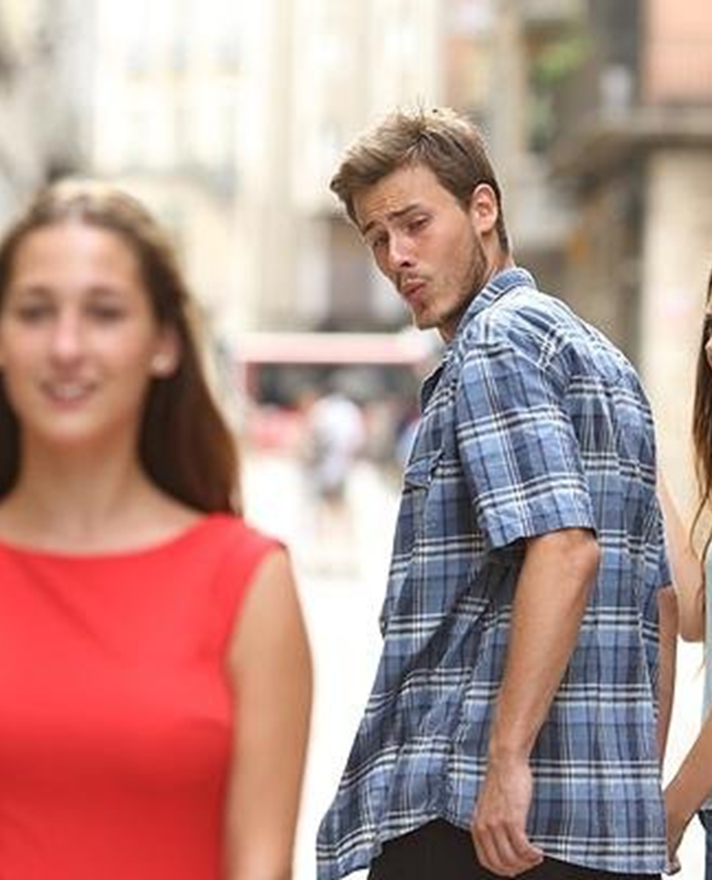
To keep somebody’s attention by being interesting, attractive, etc.
_ _ _ _ _ _ _ _ _
CAPTIVATE

Slide 19

The growing connection and interaction between countries worldwide.
_____________
GLOBALISATION

Slide 20
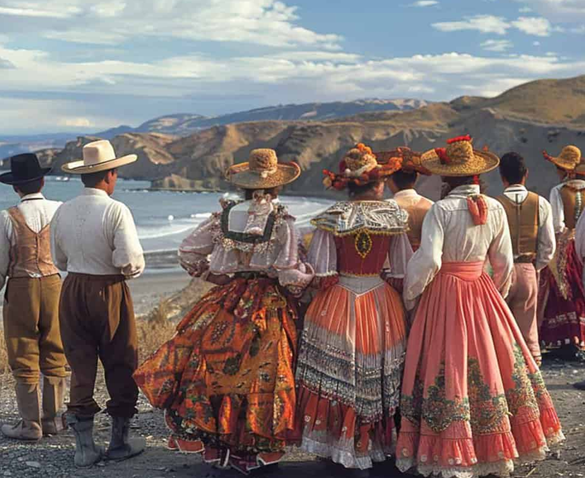
An accepted way of behaving or of doing things in a society or a community
_ _ _ _ _ _
CUSTOM

Slide 21

To continue to be in contact with somebody
_ _ _ _ _ _
KEEP
UP
_ _ _ _
WITH

Slide 22
Video watching
WARM-UP
Task 1: Discuss the questions.
Vocabulary
Spelling bee
PRE-READING
WHILE-READING
Task 2: Match each section with a heading.
Task 3: Choose the correct answer A, B, or C.
POST-READING
- Task 4: Discussion.
CONSOLIDATION
Wrap-up
Homework

Slide 23

WHILE-READING

Slide 24
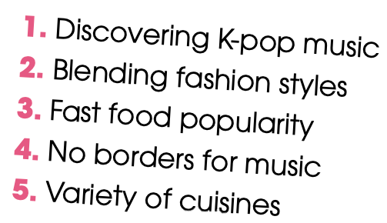
02
Read the article and match each section (A–C) with a heading (1–5). There are TWO extra headings.

Slide 25
02
Read the article and match each section (A–C) with a heading (1–5). There are TWO extra headings.
As a result of globalisation, the world is becoming more and more connected. This has changed people's way of life, beliefs, art and customs, or their culture, in many respects. Although people's experiences around the world have become very similar, globalisation has also encouraged cultural diversity. Below are some examples.

Slide 26
02
Read the article and match each section (A–C) with a heading (1–5). There are TWO extra headings.
5. Variety of cuisine
A. _________
Fast food chains and international restaurants have become popular, offering a wide range of dishes and more food choices to local people. For example, here in Viet Nam, we can enjoy Italian pizza or Japanese sushi, in addition to our traditional food. Moreover, some international dishes use local ingredients, which make them unique and more suitable to local tastes. On the other hand, Vietnamese specialties, such as pho and banh mi, are also gaining popularity worldwide.

Slide 27
02
Read the article and match each section (A–C) with a heading (1–5). There are TWO extra headings.
4. No borders for music
B. _________
Thanks to globalisation, people can quickly discover new music from all over the world. People nowadays enjoy listening to music from different countries and cultures, and in different languages. For example, American teens are captivated by K-pop music and dance. There are also many music festivals around the globe that bring artists and music fans together. In today's connected world, it is very common for musicians across the world to work on music projects and share ideas together.

Slide 28
02
Read the article and match each section (A–C) with a heading (1–5). There are TWO extra headings.
2. Blending fashion styles
C. _________
Globalisation has also impacted fashion by opening it up to a variety of styles and influences from around the world. Cross-cultural styles that blend both traditional and modern elements are on the rise. This presents opportunities for fashion designers to be creative and reflect the cultural richness of the world. It is now easier for people to keep up with fashion trends from different cultures and regions, and express their identities in new and exciting ways.

Slide 29
02
Read the article and match each section (A–C) with a heading (1–5). There are TWO extra headings.
In conclusion, globalisation has helped strengthen cultural diversity in the world and made people appreciate different cultures and lifestyles.

Slide 30
Read the article again and choose the correct answer A, B, or C.
03
1. How has globalisation affected people’s eating habits?
  A. It has decreased the popularity of traditional food.
  B. It has limited people’s food choices to local dishes.
  C. Local people are trying new cuisines.

Slide 31
Read the article again and choose the correct answer A, B, or C.
03
A. _________
Fast food chains and international restaurants have become popular, offering a wide range of dishes and more food choices to local people. For example, here in Viet Nam, we can enjoy Italian pizza or Japanese sushi, in addition to our traditional food. Moreover, some international dishes use local ingredients, which make them unique and more suitable to local tastes. On the other hand, Vietnamese specialties, such as pho and banh mi, are also gaining popularity worldwide.

Slide 32
Read the article again and choose the correct answer A, B, or C.
03
2. Which of the following is NOT mentioned as something that local people can try in Viet Nam?
  A. Dishes from other cultures using ingredients grown in Viet Nam.
  B. Traditional dishes using international ingredients.
  C. A Japanese dish of cooked rice and raw fish.

Slide 33
Read the article again and choose the correct answer A, B, or C.
03
A. _________
Fast food chains and international restaurants have become popular, offering a wide range of dishes and more food choices to local people. For example, here in Viet Nam, we can enjoy Italian pizza or Japanese sushi, in addition to our traditional food. Moreover, some international dishes use local ingredients, which make them unique and more suitable to local tastes. On the other hand, Vietnamese specialties, such as pho and banh mi, are also gaining popularity worldwide.

Slide 34
Read the article again and choose the correct answer A, B, or C.
03
3. What can be inferred from the passage about music?
  A. Music has connected people across cultures.
  B. It Teens around the world love listening to K-pop music.
  C. It is easier to organise music festivals.

Slide 35
Read the article again and choose the correct answer A, B, or C.
03
B. _________
Thanks to globalisation, people can quickly discover new music from all over the world. People nowadays enjoy listening to music from different countries and cultures, and in different languages. For example, American teens are captivated by K-pop music and dance. There are also many music festivals around the globe that bring artists and music fans together. In today's connected world, it is very common for musicians across the world to work on music projects and share ideas together.

Slide 36
Read the article again and choose the correct answer A, B, or C.
03
4. How has globalisation affected fashion?
  A. It has introduced more traditional elements in fashion design.
  B. It has promoted the exchange of fashion ideas and styles from around the world.
  C. It has made it easier for people to create their own clothes.

Slide 37
Read the article again and choose the correct answer A, B, or C.
03
C. _________
Globalisation has also impacted fashion by opening it up to a variety of styles and influences from around the world. Cross-cultural styles that blend both traditional and modern elements are on the rise. This presents opportunities for fashion designers to be creative and reflect the cultural richness of the world. It is now easier for people to keep up with fashion trends from different cultures and regions, and express their identities in new and exciting ways.

Slide 38
Read the article again and choose the correct answer A, B, or C.
03
5. What is the purpose of the article?
  A. To discuss the positive impacts of globalisation on cultures.
  B. To introduce features of new cultures to readers.
  C. To explain how globalisation can help people have the same experiences.

Slide 39
Video watching
WARM-UP
Task 1: Discuss the questions.
Vocabulary
Spelling bee
PRE-READING
WHILE-READING
Task 2: Match each section with a heading.
Task 3: Choose the correct answer A, B, or C.
POST-READING
- Task 4: Discussion.
CONSOLIDATION
Wrap-up
Homework

Slide 40

POST-READING

Slide 41
Work in groups. Discuss the following question.
04
What are some other effects of globalisation on cultural diversity? Give some examples in the context of Viet Nam

Slide 42
Work in groups. Discuss the following question.
04
SUGGESTED ANSWER
Globalization can both support and harm cultural diversity. It helps spread cultures through media, travel, and trade. This makes people appreciate them more. For example, in Vietnam, globalization has made foreign music, movies, and food more popular. However, it can also lead to dominant cultures replacing others, such as Western-style clothing replacing traditional Vietnamese clothing. It's important to share cultures while still protecting local ones.

Slide 43
Video watching
WARM-UP
Task 1: Discuss the questions.
Vocabulary
Spelling bee
PRE-READING
WHILE-READING
Task 2: Match each section with a heading.
Task 3: Choose the correct answer A, B, or C.
POST-READING
- Task 4: Discussion.
CONSOLIDATION
Wrap-up
Homework

Slide 44

CONSOLIDATION

Slide 45
01
Wrap up
What have you learnt today?
Some lexical items about globalisation and cultural identity.
Reading skills for general ideas and for specific information about globalisation and cultural identity.

Slide 46
02
Homework
Do exercises in the workbook.
Prepare for Lesson 4.

Slide 47
Thanks!

