Slide 1
WELCOME TO CLASS 12A6

Slide 2
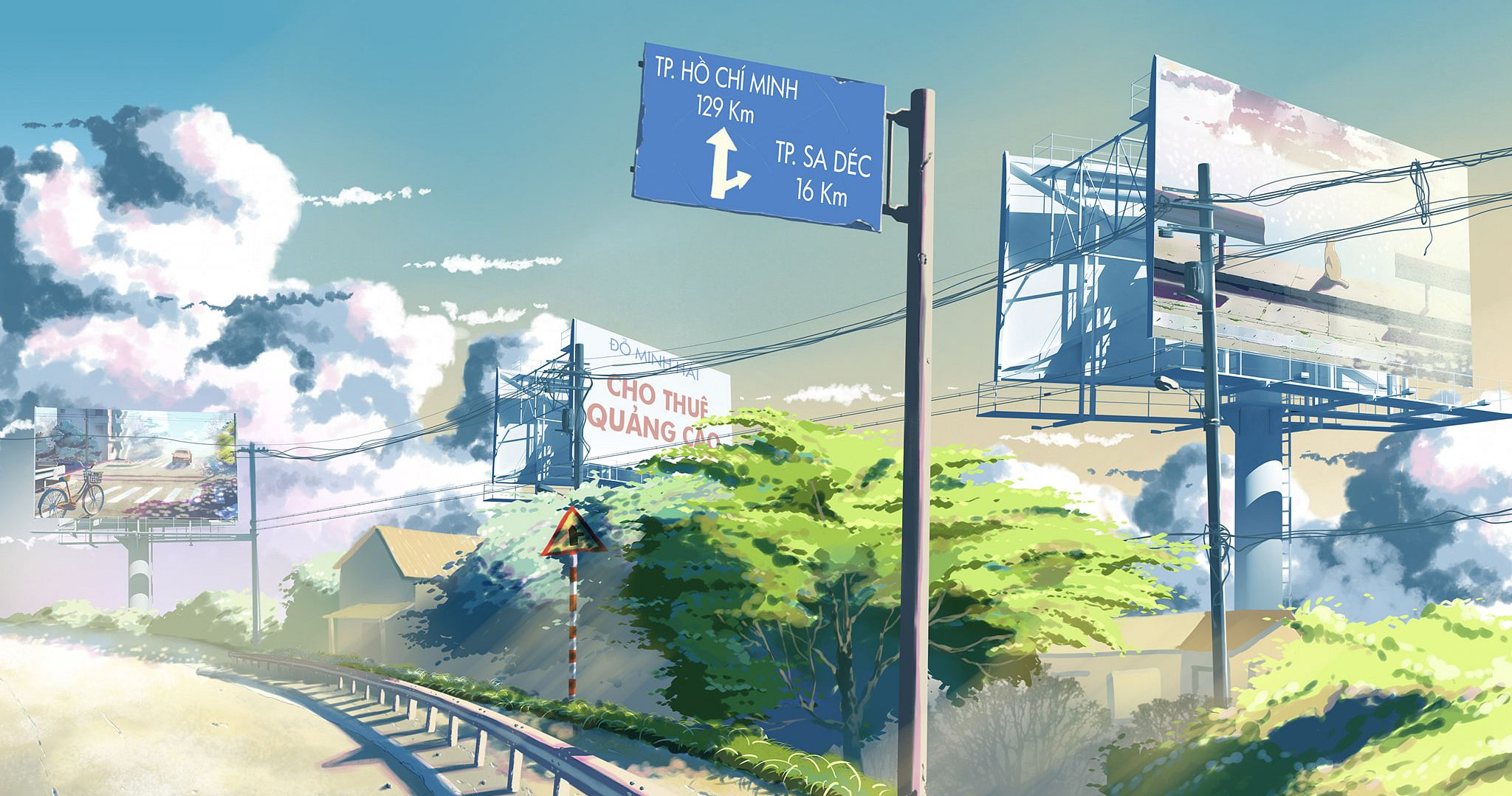
WARM-UP
WARM-UP
Lucky Wheel
Work in 4 groups.
Answer the question to get a bonus.
The team has the most correct answers is the winner.

Slide 3





WARM-UP
1
2
3
8
9
10
10
4
5
6
10
10
7
8
9
9
8
TURN

Slide 4







WARM-UP
An area of land where waste materials are buried under the surface
BACK
A. landfill (n)
B. packaging (n)
C. container (n)
D. reuse (v)

Slide 5


WARM-UP
Something such as a box or bowl that you can use to keep things in
BACK
A. packaging (n)
B. container (n)
C. reuse (v)
D. landfill (n)

Slide 6

WARM-UP
To use something again
BACK
A. reuse (v)
B. landfill (n)
C. container (n)
D. waste (n)

Slide 7
WARM-UP
The act of using something in a careless way, causing it to be lost or destroyed
BACK
A. pollution
B. packaging (n)
C. waste (n)
D. container (n)

Slide 8
WARM-UP
Materials used to wrap or protect things
we buy from shops
BACK
A. container (n)
B. packaging (n)
C. reuse (v)
D. landfill (n)

Slide 9
WARM-UP
Many people have now started to care _________ the environment
BACK
A. in
B. about
C. at
D. of

Slide 10
WARM-UP
We should work _________ some solutions
to reduce plastic pollution.
BACK
A. for
B. on
C. out
D. with

Slide 11


WARM-UP
The future of our planet depends _________ how we deal with climate change.
BACK
A. on
B. from
C. in
D. with

Slide 12
WARM-UP
My sister is responsible for looking _________ the plants at home.
BACK
A. up
B. after
C. for
D. with

Slide 13
Unit 4
urbaniSation
GETTING STARTED
Urban Development

Slide 14

VOCABULARY

Slide 15
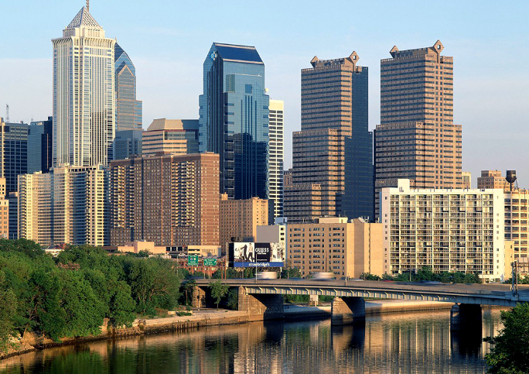
VOCABULARY
urban (adj)
/ˈɜːbən/
of or in a city or town

Slide 16
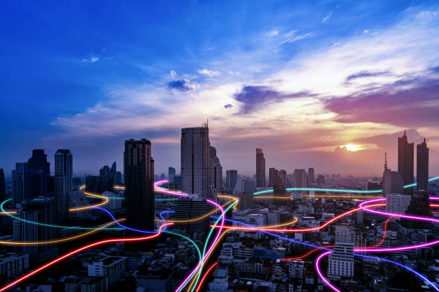
VOCABULARY
urbanisation (n)
/ˈɜːbən¸naizeiʃən/
the process of population concentration in cities and the transformation of rural land for urban use.

Slide 17

VOCABULARY
expand (v)
/ɪkˈspænd/
to increase in size, number, or importance, or to make something increase in this way

Slide 18

VOCABULARY
housing (n)
/ˈhaʊ.zɪŋ/
buildings for people to live in

Slide 19
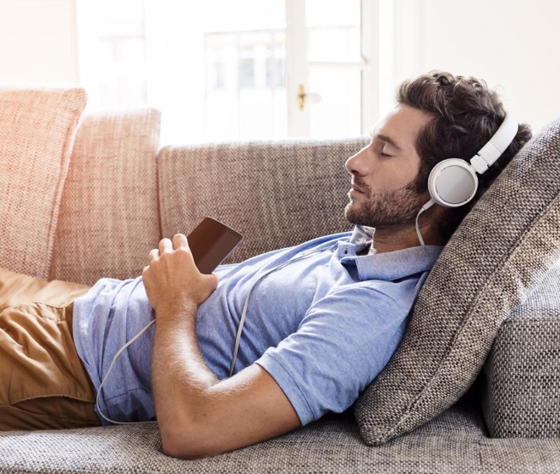
VOCABULARY
leisure (n)
/ˈleʒ.ər/
the time when you are not working or doing other duties

Slide 20
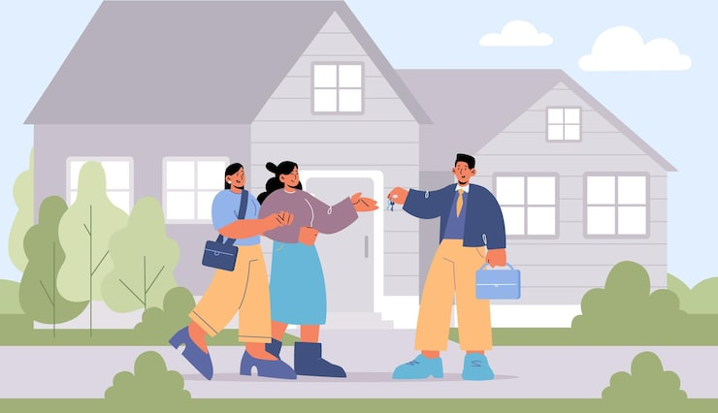
VOCABULARY
resident
/ˈrezɪdənt/
a person who lives or has their home in a place

Slide 21
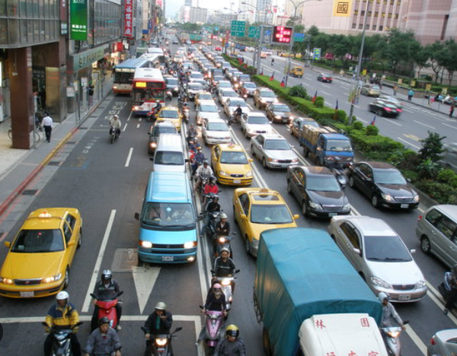
VOCABULARY
rush hour
/ˈrʌʃ ˌaʊər/
the busy part of the day when towns and cities are crowded, either in the morning when people are travelling to work, or in the evening when people are travelling home

Slide 22
New words | Pronunciation | Meaning | Vietnamese meaning
urban (a) | /ˈɜ:bən/ | of or in a city or town | Thuộc về đô thị
urbanisation (n) | /ˌɜːbənaɪˈzeɪʃən/ | the process of population concentration in cities and the transformation of rural land for urban use | Đô thị hoá
expand (v) | /ɪkˈspænd/ | to increase in size, number, or importance, or to make something increase in this way | Mở rộng (về diện tích)
housing (n) | /ˈhaʊzɪŋ/ | buildings for people to live in | Nhà ở

Slide 23
New words | Pronunciation | Meaning | Vietnamese meaning
leisure (n) | /ˈleʒər/ | the time when you are not working or doing other duties | Sự giải trí, thư giãn
resident (n) | /ˈrezɪdənt/ | a person who lives or has their home in a place | Người dân
rush hour (n) | /ˈrʌʃˌou(ə)r/ | the busy part of the day when towns and cities are crowded, either in the morning when people are travelling to work, or in the evening when people are travelling home | Giờ cao điểm

Slide 24
MATCHING GAME

Slide 25

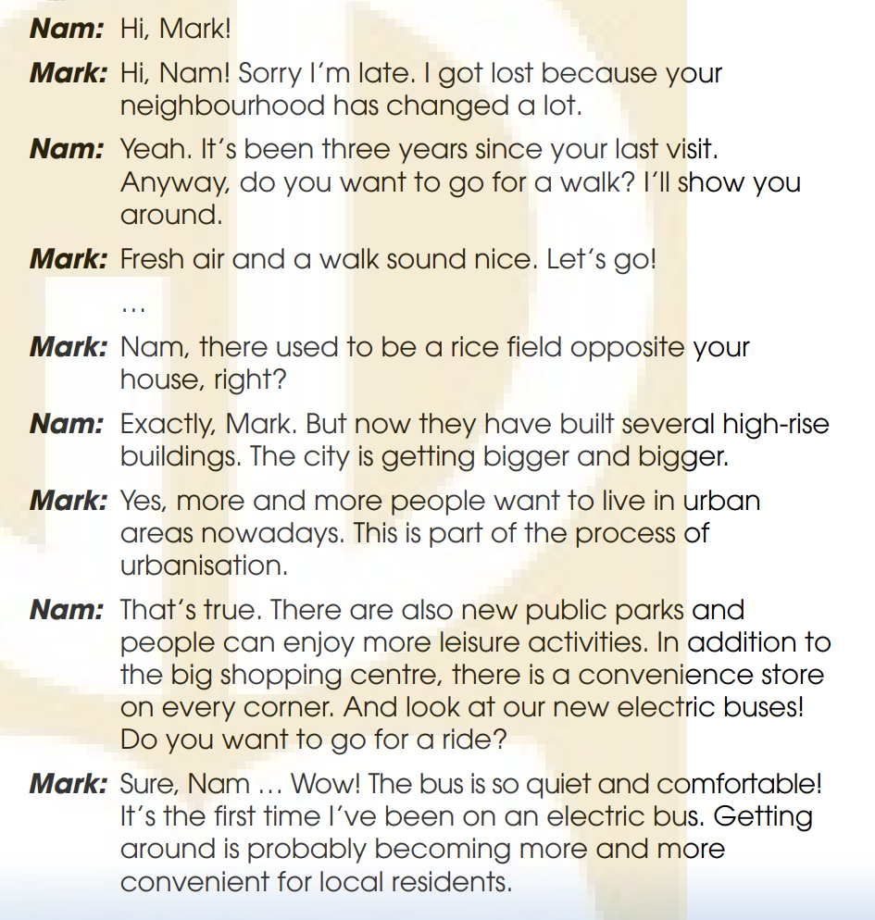
PRACTICE
1
Listen and read.

Slide 26
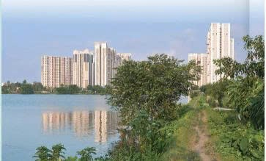
PRACTICE
1
Listen and read.
Questions:
- What can you see in the picture?
- What do you think the land was used for in the past?
Suggested answers:
- blocks of flats/ high-rise buildings.
- for growing rice and vegetables/ farming

Slide 27
PRACTICE
2
Nam: Hi, Mark!
Mark: Hi, Nam! Sorry, I’m late. I got lost because your neighborhood has changed a lot.
Nam: Yeah. It’s been three years since your last visit.
Anyway, do you want to go for a walk? I’ll show you
around.
Mark: Fresh air and a walk sound nice. Let’s go!
…
Mark: Nam, there used to be a rice field opposite your house, right?
Nam: Exactly, Mark. But now they have built several high-rise
buildings. The city is getting bigger and bigger
True or False.
 | T | F
1. The last time Mark visited Nam’s place was three years ago.
2. There used to be a park opposite Nam’s house.
✓
✓
There used to be a rice field

Slide 28
PRACTICE
Nam: That’s true. There are also new public parks and
people can enjoy more leisure activities. In addition to
the big shopping centre, there is a convenience store
on every corner. And look at our new electric buses!
Do you want to go for a ride?
Mark: Sure, Nam … Wow! The bus is so quiet and comfortable!
It’s the first time I’ve been on an electric bus. Getting
around is probably becoming more and more
convenient for local residents.
Nam: Not really. The more crowded the area becomes, the worse traffic jams get, especially during rush hour. The cost of living is also going up. These are the changes that I don’t like.
Mark: That’s true, Nam. I guess urbanization
can also cause problems.
2
True or False.
 | T | F
3. There aren’t any new leisure or shopping facilities in Nam’s neighbourhood
4. Traffic jams and rising cost of living are the two problems that Nam mentioned
✓
There are also new public parks and a convenience store
✓

Slide 29

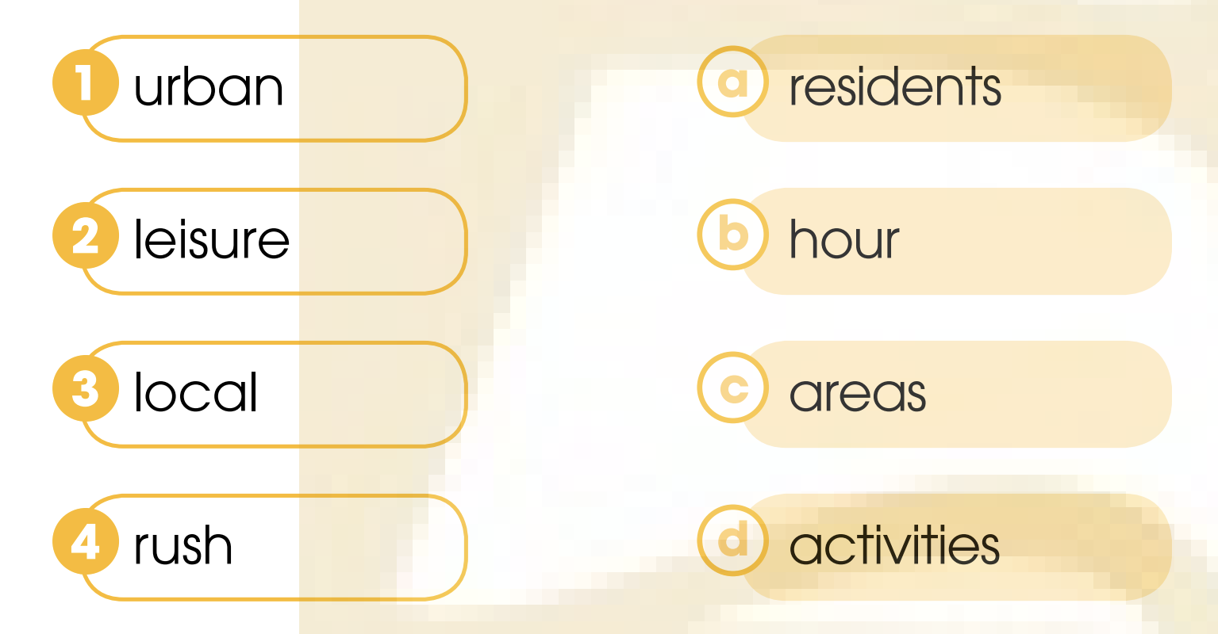
PRACTICE
3
Match the words to make phrases mentioned in 1.

Slide 30


PRACTICE
4
Complete the sentences using words and a phrase from 1.
They ________ several high-rise buildings opposite Nam’s house.
The city where Nam lives is getting ________________ .
_______________Mark has been on an electric bus.
________ crowded the area becomes, ________ traffic jams get.

Slide 31
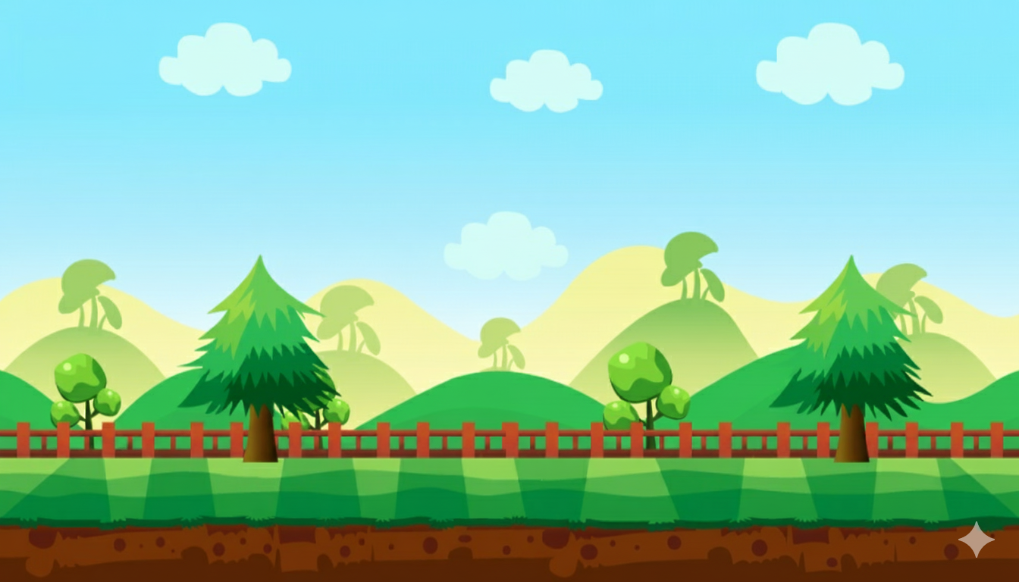


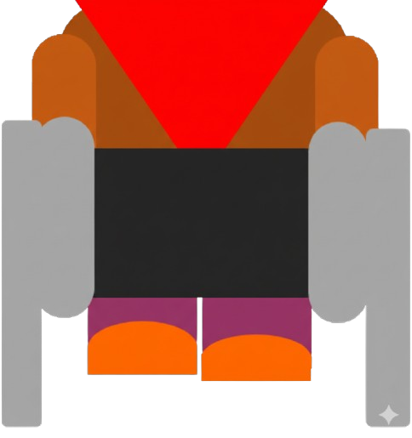

GOLD MINING
PLAY

Slide 32
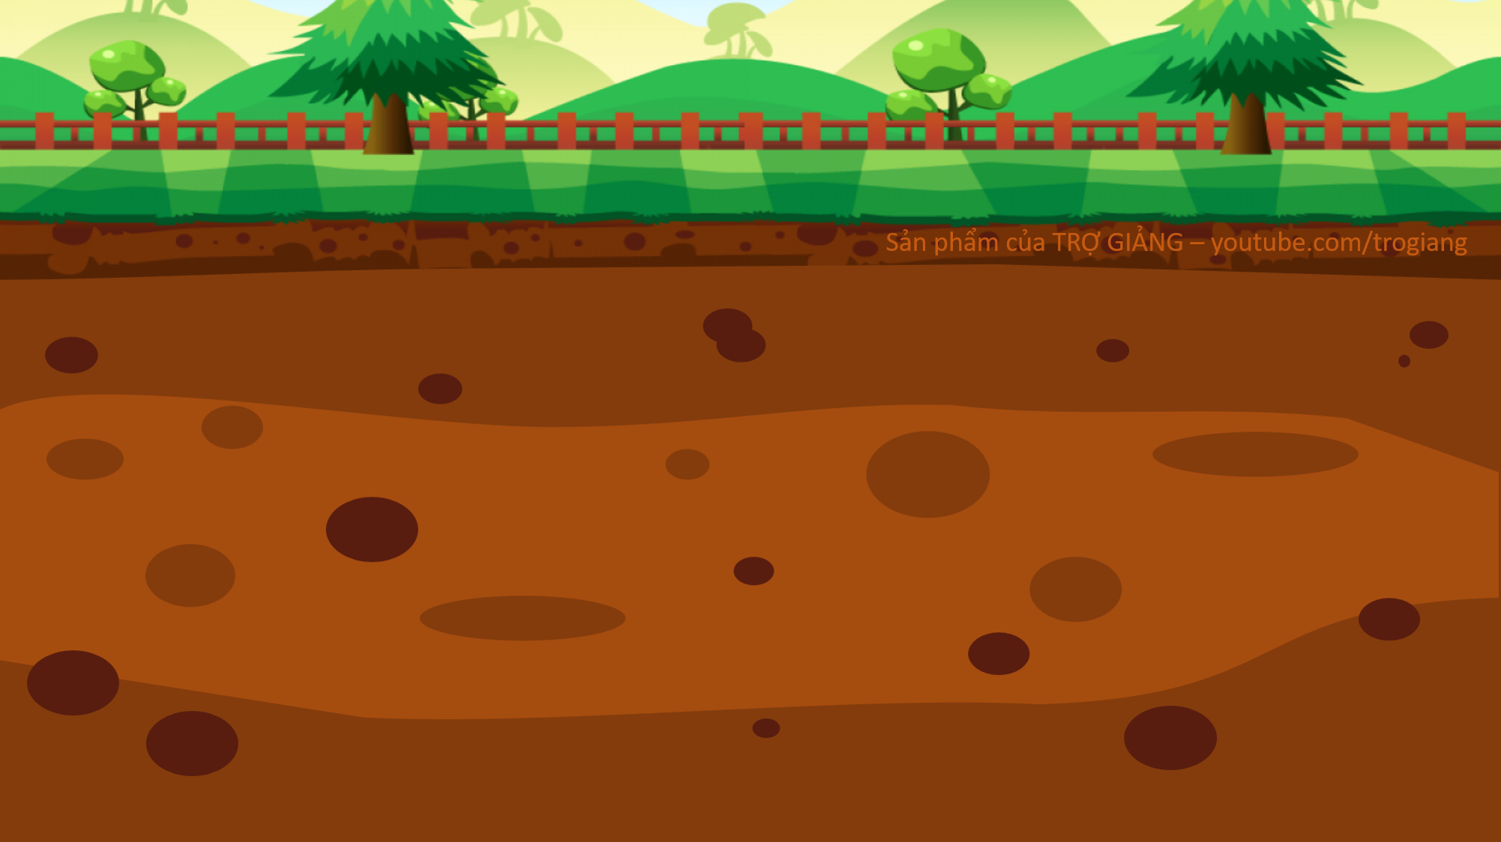






100$
150
50$
20$
100$
10$
150$
50$
20$

Slide 33

They ________ several
high-rise buildings opposite Nam’s house.
have built
BACK

Slide 34
2. The city where Nam lives is getting _______________.
bigger and bigger
BACK

Slide 35
3. _____________ Mark has been on an electric bus
It’s the first time
BACK

Slide 36
4. _______ crowded the area becomes, ________ traffic jams get.
The more
the worse
BACK

Slide 37
PRACTICE
4
Complete the sentences using words and a phrase from 1.
Nam: Exactly, Mark. But now they have built several high-rise buildings.
The city is getting bigger and bigger.
They ________ several
high-rise buildings opposite Nam’s house.
have built
2. The city where Nam lives is getting ________________ .
bigger and bigger

Slide 38

PRACTICE
4
Complete the sentences using words and a phrase from 1.
Mark: Sure, Nam … Wow! The bus is so quiet and comfortable! It’s the first time I’ve been on an electric bus. Getting around is probably becoming more and more convenient for local residents.
Nam: Not really. The more crowded the
area becomes, the worse traffic jams
get, especially during rush hour. The
cost of living is also going up. These
are the changes that I don’t like.
It’s the first time
3. _______________Mark has been on an electric bus.
The more
4. ________ crowded the area becomes, ________ traffic jams get.
the worse

Slide 39
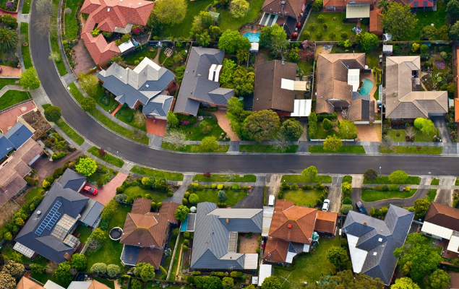


PRODUCTION
Role-play
Work in pairs.
Student A has just returned to the neighborhood. You don’t know much about the area because everything has changed. You ask for more information about the town.
Student B poses as a local to introduce the neighborhood.
5 minutes to prepare for the role play.
3 minutes for each performance.

Slide 40
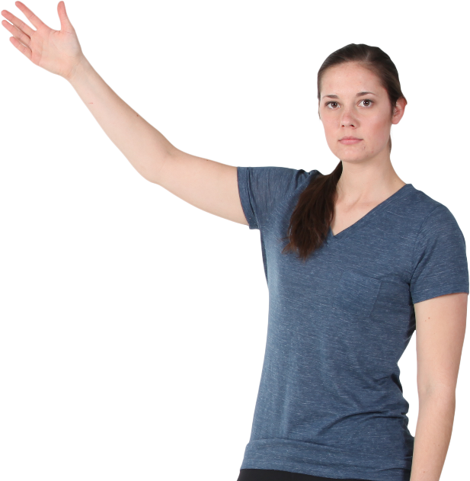
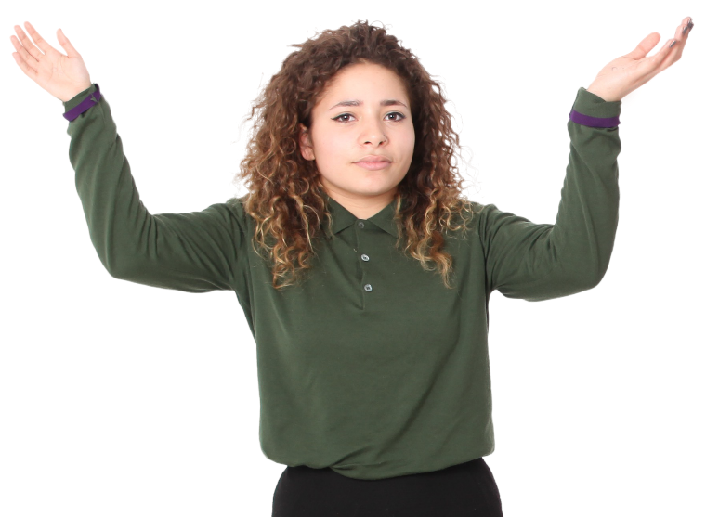

Role-play
PRODUCTION
Excuse me! Could you help me? I got lost because the neighbourhood has changed a lot.
What can I do for you?
Can you show me the way to the nearest bus stop? It used to be here three years ago, but I can’t find it now.
It was relocated to the corner of Cach Mang Thang Tam street and Bac Hai street last year. That place is now a busy street. Things has changed rapidly.
I guess this is part of the process of urbanisation. Thank you. You are so reliable.
You’re welcome!

Slide 41

CONSOLIDATION
1
Wrap-up
What have you learnt today?
More knowledge about Urban Development
Reading for specific information

Slide 42



Multiple - choice questions

Slide 43

Question 1: It is found that higher temperatures go with____________ urbanisation rates.
A. higher
B. bigger
C. big
D. high
NEXT

Slide 44
Question 2: Urbanisation can affect__________ for different types of commodities and services.
A. need
B. demand
C. habit
D. want
NEXT

Slide 45
Question 3: Population density can be____________ in tall buildings.
A. accomodated
B. lived
C. contained
D. put
NEXT

Slide 46
Question 4: Poor ____ can lead to a number of impacts of urbanisation.
A. crowd
B. quantity
C. quality
D. infrastructure
NEXT

Slide 47
Question 5: High-density cities can ____ water supplies.
A. improve
B. devalue
C. hold
D. degrade
quality

Slide 48
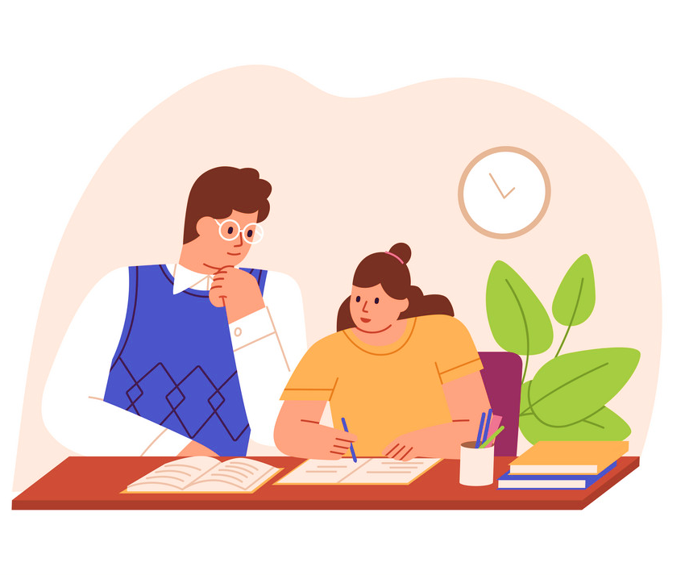
CONSOLIDATION
2
Homework
Learn by heart new vocabulary.
Do exercises in the workbook.
Prepare for Lesson 2 - Unit 4.
Prepare for the Project (Lesson 8).

Slide 49
THANKS FOR YOUR ATTENTION

