Slide 1
6TH GRADE
A SOCIAL AWARENESS CLUB MEETING
LESSON I – GETTING STARTED
Unit
9
SOCIAL ISSUES
FAMILY LIFE
Unit

Slide 2

WARM UP

Slide 3
CHOOSE THE CORRECT ISSUE
Rules:
Students work in 4 groups
There are some news headlines, pictures and short clips about social issues.
Raise your hands and give the correct names of the issues.

Slide 4


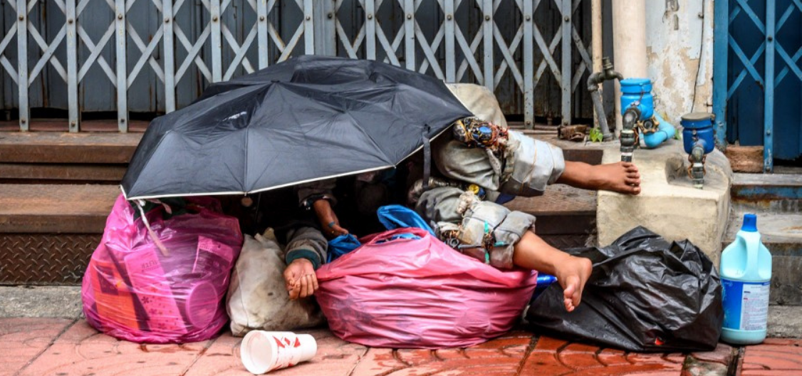
Find the correct name of the issue.
1
Gender inequality
Climate Change
Childhood obesity
Homelessness

Slide 5
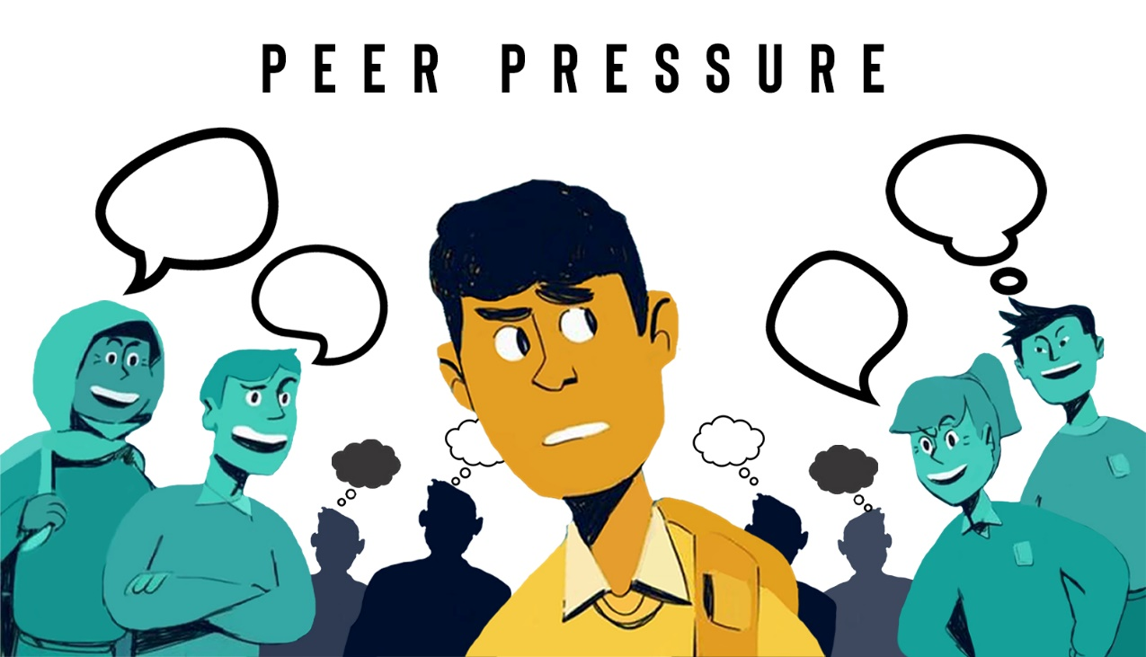
Find the correct name of the issue.
2
knowledge that something exists, or understanding of a situation
criticism of someone based on the shape, size, or appearance of their body
the strong influence of a group, especially of children
hurt or frighten someone

Slide 6
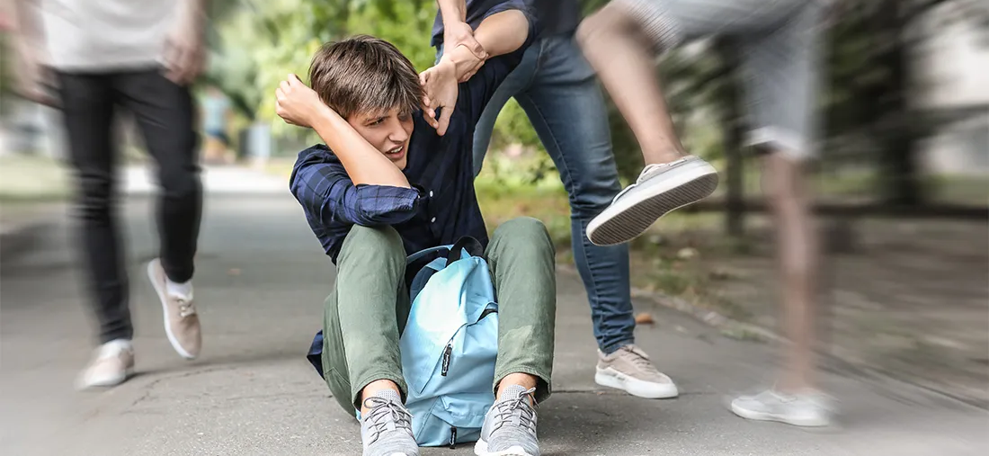
Find the correct name of the the issue.
3
School violence
Health care availability
Gender inequality
Overpopulation

Slide 7

Find the correct name of the the issue.
4
Climate change
Childhood obesity
Homelessness
Gender inequality

Slide 8

Find the correct name of the issue.
5
hurt or frighten someone
the strong influence of a group, especially of children
knowledge that something exists, or understanding of a situation
criticism of someone based on the shape, size, or appearance of their body

Slide 9

Find the correct name of the issue.
6
Climate change
Vocalnic eruption
Overpopulation
Ice melting

Slide 10
6TH GRADE
A SOCIAL AWARENESS CLUB MEETING
LESSON I – GETTING STARTED
Unit
9
SOCIAL ISSUES
FAMILY LIFE
Unit

Slide 11
LESSON I
GETTING STARTED
WARM-UP
Quiz
PRESENTATION
Vocabulary
Task 1: Listen and read.
Task 2: Tick (✓) the correct box.
Task 3: Find five social issues.
Task 4: Complete the summary.
PRACTICE
PRODUCTION
Discussion
CONSOLIDATION
Wrap-up
Homework

Slide 12
VOCABULARY

Slide 13


VOCABULARY
awareness (n)
/əˈweənəs/
knowledge that something exists, or understanding of a situation or subject at the present time based on information or experience

Slide 14

VOCABULARY
campaign (n)
/kæmˈpeɪn/
a planned group of especially political, business, or military activities that are intended to achieve a particular aim

Slide 15
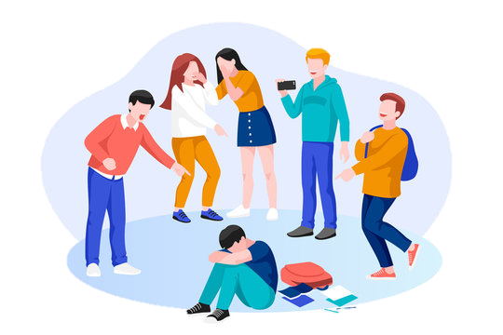
VOCABULARY
bully (v)
/ˈbʊl.i/
to hurt or frighten someone, often over a period of time, and often forcing that person to do something they do not want to do

Slide 16

VOCABULARY
peer pressure (n)
/ˈpɪə ˌpreʃər/
the strong influence of a group, especially of children, on members of that group to behave as everyone else does

Slide 17
VOCABULARY
body shaming (n)
/ˈbɒdi ˌʃeɪmɪŋ/
criticism of someone based on the shape, size, or appearance of their body

Slide 18


VOCABULARY
crime (n)
/kraɪm/
an action or activity that is against the law, or illegal activity generally

Slide 19
VOCABULARY
Form | Pronunciation | Meaning
1. awareness (n) | /əˈweənəs/ | sự nhận thức
2. campaign (n) | /kæmˈpeɪn/ | chiến dịch
3. bully (v) | /ˈbʊli/ | bắt nạt
4. peer pressure (n) | /ˈpɪə ˌpreʃər/ | áp lực đồng trang lứa
5. body shaming (n) | /ˈbɒd.i ˌʃeɪmɪŋ/ | miệt thị ngoại hình
6. crime (n) | /kraɪm/ | tội phạm

Slide 20
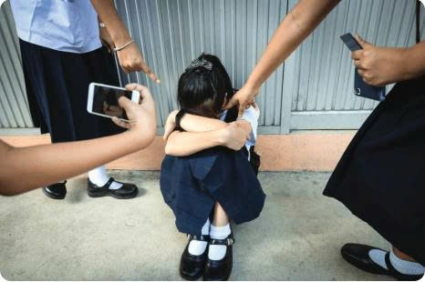
PRESENTATION
1
Listen and read.
1. Why is the girl in school uniform hiding her face?
→ Because she is feeling helpless and frightened.
2. What are the other people around her doing?
→ Taking photos and poking her.

Slide 21
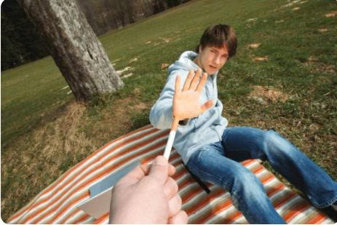
PRESENTATION
1
Listen and read.
3. Why is the boy saying no?
→ He doesn’t want to smoke.

Slide 22
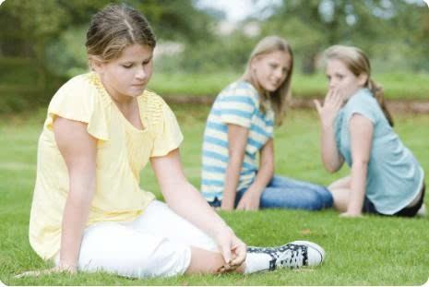
PRESENTATION
1
Listen and read.
4. Why is the girl in casual clothes looking sad?
→ Because her friends are talking behind her back.
5. Is this behaviour acceptable?
→ No, it’s bullying.

Slide 23
1
Listen and read.
Mark: Hi, everyone. Last time our club met, we decided to start an awareness campaign to draw attention to a pressing social issue. So have you thought about any issues that we could focus on?
Mai: Yes, I think we should promote issues that affect a lot of people in our city, such as crime and overpopulation.
Nam: I like your ideas, Mai, but I think we should plan our campaign around social issues that directly affect teenagers like us.
Mark: Can you give us some examples?
Nam: Well, bullying, peer pressure, and body shaming, for instance, are major problems among teenagers today although many people don’t feel comfortable talking about them.
Mai: I agree with you. Hmm... so Mark, what do you think? Should we focus our campaign on a general social issue or one affecting mainly teens?
Mark: Hmm. I think this time we should focus on a problem teens struggle with every day because this won't be a big campaign. However, we'll try to use your ideas for another project, Mai.
Mai: Sounds good! Now let’s decide on a social issue. Is the top problem facing teens today peer pressure, body shaming, or bullying?
Nam: I think it’s bullying because it’s very common today, and ...

Slide 24
EXERCISE

Slide 25
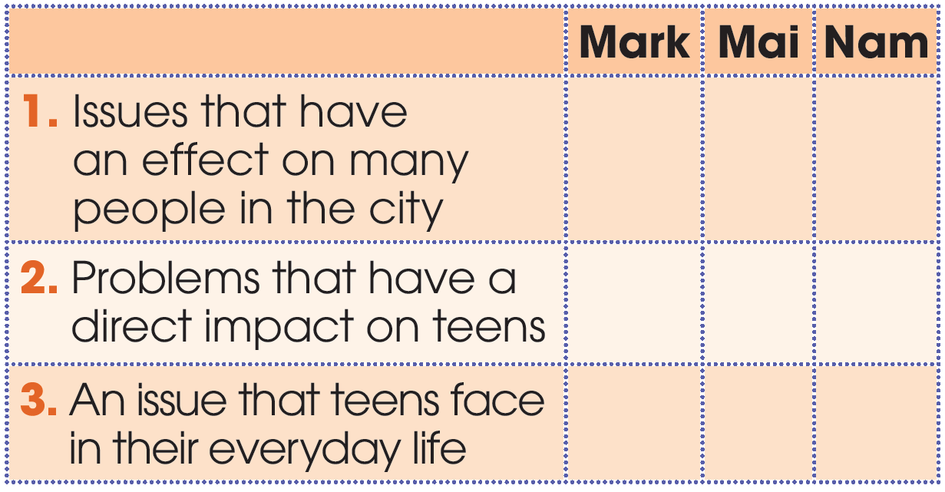
PRACTICE
2
Who suggests the following ideas? Tick (✓) the correct box.

Slide 26


Slide 27
PRACTICE
2
Who suggests the following ideas? Tick (✓) the correct box.
✓
Yes, I think we should promote issues that affect a lot of people in our city, such as crime and overpopulation.

Slide 28
PRACTICE
2
Who suggests the following ideas? Tick (✓) the correct box.
I like your ideas, Mai, but I think we should plan our campaign around social issues that directly affect teenagers like us.
✓

Slide 29
PRACTICE
2
Who suggests the following ideas? Tick (✓) the correct box.
Hmm. I think this time we should focus on a problem teens struggle with every day because this won't be a big campaign.
✓
✓

Slide 30
PRACTICE
2
Who suggests the following ideas? Tick (✓) the correct box.
✓
✓
✓
✓

Slide 31

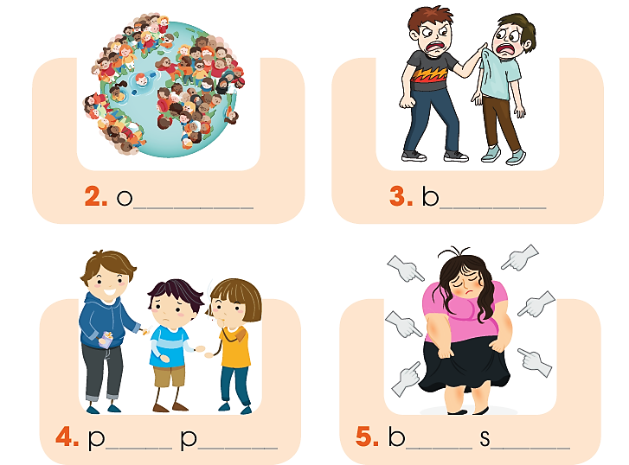
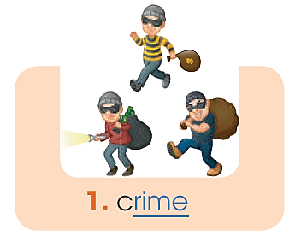
PRACTICE
3
Find five social issues in 1. Use the pictures and hints below to help you.

Slide 32


Slide 33

GUESS THE WORDS
overpopulation
_ _ _ _ _ _ _ _ _ _ _ _ _ _
14 letters

Slide 34
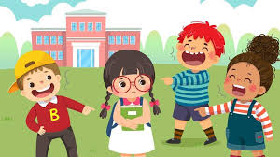
GUESS THE WORDS
bullying
_ _ _ _ _ _ _ _
8 letters

Slide 35

GUESS THE WORDS
peer pressure
_ _ _ _ _ _ _ _ _ _ _ _
12 letters

Slide 36
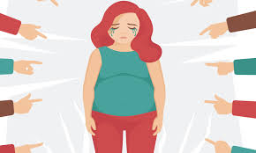
GUESS THE WORDS
body shaming
_ _ _ _ _ _ _ _ _ _ _
11 letters

Slide 37
PRACTICE
3
Find five social issues in 1. Use the pictures and hints below to help you.
verpopulation
ullying
eer
ressure
ody
haming

Slide 38
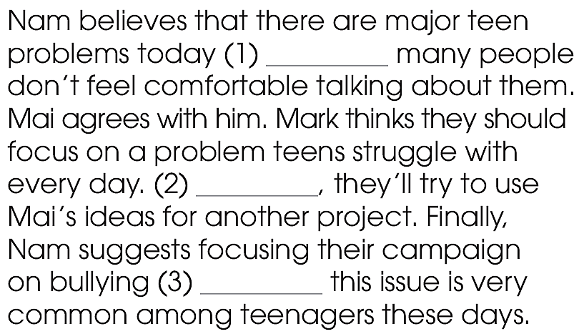
PRACTICE
4
Complete the summary with words from 1.
although
However
because

Slide 39
DISCUSSION

Slide 40

PRACTICE
5
Discussion
Can you think of other social issues that directly affect teenagers?
What can we do to stop them or help the victims?

Slide 41
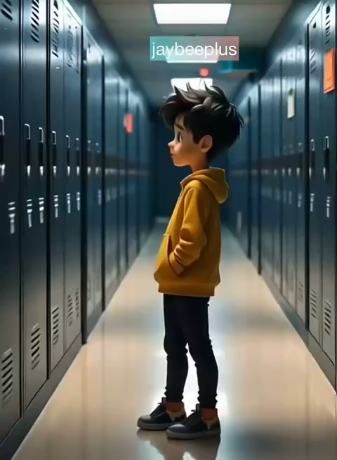
Watch the video and answer the questions

Slide 42
Teacher need training to recognize and address bullying behaviour effectively
Strong social support system helps victims feel safer and more secure
What can we do to stop bullying or help the victims?
Parents should maintain open communication with children about bullying experiences.
School can implement anti-bullying programs and awareness campaigns

Slide 43
1. WRAP-UP
CONSOLIDATION
What have you learnt today?
Use appropriate intonation in choice questions.
Understand and use words and phrases related to social issues.

Slide 44
Complete the sentences using the words in the box.
1. Many cities are facing the problem of _____________ as more people are moving to large urban areas.
2. We should help the police to fight _____ if we want to live in a safe neighbourhood.
3. The best way to stop ____________ is to accept differences in size and shape.
4. When my brother started coming home with bruises on his arms and legs, my parents thought he was a victim of physical ______.
overpopulation | body shaming | poverty | crime
bullying | peer pressure | depression | alcohol
overpopulation
crime
body shaming
bullying

Slide 45
Complete the sentences using the words in the box.
5. The police found out that the taxi driver had drunk ______ before the accident.
6. The increasing number of young people suffering from ________ is worrying.
7. I don't say no to ___________ because I want to try the things that my friends are doing.
8. We often organise charity events to raise money for people living in _______.
overpopulation | body shaming | poverty | crime
bullying | peer pressure | depression | alcohol
alcohol
depression
peer pressure
poverty

Slide 46
2. HOMEWORK
CONSOLIDATION
Do exercises in the workbook.
Prepare for Lesson 2 - Unit 9.
Prepare materials for the project in lesson 8

