Slide 1
WELCOME TO OUR CLASS

Slide 2

WARM UP

Slide 3
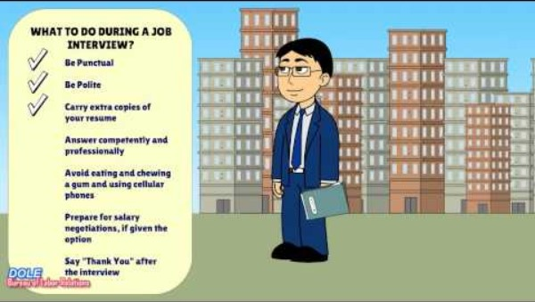
Notes:
https://www.youtube.com/watch?v=ep-w4mzXMa0&t=3s

Slide 4
DISCUSSION ON DIFFERENT CAREERS
UNIT 9
Career paths
LESSON 4
SPEAKING

Slide 5
LESSON 4
SPEAKING
WARM-UP
Quiz
Vocabulary
Task 1: Complete the information.
CONTROLLED PRACTICE
LESS-CONTROLLED PRACTICE
Task 2: Discuss and complete information
Task 3: Compare the job in Task 1 and 2.
CONSOLIDATION
Wrap-up
Homework

Slide 6

1. What is the recommended time to arrive for a job interview?
5 minutes early
15 minutes early
On time
30 minutes early

Slide 7
2. How should you dress for a job interview?
Casual attire
Business casual
Formal wear
Professional and conservative

Slide 8
3. What should you do if you don't understand a question during the interview?
Make up an answer
Change the topic
Politely ask for clarification
Pretend you heard and answer vaguely

Slide 9
4. How should you respond to salary negotiation?
Avoid discussing salary
Express disinterest in negotiation
Accept the first offer without discussion
Be prepared to negotiate based on research

Slide 10
5. What is the recommended etiquette regarding cell phones during an interview?
Turn it off
Keep it visible for emergencies
Put it on silent mode
Answer calls discreetly

Slide 11
6. How should you conclude the interview?
Thank the interviewer and express interest
Ask for feedback
Leave without saying anything
Hand over additional resumes

Slide 12
7. Where can you find information about a company before an interview?
Social media
Company website
News articles
All of the above

Slide 13
8. What is the appropriate length for answers during an interview?
Very short
2-3 sentences
As long as necessary
5-10 minutes

Slide 14


apprenticeship (n)
/əˈprentɪsʃɪp/
Thực tập
a period of time working as an apprentice

Slide 15

diploma (n)
/dɪˈpləʊmə/
Bằng cấp
a document given by a college or university to show that you have passed a particular exam or finished your studies

Slide 16

architecture (n)
/ˈɑːkɪtektʃər/
Công trình kiến trúc
the art and practice of designing and making buildings

Slide 17

combine (v)
/kəmˈbaɪn/
to (cause to) exist together, or join together to make a single thing or group
Kết hợp

Slide 18
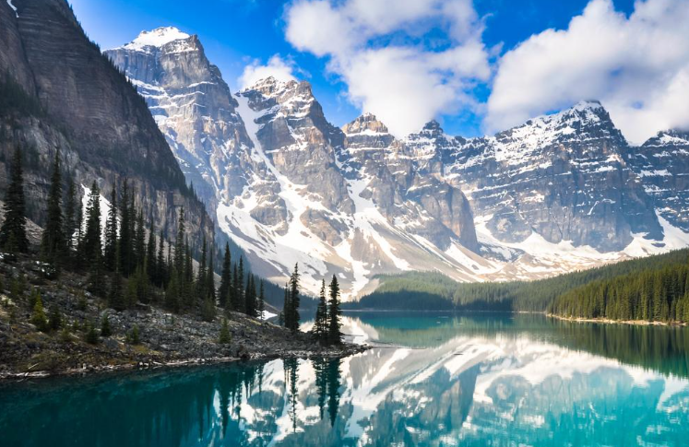
natural sites (n)
/ˈnætʃərəl saɪtz/
Cảnh quan tự nhiên
areas or locations in nature that have distinctive features, ecological significance, or aesthetic value.

Slide 19
VOCABULARY
Form | Pronunciation | Meaning
1. apprenticeship (n) | /əˈprentɪsʃɪp/ | thực tập
2. diploma (n) | /dɪˈpləʊmə/ | bằng
3. architecture (n) | /ˈɑːkɪtektʃər/ | công trình kiến trúc
4. combine (v) | /kəmˈbaɪn/ | kết hợp
5. natural sites (n) | /ˈnætʃərəl saɪtz/ | cảnh quan tự nhiên

Slide 20
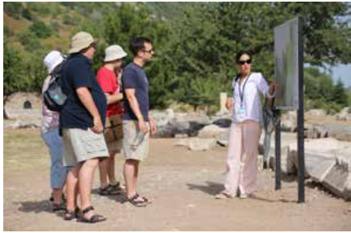
Practice
Use the given ideas to complete the information about the job of a tour guide.
1
A. attend part-time courses or complete an apprenticeship
B. may only be employed in the high season
C. be patient, confident, and able to deal with stressful situations
D. good communication skills

Slide 21
Controlled Practice
Personality and interests: | (1) ____ be interested in culture, history, and architecture
A. attend part-time courses or complete an apprenticeship
B. may only be employed in the high season
C. be patient, confident, and able to deal with stressful situations
D. good communication skills

Slide 22
Practice
Skills and knowledge: | (2)_____ knowledge of the local area: cultural, historical, and natural sites and events knowledge of languages
A. attend part-time courses or complete an apprenticeship
B. may only be employed in the high season
C. be patient, confident, and able to deal with stressful situations
D. good communication skills

Slide 23
Practice
Education and training: | • diploma in travel and tourism is useful, but a degree is not required • (3) ____ • learn on the job
A. attend part-time courses or complete an apprenticeship
B. may only be employed in the high season
C. be patient, confident, and able to deal with stressful situations
D. good communication skills

Slide 24
Controlled Practice
Employment opportunities: | • (4)____ • many tour guides are self-employed or combine tour guiding with another job • might be replaced by robots in the future
A. attend part-time courses or complete an apprenticeship
B. may only be employed in the high season
C. be patient, confident, and able to deal with stressful situations
D. good communication skills

Slide 25
Practice
2
Choose one of these jobs. Discuss and complete information about the job you choose.
To become a teacher of English/police officer/doctor, you need to consider:
*Example:
A: Let’s talk about the job of a doctor. What do you think we need to consider before we pursue this career?
B: Well, I think a doctor’s personality is very important. You must be very kind and care for patients. You must have a passion for helping people.
C: …

Slide 26
Practice
2
Choose one of these jobs. Discuss and complete information about the job you choose.
Personality and interests | _____________ _____________
Skills and knowledge | _____________ _____________
Education and training | _____________ _____________
Employment opportunities | _____________ _____________

Slide 27
Practice
Personality and interests: | be very kind and care for patients have a passion for helping people be interested in health, causes of diseases, and medical science
Skills and knowledge: | soft skills such as good communication, decision-making, time management and teamwork skills technical skills and medical knowledge to assess patient’s condition, prescribe medication, offer treatments, etc.

Slide 28
Practice
Education and training: | study at medical school to get a medical degree complete general medical training where you combine work experience with on-the-job training usually at a hospital complete specialty training in a specialist area of medicine or in general practice
Employment opportunity: | many varied opportunities and different career options there will always be demand for doctors may have a poor work-life balance

Slide 29

Practice
3
Compare the job in 1 with your chosen job in 2. Discuss the similarities and differences and decide which job you prefer and why.

Slide 30
01
Wrap up
CONSOLIDATION
*What have you learnt today?
Discuss the similarities and differences of different careers, and then report to the class.

Slide 31
Homework
CONSOLIDATION
02
Do exercises in the workbook.
Prepare Lesson 5 – Unit 9.

