Slide 1
Unit 11: My home
Lesson 1 - period 1

Slide 2
01
Warm-up

Slide 3
02
Look, listen and repeat.

Slide 4

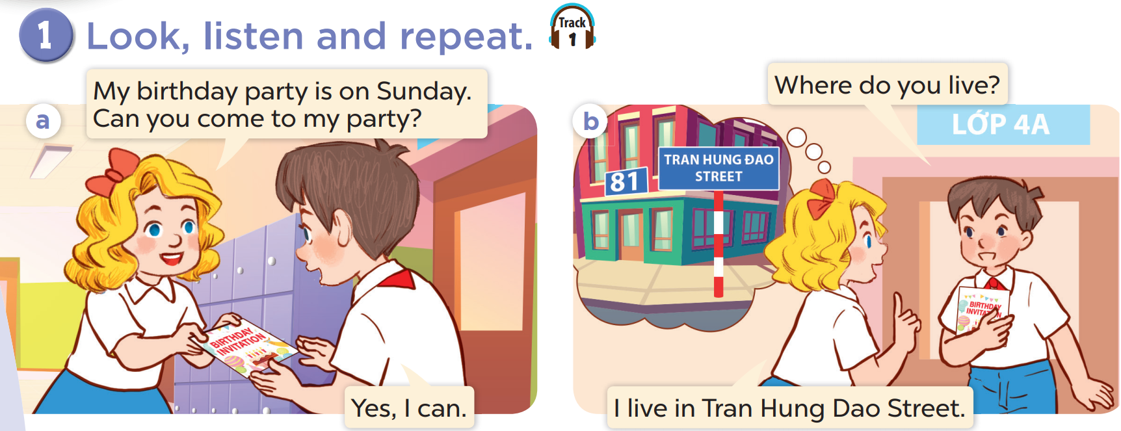

Slide 5
03
Listen, point and say.

Slide 6
vocabulary

Slide 7
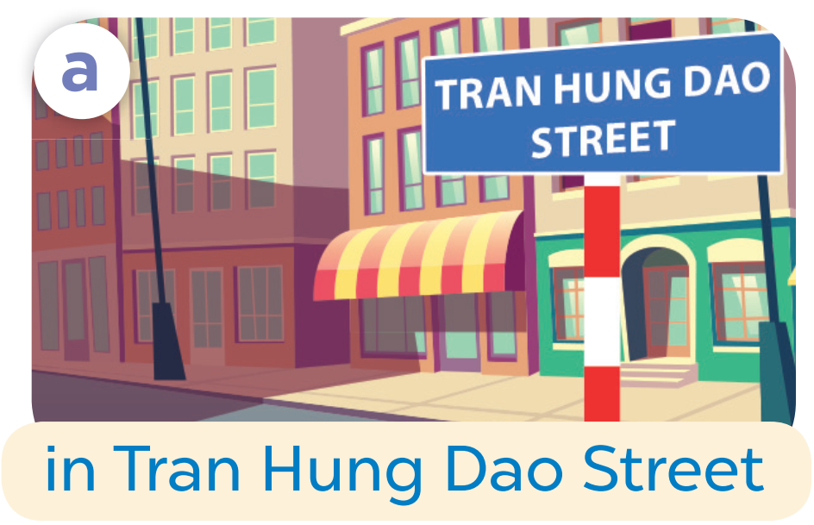

Slide 8


Slide 9
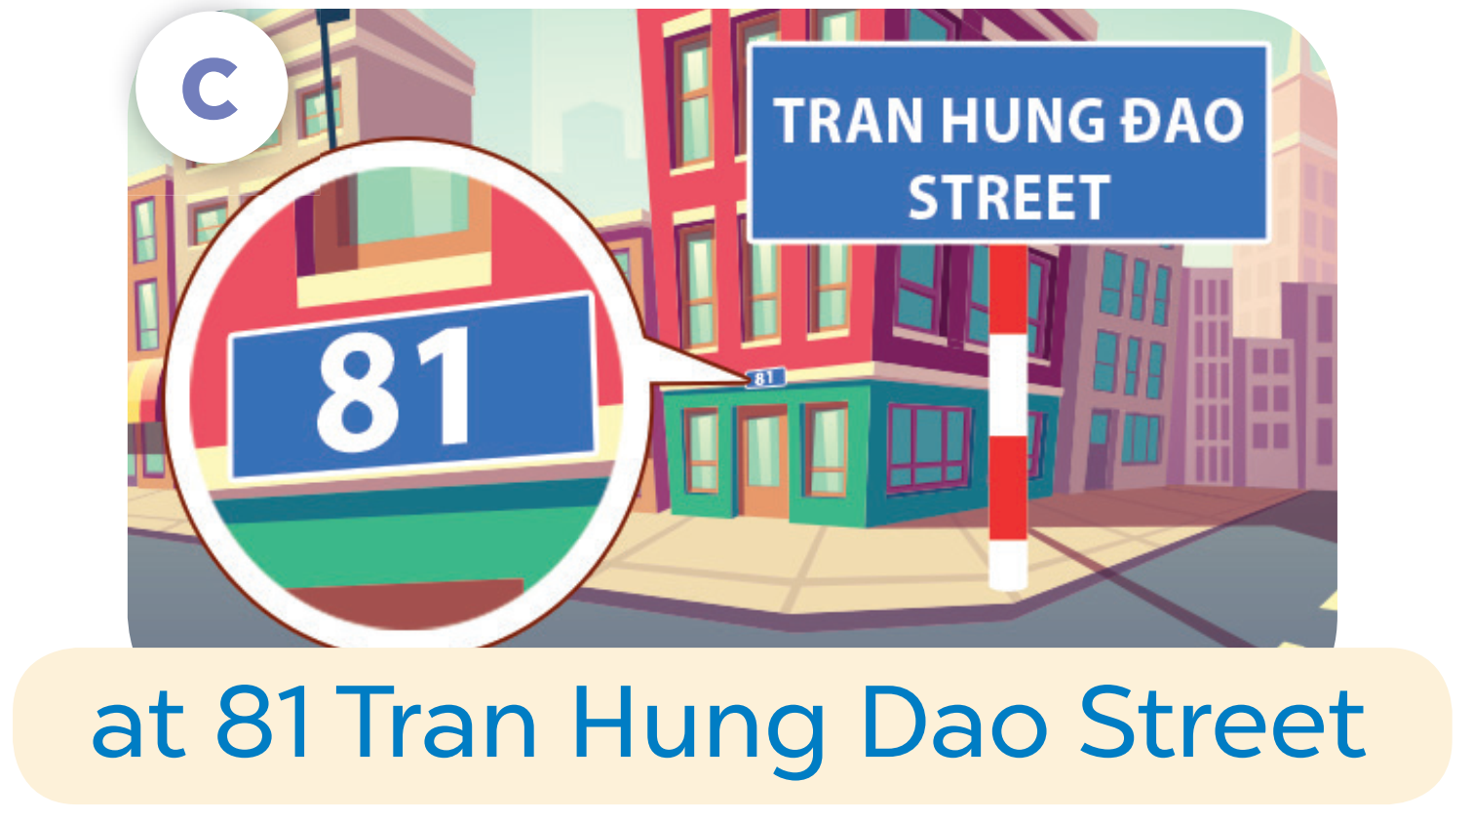

Slide 10
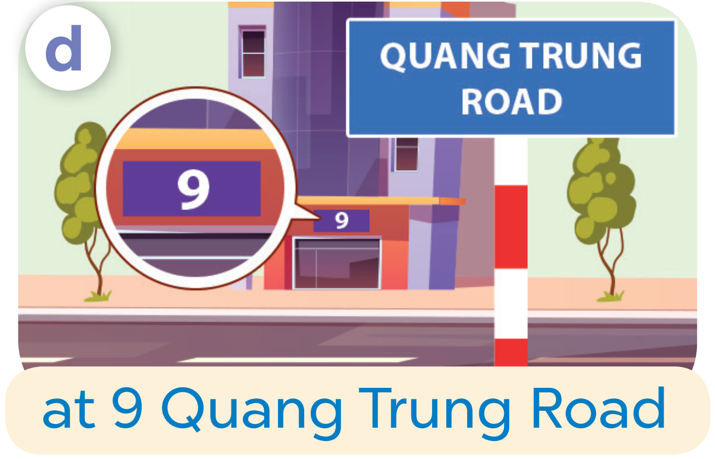

Slide 11
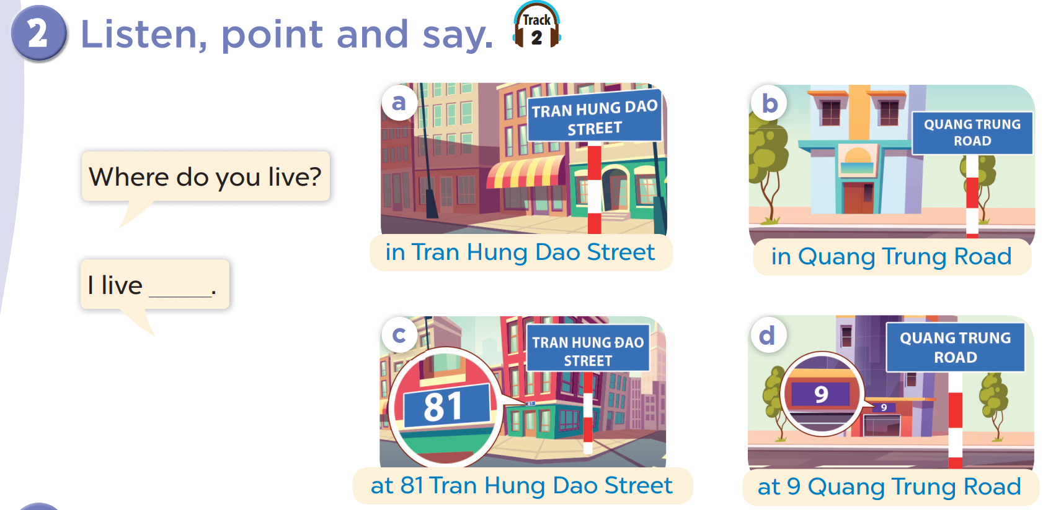

Slide 12
Where do you live?
I live in Tran Hung Dao Street.

Slide 13
04
Let’s talk.

Slide 14
