Slide 1
Unit 11: My home
Lesson 1 - period 2

Slide 2
Table of Contents
01
02
03
04
Listen and tick or cross.
Warm-up
Look, complete and read.
Let’s play.
05
Fun corner & wrap-up

Slide 3
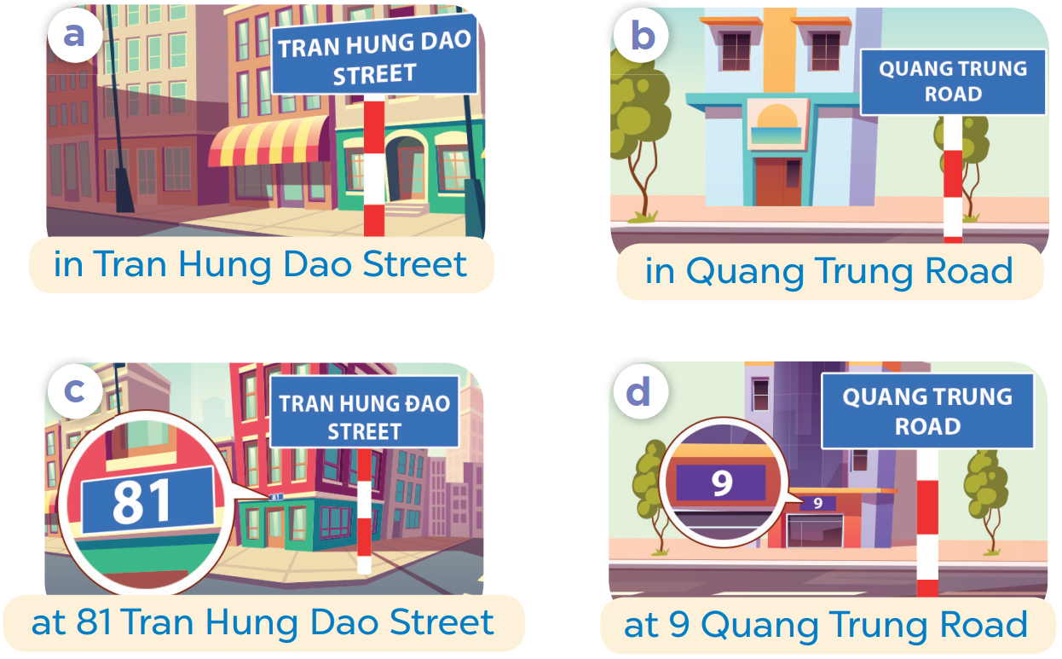
01
Warm-up
SLAP THE BOARD

Slide 4
02
Listen and tick or cross.

Slide 5
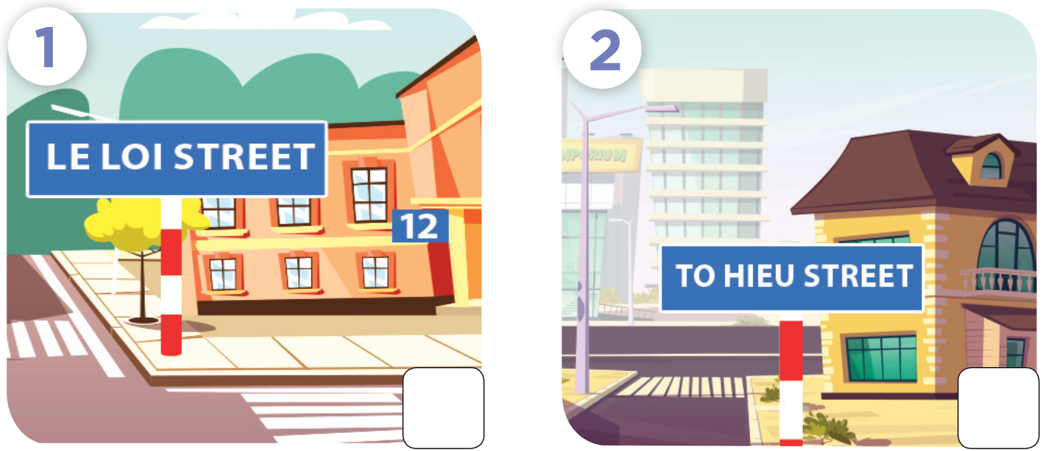

Slide 6
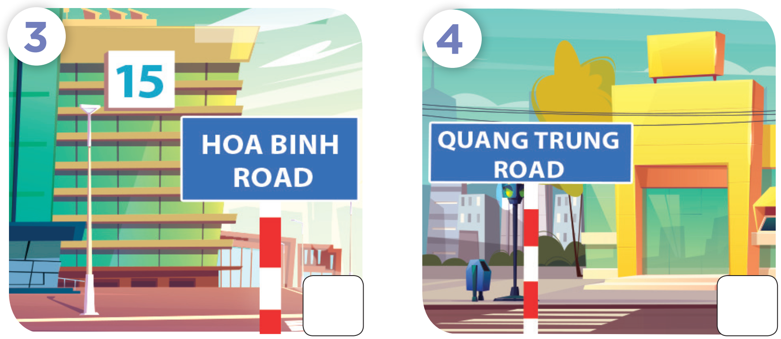

Slide 7
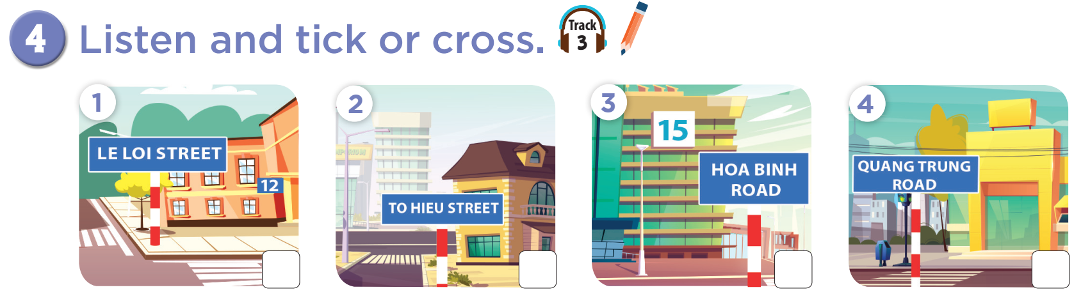


Slide 8



Slide 9
03
Look, complete and read.

Slide 10

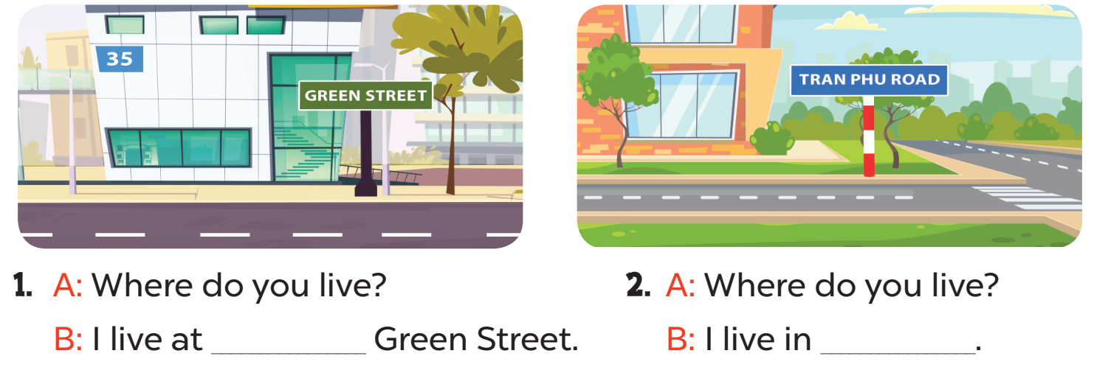
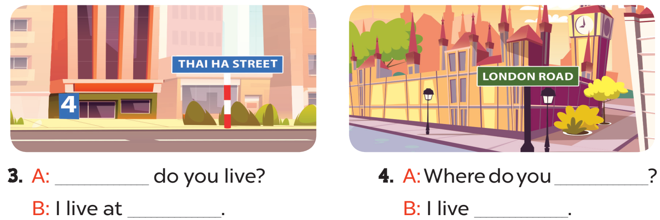

Slide 11
35
Tran Phu Road
Where
live
4 Thai Ha Street
at London Road

Slide 12
04
Let’s play.

Slide 13
