Slide 1



Unit 12: Our Tet holiday
Lesson 1 - Period 1

Slide 2
1
Warm-up
You can enter a subtitle here if you need it

Slide 3
2
Look, listen and repeat.
Activity 1

Slide 4
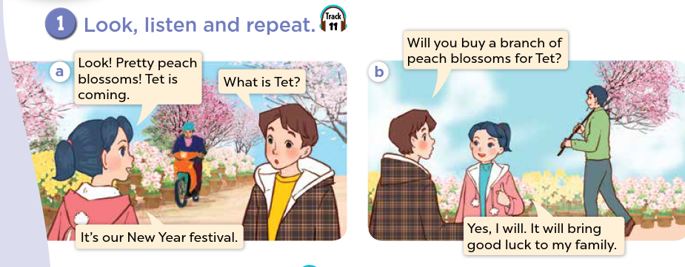
What can you see?
Who are they?
What are they talking about?

Slide 5

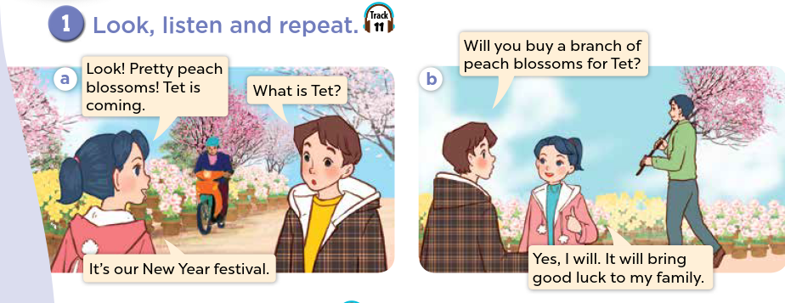
Look, listen and repeat.

Slide 6
3
Listen, point and say.
Activity 2

Slide 7
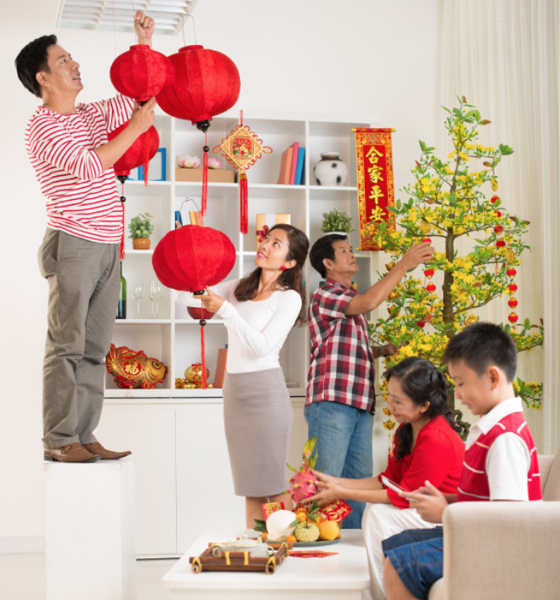
decorate the house

Slide 8

do the shopping

Slide 9
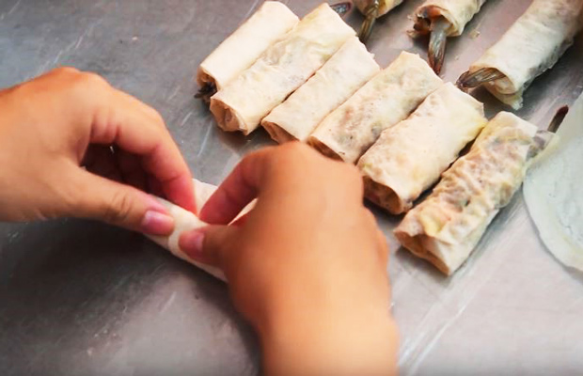
make spring rolls

Slide 10
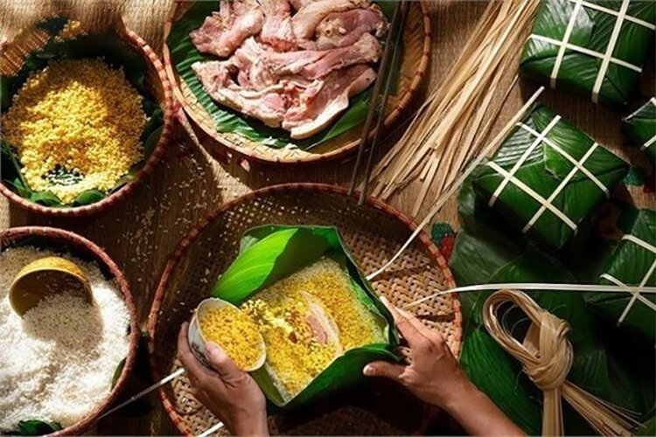
make banh chung

Slide 11
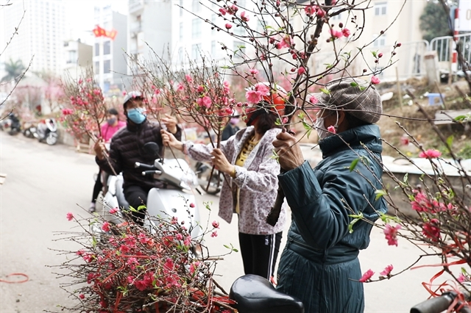
buy a branch of peach blossoms

Slide 12
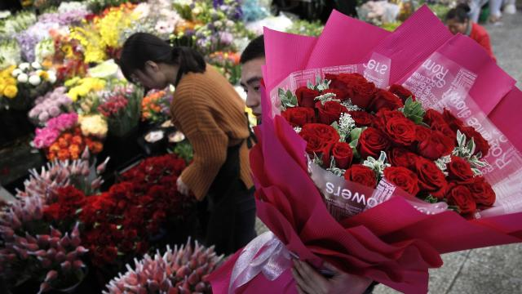
buy roses

Slide 13

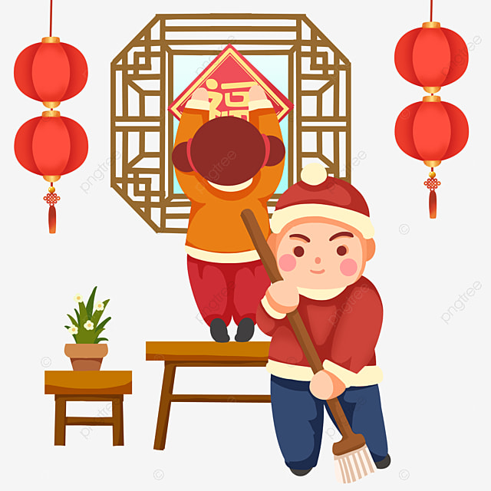


Will you decorate the house?
Yes, I will.

Slide 14
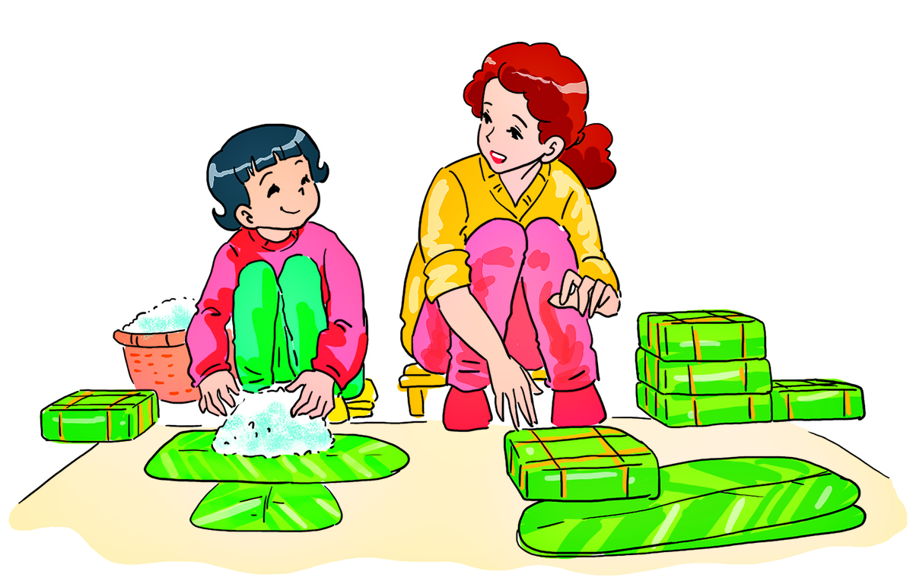

Will you make spring rolls?
No, I won’t. I will make banh chung.

Slide 15
Listen, point and say.

Slide 16
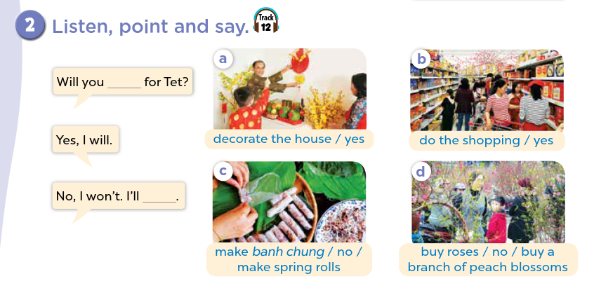

Slide 17
4
Let’s talk.
Activity 3

Slide 18
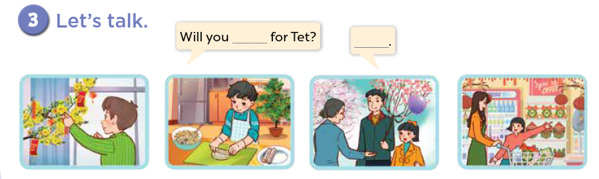

Slide 19
Website: hoclieu.vn
Fanpage: facebook.com/www.tienganhglobalsuccess.vn

