Slide 1



Unit 12: Our Tet holiday
Lesson 1 - Period 2

Slide 2
I.
Warm-up
Make banh chung for Tet.

Slide 3
Activity 4
II.
Listen and tick.

Slide 4
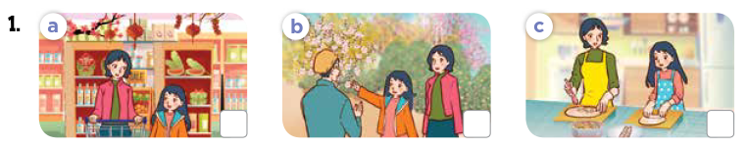
Look at the pictures.
What will they do for Tet?

Slide 5


Listen and tick.

Slide 6
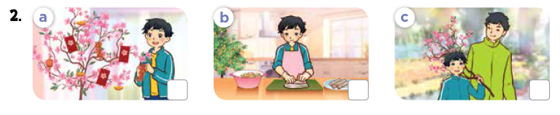
Look at the pictures.
What will they do for Tet?

Slide 7
Listen and tick.


Slide 8
III.
Activity 5
Read and complete.

Slide 9
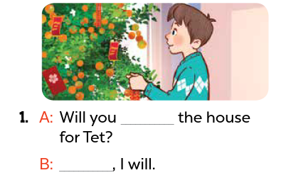
Look at the pictures. What will the boy do?
What are the missing words?
decorate
Yes

Slide 10
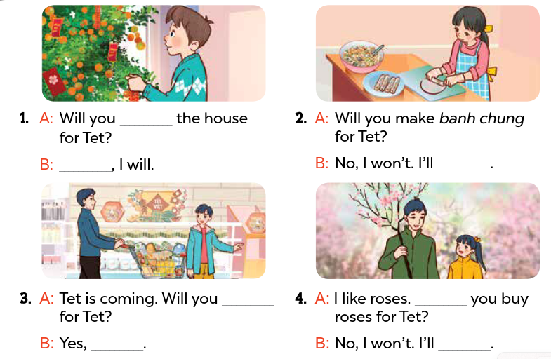
decorate
Yes
make
spring rolls
do the shopping
Will
I will
buy a branch of peach blossoms

Slide 11
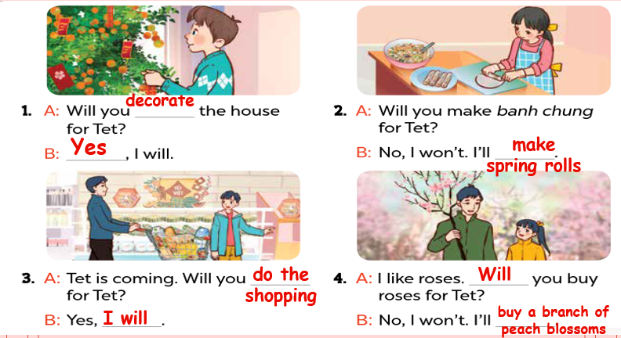
Practice in pairs.
Act it out!

Slide 12
Activity 6
IV.
Let's sing!

Slide 13
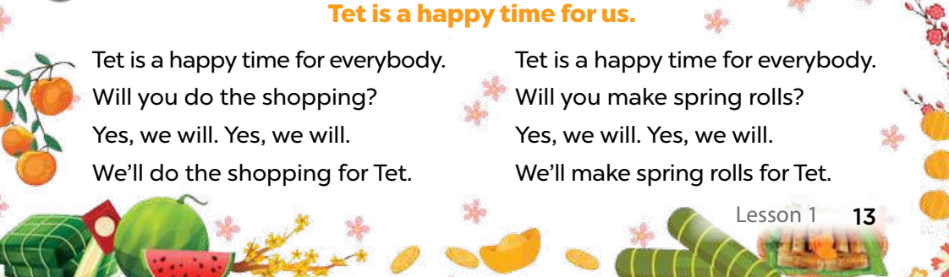
Read the lyrics.

Slide 14
Listen.
Practice line by line.
Sing the song.

Slide 15
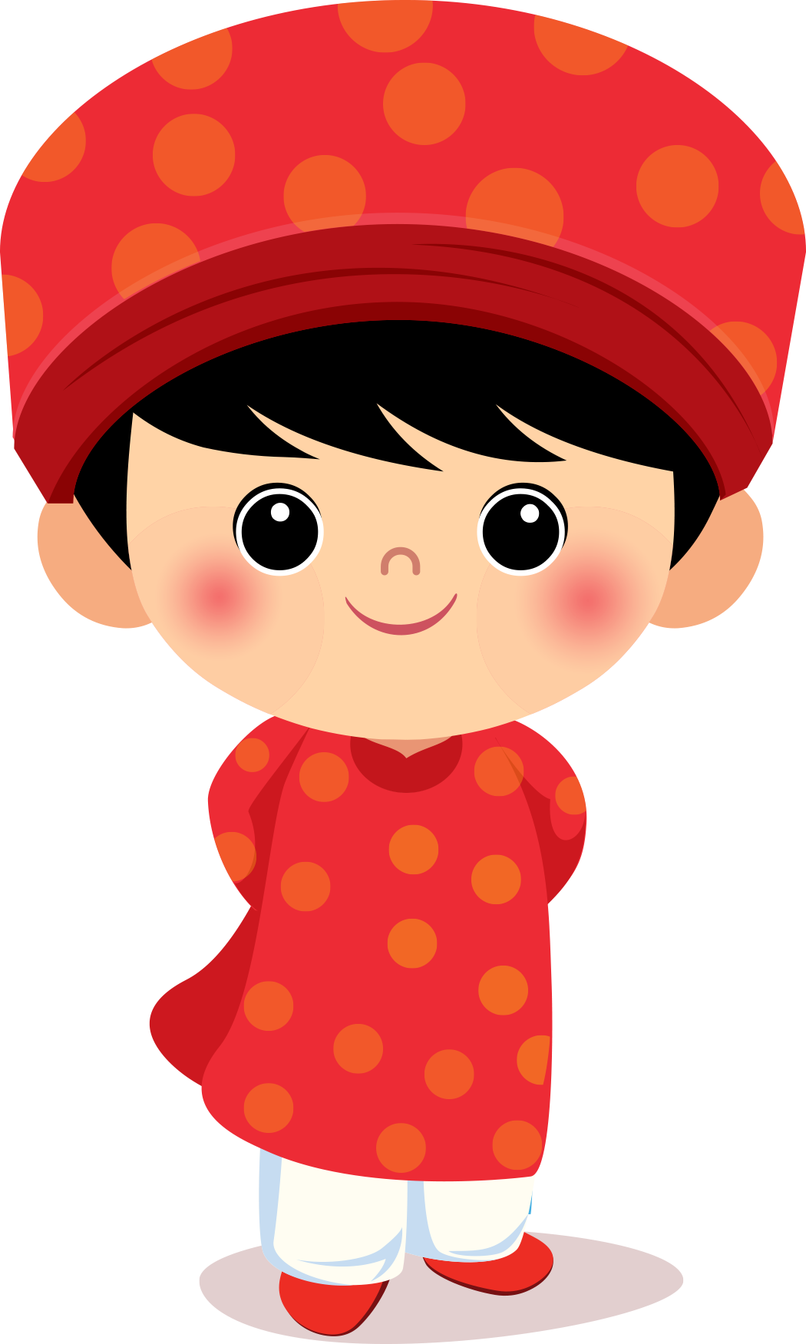
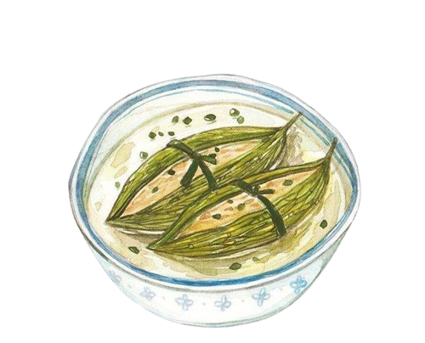
CORRECT!!!
Lan: Will you do the shopping, Dad?
Dad: ______. I'll decorate the house.
A
No, I don't.
B
Yes, I do.
D
No, I won't.
C
Yes, I will.

Slide 16
Thanks

