Slide 1







12
LESSON 2 – Period 3

Slide 2
1
Warm-up and review
Game: Simon says
Notes:
Teacher says “Simon says…” for the pupils to do the actions. When the teacher doesn’t start the sentence with “Simon says”, pupils do nothing.
Who can make it until the end is the winner.

Slide 3
2
Look, listen and repeat.

Slide 4
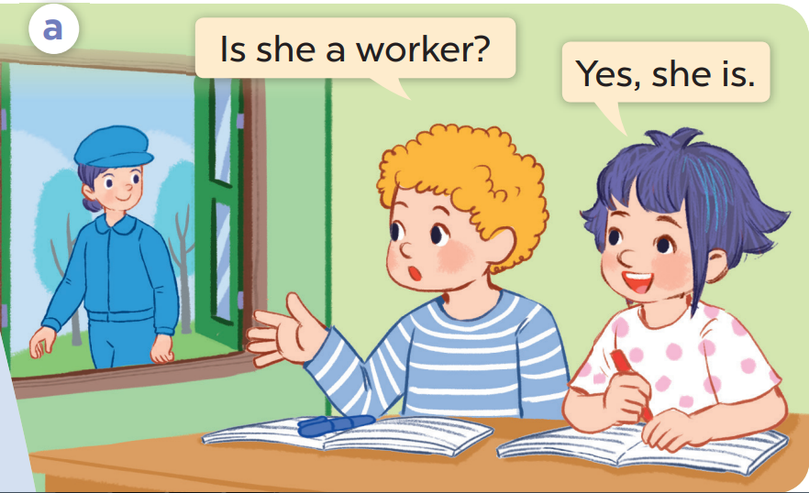
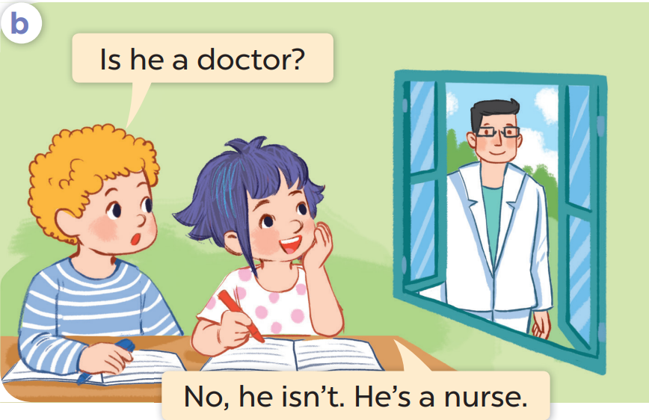

Slide 5


Slide 6
3
Listen, point and say.

Slide 7
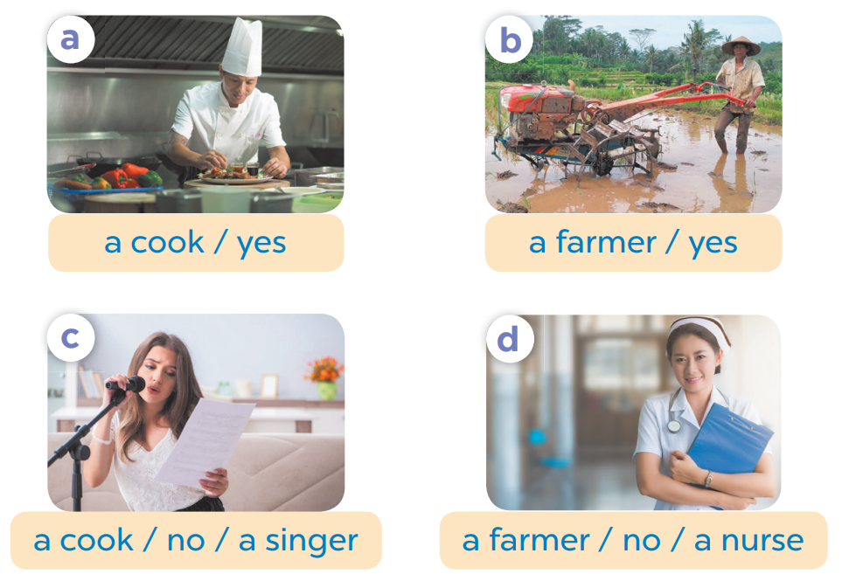
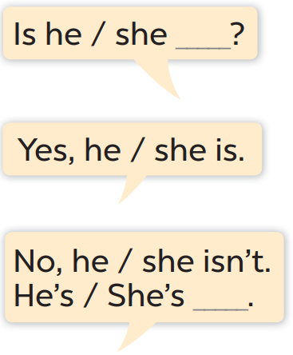

Slide 8
4
Let’s talk.

Slide 9
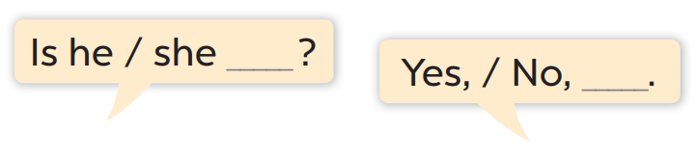



Slide 10



Slide 11
5
Fun corner and wrap-up

Slide 12

Game time!!!

Slide 13
doctor
teacher
driver
farmer
job
worker
singer
cook
nurse

Slide 14

Website: hoclieu.vn
Fanpage: facebook.com/www.tienganhglobalsuccess.vn

