Slide 1







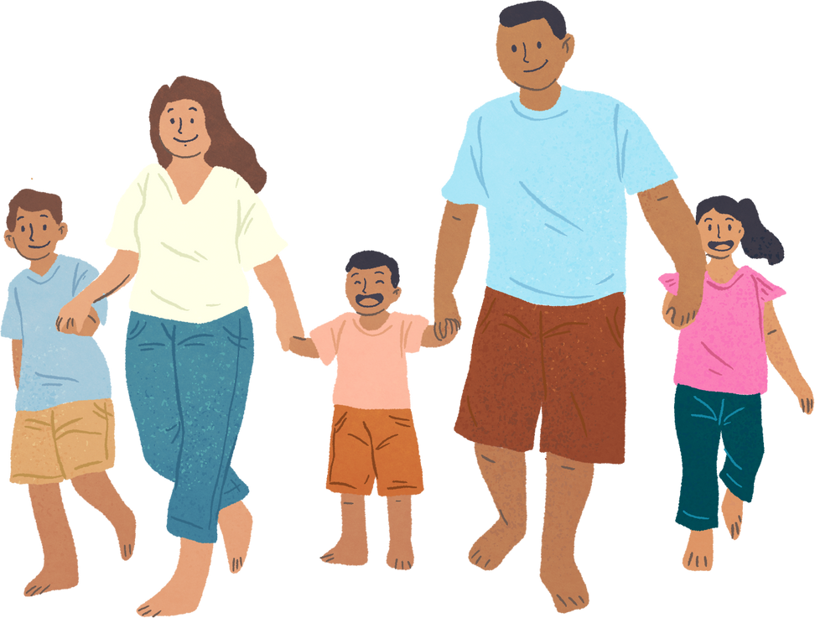


Unit 11: FAMILY TIME
Lesson 1 - Period 2

Slide 2








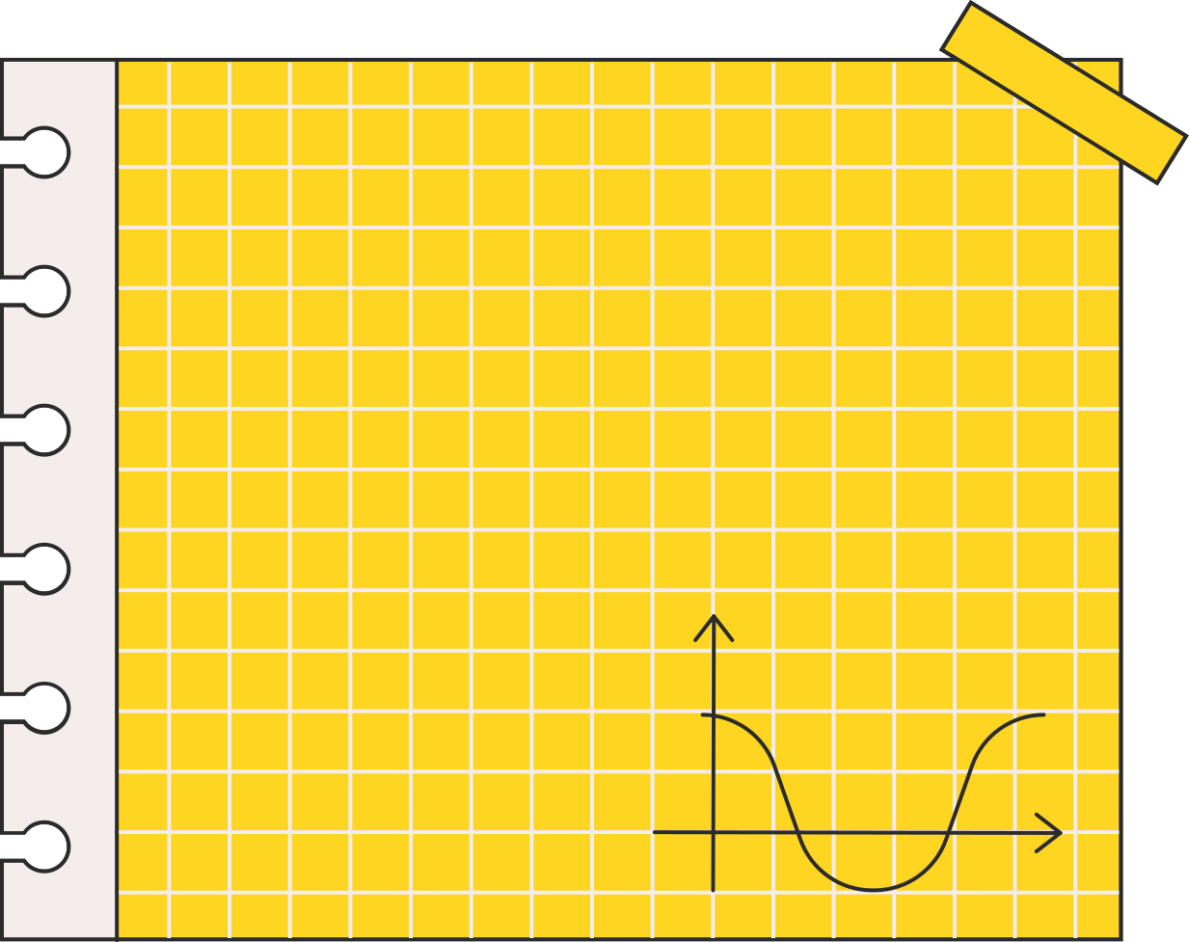



01
Activity 4
Listen and match.

Slide 3


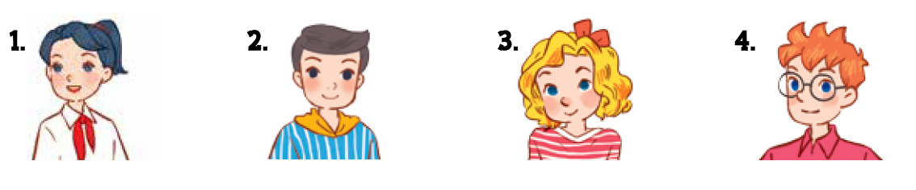


Who are they?
Notes:
Step 1: Draw pupils’ attention to the pictures. Ask questions to help them identify the characters in the pictures and the activities.

Slide 4

What did they do?
Notes:
Step 1: Draw pupils’ attention to the pictures. Ask questions to help them identify the characters in the pictures and the activities.

Slide 5

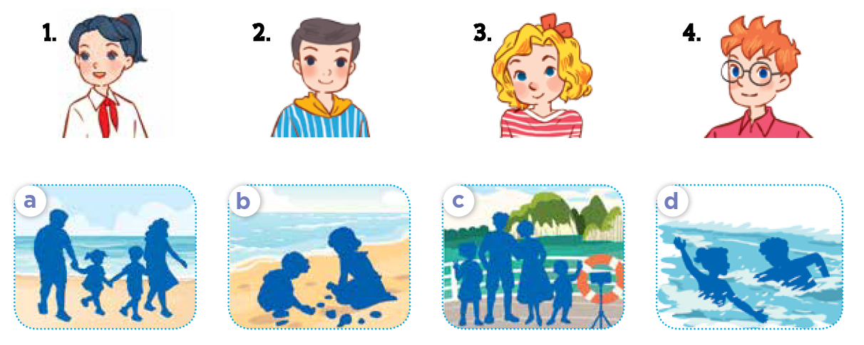
Listen and match.
Notes:
Step 2: Play the recording for pupils to listen. Play the recording again for them to do the task by matching the characters to their activities. Play the recording a third time to give pupils another listening opportunity if necessary.
Step 3: Check answers together as a class. Play the recording again for pupils to double-check their answers.

Slide 6
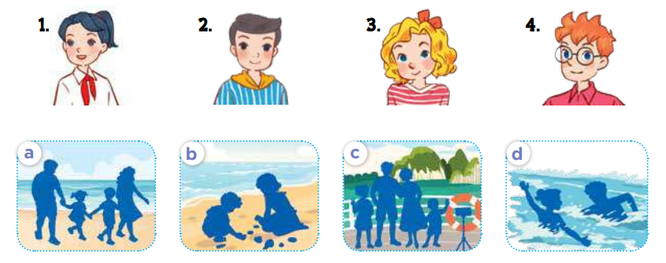
Listen and double-check.
Notes:
Step 3: Check answers together as a class. Play the recording again for pupils to double-check their answers.
Extension: If time allows, play the recording, sentence by sentence, for the class to listen and repeat in chorus. Correct their pronunciation where necessary.

Slide 7
03
Activity 5
Read and circle.

Slide 8



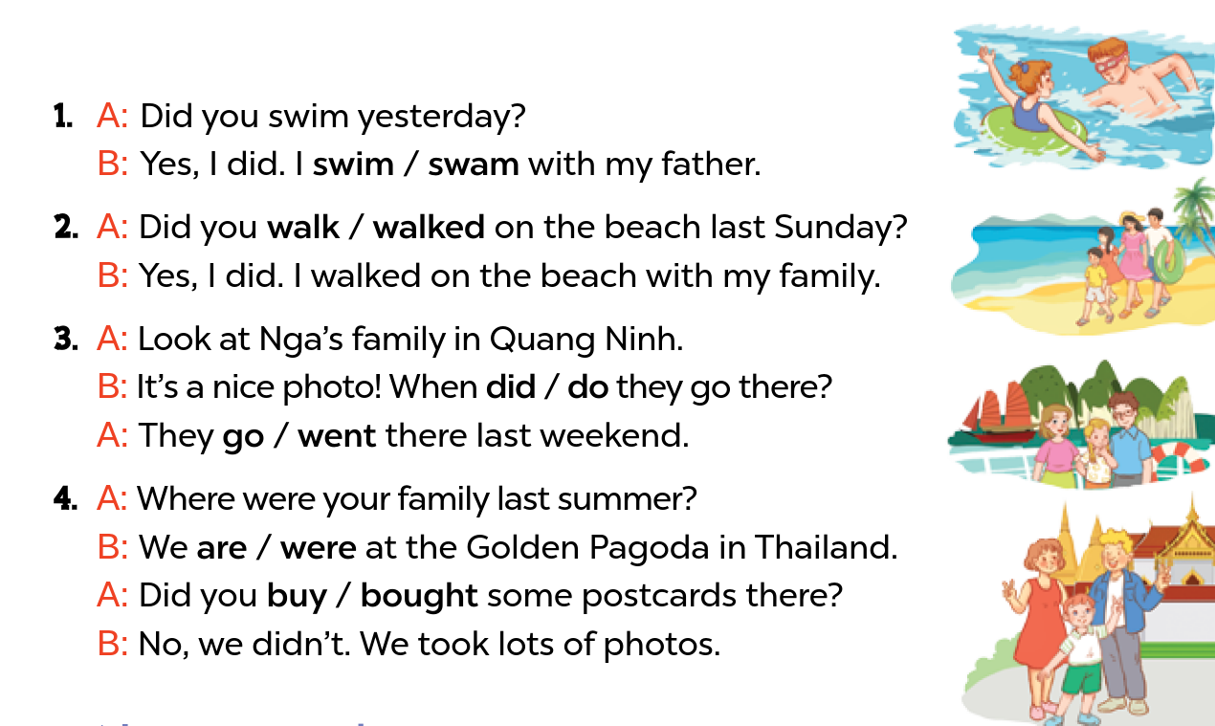


Read and circle
Notes:
Step 1: Have pupils look at the pictures. Get them to identify the characters and options indicating activities (in the questions and answers) at present or in the past.
Step 2: Have pupils look at the options and choose the correct answers with the help of picture cues.

Slide 9

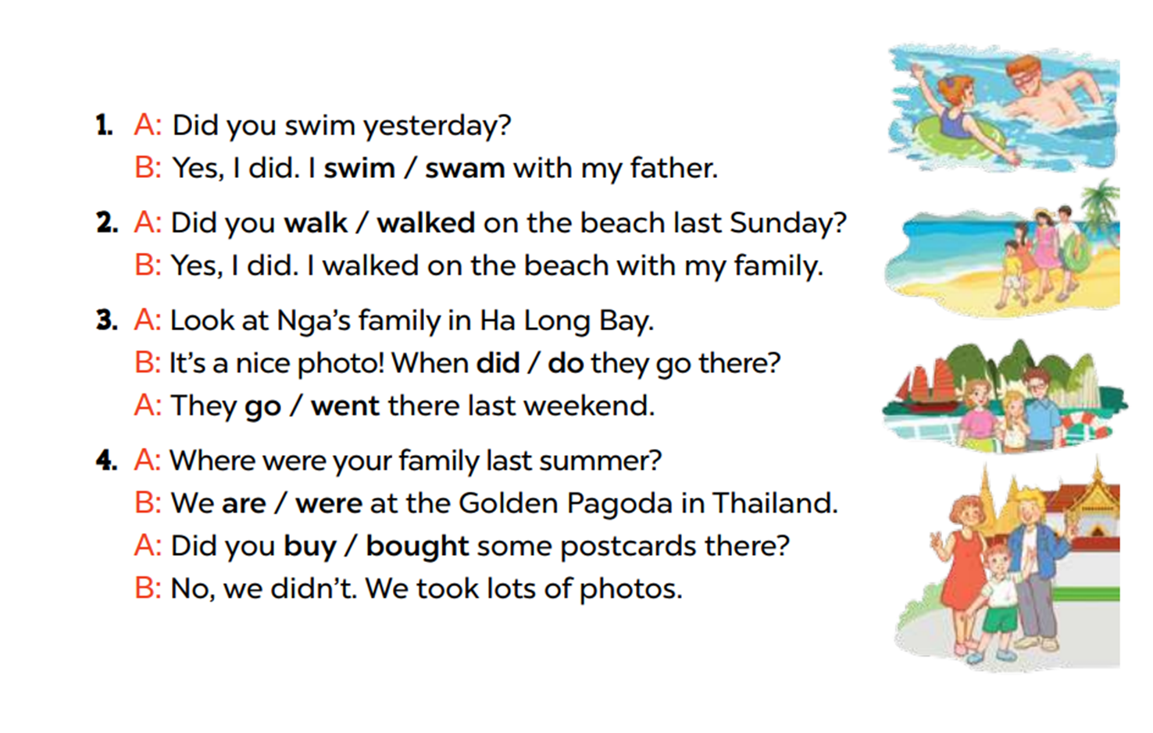
Model with Picture 1
Notes:
Step 3: Model with Picture 1. Have pupils look at the options. Ask them what the girl did in the sea with her father (swam). Then have pupils circle the correct answer (swam)

Slide 10
Read and circle.
Notes:
Step 4: Follow the same procedure with Pictures 2, 3 and 4. Draw pupils’ attention to the options and choose the correct answers with the help of the picture cues.
Step 5: Have pupils do the task individually and ask a pair to read them aloud.

Slide 11
04
Activity 6
Listen, complete and sing.

Slide 12






Listen, complete and sing
Did you swim last Sunday?
Where were you last Sunday?
I was on the (1) ________.
Did you swim?
Yes, I did. I swam with my mum.
beach
Where were you last weekend?
I was in the (2) ________.
Did you walk?
No, I didn't. I (3) ________ photos there.
park
took
Notes:
Step 1: Draw pupils’ attention to the gapped sentences. Encourage pupils to guess the missing words and complete the sentences. Step 2: Play the recording all the way through for pupils to listen to the whole song. Then play the recording again for them to fill in the gaps with missing words. Step 3: Check answers together as a class. Play the recording line by line for pupils to listen and repeat. Correct their pronunciation where necessary. Step 4: Play the recording all the way through for pupils to sing along and clap along with the recording. Extension: Invite some groups to the front of the class to perform while the rest of the class sings and claps along.

