Slide 1







Unit 13:
In the maths class
Lesson 1

Slide 2





Warm-up and Review.

Slide 3







COUNT WITH ME

Slide 4

1
one

Slide 5

2
two

Slide 6

3
three

Slide 7
4
four

Slide 8

5
five

Slide 9

6
six

Slide 10
7
seven

Slide 11

8
eight

Slide 12

9
nine

Slide 13

10
ten

Slide 14

Listen and repeat.

Slide 15
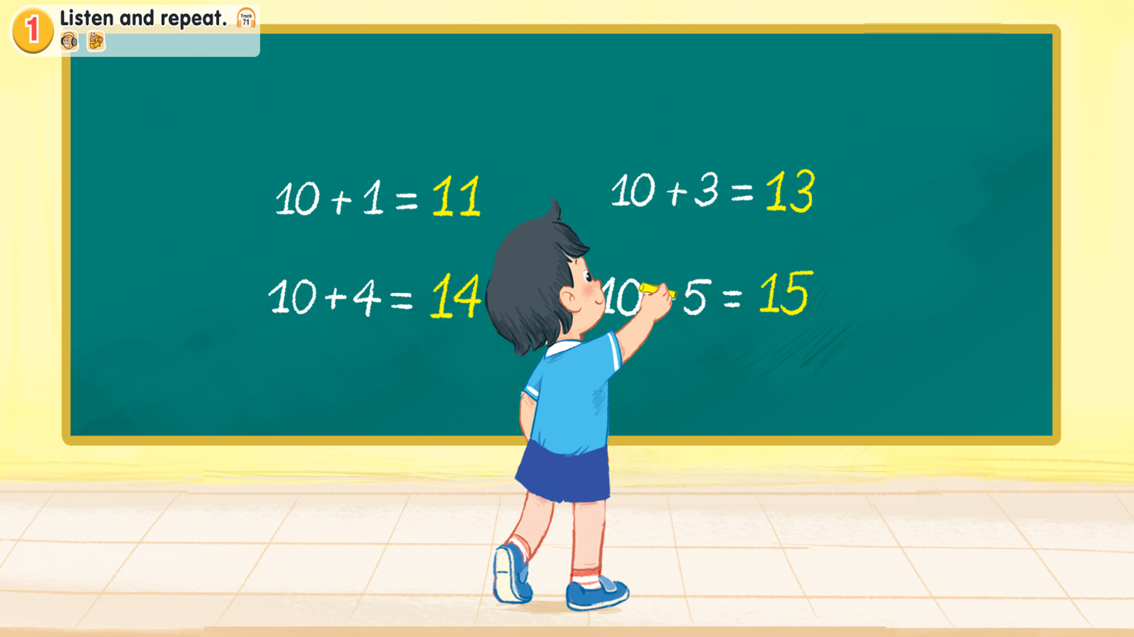
Look and say.
Notes:
Step 1: Draw pupils’ attention to the picture (say “Look at the picture.”). Ask questions to help them identify the context (see Input).

Slide 16

1.Listen and repeat.
Notes:
Step 2: Have pupils point to the letter N/n (say “Point to the letter N.”). Explain that the name of the letter N/n is different to its sound (say “Listen. /en/ /n/.”).
Step 3: Play the recording of the name and sound of the letter N/n and encourage pupils to repeat (say “Listen and repeat.”). Do this several times, with pupils repeating both individually and in chorus. Correct their pronunciation if necessary, and praise them when their pronunciation is good.

Slide 17
1.Listen and repeat.
eleven
Notes:
Step 4: Have pupils look at the number 11 (say “Look at the number eleven”). Then have them point to the word eleven (say “Point to the word eleven.”). Draw their attention to the colour of the letter n (say “Look at the colour of the letter n. It is red.”).
Step 5: Play the recording of eleven and encourage pupils to repeat (say “Listen and repeat.”). Do this several times, with pupils repeating both individually and in chorus. Correct their pronunciation if necessary, and praise them when their pronunciation is good.

Slide 18
1.Listen and repeat.
eleven
thirteen
fourteen
fifteen
Notes:
Step 6: Repeat Steps 4 and 5 for thirteen, fourteen and fifteen.
Step 7: Play the recording in full and encourage pupils to repeat the name and sound of the letter N/n, eleven, thirteen, fourteen and fifteen both individually and in chorus.

Slide 19

Point and say.

Slide 20
2. Point and say.
Notes:
Step 1: Have pupils point to the letter N/n and correctly pronounce its name and sound (say “Point to the letter N. Say /en/. Now say /n/.”).

Slide 21
2. Point and say.
eleven
thirteen
fourteen
fifteen
Notes:
Step 2: Have pupils point to and correctly pronounce eleven (say “Point to eleven. Say eleven.”). Do this several times, with pupils repeating both individually and in chorus. Correct their pronunciation if necessary, and praise them when their pronunciation is good.
Step 3: Repeat Step 2 for thirteen, fourteen and fifteen.

Slide 22
Work in pairs.
eleven
thirteen
fourteen
fifteen
Notes:
Step 4: Put pupils into pairs or groups for further practice of Steps 1 to 3. Go around the class to offer help or correct pupils’ pronunciation, if necessary.

Slide 23

Website: hoclieu.vn
Fanpage: https://www.facebook.com/tienganhglobalsuccess.vn/

