Slide 1






Unit 13:
In the maths class
Lesson 2

Slide 2





Listen and chant.

Slide 3
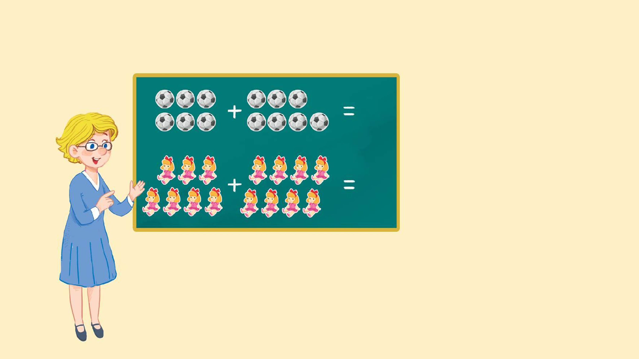
Look and say.
13
thirteen
15
fifteen

Slide 4

3.Listen and chant.
N, n, eleven.
N, n, eleven.
N, n, eleven.
N, n, eleven.
N, n, thirteen.
N, n, thirteen.
N, n, thirteen.
N, n, thirteen.
How many balls?
How many balls?
How many balls?
How many balls?
Eleven or thirteen.
Eleven or thirteen.
Eleven or thirteen.
Eleven or thirteen.
N, n, fourteen.
N, n, fourteen.
N, n, fourteen.
N, n, fourteen.
N, n, fifteen.
N, n, fifteen.
N, n, fifteen.
N, n, fifteen.
How many dolls?
How many dolls?
How many dolls?
How many dolls?
Fourteen or fifteen.
Fourteen or fifteen.
Fourteen or fifteen.
Fourteen or fifteen.

Slide 5
Work in teams.
N, n, eleven.
N, n, thirteen.
How many balls?
Eleven or thirteen.
N, n, fourteen.
N, n, fifteen.
How many dolls?
Fourteen or fifteen.

Slide 6

Listen and tick.

Slide 7

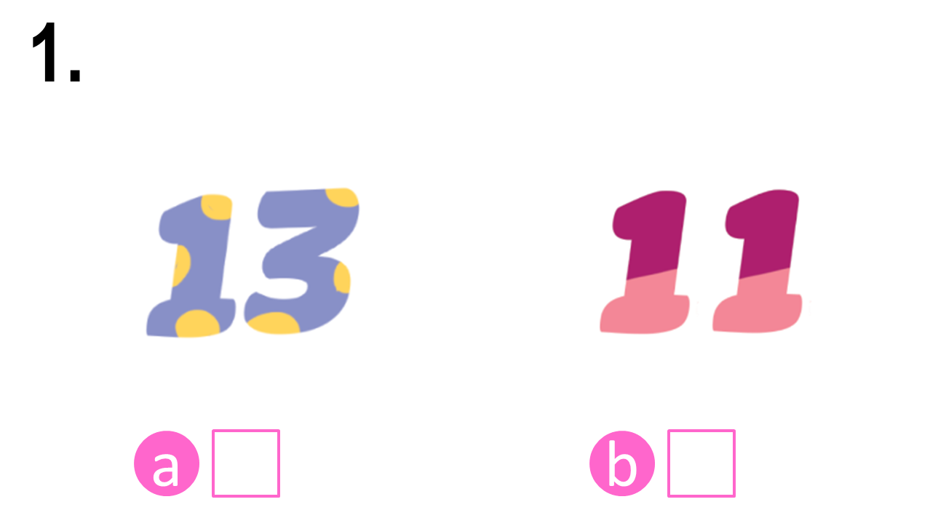
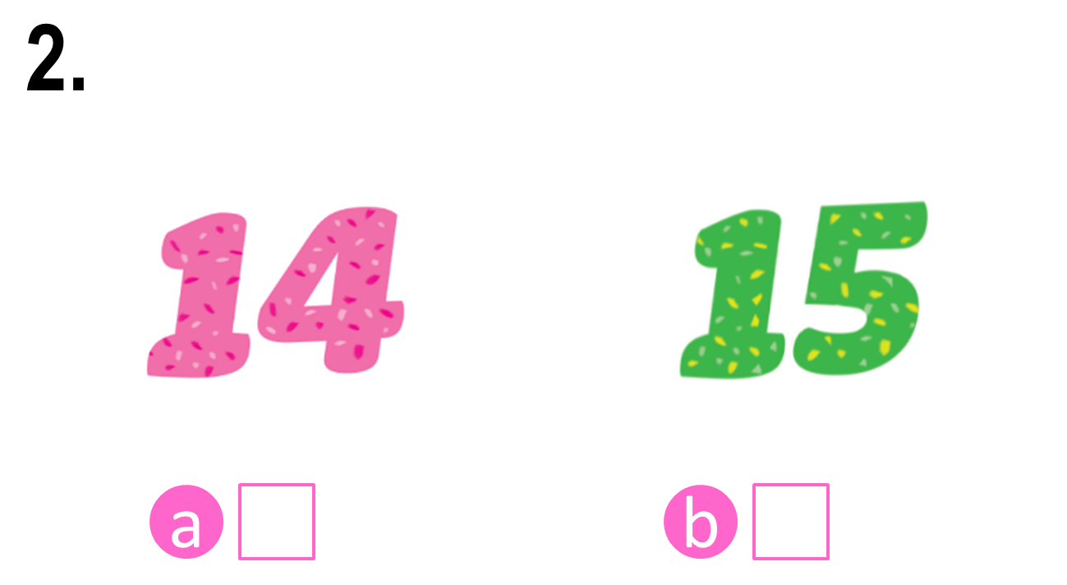


Look and say.

Slide 8
4. Listen and tick.

Slide 9
Check the answers.

Notes:
Step 3: Check the answers by asking “a or b?” When pupils answer correctly, confirm by saying “1a. Can you see the number thirteen?”/ “2b. Can you see the number fifteen?” and encourage them to repeat.

Slide 10
Check the answers.


Slide 11

Write and say.

Slide 12







Look and say.
eleve__
thirtee__
fourtee__
fiftee__

Slide 13
5. Write and say.
eleve__
thirtee__
fourtee__
fiftee__

Slide 14
Check the answers.
n
n
n
n
eleve__
thirtee__
fourtee__
fiftee__

Slide 15
Say the words.
n
n
n
n
eleve__
thirtee__
fourtee__
fiftee__

Slide 16
Website: hoclieu.vn
Fanpage: https://www.facebook.com/tienganhglobalsuccess.vn/

