Slide 1






Unit 13:
In the maths class
Lesson 3

Slide 2





Warm-up and Review.

Slide 3

Listen and repeat.

Slide 4

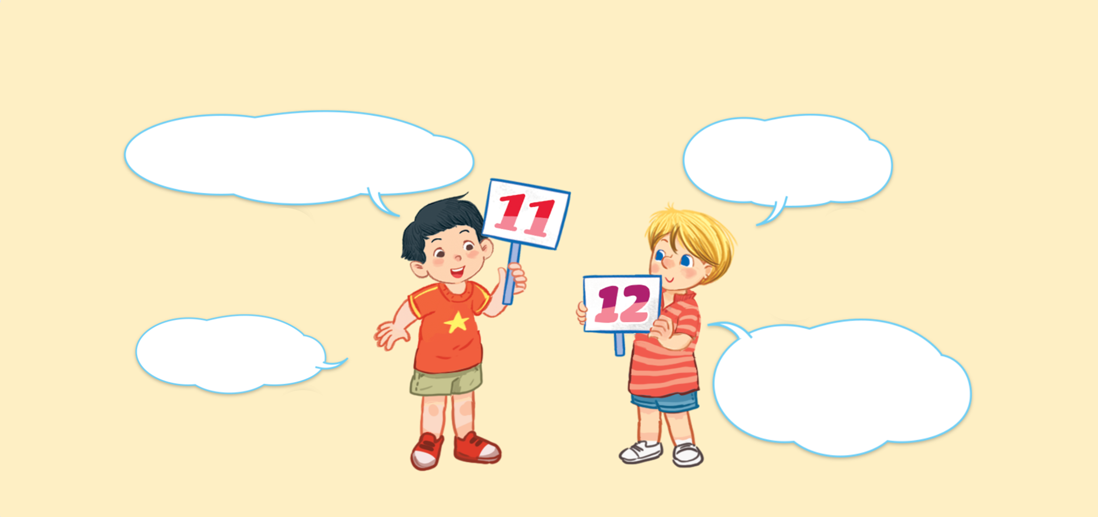


Look and say.
What number is it?
What number is it?
What number is it?
What number is it?
It’s eleven.
It’s eleven.
It’s eleven.
It’s eleven.
It’s twelve.
It’s twelve.
It’s twelve.
It’s twelve.
What number is it?
What number is it?
What number is it?
What number is it?

Slide 5

6. Listen and repeat.
What number is it?
What number is it?
What number is it?
What number is it?
It’s eleven.
It’s eleven.
It’s eleven.
It’s eleven.
It’s twelve.
It’s twelve.
It’s twelve.
It’s twelve.
What number is it?
What number is it?
What number is it?
What number is it?

Slide 6

Let’s talk.

Slide 7








Look and say
What number ______?
.
______.
a
b
c
d

Slide 8
7. Let’s talk.
What number ______?
.
______.
a
b
c
d

Slide 9
Work in pairs.
What number ______?
.
______.
a
b
c
d

Slide 10

Let’s sing.

Slide 11

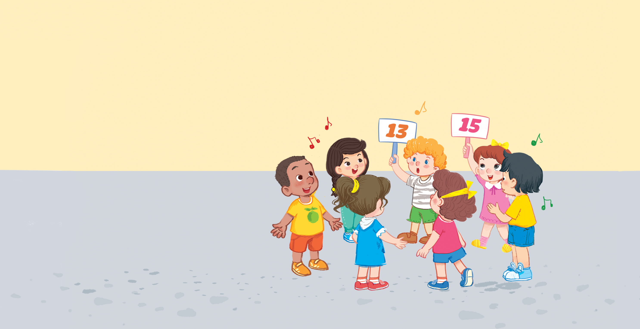


Look and say.

Slide 12
8. Let’s sing.
What number is it?
What number is it?
What number is it?
What number is it?
Eleven, twelve or thirteen.
Eleven, twelve or thirteen.
Eleven, twelve or thirteen.
Eleven, twelve or thirteen.
It’s thirteen.
It’s thirteen.
It’s thirteen.
It’s thirteen.
What number is it?
What number is it?
What number is it?
What number is it?
Thirteen, fourteen or fifteen.
Thirteen, fourteen or fifteen.
Thirteen, fourteen or fifteen.
Thirteen, fourteen or fifteen.
It’s fifteen.
It’s fifteen.
It’s fifteen.
It’s fifteen.

Slide 13
Work in groups.
What number is it?
Eleven, twelve or thirteen.
It’s thirteen.
What number is it?
Thirteen, fourteen or fifteen.
It’s fifteen.
Notes:
Step 5: Have pupils work in groups to make up actions for the song. Invite a few groups to perform the song for the class.

Slide 14
Website: hoclieu.vn
Fanpage: https://www.facebook.com/tienganhglobalsuccess.vn/

