Slide 2





Slide 3



✗
✓
✓
✗

Slide 4
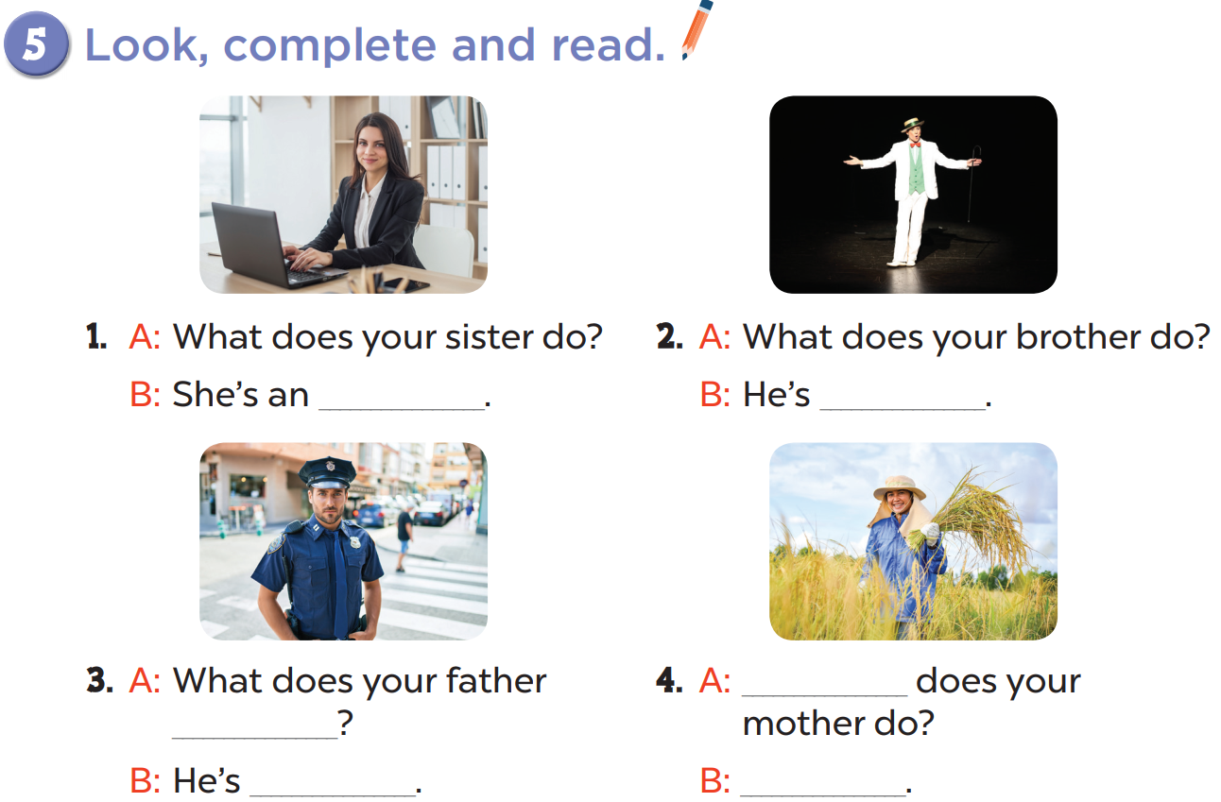

Slide 5
office worker
an actor
What
do
a policeman
She’s a farmer

Slide 6
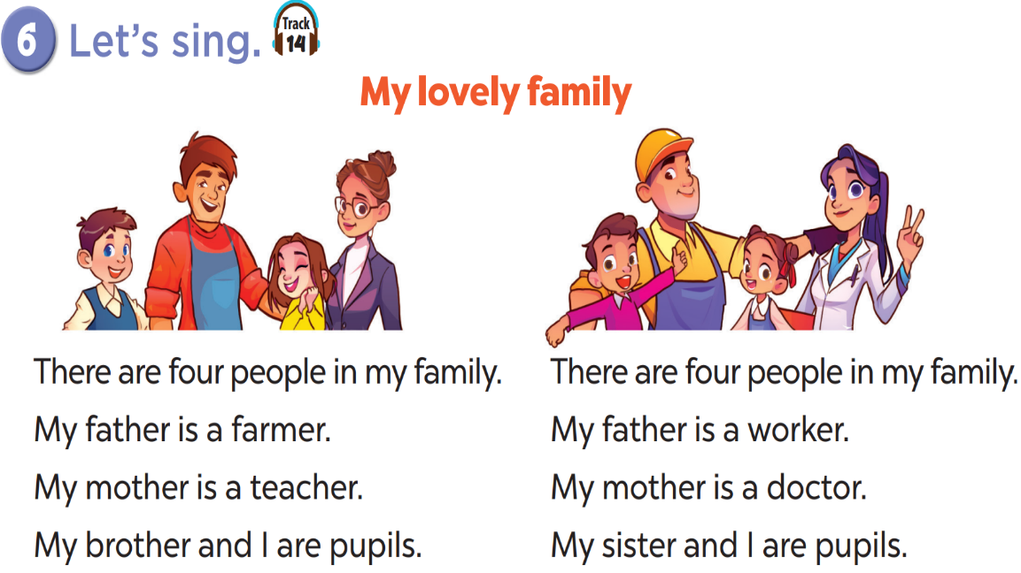

Slide 7








THANK YOU
Website: hoclieu.vn
Fanpage: facebook.com/www.tienganhglobalsuccess.vn
Website: sachmem.vn; hoclieu.vn
Fanpage: www.facebook.com/sachmem.vn

