Slide 2
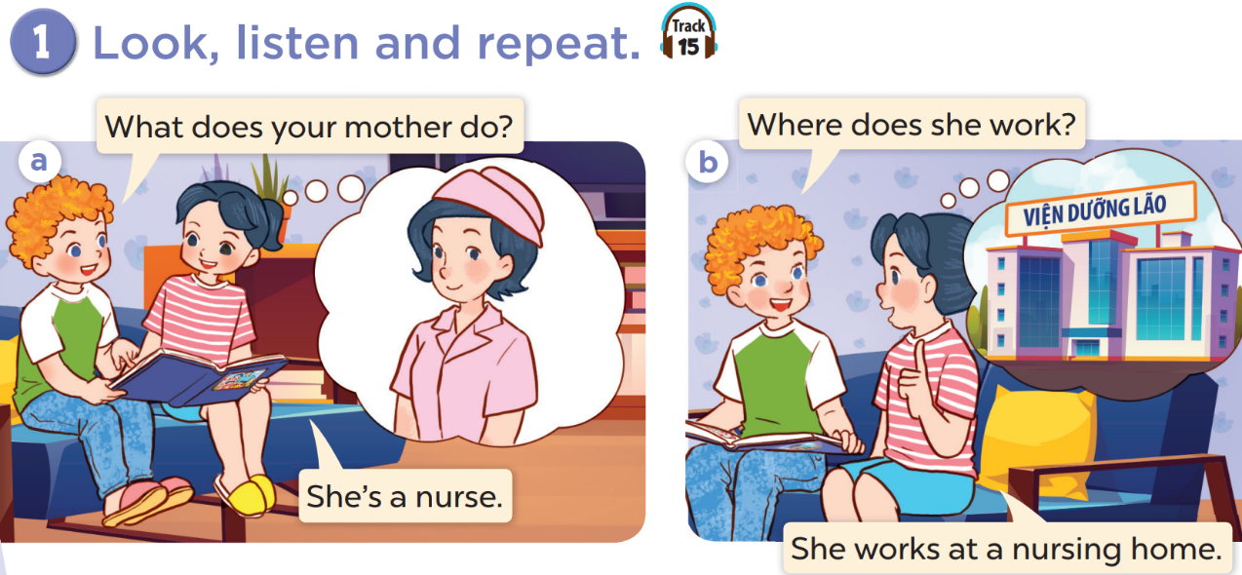

Slide 3


Slide 4
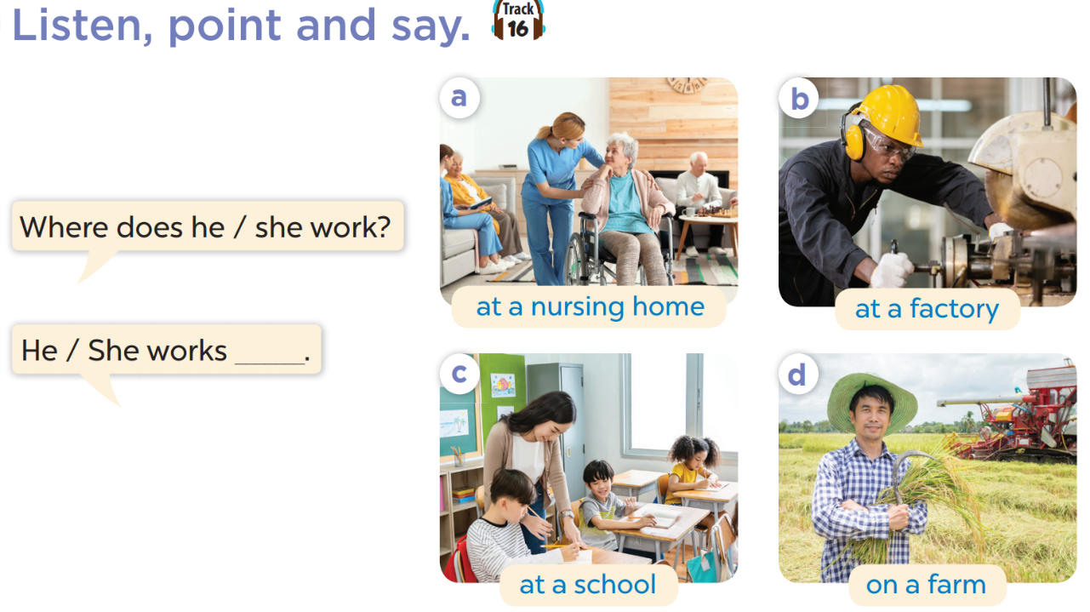

Slide 5
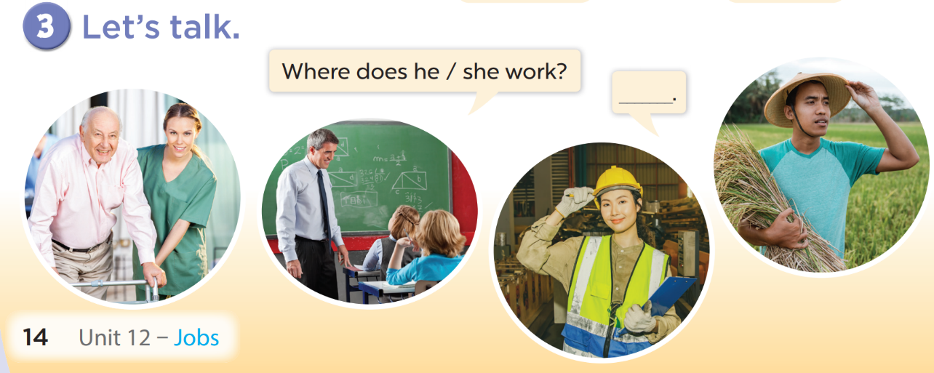

Slide 7
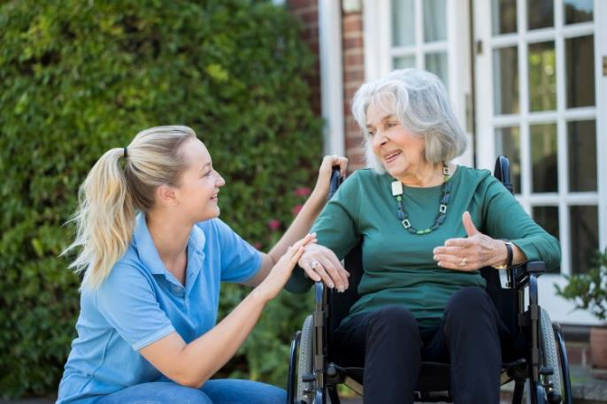
Where does she work?
She works at a nursing home.

Slide 8
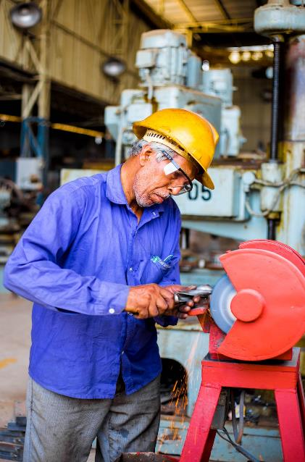
Where does he work?
He works at a factory.

Slide 9

Where does he work?
He works at a school.

Slide 10
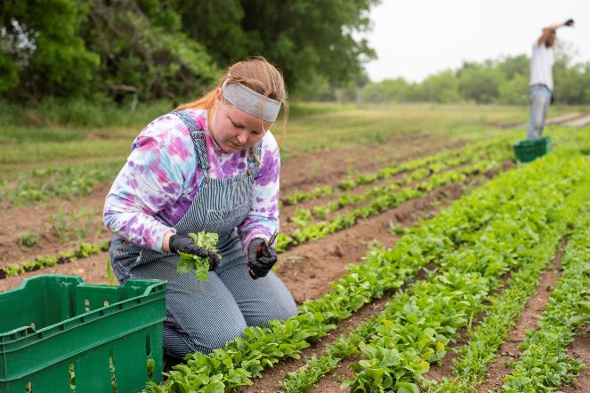
Where does she work?
She works on a farm.

Slide 11








THANK YOU
Website: hoclieu.vn
Fanpage: facebook.com/www.tienganhglobalsuccess.vn
Website: sachmem.vn; hoclieu.vn
Fanpage: www.facebook.com/sachmem.vn

