Slide 1



13
My house
LESSON 2 - PERIOD 3

Slide 2
1
Warm-up and review

Slide 3
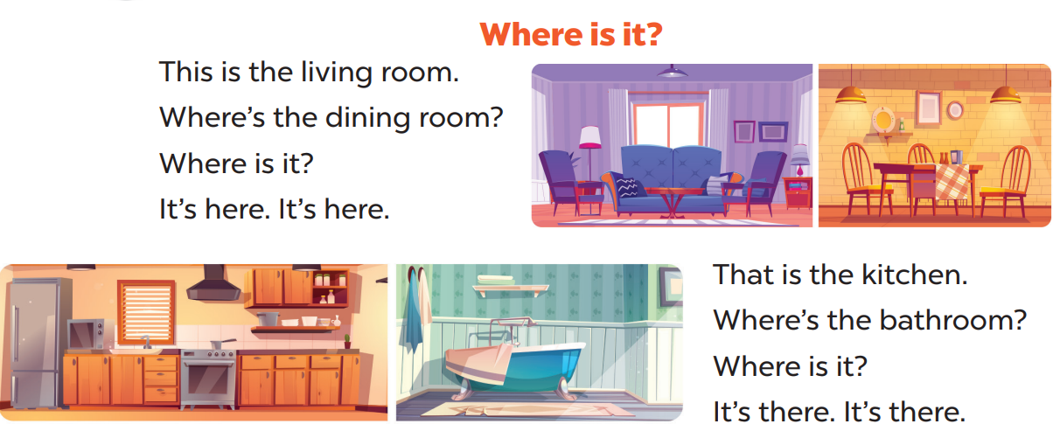

Sing a song
Option 1

Slide 4
2
Look, listen and repeat.

Slide 5
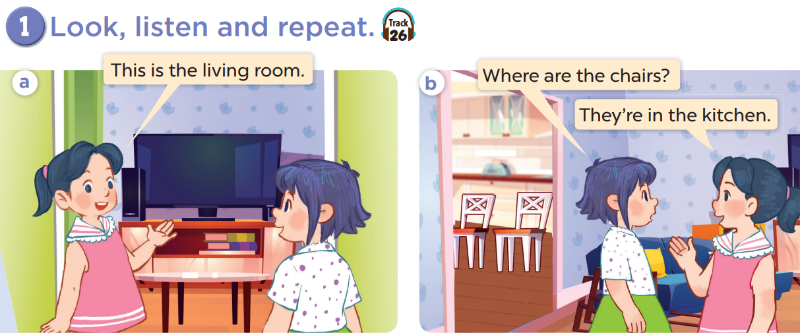

Slide 6
Work in pairs and act.

Slide 7
3
Listen, point and say.

Slide 8
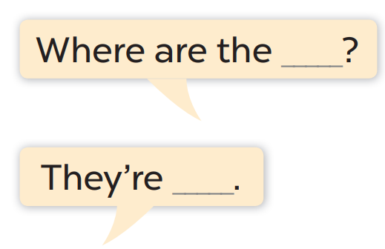
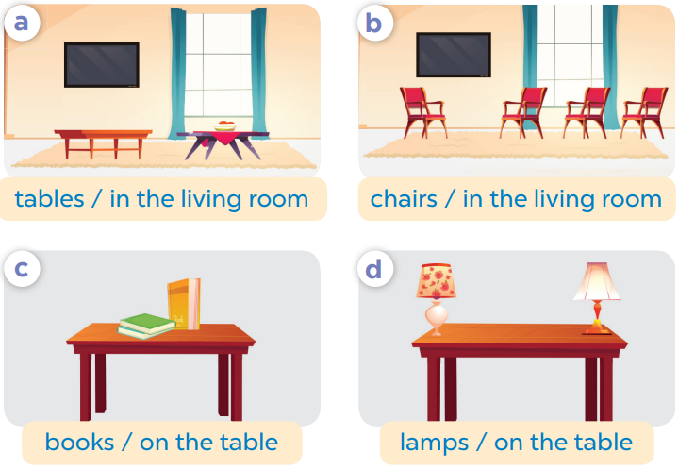
Work in pair, ask and answer.

Slide 9
4
Let’s talk.

Slide 10
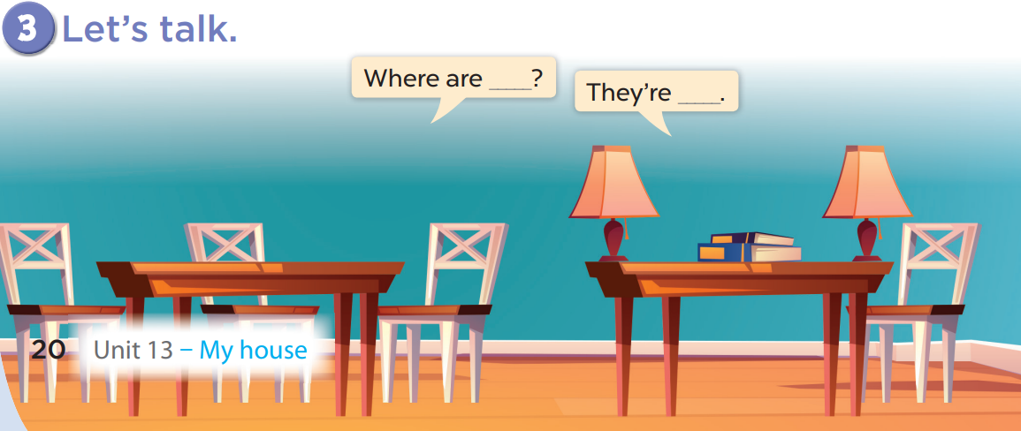
Work in pairs, ask and answer.

Slide 11

Website: hoclieu.vn
Fanpage: facebook.com/www.tienganhglobalsuccess.vn

