Slide 1



13
My house
LESSON 2 - PERIOD 4

Slide 2
1
Warm-up and review

Slide 3
2
Listen and number.

Slide 4
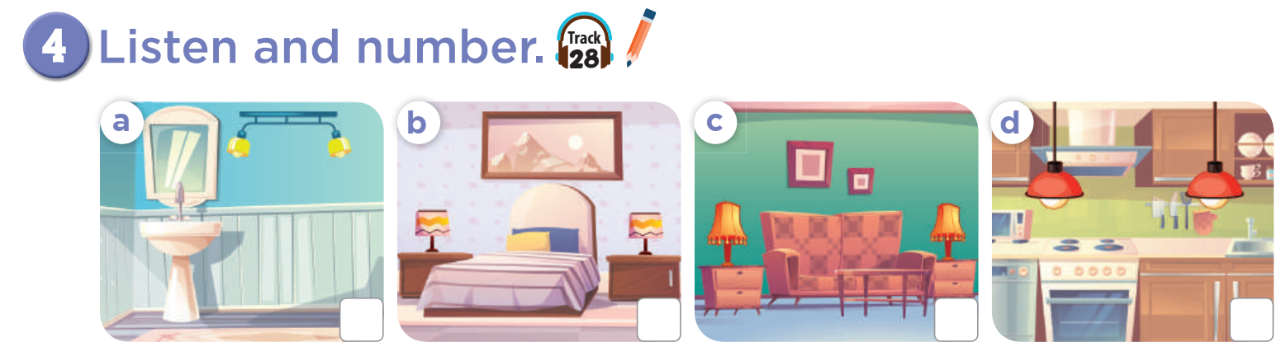

3
4
1
2

Slide 5
3
Look, circle and read. .

Slide 6
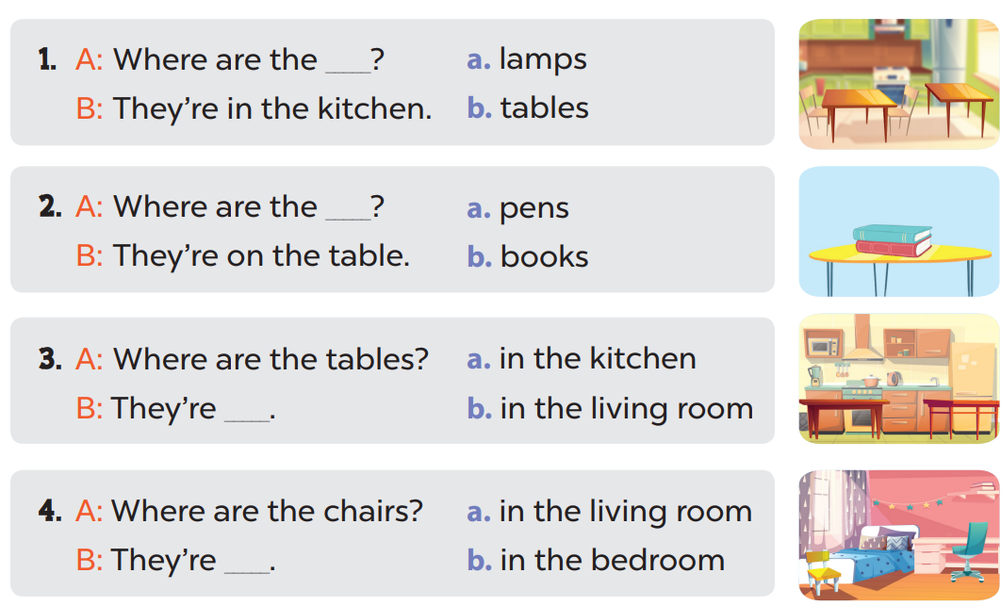

Slide 7
4
Let’s play.

Slide 8
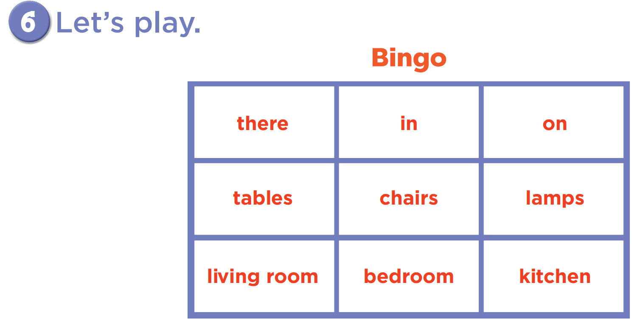

Slide 9
05
Fun corner and wrap-up

Slide 10


5
10
1
7
8
SPIN
-5
3
9
-3
4
6
2
tekhnologic
Notes:
Teacher calls some pairs to the board to practise asking and answering with the sentence models they have learnt.
Pupils/ teachers click the “spin” button to get points.

Slide 11

Website: hoclieu.vn
Fanpage: facebook.com/www.tienganhglobalsuccess.vn

