Slide 1

OUR SPECIAL DAYS
Lesson 1 - Period 1

Slide 2
02
Activity 1
Look, listen and repeat.

Slide 3
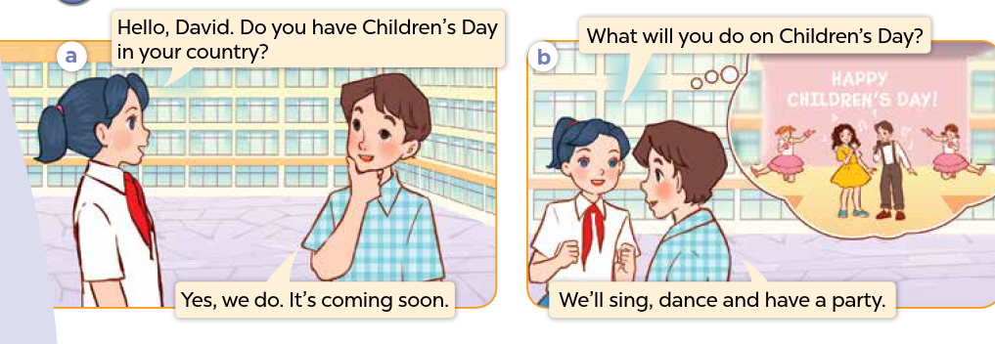
Who can you see? Where are they?
What are they talking about?

Slide 4

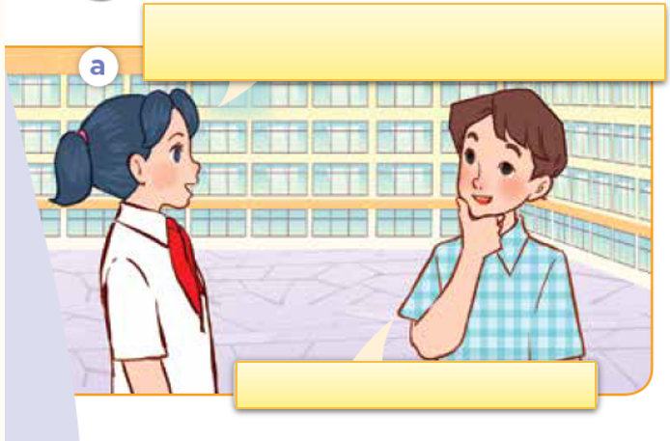
Look, listen and repeat.

Slide 5
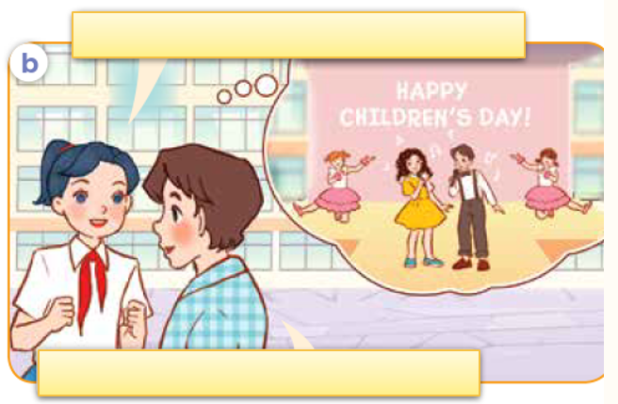
Look, listen and repeat.

Slide 6
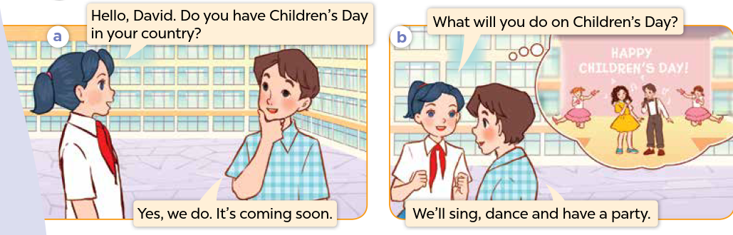
Look, listen, and repeat.

Slide 7
03
Activity 2
Listen, point and say.

Slide 8
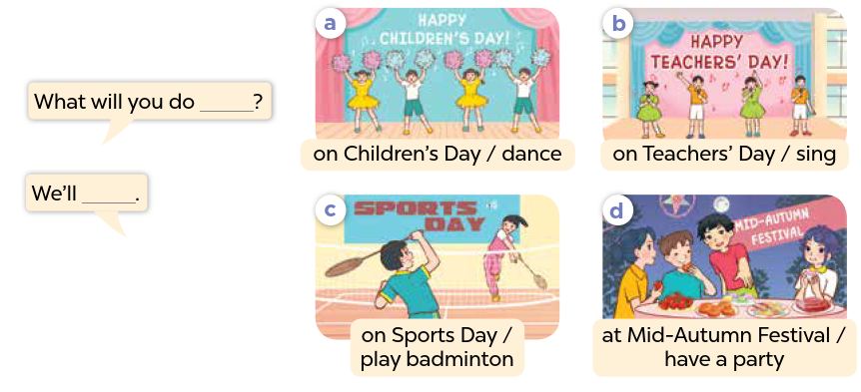

Slide 9
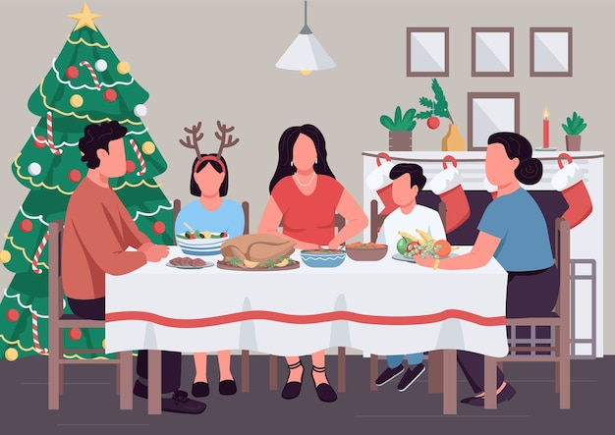





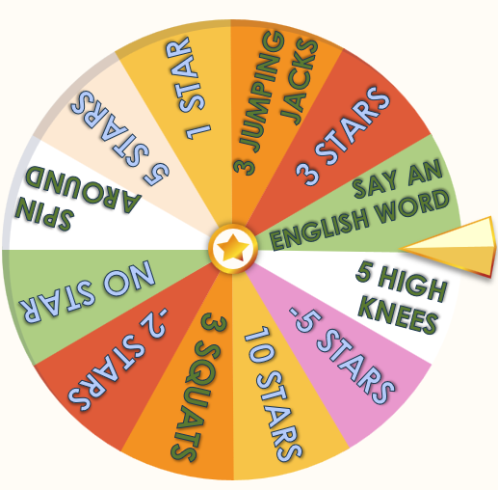
Ask and answer.
_________ on Christmas Day?
What will you do
___________.
We'll have a party

Slide 10
Activity 3
04
Let's talk.

Slide 11


