Slide 1

OUR SPECIAL DAYS
Lesson 1 - Period 2

Slide 2
02
Activity 1
Listen and tick or cross.

Slide 3
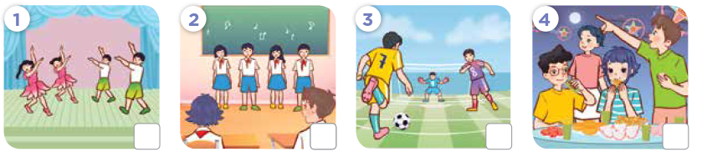
Look! What will they do?

Slide 4


Listen and tick or cross.

Slide 5
Listen and repeat.

Slide 6
03
Activity 2
Read and complete.

Slide 7
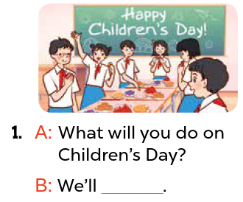
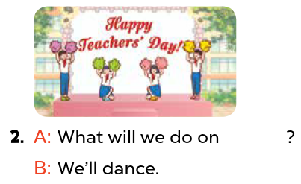
Read and complete.
Teachers’ Day
have a party

Slide 8
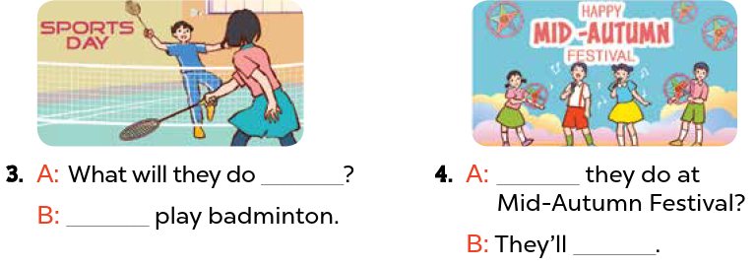
Read and complete.
on Sports Day
What will
We’ll
sing and dance

Slide 9
Activity 3
04
Listen, complete and sing.

Slide 10
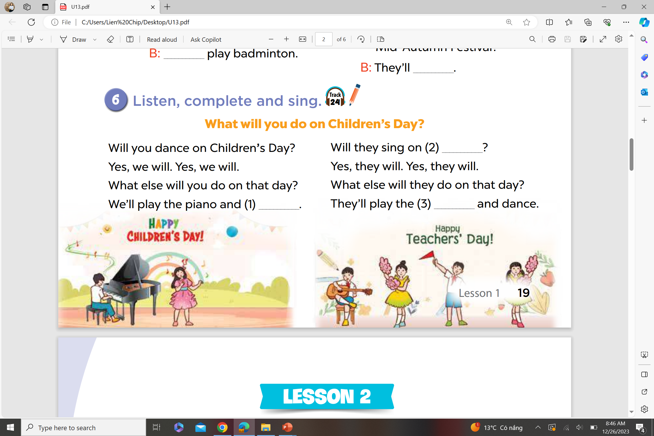
Listen, complete and sing.
Teachers’ Day
sing
guitar

Slide 11
Website: hoclieu.vn
Fanpage: facebook.com/www.tienganhglobalsuccess.vn

