Slide 1








Unit 14: STAYING HEALTHY
Lesson 1 - Period 1

Slide 2




02
Activity 1
Look, listen and repeat.

Slide 3




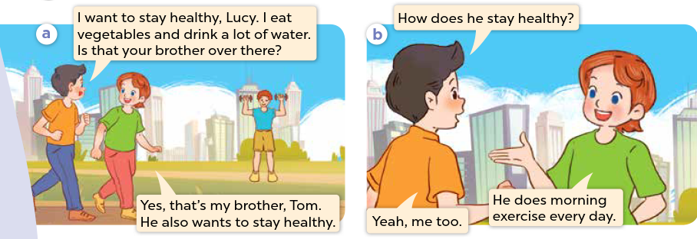


Look, listen and repeat.
Notes:
Step 4: Play the recording again, sentence by sentence, for pupils to listen, point to the sentences and repeat. Correct their pronunciation where necessary.
Step 5: Draw pupils’ attention to the question How does he stay healthy? and the answers He does morning exercise every day. Explain that they are used to talk about a someone’s lifestyle.

Slide 4
03
Activity 2
Listen, point and say.

Slide 5



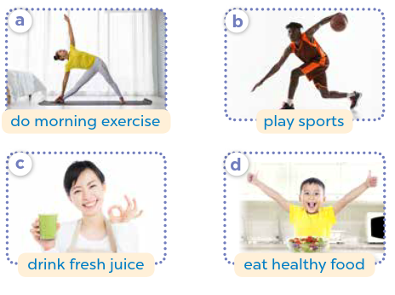



Listen, point and say.
How does he / she stay healthy?
He / She _____.
Notes:
Step 5: Invite a few pairs to point at the pictures and ask and answer questions about a family member’s lifestyle.

Slide 6





Listen, point and say.
How does he stay healthy?
He eats healthy food.
d. eat healthy food
Notes:
Step 5: Invite a few pairs to point at the pictures and ask and answer questions about a family member’s lifestyle.

Slide 7
04
Activity 3
Let’s talk.

Slide 8





Let’s talk.
How does your _____ stay healthy?
_____.
Notes:
Step 1: Draw pupils’ attention to the picture. Ask questions to help them identify the context (see Input).
Step 2: Point at the first character and elicit the question in the first speech bubble (e.g. How does your sister stay healthy?) and the answer in the second speech bubble (She does morning exercise.) as an example. Then write the sentences on the board. Get pupils to say the completed sentences. Repeat the same procedure with other pictures.

Slide 9
Website: hoclieu.vn
Fanpage: https://www.facebook.com/tienganhglobalsuccess.vn/

