Slide 1
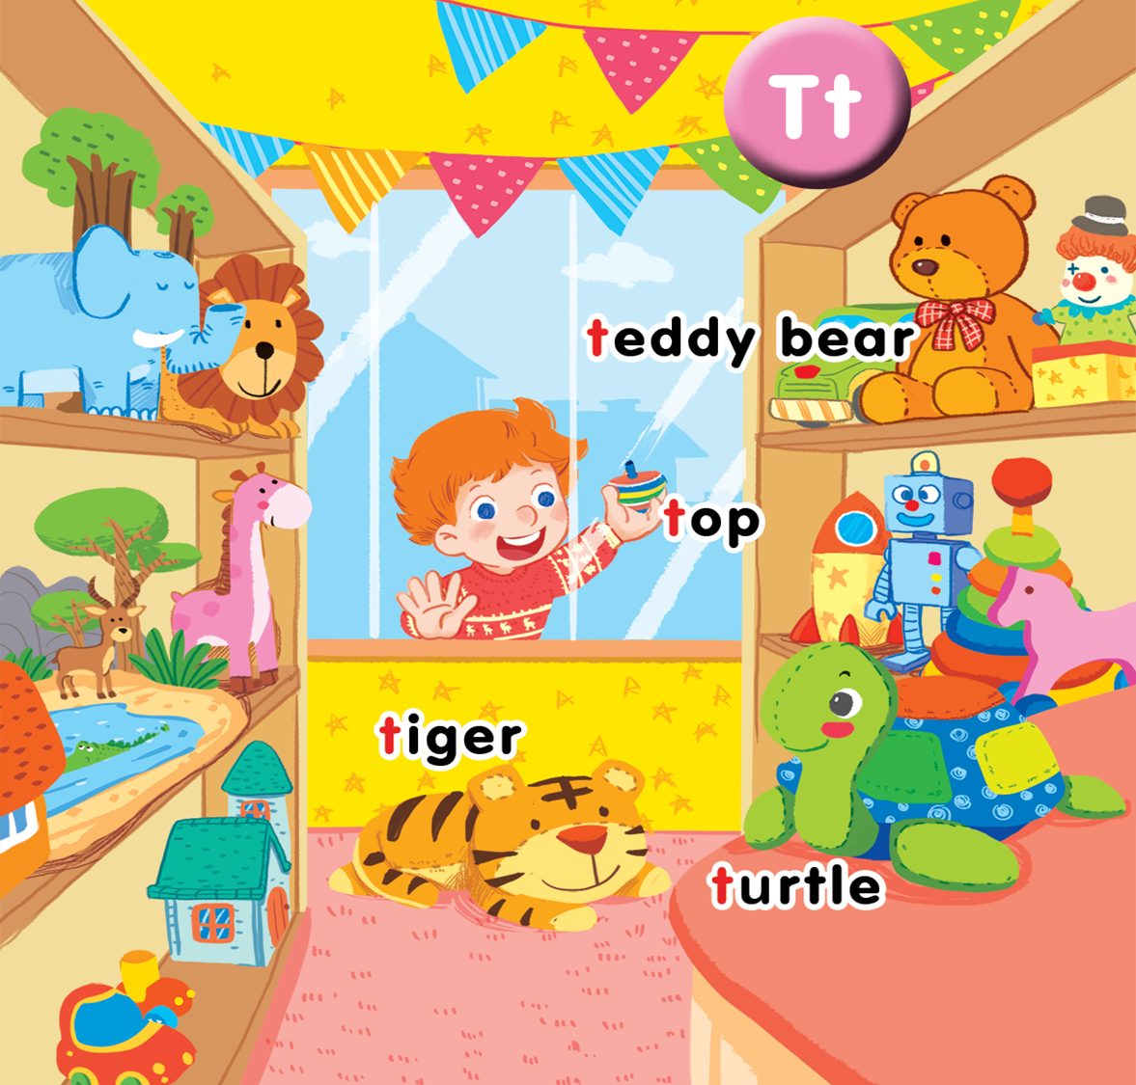
Unit 14 In the toyshop Lesson 3
Notes:
By the end of the lesson, pupils will be able to:
use I can see_____ to talk about the toy.
sing a song with the structure “He has _____.” and “I can see______.”

Slide 2


Listen and repeat
Notes:
Listen and repeat is divided in to 2 steps.
Step 1
Goal: Introduce the sound and the meaning of the structure I can see_____?
Time: 3 minutes
Point to a flashcard for tiger and say I can see a tiger. Use TPR to demonstrate the meaning of “see”.
Repeat the sentence many times and ask pupils to repeat once.
Ask pupils if they understand the sentence and explain in mother tongue if it is needed.
Step 2
Goal: Pupils will be able to repeat the structure I can see a tiger.
Time: 3 minutes.
Have pupils open the book, listen and repeat in chorus, groups and in pairs with different voice for fun.

Slide 3
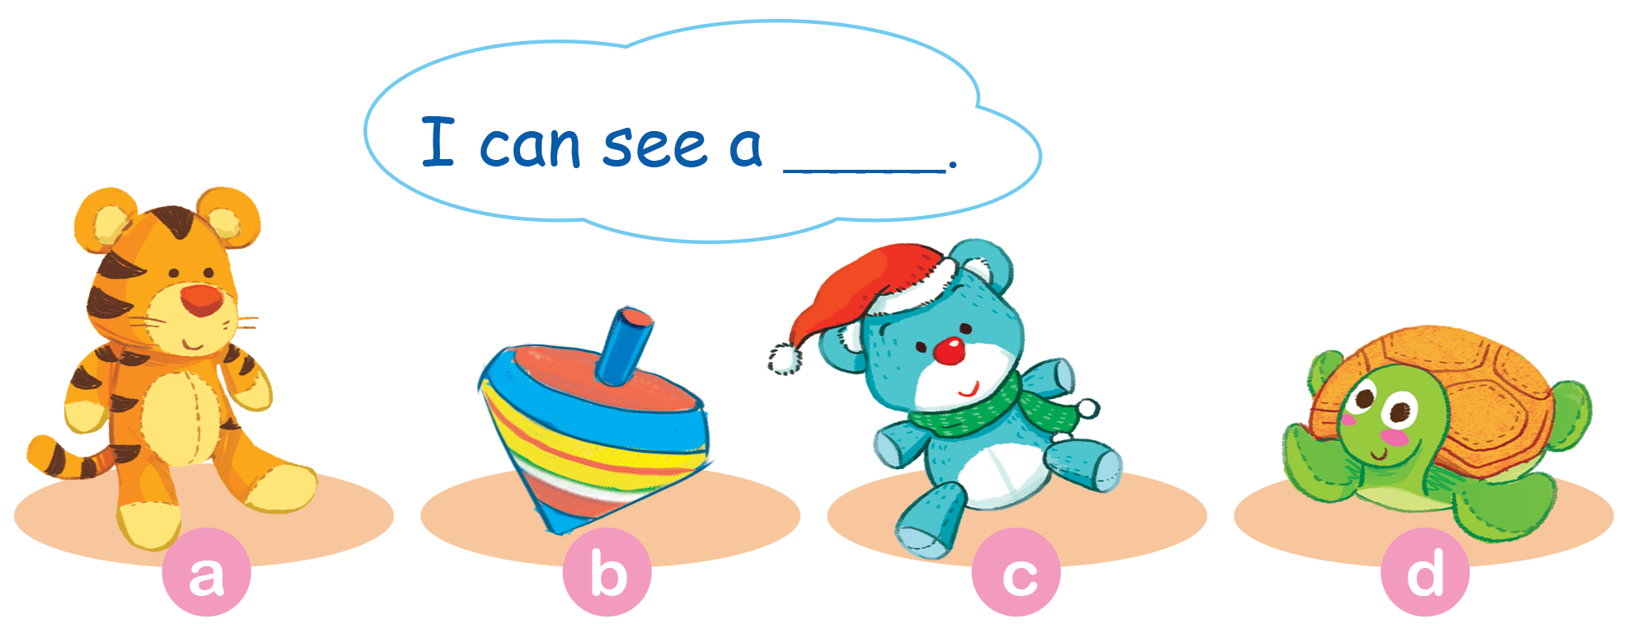
Notes:
Step 1
Goal: Pupils practice speaking, using the structure I can see..
Time: 3 minutes
Have pupils open the book, activity 7.
Point to the picture of turtle and say I can see a turtle.
Have pupils repeat.
Then ask pupils to do the same with other pictures in the book in groups (point and say in groups).

Slide 4

top
Notes:
Step 2
Goal: Pupil will use the structure I can see… to talk about what they see.
Times: 5 mins
Show the slide.
Pupils will say I can see… when they see the slide.
Teacher can have pupils say in chorus, groups or individuals. Or can play a game between groups.

Slide 5

teddy bear

Slide 6

Tony

Slide 7

turtle

Slide 8


Let’s sing
Notes:
Step 1
Goal: Pupils will be able to read the song lyrics.
Time: 3 minutes
Have pupils read the song lyrics in chorus then in groups.
Step 2:
Goal: Pupils will be able to sing along the song.
Time: 5 minutes
Have pupils listen and sing along the song in chorus then in groups.
Step 3
Goal: Pupils will be able to sing the song with TPR.
Time: 5 minutes
Have groups create their own TPR for the song then present.
Finish the song with the TRP for high five and fist bump.
If possible, teacher could have pupils create their own song lyrics and perform.

Slide 9
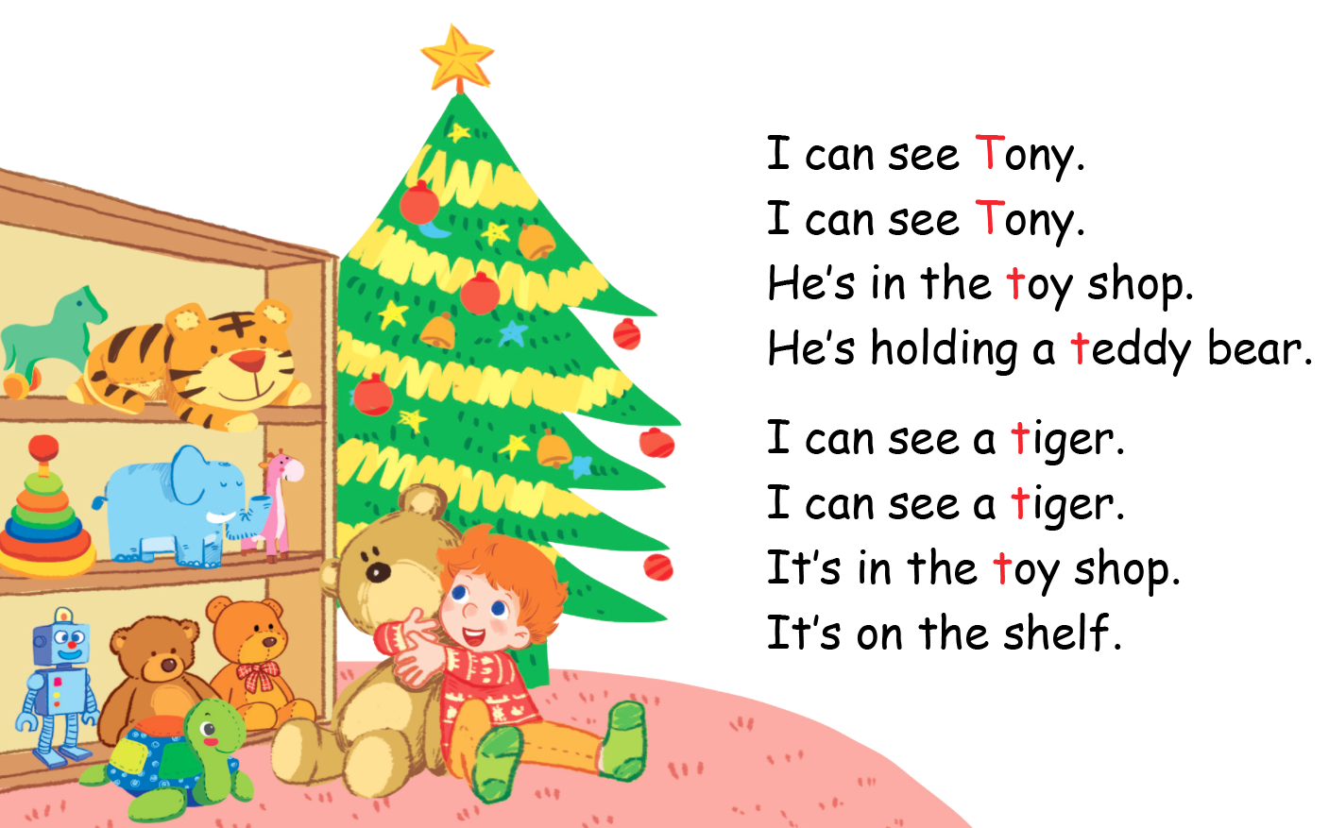

Let’s sing

Slide 10
Website: hoclieu.vn
Fanpage: facebook.com/www.tienganhglobalsuccess.vn

