Slide 2
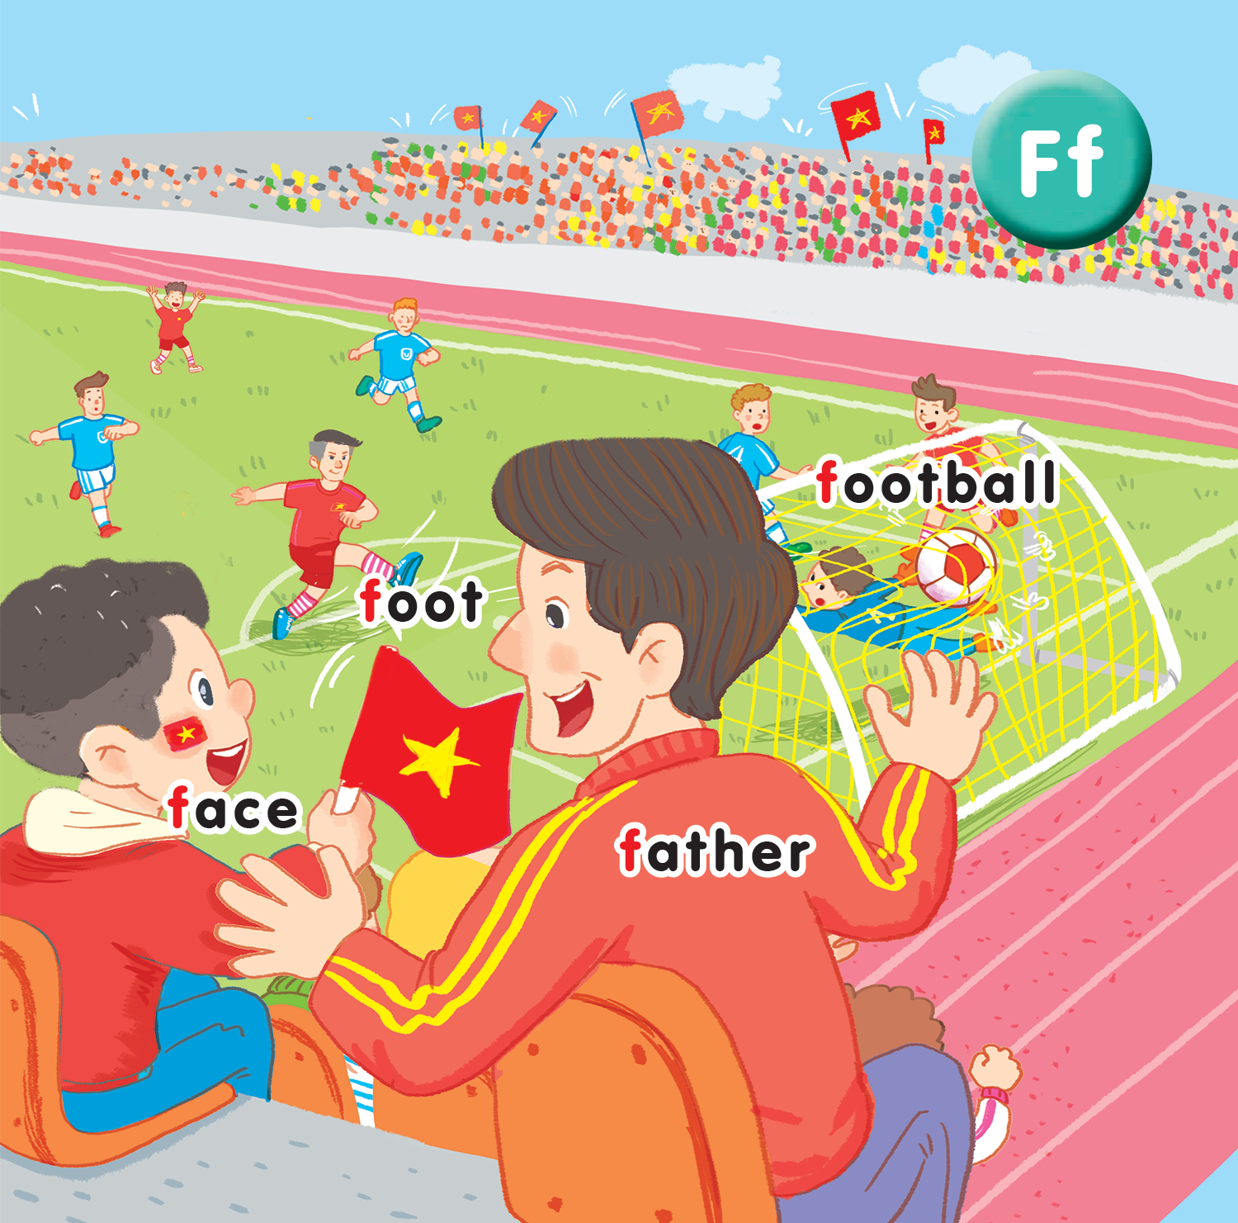
Unit 15
At the football match
Lesson 1
Notes:
By the end of the unit, pupils will be able to:
pronounce the sound of the letter F/f in isolation and in the words football, foot, father, face correctly.
say the sound of the letter F/f and the words football, foot, father, face in the chant.
recognize the words in different situations when listening.
use “Point to your_____.” to talk about imperative.
trace the letter F/f.
sing a song with the structure “Point to your____.”
Lesson 1
By the end of the lesson, pupils will be able to:
listen and recognize the words football, foot, father, face.
recognize and say the words.

Slide 3

Warm-up
Notes:
Goal: Warm up the class and get pupils ready for the new lesson.
Time: 5 minutes
Game “Simon says”
Say Simon says tiger, pupils will say I can see a tiger and do TPR.
Say Turtle, pupils do TPR only.
Word can be used for the game: teddy bear, toyshop, top, car, turtle, ball, football.

Slide 4



Notes:
Listen and repeat is divided into 3 steps.

Slide 5
Tranh baif 15 lesson 1
Notes:
Step 1
Goals: Set up the context; Predict what pupils will learn.
Time: 3 minutes
Open digital book and ask pupils to describe what they can see (can be both in English or Vietnamese).
Pupils can give various answers.
Say Today the letter F will bring us to a football match. Let’s see what we have.

Slide 6

foot football
F f
face father
Notes:
Step 2
Goal: Pupils will be able to listen and repeat the sound f.
Time: 3 mins
Have pupils look at the picture in the screen.
Point to 4 words and ask What letter is in all four words?
Play the recording f and introduce how does f pronounce.
Have pupils repeat 3 times.

Slide 7


face
Notes:
Step 3
Goal: Pupils will be able to understand the meaning, listen and repeat the unit key words football, foot, father, face.
Tim: 5 minutes
Use the flashcard to present the new words.
Show the flashcard of face and say face.
Do the TPR to demonstrate the meaning of face.
Say and have pupils repeat in chorus, group and individual.
Do the same with other words.

Slide 8

father

Slide 9
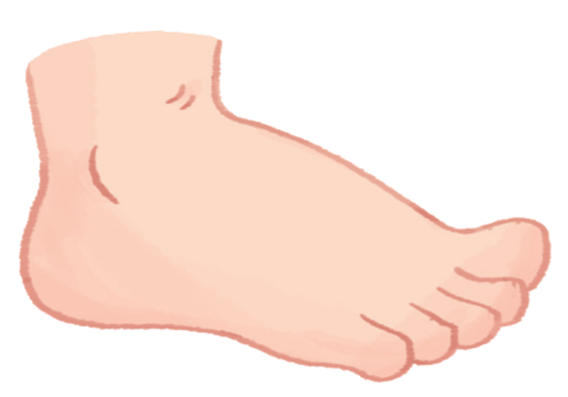
foot

Slide 10

football

Slide 12



Notes:
Point and say is divided into 2 steps.
Step 1.
Goal: Pupils will be able to point and say the new words.
Time: 5 minutes
Have pupils listen and point to the pictures in the book.
Hold up your index finger, demonstrate the action for Point.
Say Point and say with the TRP actions.
Point to the foot and say foot. Have pupil point and say.
Repeat the procedure.
Vary the speed to make the activity fun.
Do the activity in groups. One points, the other take turn to say.
Ask one or two students to point to the picture and have other pupils say the word.

Slide 13
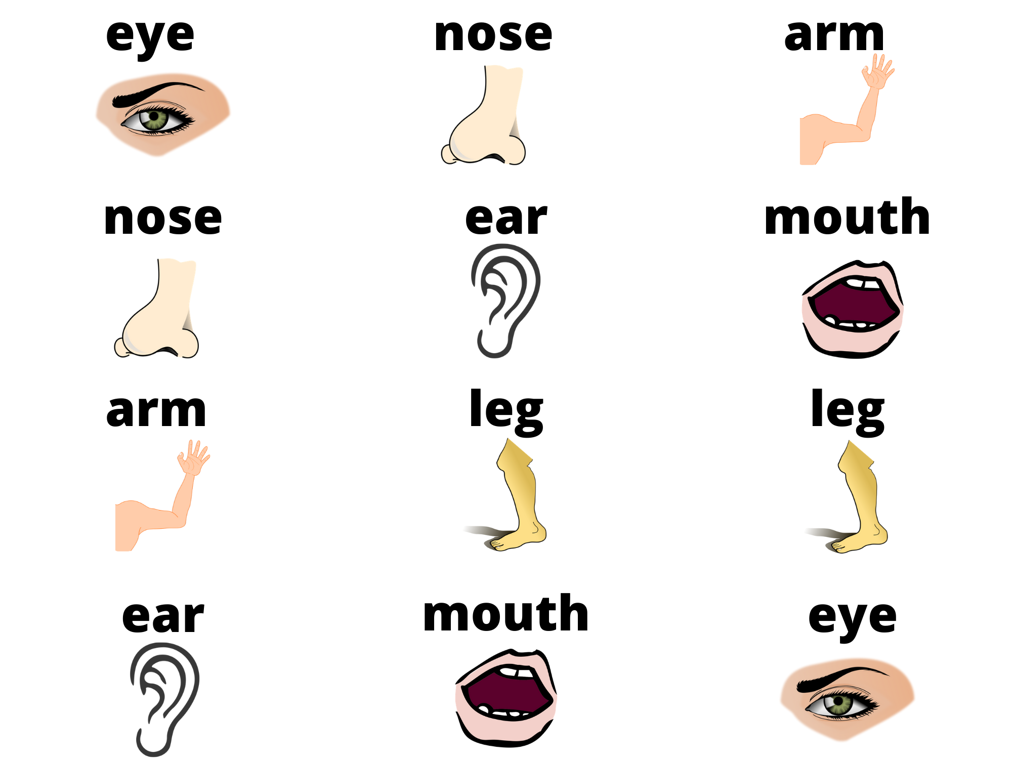
1
2
3
4
5
6
7
8
9
10
11
12
Notes:
Step 2
Goal: Pupils are able to say the word.
Time: 8 mins
Game: Matching pictures
Divide the class into two teams. Each team then takes turns in choosing TWO squares.
If the two squares are the same word / picture, then the team gets a point.
If the two squares are different, then click on the red circle to hide the picture again.
Pupils must try to remember where the matching pairs of words are.

Slide 14
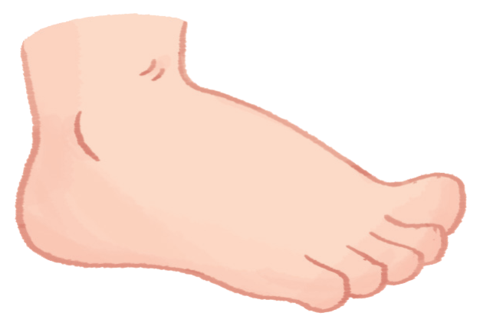
Goodbye
foot
Notes:
Teacher shows the vocabulary of the lesson on slide.
Pupils say goodbye.

Slide 15

Goodbye
face

Slide 16

Goodbye
football

Slide 17

Goodbye
father

Slide 18
Website: hoclieu.vn
Fanpage: facebook.com/www.tienganhglobalsuccess.vn

