Slide 2

Listen and chant
Notes:
Step 1
Goal: Pupils will be able to listen, chant and clap along.
Time: 4 minutes
Play the recording
Round 1. Have pupils listen and clap along.
Round 2. Have pupils listen and repeat to the chant.
Repeat each round 2 to 3 several times.
Step 2
Goal: Pupils will be able to chant with TPR.
Time: 3 minutes
Have people practice chanting in groups.
Then group members create their own TPR.
Group present their chant with TPR to get stars for their groups.
Step 3 (optional)
Goal: Pupils will be able to create their own chant.
Time: 3 minutes
If possible, have group of people create their own chant lyrics by replacing some words of the chant.

Slide 3
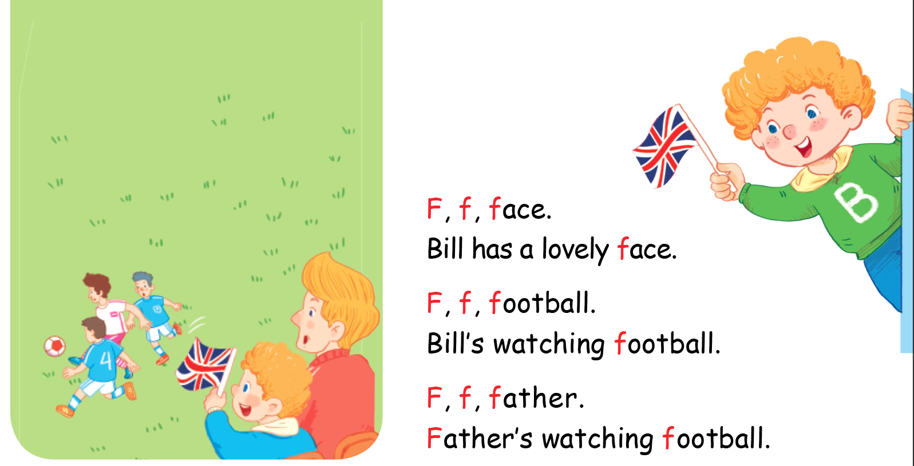

Listen and chant

Slide 4


Listen and tick
Notes:
Listen and tick is divided into 2 steps.
Step 1
Goal: Pupils will be able to listen and choose the correct pictures.
Time: 5 minutes
Say Listen and tick with the TPR actions.
Play the recording and demonstrate the example.
Play the recording and have pupils do the task.
Step 2
Goal: Check
Time: 5 minutes
Play the recording and have pupils say the answer.
Play the recording again and have pupils repeat then give correct answer.

Slide 5
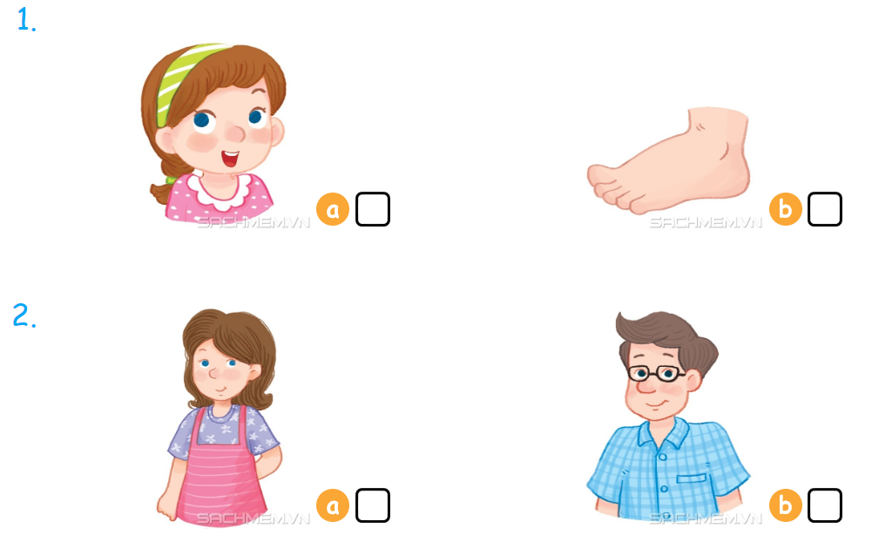

Listen and tick

Slide 6



Look, trace and write
Notes:
Goal: Pupils will be able to trace the letter.
Time: 5 minutes
Have pupils write the word by air tracing and say the word.
Demonstrate how to trace the word and have pupils do the task.

Slide 7
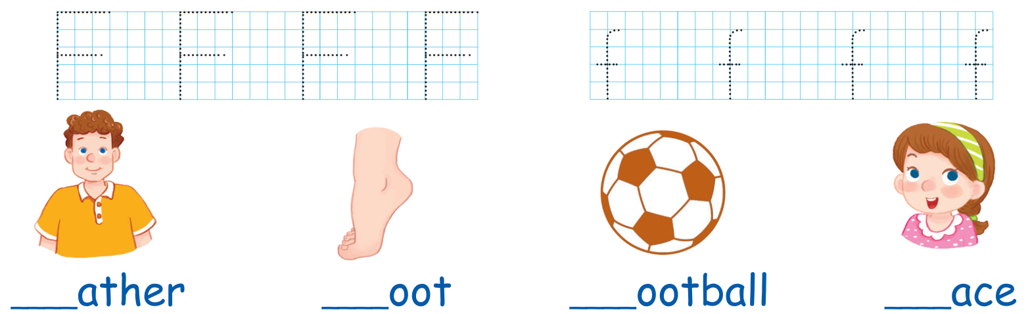

Slide 8
Website: hoclieu.vn
Fanpage: facebook.com/www.tienganhglobalsuccess.vn

